Slide 1
Flow control
File I/O and Streams

Slide 2
Objective
After working through this session you should:
  Stream classes
  Console I/O
  File I/O
  Reading and writing file data
Prescribed Reading
  Chapter 11, page 392-425;

Slide 3
Outline
Opening and closing files
Error checking files handlers
Reading from a file
Writing to a file

Slide 4
File in General
A File Is a Collection of Data Stored on a Computer Disk
Information Can Be Saved to Files and Later Reused
The Life Span of Data
  Thus far, all of our data has been stored in controls and variables existing in RAM
  This data disappears once the program stops running
  If data is stored in a file on a computer disk, it can be retrieved and used at a later time

Slide 5
Three Steps in Using a File
The file must be opened
  - If it does not yet exist, it will be created
Data is read from or written to the file
The program closes the file

Slide 6
Reading and Writing to a File
Data must be retrieved from disk and put in memory for an application to work with it
Data is transferred from disk to memory by:
  Reading it from an input file
  Placing it in variables or control properties
Data is transferred from memory to disk by:
  Writing it to an output file
  Getting it from variables or control properties
Data is frequently placed in the text property of a control

Slide 7
File Types/Access Methods
Text file type
  Character based text
  Contents can be viewed by Notepad
Binary file type
  Pure binary form
  Contents cannot be viewed with a text editor
Access Methods
  Sequential access – a continuous stream of data written and read as a whole from beginning to end
  Random access – access in any order with data written to or read from specific places in the file
  Like the difference between a tape and a CD, DVD

Slide 8
Creating Files with StreamWriter Objects
Before class declared, add
using System.IO;
  Makes StreamWriter classes available in code
A StreamWriter object is used to create a sequential text file in the following way:
  Declare an object variable of type StreamWriter
  StreamWriter sw;
  Call CreateText method passing the filename
  sw = File.CreateText("MyNumbers.txt");
  Method returns a StreamWriter object
  Object is assigned to a StreamWriter variable sw now defines a stream of data that can be written to MyNumbers.txt

Slide 9
Create File example
using System;
using System.IO;
class W9 // w8a.cs
{
static void Main()
{
StreamWriter sw;
sw = File.CreateText("MyNumbers.txt");
for( int i = 0; i < 10; i++)
sw.Write("{0}, ", i);
sw.Write("10"); // writhe the last number without ,
sw.Close();
}
}
Check in the same W9.exe directory will has the file "MyNumbers.txt" and the file stored:
0, 1, 2, 3, 4, 5, 6, 7, 8, 9, 10

Slide 10
File Paths
Filename can include the file path
  Can be a complete file path with drive letter
    "C:\temp\MyNumbers.txt"
  Refer to a file in the default drive root directory
    "MyNumbers.txt"
  Or include no path information at all
    "MyNumbers.txt"
If no path information specified, the bin folder of the current project is used

Slide 11
Writing Data to a File
The WriteLine method of a StreamWriter object actually writes data to the file
    sw.WriteLine(Data);
  Streamwriter object identified by sw
  The method’s Data argument consists of constants or variables with data to be written
WriteLine appends an invisible newline character to the end of the data
Omit argument to write a blank line to a file
    sw.WriteLine()

Slide 12
Writing Data to a File Example
//w8b.cs
StreamWriter studentFile;
studentFile = File.CreateText("StudentData.txt");
studentFile.WriteLine("Jim");
studentFile.WriteLine(95);
studentFile.WriteLine("Karen");
studentFile.WriteLine(98);
studentFile.WriteLine("Bob");
studentFile.WriteLine(82);
studentFile.Close();
The
File,
StudentData.txt
Jim
95
Karen
98
Bob
82

Slide 13
The StreamWriter Write Method
sw.Write(Data)
The Write method writes an item of data without writing a newline character
Usually need to provide some sort of delineation or delimiter between data items
  A blank space could be used
  Comma is a more common delimiter
  In example w8a.cs and w8b.cs

Slide 14
Writing Data to a File Example
//w8b.cs
StreamWriter studentFile;
studentFile = File.CreateText("StudentData.txt");
studentFile.Write ("Jim,");
studentFile.WriteLine(95);
studentFile.Write ("Karen,");
studentFile.WriteLine(98);
studentFile.Write ("Bob,");
studentFile.WriteLine(82);
studentFile.Close();
The
File,
StudentData.txt
Jim,95
Karen,98
Bob,82

Slide 15
Closing a StreamWriter Object
Should close files when finished with them
  Avoids losing data
  Data is initially written to a buffer
  Writes unsaved data from the buffer to the file
The Close method of a StreamWriter object clears the buffer and closes the file
    sw.Close()
  StreamWriter object identified by sw

Slide 16
Appending Text with StreamWriter
A StreamWriter object is used to append data to a sequential text file in the following way:
  Declare an object variable of type StreamWriter
  StreamWriter sw;
  Call AppendText method passing the filename
    sw = File.AppendText("MyNumbers.txt");
  Method returns a StreamWriter object
  Object is assigned to a StreamWriter variable sw now defines a stream of data that can be added to the end of MyNumbers.txt

Slide 17
Append File example
Check in the same W9.exe directory will has the file "MyNumbers.txt" and the file stored:
using System;
using System.IO;
class W9 // w8c.cs
{
static void Main()
{
StreamWriter sw;
sw = File.AppendText("MyNumbers.txt");
sw.WriteLine(); // create a new line before write new numbers
for( int i = 11; i < 20; i++) sw.Write("{0}, ", i);
sw.Write("20"); // writhe the last number without ,
sw.Close();
}
}
0, 1, 2, 3, 4, 5, 6, 7, 8, 9, 10
11, 12, 13, 14, 15, 16, 17, 18, 19, 20

Slide 18
Appending to a File
If opening an existing file with CreateText
  Existing contents are removed
  New text overwrites the old text
If opening an existing file with AppendText
  Existing contents are retained
  New text adds on to the end of the old text
If adding a new friend to friendFile, use:
sw = File.AppendText("MyNumbers.txt");

Slide 19
Create MyFriends.Txt
using System;
using System.IO;
class W9d //w8d.cs
{
static void Main()
{
StreamWriter friendFile;
friendFile = File.CreateText("MyFriends.txt");
friendFile.Write("{0}\n{1}\n{2}", "Jim Weaver", 30, "P.O. Box 124");
friendFile.Write("\n{0}\n{1}\n{2}", "Mary Duncan", 24, "47 Elm Street");
friendFile.Write("\n{0}\n{1}\n{2}", "Karen Warren", 28, "24 Love Lane");
// Not WriteLine to avoid read back a blank record at the end
friendFile.Close();
}
}

Slide 20
Appending a File Example
//Declare an object variable in w8e.cs
StreamWriter friendFile;
//Open the file
friendFile = File.AppendText("MyFriends.txt");
//Write the data
friendFile.WriteLine("\nBill Johnson");
friendFile.WriteLine(30);
friendFile.Write("36 Oak Street");
//Close the file
friendFile.Close();
friendFile "After"
Jim Weaver
30
P.O. Box 124
Mary Duncan
24
47 Elm Street
Karen Warren
28
24 Love Lane
Bill Johnson
30
36 Oak Street
Jim Weaver
30
P.O. Box 124
Mary Duncan
24
47 Elm Street
Karen Warren
28
24 Love Lane
friendFile "Before"

Slide 21
StreamReader Objects
Use StreamReader objects to read from a file
Define and open similar to StreamWriter:
Sample code:
Variable friendFile now defines a stream of data that can be read from MyFriends.txt
Must have using System.IO; before class declaration as was done with StreamWriter
StreamReader variable;
variable = File.OpenText(Filename);
StreamReader friendFile;
friendFile = File.OpenText("MyFriends.txt");

Slide 22
Reading Data from a File
The ReadLine method of a StreamReader object actually reads data from the file
    dataVariable = sr.ReadLine();
  Streamwriter object identified by ObjectVar
  The result of the method, the data read from the file, is assigned to string variable dataVar
Sample code:
  StreamReader friendFile;
  friendFile = File.OpenText("MyFriends.txt");
  string name = friendFile.ReadLine();
name holds the data read from the file
StreamReader also has a Close method

Slide 23
Reading Data from MyFriends.txt File
using System;
using System.IO;
class W8 //w8f.cs
{
static void Main()
{
StreamReader friendFile; //Declare an object variable
friendFile = File.OpenText("MyFriends.txt"); //Open the file
string name = friendFile.ReadLine(); //Read 1st name
while( name != null)
{
int age = Int32.Parse(friendFile.ReadLine());
string address = friendFile.ReadLine();
Console.WriteLine("Name: {0, -20} Age: {1,3} Address: {2}", name, age, address);
name = friendFile.ReadLine();
}
friendFile.Close(); //Close the file
}
}

Slide 24
Checking the File
try
{
  FileStream fs = new FileStream(@"H:\Friend.txt", FileMode.Open, FileAccess.Read);
  StreamReader sr = new StreamReader(fs);
string name = sr.ReadLine(); //Read 1st name
while(name != null) // check for EOF
{
int age = Int32.Parse(sr.ReadLine());
string address = sr.ReadLine();
Console.WriteLine("Name: {0, -20} Age: {1,3} Address: {2}", name, age, address);
name = sr.ReadLine();
}
sr.Close(); //Close the file
}
catch(Exception error)
{ Console.WriteLine(“Error in Open Friend.txt file – {0}“, error.Message); }

Slide 25
Determining Whether a File Exists
The File.OpenText method issues a runtime error if the file does not exist
try { … } & catch() { .. }
Avoid this by using the File.Exists method
  Format is File.Exists(filename)
  Returns a boolean result that can be tested:
//w8g.cs
StreamReader friendFile; //Declare an object variable
string Filename = "Friend.txt";
if (File.Exists(Filename))
friendFile = File.OpenText(Filename); // Open the file.
else
Console.WriteLine(Filename + " does not exist.");

Slide 26
Detecting the End of a File
The Peek method tests if you’ve reached end of file (no more characters to read)
  Format is StreamReaderVar.Peek()
  If no more characters, the value -1 is returned
//w8h.cs
string name = friendFile.ReadLine(); //Read 1st name
while( friendFile.Peek() != -1) // check for EOF
{
int age = Int32.Parse(friendFile.ReadLine());
string address = friendFile.ReadLine();
Console.WriteLine("Name: {0, -20} Age: {1,3} Address: {2}", name, age, address);
name = friendFile.ReadLine();
}
friendFile.Close(); //Close the file

Slide 27
Read Method
Read method returns the integer code of the next character in the file
  Chr function converts integer code to character
This loop appends one character at a time to input until no more characters are in the file
char data = ' ';
data = Convert.ToChar(friendFile.Read()); //Read 1st name
while( friendFile.Peek() != -1)
{
Console.Write(data);
data = Convert.ToChar(friendFile.Read());
}
friendFile.Close(); //Close the file
//w8i.cs

Slide 28
ReadToEnd Method
ReadToEnd method returns the rest of the file from the current read position to end of file
Functions differently from ReadLine method
  ReadToEnd method ignores line delimiters
The statement
string data = StreamReaderVar.ReadToEnd();
reads the file contents and stores it in data
//w8j.cs

Slide 29
using System;
using System.IO;
class W8 // w8j.cs
{
static void Main()
{
string Filename = "MyFriends.txt";
if (File.Exists("Filename"))
{
StreamReader friendFile; //Declare an object variable
friendFile = File.OpenText(Filename); // Open the file.
string data = "";
if( friendFile.Peek() != -1) // check for empty file
{
data = friendFile.ReadToEnd(); //Read 1st name
Console.WriteLine(data);
}
else Console.WriteLine("There is not data in the file");
friendFile.Close(); //Close the file
}
else Console.WriteLine(Filename + " does not exist.");
}
}

Slide 30
Write Then Read an Entire Array
using System;
using System.IO;
class W8
{
static void Main()
{
// data array
string[] list = new string[5] {"Helen Smith", "Tom Brown", "Antony Green", "Bob Bloggs", "Ken Jones"};
// declare variables
StreamWriter sw;
string FileName = "NameList.txt";
sw= File.CreateText(FileName);
if(File.Exists(FileName)) // check file creation
foreach(string s in list) // loop thru the array
sw.WriteLine(s); // write to file
sw.Close(); // close StreamWriter

Slide 31
Write Then Read an Entire Array
  if(File.Exists(FileName)) // check the input file
  {
    StreamReader sr = File.OpenText(FileName);
    string[] copylist = new string[100];
    int count = 0;
    string temp = sr.ReadLine();
    while(sr.Peek() != -1)
    {
    copylist[count] = temp;
    count++;
    temp = sr.ReadLine();
    }
    sr.Close(); //Close the file
    for(int i = 0; i < count; i++)
    Console.WriteLine(copylist[i]);
    }
  else Console.WriteLine(FileName + " does not exist.");
}
}

Slide 32
OpenFileDialog and SaveFileDialog
Windows has a standard method of allowing a user to choose a file to open or save
  These methods let users browse for a file
The OpenFileDialog and SaveFileDialog controls provide this capability in C#
To use the OpenFileDialog control
  Double click on this tool in the Toolbox
  Appears in component tray
  Use ofd as standard prefix when naming
SaveFileDialog is used in a similar way using sfd

Slide 33
Displaying an Open Dialog Box
Display control with the ShowDialog method
    ControlName.ShowDialog();
Method returns a value indicating which dialog box button the user selects, either
  DialogResult.OK, or
  DialogResult.Cancel
For example in w8l.cs

Slide 34
Save Array Example
using System;
using System.IO;
using System.Windows.Forms;
class W8
{
[STAThread] // need to add this to run on Console Application
static void Main()
{ // data array
string[] list = new string[5] {"Helen Smith", "Tom Brown", "Antony Green", "Bob Bloggs", "Ken Jones"};
// declare save file dialog sfd
SaveFileDialog sfd = new SaveFileDialog();
if( sfd.ShowDialog() == DialogResult.OK )
{
// then do not need to check File creation
StreamWriter sw= File.CreateText(sfd.FileName);
foreach(string s in list)
sw.WriteLine(s);
sw.Close();
}

Slide 35
Read Array Example
OpenFileDialog ofd = new OpenFileDialog();
if(ofd.ShowDialog() == DialogResult.OK )
{
  StreamReader sr = File.OpenText(ofd.FileName);
  string[] copylist = new string[100];
  int count = 0;
  string temp = sr.ReadLine();
  while(sr.Peek() != -1)
  {
  copylist[count] = temp;
  count++;
  temp = sr.ReadLine();
  }
  sr.Close(); //Close the file
  for(int i = 0; i < count; i++)
  Console.WriteLine(copylist[i]);
}
} // end Main
} // end class

Slide 36
Dialog Box Filter Property
FileDialog controls have a Filter property
  Limits files shown to specific file extensions
  Specify filter description shown to user first
  Then specify the filter itself
  Pipe symbol (|) used as a delimiter
Following Filter property lets user choose:
  Text files (*.txt), displays all .txt files
  All files (*.*), displays all file extensions
ofd.Filter = "Text files (*.txt)|*.txt|All files (*.*)|*.*";

Slide 37
Other OpenFileDialog Properties
InitialDirectory property specifies folder to use
  Default if not specified is current folder
  To set dialog box initial directory to C:\Data:
    ofd.InitialDirectory = "C:\Data";
Title property specifies the text on the title bar
  Default title is Open if not specified
    ofd.Title = "Select a File to Open";
Filename property returns file selected from dialog box by user, in this case to selectedFile
    selectedFile = ofd.Filename;

Slide 38
Open Dialog Box Example
User may choose to display .txt files or all files
Files from Data folder of hard drive are shown
Dialog box title shows Select a File to Open
Variable ofd.FileName holds file selected by user

Slide 39
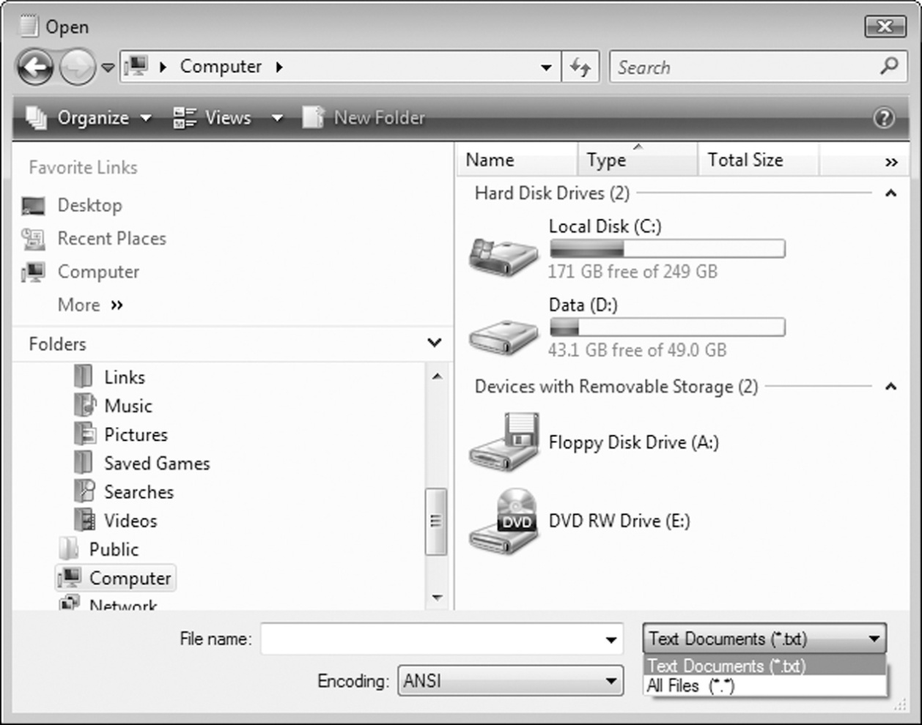
Open Dialog Box Example
InitialDirectory property
Title property
Filter property

Slide 40
using System;
using System.IO;
using System.Windows.Forms;
class W8 // w8m.cs – write to file
{
[STAThread] // need this to use the dialog
static void Main()
{ // data array
string[] list = new string[5] {"Helen Smith", "Tom Brown", "Antony Green", "Bob Bloggs", "Ken Jones"};
// declare SaveFileDialog sfd
SaveFileDialog sfd = new SaveFileDialog();
// set the sfd
string path = Environment.CurrentDirectory;
sfd.InitialDirectory = path;
sfd.Title = "Select a File to Save For W9m Program";
sfd.Filter = "Text files (*.txt)|*.txt|All files (*.*)|*.*";
if( sfd.ShowDialog() == DialogResult.OK )
{
string FileName = sfd.FileName; // declare string FileName
StreamWriter sw= File.CreateText(FileName); // do not need to check file creation
foreach(string s in list) sw.WriteLine(s);
sw.Close();
}

Slide 41
OpenFileDialog ofd = new OpenFileDialog(); // declare OpenFileDialog ofd
ofd.InitialDirectory = path; // dialog setting
ofd.Title = "Select a File to Open For W9m Program";
ofd.Filter = "Text files (*.txt)|*.txt|All files (*.*)|*.*";
if(ofd.ShowDialog() == DialogResult.OK )
{ string FileName = ofd.FileName; // declare FileName variable
StreamReader sr = File.OpenText(FileName);
// declare the copy array with max 100 to store unknown data from the file
string[] copylist = new string[100];
int record = 0; // declare count to keep track or how many read record
string temp = sr.ReadLine(); // read 1st record
while(sr.Peek() != -1) // while not end of file
{ copylist[record] = temp; // add to the array record location
record ++; // increase record no
temp = sr.ReadLine(); // read next data
}
sr.Close(); //Close the file
for(int i = 0; i < record; i++) // loop thru number of read record
Console.WriteLine(copylist[i]); // display the record i
}
}
}

