Slide 1

INFO 6105 Final Presentation
Qiaotong Huang & Gulinigeer Aihemaiti

Slide 2
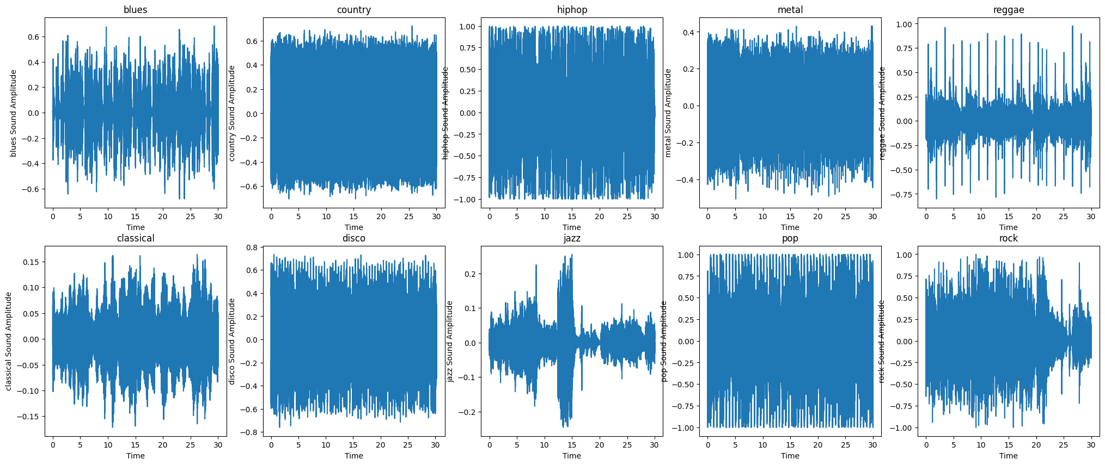
DataSet: Music Genre Classcification
MFCC Features
why interesting?

Slide 3
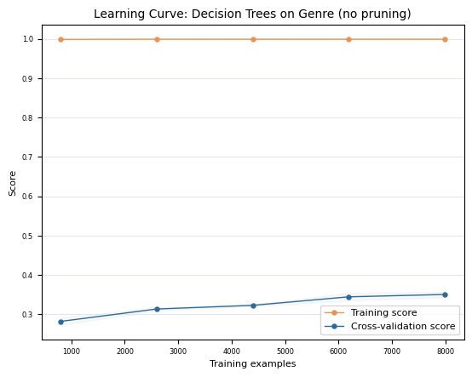
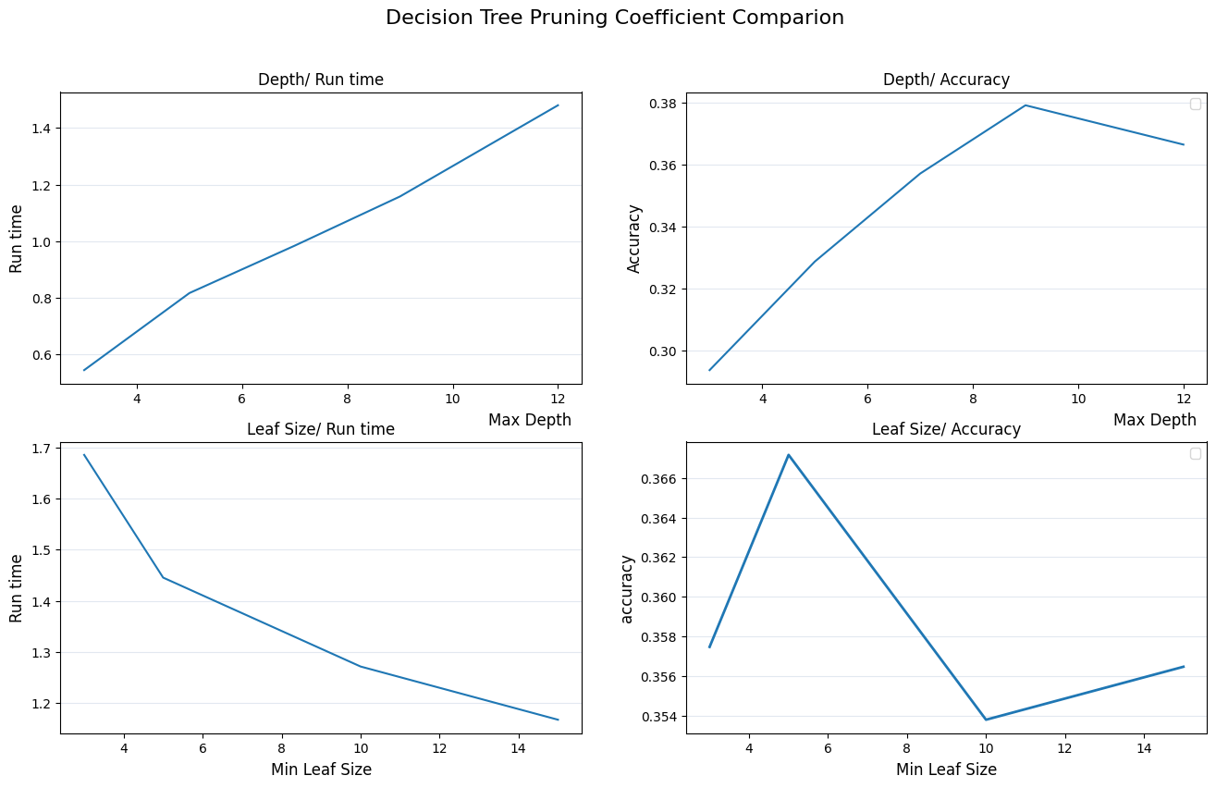
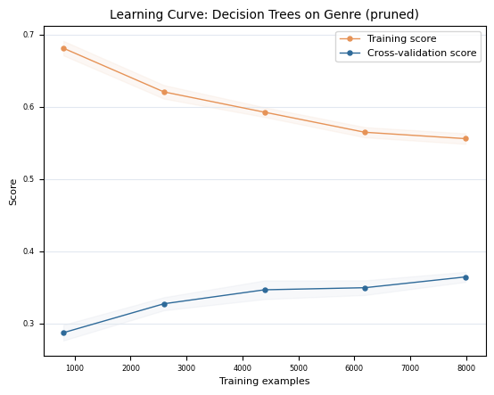
Decision Tree

Slide 4
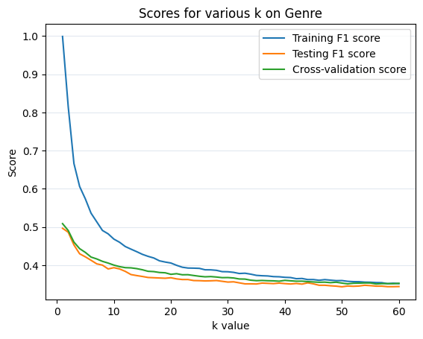
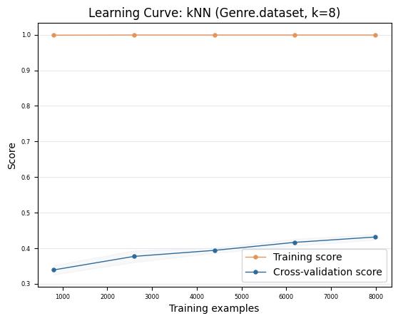
KNN

Slide 5
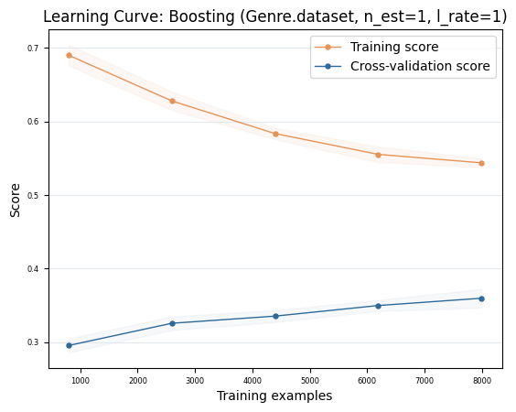
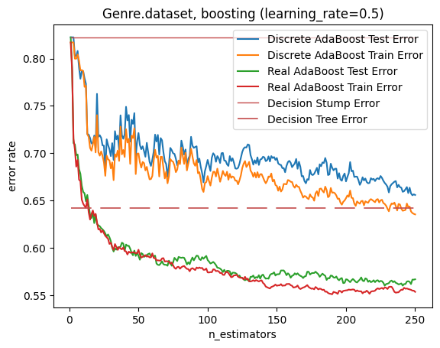
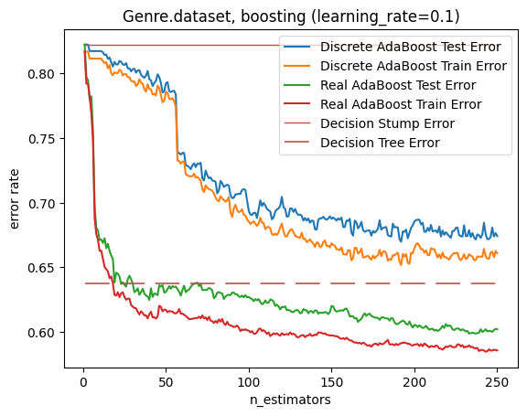
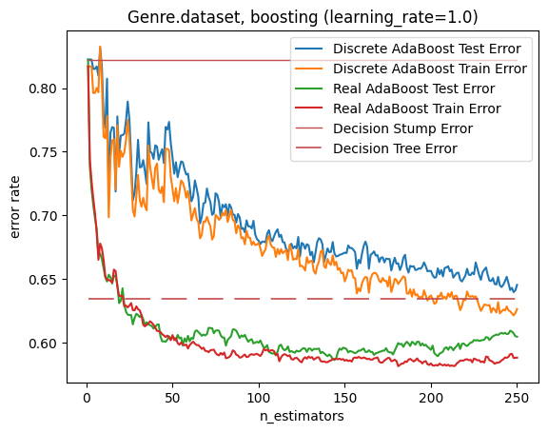
Boosting

Slide 6
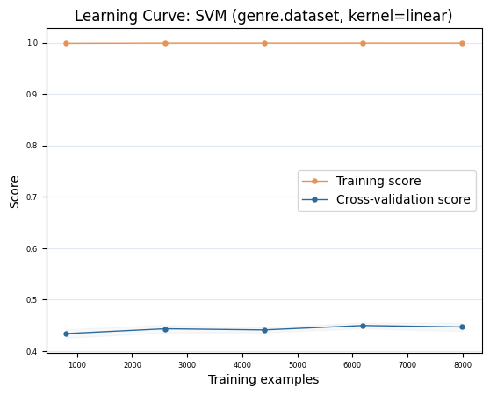
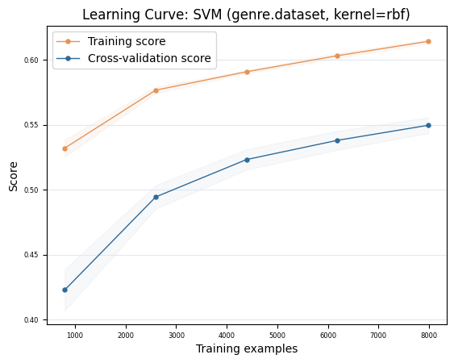
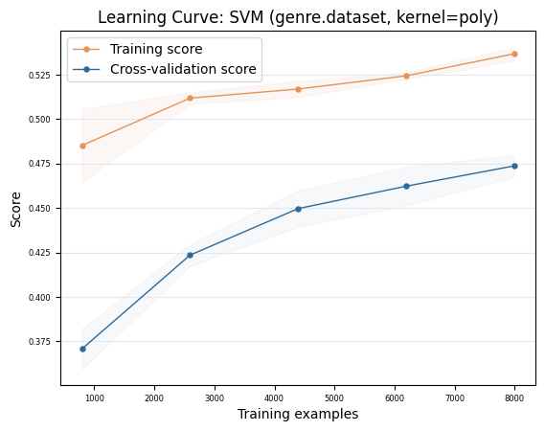
SVM

Slide 7
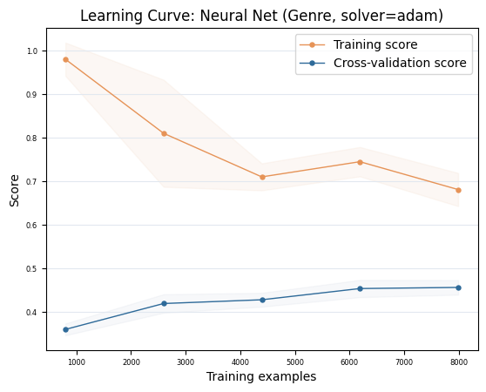
MLP

Slide 8
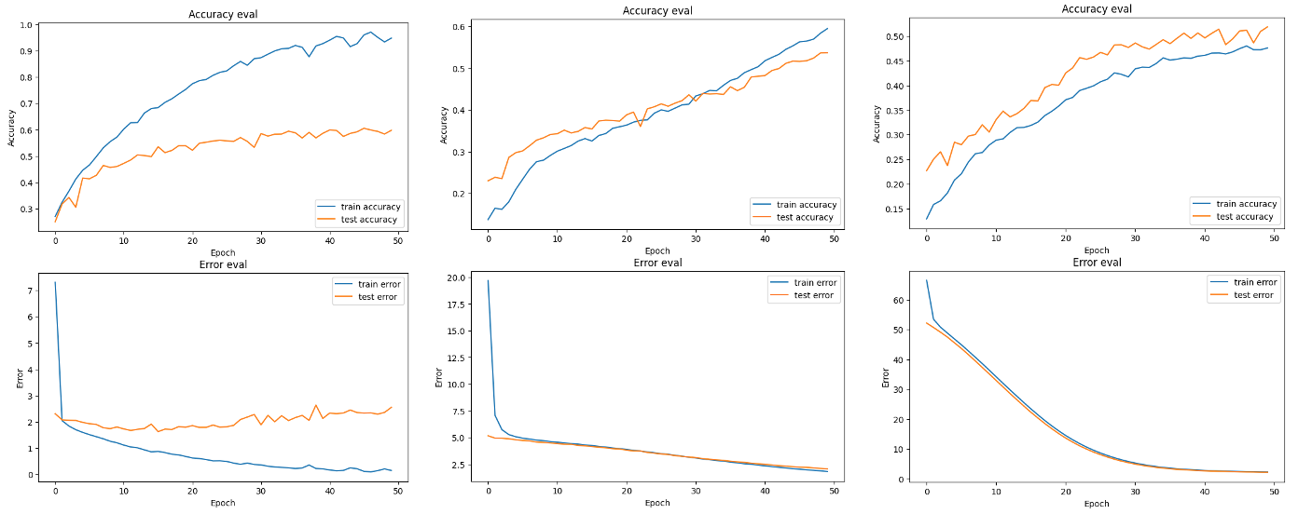
ANN

Slide 9
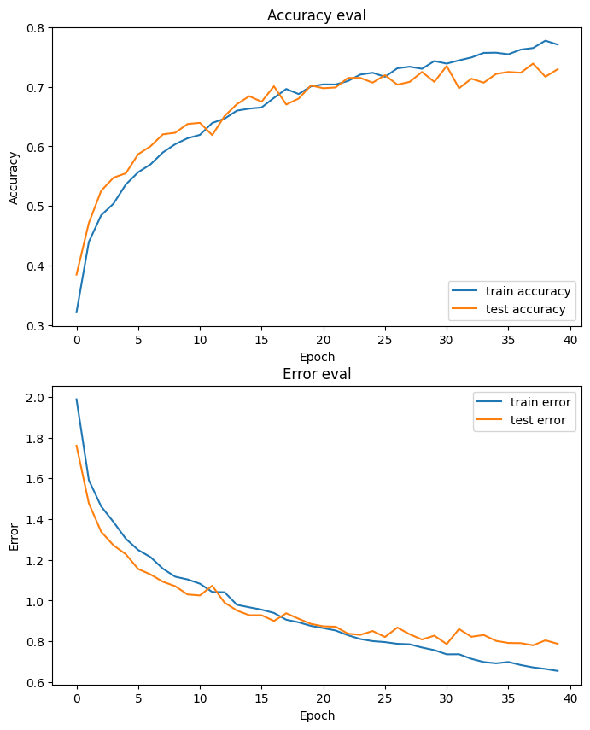
CNN

Slide 10
conclusion
CNN can perform better than all other algorithms, showing the unique advantages of convolutional neural networks in music processing.
This also proves that deep learning itself can extract useful features from the original mel spectrogram.
Additionally, while the accuracy of the model is lower, we believe this may be due to two things :
Insufficient samples.
Challenges of GTZan dataset and confusion between categories.

Slide 11
Thank You

