Slide 1

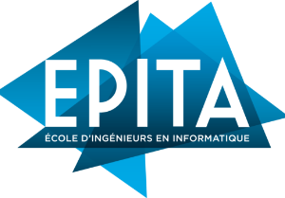
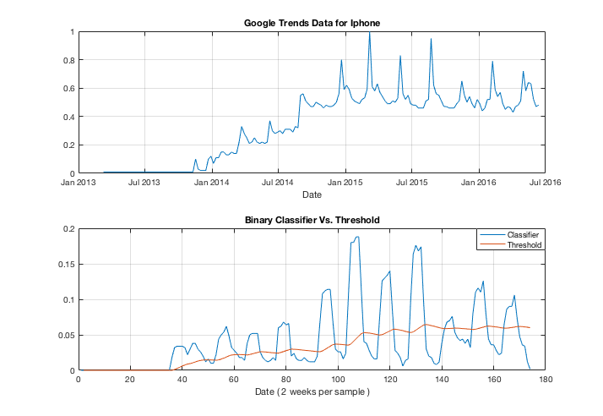
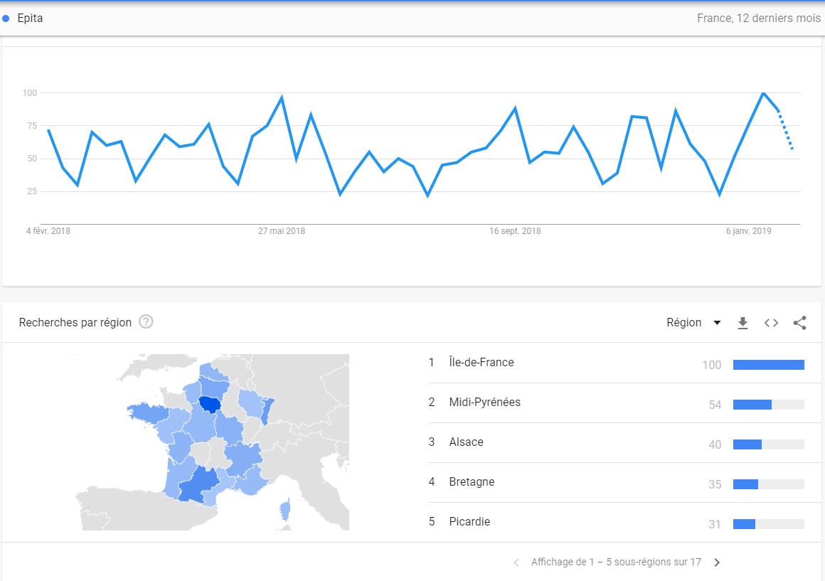
Blue Ocean Whale Sharks
Antonios Todoris Arun Kumar Bashetty Quentin Derosin Amaury Julien Qiaoyu Liu
PROJECT DESCRIPTION
TOOLS & PACKAGES
The application is an interactive tool which lets the user see relevant marketing information for a chosen product in a specified country.
The project is based on Google marketing trends combined with analog and digital marketing. The developed tool will take the product that the user wants to promote as input, alongside with the target country. The expected output will be specific charts with useful information that marketers need to consider, before starting developing their marketing plans, in order to maximize the impact and return on investment.
Trending score generated from application
NumPy: stands for Numerical Python. The most powerful feature of NumPy is an n-dimensional array.
Pandas: for structured data operations and manipulations. It is extensively used for data munging and preparation.
Pytrends: Provides APIs that fetch data from Google Trends live.
PytQt5: PyQt5 is a comprehensive set of Python bindings for Qt v5. It is implemented as more than 35 extension modules and enables Python to be used as an alternative application development language to C++ on all supported platforms including iOS and Android.
Pycharm: PyCharm is an integrated development environment used in computer programming, specifically for the Python language. It is developed by the Czech company JetBrains.
Trending Score
FUTURE WORK
Expansion of the charts with additional labels for analog and digital marketing.
Creation of more auto recommendation texts to provide the user with a variety of possible strategies to follow.
Development of more services to fetch additional information about the product’s marketing popularity.
DEVELOPMENT
QUICK FACTS
Test Planning: The planning was organized based on the overall requirements and user stories.
Test Case Development: The cases were split into unit test cases considering the different marketing methods that could be used for the promotion of a product.
Test Execution and Documentation: In this phase, all the test cases were executed one by one and the results were documented with screenshots of the developed system and analyzed for further improvement.
Finalization: On this last phase the application’s services were improved and corrected corresponding the needs of the user stories and deployed for production.
> In this era, Digital Marketing
has become more and more popular considering the growth of technology use. Traditional Marketing though remains still strong in this era as « Billboards » which is a traditional marketing type is one of the most successful and popular ways to promote almost any product worldwide.
>Today digital marketers are operating in a drastically different landscape from what they encountered 10 years ago.
>The best most successful digital marketers know the importance of agility when it comes to engaging today’s fast-moving, always-on consumers.
Visualization of search results for EPITA in France
Fall Semester 2018
Notes:
This is a template to be used for your PRI project poster to insure the same look and feel for all posters.
The category titles for the sections of text are fixed. The amount of text for each section could vary based on your project.
The charts and images are provided as placeholders. You do not have to use the sample charts provided and may prefer others.
Three charts and two images are not required, but you should definitely have graphics to illustrate key points and to make your poster attractive.
The final version will be printed either A1 or A0 size.

