Slide 1
Attendance Code:

Slide 2
Data Structures, Algorithms, and Databases – Week 1
Jizheng Wan
Jan 2024

Slide 3
Content
Course Overview
Module Team
Week 1 Introduction
Linear Search
Pre-conditions, Invariants and Post-conditions
Time Complexity and Space Complexity

Slide 4
Course Overview
This course contains:
Four blocks of teaching.
Three assignments (20%) + one exam (80%).
Week 1
Week 4
Week 7
Week 10
Data Structure & Alg, Part 1
Databases, Part 1
Data Structure & Alg, Part 2
Databases, Part 2
A1
A2
A3

Slide 5
Course Overview
Block 1
Searching
Search tree data structure
Block 2
Relational algebra
Entity-Relationship modelling
Block 3
Sorting
Graph data structure
Block 4
Table design
Performance

Slide 6
Module Team
Uday Reddy
Mirco Giacobbe
Jizheng Wan
Ahmad Ibrahim
Module Lead
Block 2 & 4
Thursday 3:30-4:30pm
Room 210
Block 3
Monday 2:00-3:00pm
Room 213
Block 1
Monday 3:00-4:00pm
Room 112
Dubai Campus
All blocks

Slide 7
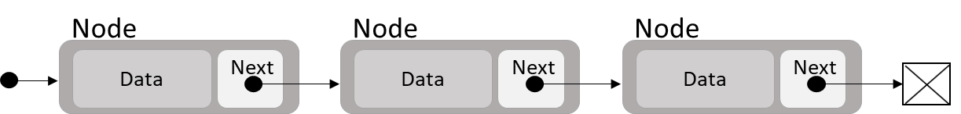
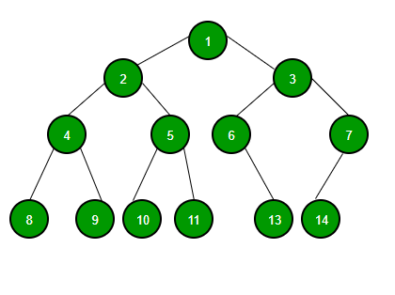
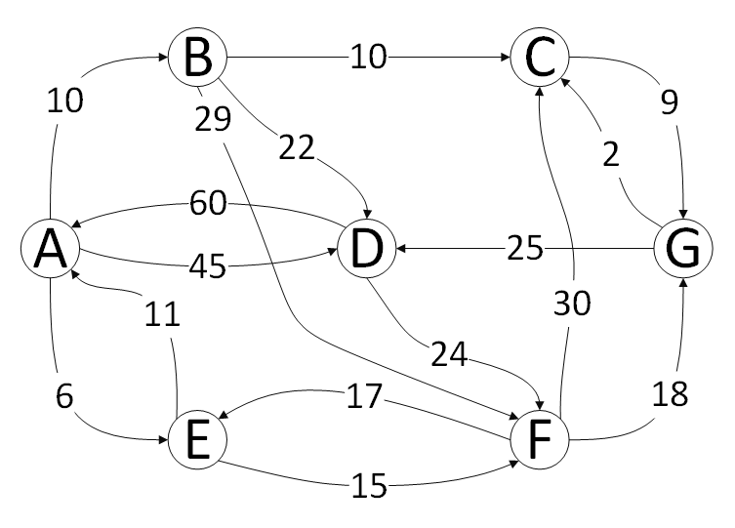
Week 1 Introduction
Data Structure:
Lists
Trees
Graphs
…
Algorithms:
Insert
Delete
Search
Sort
…

Slide 8
Week 1 Introduction
Efficiency:
How fast? – Time Complexity
A measure of the amount of time an algorithm takes to complete as a function of the length of the input.
Big O Notation -> O() E.g.
O(n) – the algorithm’s run time increases linearly with the input size.
O(log n)
O(n log n)
O(n^2)
…

Slide 9
Week 1 Introduction
Efficiency:
How fast? – Time Complexity
How much memory? – Space Complexity
The total amount of memory that an algorithm or operation needs to function relative to the size of the input data (additional space required by the algorithm itself, not the space taken up by the input data).
Also expressed using Big O Notation.
Specification:
What we intend the algorithm to do.
Detailed and precise (e.g. constraints, edge cases and handling errors).

Slide 10
Week 1 Introduction
Pre-conditions:
Conditions or rules that must be true before the execution of an algorithm or a function.
E.g. an array must be sorted first.
Post-conditions:
Conditions that must be true after the execution of an algorithm or a function.
Invariants:
Condition that remains true throughout the execution of an algorithm.
Used to ensure the algorithm or data structure maintains its integrity and behaves as expected.

Slide 11
Algorithm Design
Think what you want it to do and write this down. This is the specification.
Think, come up with an idea, and write down your algorithm step by step.
Check that your algorithm does indeed satisfy the specification (post-conditions and invariants).
If necessary, check the Time and Space Complexity.

Slide 12

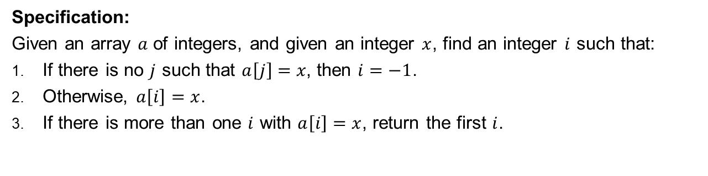
Linear Search
0
1
2
3
4
5
6
$$a=$$
20
15
10
50
16
18
18
Specification:
Given an array $a$ of integers, and given an integer $x$, find an integer $i$ such that:
If there is no $j$ such that $a\left[j\right]=x$, then $i=−1$.
Otherwise, $a\left[i\right]=x$.
If there is more than one $i$ with $a\left[i\right]=x$, return the first $i$.

Slide 13

Linear Search
0
1
2
3
4
5
6
$$a=$$
20
15
10
50
16
18
18
Algorithm:
Start from the Beginning: Begin at the first element of the list.
Compare Each Element: Compare the current element with the value you are searching for.
Match Found: If the current element matches the search value, return the index of this element, indicating the position of the value within the list.
Move to the Next Element: If the current element is not a match, move to the next element in the list.
Repeat the Process: Continue steps 2-4 until you either find a match or reach the end of the list.
End of List: If you reach the end of the list without finding a match, the search value is not in the list and returns -1 as the result.

Slide 14
Linear Search
0
1
2
3
4
5
6
$$a=$$
20
15
10
50
16
18
18
Pre-conditions:
The list (or array) to be searched is accessible and not null.
The value to be searched for is defined and comparable with the elements in the list.
The list does not necessarily need to be sorted.
Invariant:
The part of the list that has been searched does not contain the target value. This is maintained throughout the execution of the algorithm.
Post-conditions:
If the target value is in the list, the algorithm returns the index of the first occurrence of the value.
If -1 is returned, then the target value is not in the list.
The list remains unchanged after the execution of the algorithm.

Slide 15
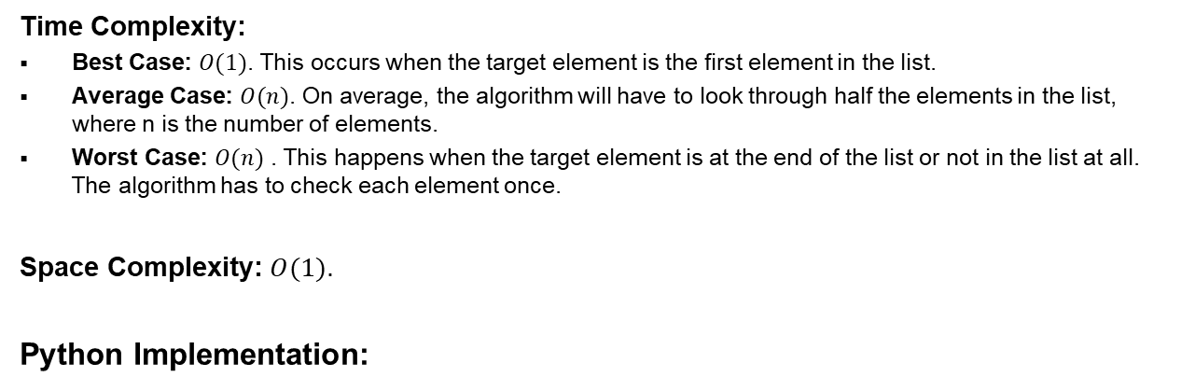
Linear Search
0
1
2
3
4
5
6
$$a=$$
20
15
10
50
16
18
18
Time Complexity:
Best Case: $O(1)$. This occurs when the target element is the first element in the list.
Average Case: $O(n)$. On average, the algorithm will have to look through half the elements in the list, where n is the number of elements.
Worst Case: $O(n)$ . This happens when the target element is at the end of the list or not in the list at all. The algorithm has to check each element once.
Space Complexity: $O(1)$.
Python Implementation:
def linear_search(_arr, _target): for i in range(len(_arr)): if _arr[i] == _target: return i return -1

Slide 16

End of Session

