Slide 1
Week 6 Consolidation Week
LM Data Structures, Algorithms, and Databases
(34141)
Dr Ahmad Ibrahim
a.ibrahim@bham.ac.uk
Feb 23, 2024
Contents based on lecture notes from Uday Reddy & Achim Jung

Slide 2

Topics by Week
Week | Date | Topic
1 | 15 Jan | Searching algorithms
2 | 22 Jan | Binary Search Tree
3 | 29 Jan | Balancing Trees – AVL Tree
4 | 5 Feb | Databases – Conceptual Design
5 | 14 Feb | Databases – Logical Design & Relational Algebra
6 | 19 Feb | Consolidation Week
7 | 26 Feb | Graph Algorithms
8 | 4 Mar | Sorting Algorithms
9 | 11 Mar | Hash tables
10 | 18 Mar | Databases – Normalization
 |  | Easter break and Eid break
11 | 22 Apr | Databases – Concurrency
12 | 29 Apr | Revision Week

Slide 3
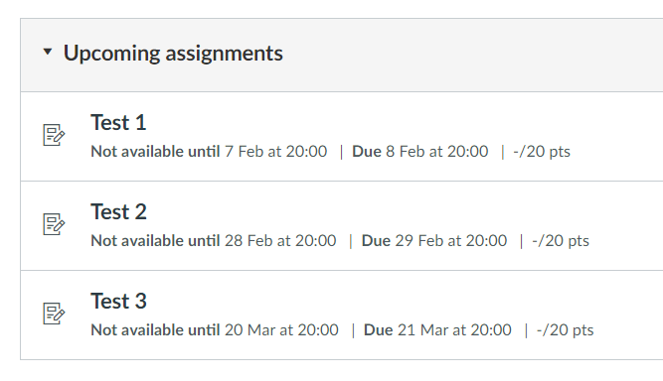
Assessments
Assessments (Test 1, Test 2, Test 3): 20%
Exam: 80%
Late Submission Policy:
Submissions between 8:00-8:30pm (Dubai Time) on 08 Feb incur a 10% penalty.
Zero marks for submissions after 8:30pm.
Wellbeing approved cases: 1 day extension only.
Week 4
Week 7
Week 10

Slide 4
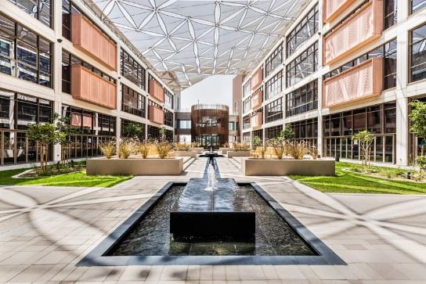
Topics covered in Week 4
Handout 1 & 2
Introduction
Relational databases
Entity-relationship (ER) diagram /Modeling
Table design and creation, SQL
Weak entities
Hierarchies
Table design (schemas) Optimisation
SQL Commands + PostgreSQL

Slide 5
Topics covered in Week 5
Handout 3,4,5
Logical Design
Relational algebra
Filter relations - Select σ
Slice relations - Project π
Combine relations (Joins)
Decomposition / Functional dependency

Slide 6
Outline (This Week)
(Part 0) SQL statements
ex00.pdf
PostgreSQL
(Part 1) ER modelling & Logical design
ex01.pdf
(Part 3) Relational algebra
ex02.pdf

Slide 7

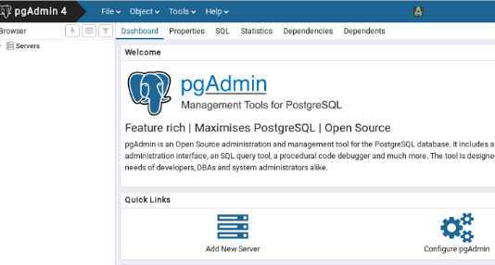
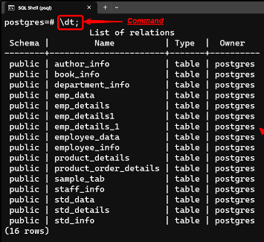
Free and open-source relational database management system
https://www.postgresql.org/download/

Slide 8
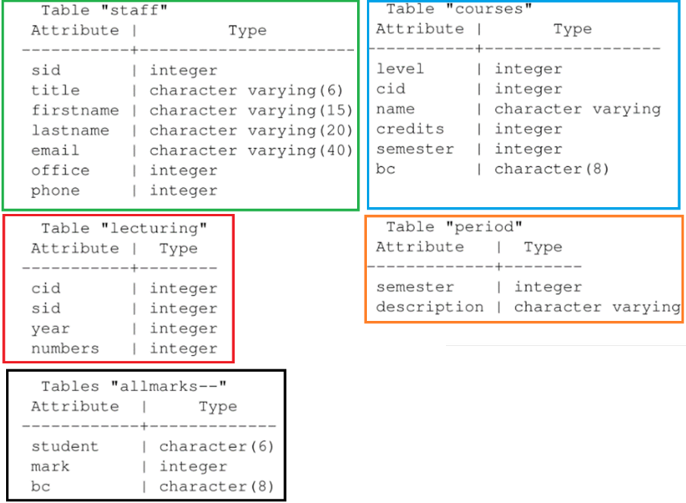
Fundamentals
Database

Slide 9
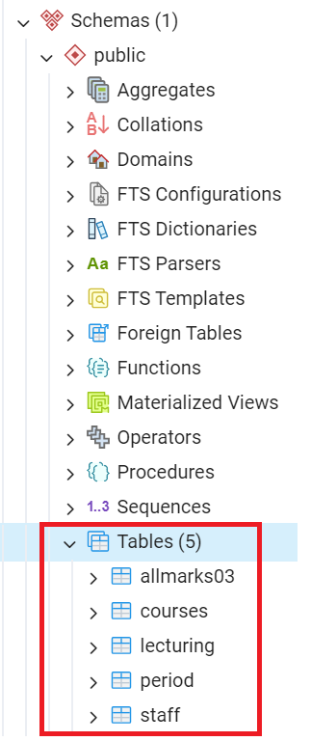
Fundamentals
Database
pgAdmin4
You need to download the file 'FundamentalsSchemaData.txt' from Canvas to create this ‘Fundamentals’ schema and data in your local PostgreSQL installation. Once completed, you will be able to solve ex00.pdf.

Slide 10


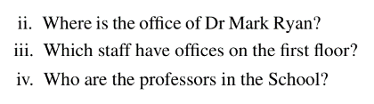

Slide 11
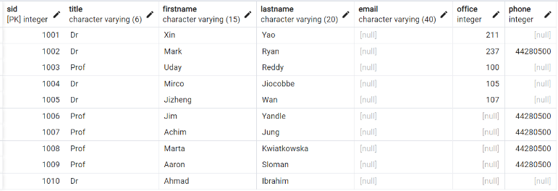
select lastname, firstname
from staff where office = 211;
staff

Slide 12

SELECT office
FROM staff
WHERE title = ’Dr’
AND firstname = ’Mark’
AND lastname = ’Ryan’;
staff

Slide 13

staff
SELECT lastname, firstname
FROM staff
WHERE office >= 100 AND office < 200;

Slide 14
staff
SELECT lastname, firstname
FROM staff
WHERE title = ’Prof’;

Slide 15
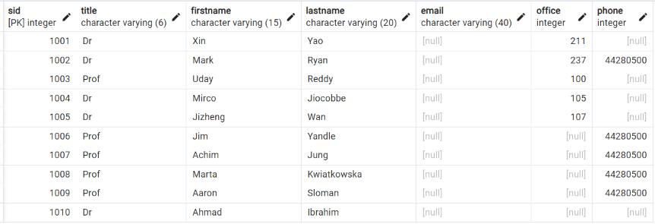
staff
SELECT *
FROM staff
ORDER BY title, lastname DESC;

Slide 16
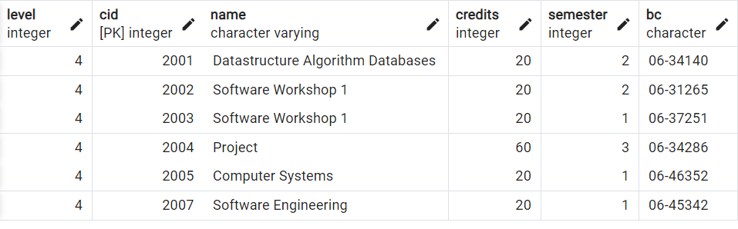
courses
SELECT cid
FROM courses
WHERE (level=3 OR level=4) AND credits>10 AND NOT (semester=2 OR semester=3);

Slide 17
staff
SELECT lastname
FROM staff
WHERE office IS NULL OR phone IS NULL;

Slide 18
staff
SELECT lastname
FROM staff
WHERE office IS NULL AND phone IS NOT NULL;

Slide 19
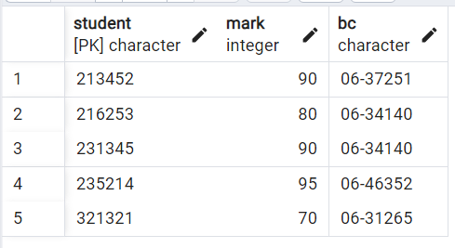
SELECT DISTINCT bc
FROM allmarks03
allmarks03

Slide 20
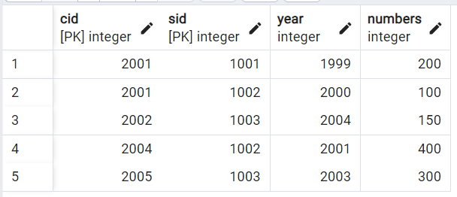
SELECT DISTINCT cid
FROM lecturing
WHERE year=2003
lecturing

Slide 21
SELECT cid FROM lecturing
WHERE year=2001
EXCEPT
SELECT cid FROM lecturing
WHERE year=2000 OR year=1999;
lecturing

Slide 22
Outline (This Week)
(Part 0) SQL statements
ex00.pdf
PostgreSQL
(Part 1) ER modelling & Logical design
ex01.pdf
(Part 3) Relational algebra
ex02.pdf

Slide 23
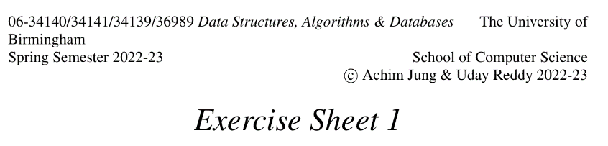
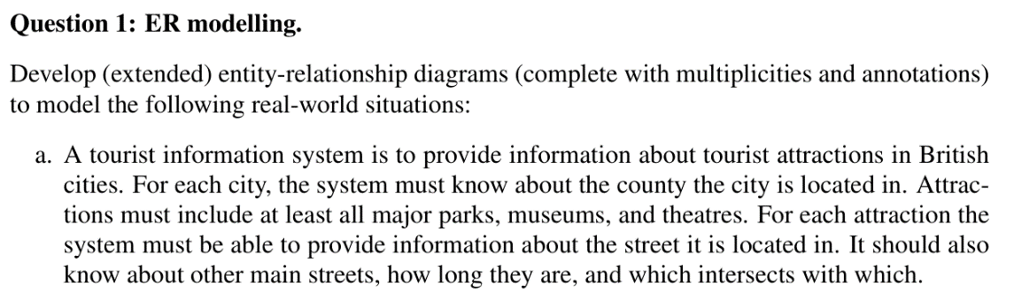

Slide 24
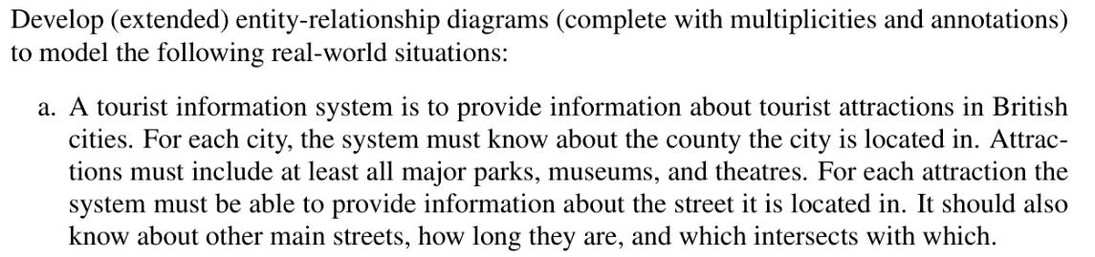
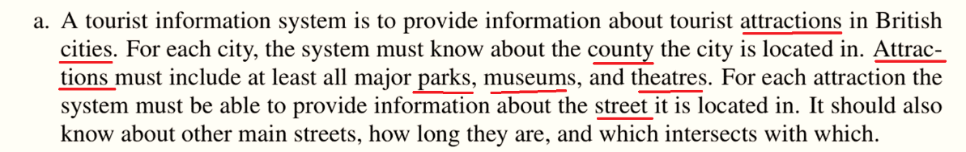
Identify Entities

Slide 25

Attraction
Class hierarchy
Partial, mutually exclusive
(p, e)
Park
Museum
Theatre

Slide 26
Identify Relationship
City in a county (region)
City has attractions
Each attraction is located on a street
Street intersects other streets

Slide 27
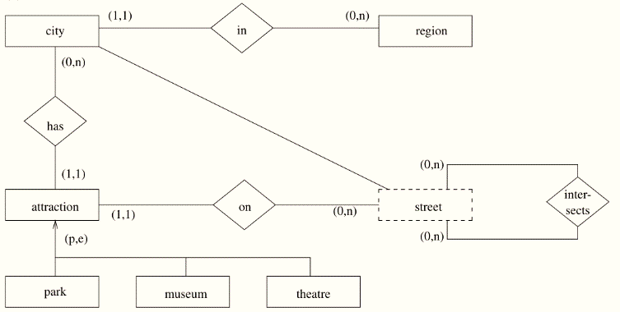
“street” is a weak entity, depending on its containing “city” for its identity

Slide 28
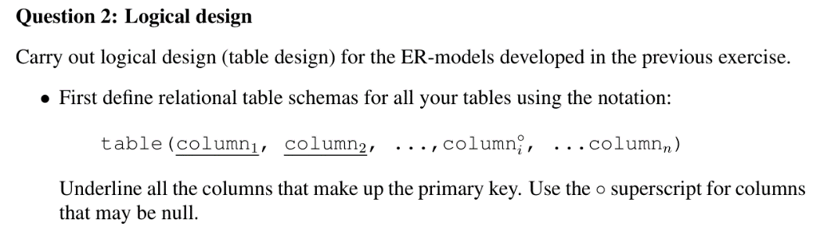
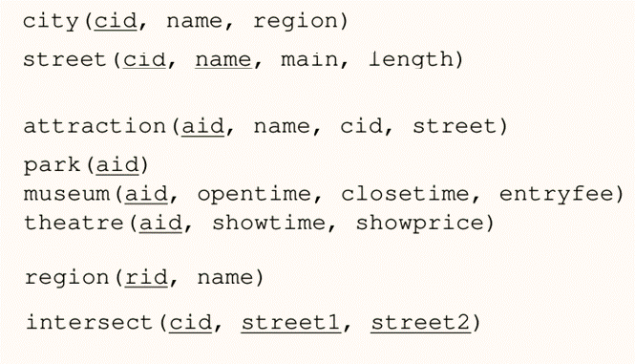

Slide 29
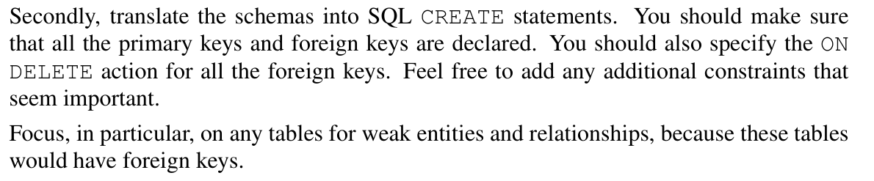
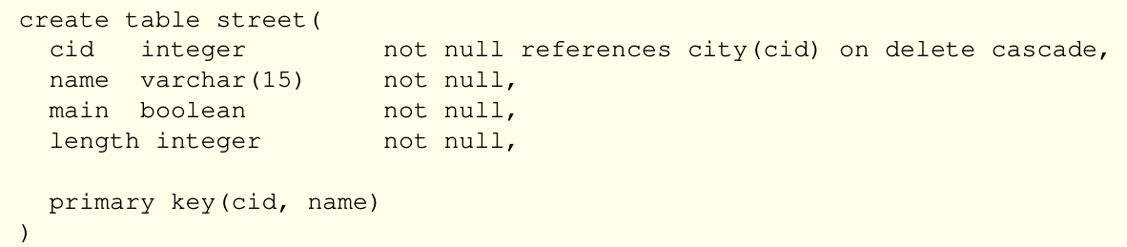
https://www.postgresqltutorial.com/postgresql-tutorial/postgresql-primary-key/

Slide 30
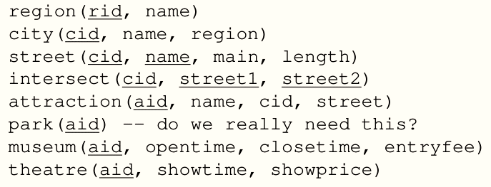
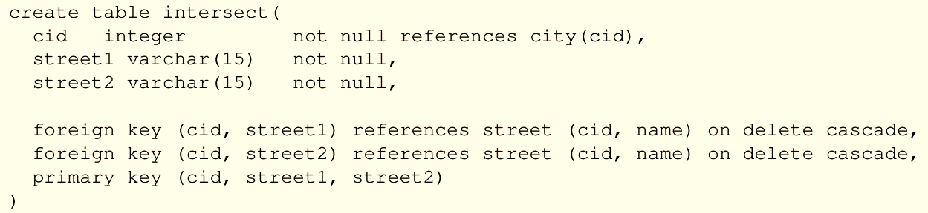
If an attraction gets deleted, its extra information in museum etc. should also get deleted.
If a city gets deleted, all its attractions should go away too.
If a street gets deleted, its intersections should also get deleted.
https://www.postgresqltutorial.com/postgresql-tutorial/postgresql-foreign-key/

Slide 31
Outline (This Week)
(Part 0) SQL statements
ex00.pdf
PostgreSQL
(Part 1) ER modelling & Logical design
ex01.pdf
(Part 3) Relational algebra
ex02.pdf

Slide 32
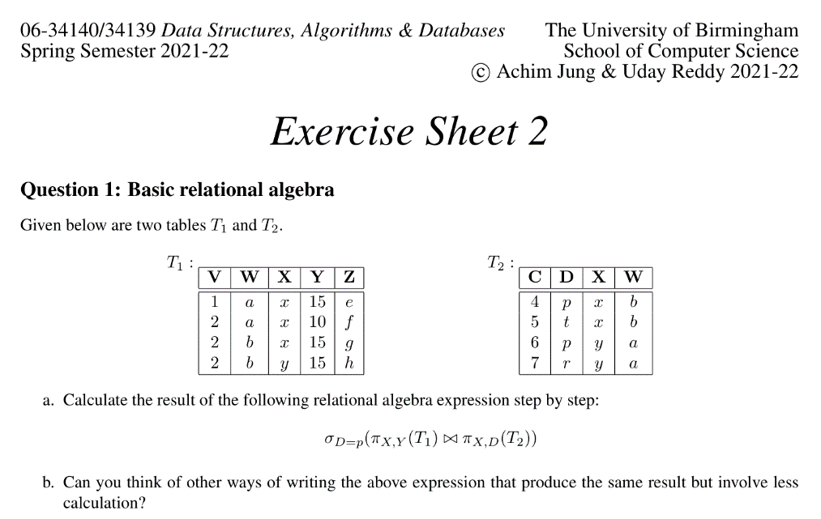

Slide 33

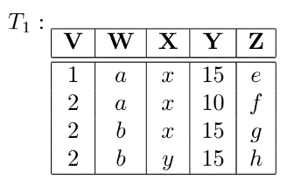
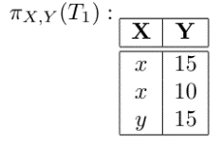

Slide 34
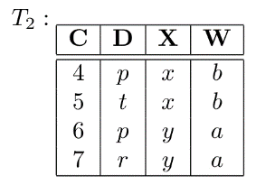
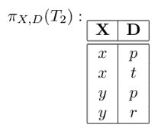

Slide 35

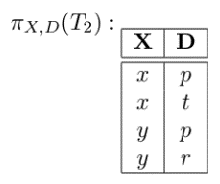
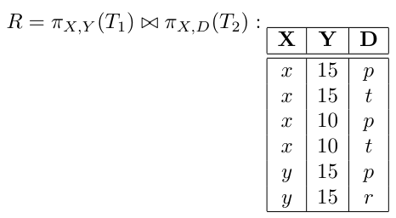

Slide 36
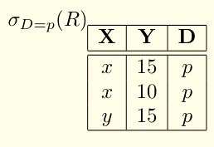

a more efficient expression is

Slide 37
Fundamentals
Database

Slide 38
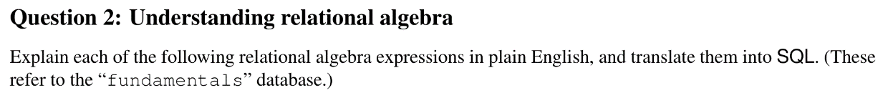

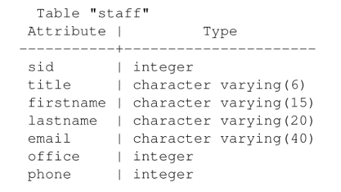

The last name of all those members of staff whose first name is ‘John’.

Slide 39
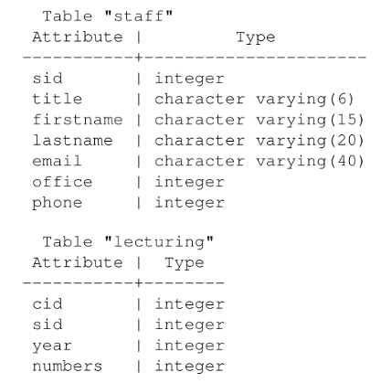

The family name of all those members of staff who taught a course with more than 100 students (in any year).

Slide 40
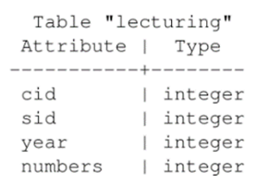
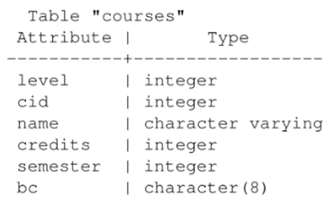
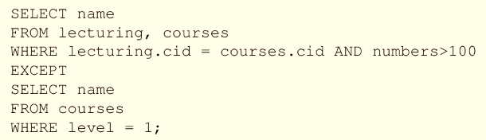
The name of those courses, which had more than 100 students on them in at least one year, and which are not at level 1.

Slide 41

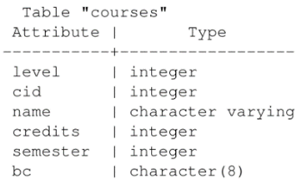
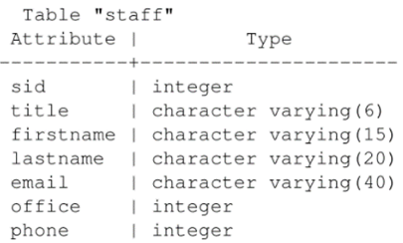

List members of staff with the level 2 courses they taught in 1999.

Slide 42
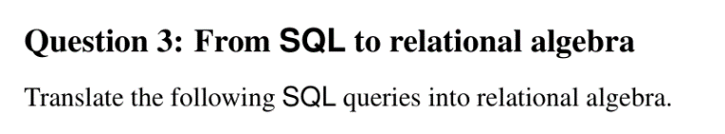
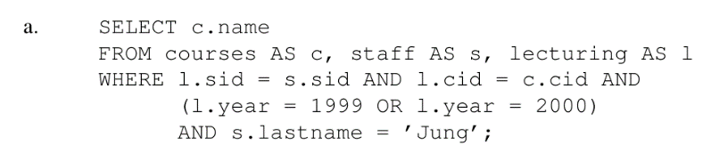

Slide 43
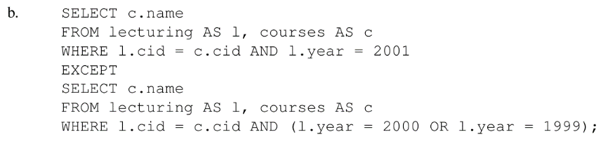

Slide 44
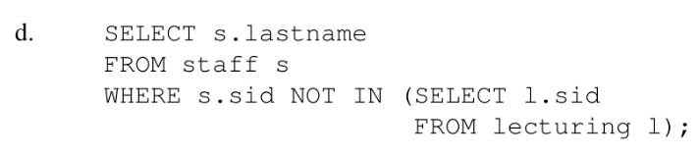


Slide 45
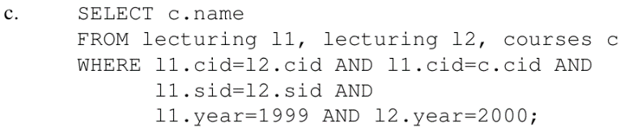


Slide 46
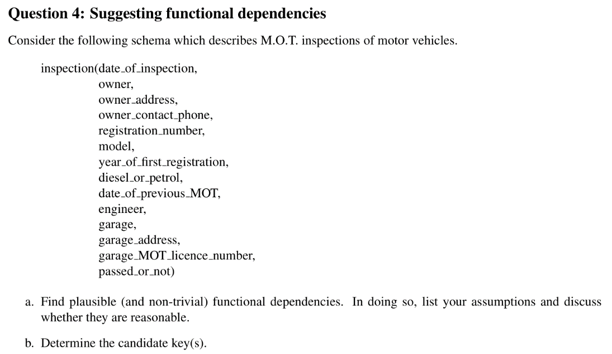

Slide 47
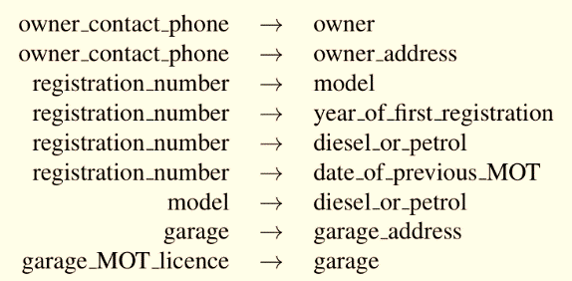

Slide 48
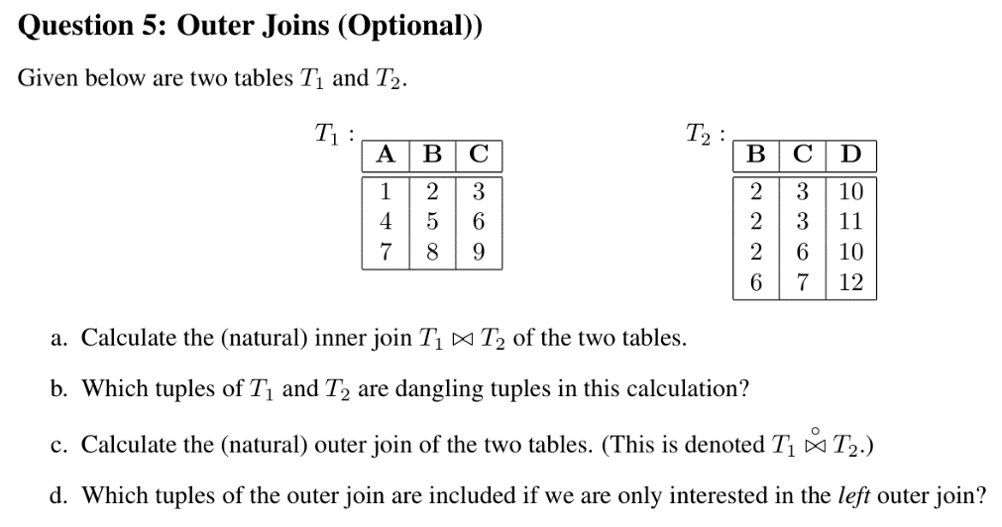

Slide 49
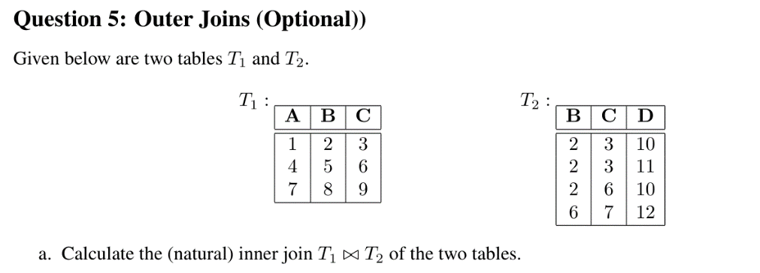
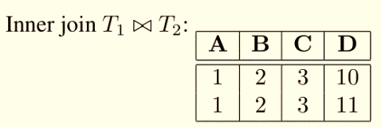

Slide 50
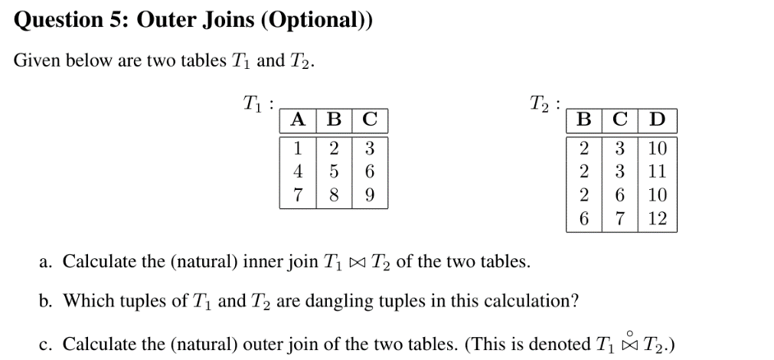


Slide 51



Slide 52


Slide 53
Questions?

