Slide 1
Attendance Code:

Slide 2
Data Structures, Algorithms, and Databases – Week 1
Jizheng Wan
Jan 2024

Slide 3
Learning Objectives
Understand the limitations of the Linear Search.
Understand the concept of Binary Search.
Time Complexity of Binary Search.
Different Python implementation.
Iterative implementation
Recursive implementation
Space Complexity of Binary Search.

Slide 4

Pros and Cons of Linear Search
Pros:
Easy to implement.
Use less memory.
No need for sorting.
Efficient for small and unsorted datasets.
Cons:
Inefficient for large datasets.
No optimisation potential.

Slide 5

Binary Search
It’s been sorted alphabetically.
You can open any page you want.

Slide 6
Binary Search
What is Binary Search?
An efficient algorithm for finding an element in a sorted array.
A classic example of the Divide-and-Conquer approach in algorithm design.
Visualiser:
https://algorithm-visualizer.org/branch-and-bound/binary-search
Common Design Approaches
Brute Force (e.g. Linear Search)
Divide & Conquer (e.g. Binary Search, Merge Sort and QuickSort)
Greedy (e.g. Dijkstra)

Slide 7


Binary Search
$$x=22$$
0
1
2
3
4
5
6
$$a=$$
10
15
18
19
22
25
28
Step 1: Let L be the first element of the array and R be the last element of the array.
Step 2: Calculate M=(L+R)/2.
Step 3: Compare a[M] with x.
-> If a[M] is equal to x, return M.
-> If a[M] is greater than x, R=M-1.
-> Otherwise, L=M+1.
Step 4: Repeat Step 2 and 3 until M is returned, or if L>R, return -1.
L
M
R
L = 0, R = 6
M = (0+6)/2 = 3
a[3] = 19 < 22
L = 3+1 = 4
M = (4+6)/2 = 5
a[5] = 25 > 22
R = 5-1 = 4
M = (4+4)/2 = 4
a[4] = 22 == 22
Return M = 4

Slide 8
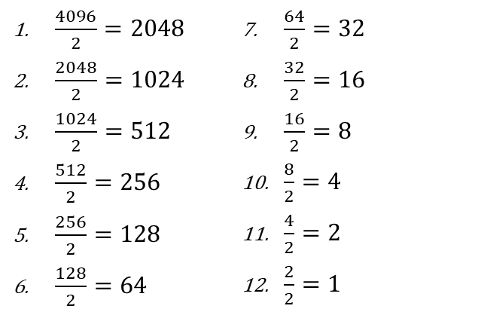


Time Complexity
Suppose $n=4096$, the Binary Search takes *at most* 12 steps:
$\frac{4096}{2}=2048$
$\frac{2048}{2}=1024$
$\frac{1024}{2}=512$
$\frac{512}{2}=256$
$\frac{256}{2}=128$
$\frac{128}{2}=64$
$\frac{64}{2}=32$
$\frac{32}{2}=16$
$\frac{16}{2}=8$
$\frac{8}{2}=4$
$\frac{4}{2}=2$
$\frac{2}{2}=1$
Worst and Average Case
$$12=\log_{2}4096 ⇒ O\left(\log_{2}n\right)$$
Best Case: $O(1)$

Slide 9

Space Complexity
Iterative: $O(1)$. As it uses a constant amount of space for L, R and M.
Recursive: $O(\log{n})$. At each recursive call, a new layer is added to the call stack and will allocate additional memory to it.

Slide 10

End of Session

