Slide 1
Microservice
Andy Chen

Slide 2
Why MicroService
What is microservice?
Microservice is an architecture design pattern. It splits one large application into multiple small and independent service based applications. Each service only does one thing.
Good/Advantage of MicroService
You can update/modify one service without downtime of the entire application.
You can easily scale up to add more services
For each service, you can use different tech stacks
Bad/Drawbacks of MicroService
Communication between services requires more time and resources
DevOps – need more server and people to maintain each servers

Slide 3
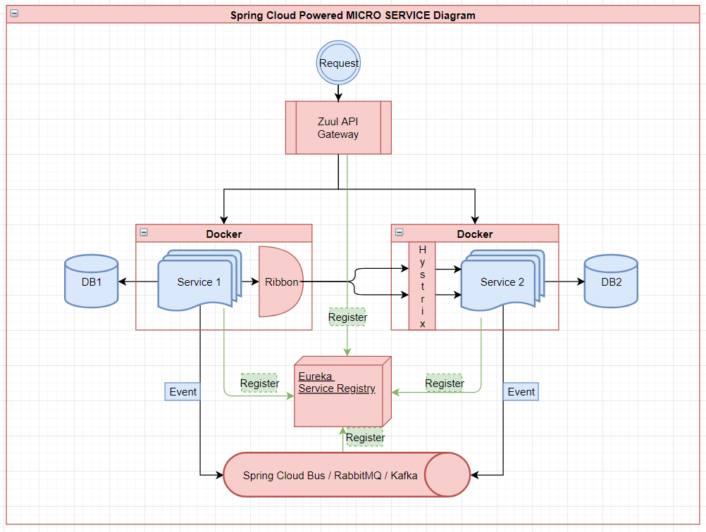
Component
Spring Cloud
Zuul API Gateway
Eureka
Ribbon Load Balancer
Hystrix Circuit Breaker
RabbitMQ
Docker
https://github.com/achen-temp/microservice-poc

Slide 4
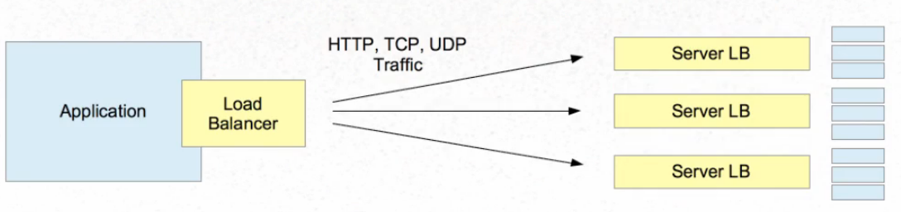
Load Balancer
Server Side Load Balancer
Client Side Load Balancer
Why client side is better?

Slide 5
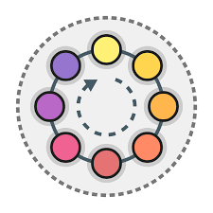
Load Balancer Algorithms
Some most popular Ribbon load balancer rules
Round Robin
Availability Filtering
Weighted Response Time
Random

Slide 6
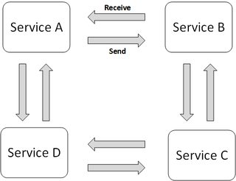
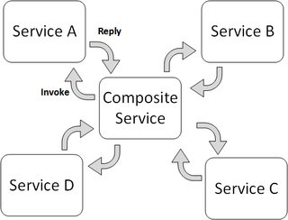
Transaction: Saga Pattern
History: Traditional global transaction Pattern: 2-phase commit
and why it may not be good for microservice
What is Saga Pattern – a sequence of independent local transactions
How to implement Saga Pattern
Events/Choreography
Command/Orchestration

Slide 7
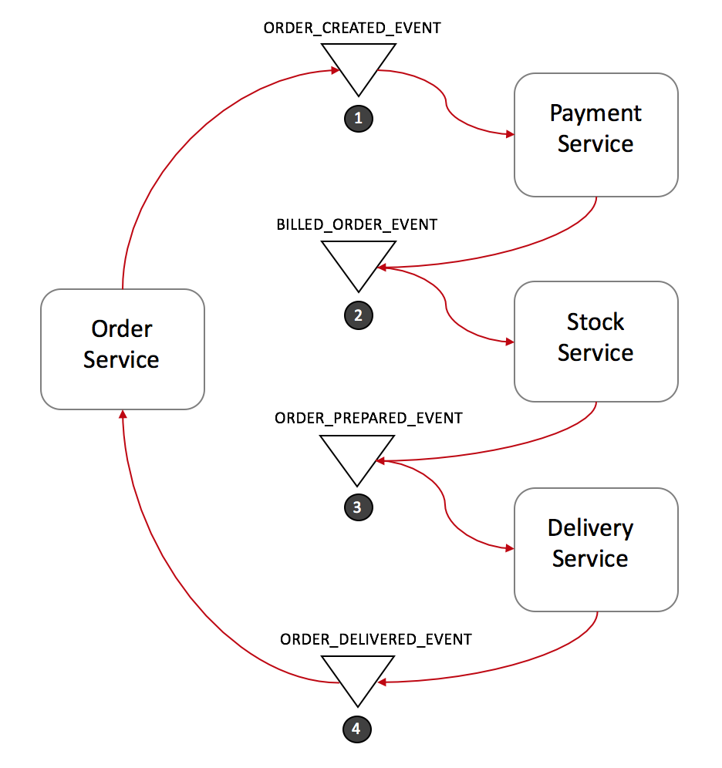
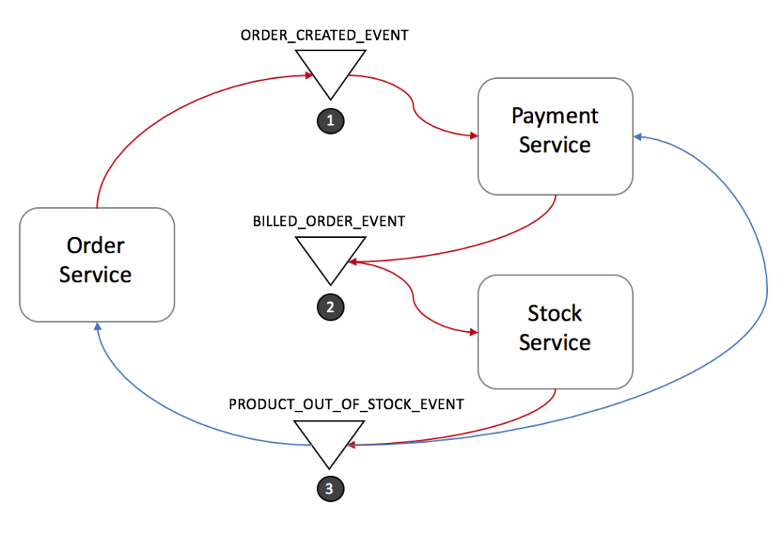
Saga: Events/Choreography
Pro:
Easy to understand
Easy to build
Con:
Hard to scale – hard to track who is listening to whom
Cyclic dependency
Normal Forward flow
Rollback flow
Pros & Cons

Slide 8
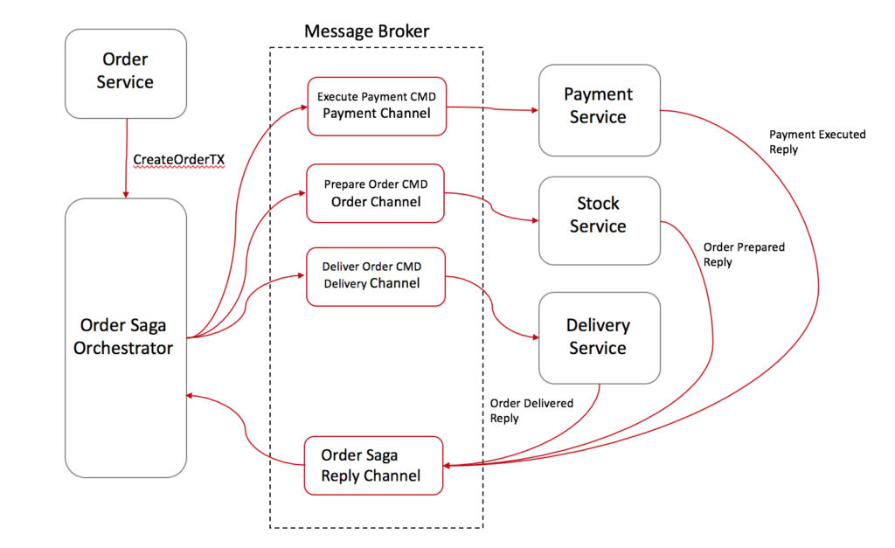
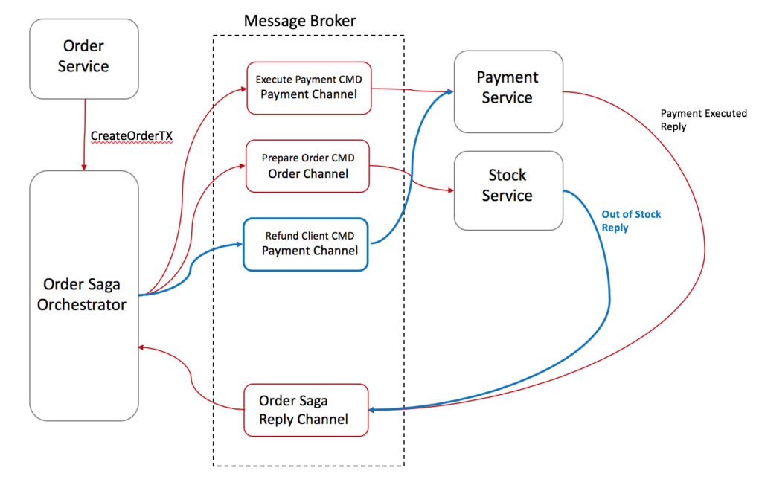
Saga: Command/Orchestration
Pro:
No cyclic dependency
Centralized orchestrator – easy to add new service
Service are independent
Con:
Relying too much on Orchestrator
Increase DevOps for new service
Normal Forward flow
Rollback flow
Pros & Cons

Slide 9
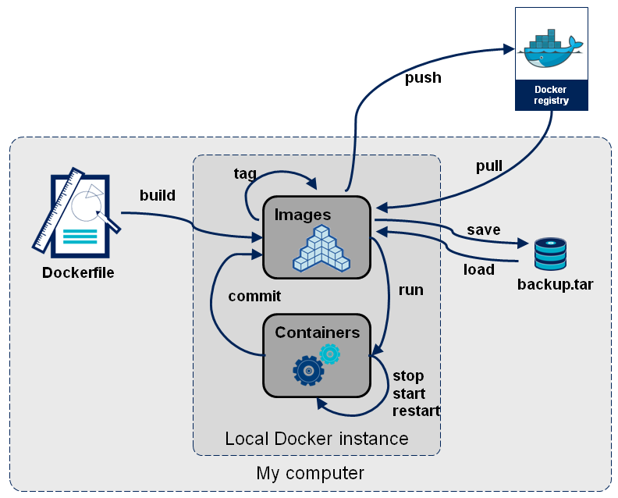
Docker
Docker vs Virtual Machine
Docker pull
Docker commit / push
Docker run

Slide 10
When we meet more We add more
To be continued

