Slide 1
XGBoost: Extreme Gradient Boosting
Amber W., David L., Mu N., Qifei C., Yixin X.

Slide 2
Dataset Introduction
Simulated credit card transaction fraud data on Kaggle
Credit Card Fraud (kaggle.com)
Binary classification problem, each transaction is either fraudulent or not.
1000000 transactions, only 87403 transactions are fraudulent. 8.74% fraud rate, very unbalanced data
We will apply stratification when dividing the dataset

Slide 3
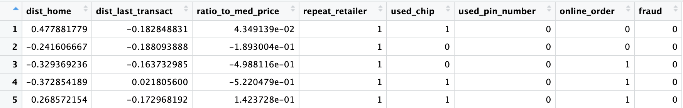
Dataset description
dist_home: the distance from home where the transaction happened
dist_last_transact: the distance from last transaction happened
ratio_to_med_price: ratio of transaction price to median purchase price
repeat_retailer: Is the transaction happened from same retailer

Slide 4
Dataset description (continue)
used_chip: Is the transaction through credit card chip?
used_pin_number: Is the transaction happened by using PIN number?
online_order: Is the transaction an online order?
fraud: Is the transaction fraudulent.

Slide 5
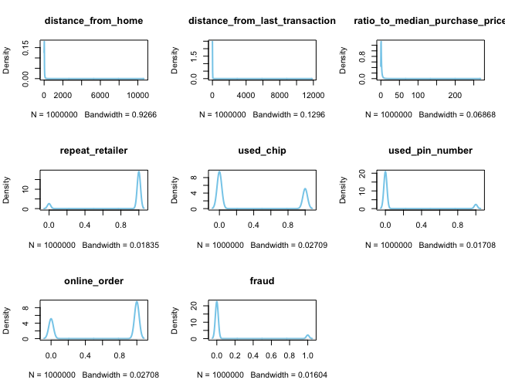
EDA
> dim(data)
[1] 1000000 8
> sum(is.na(data))
[1] 0
# distribution and outliers in each feature

Slide 6
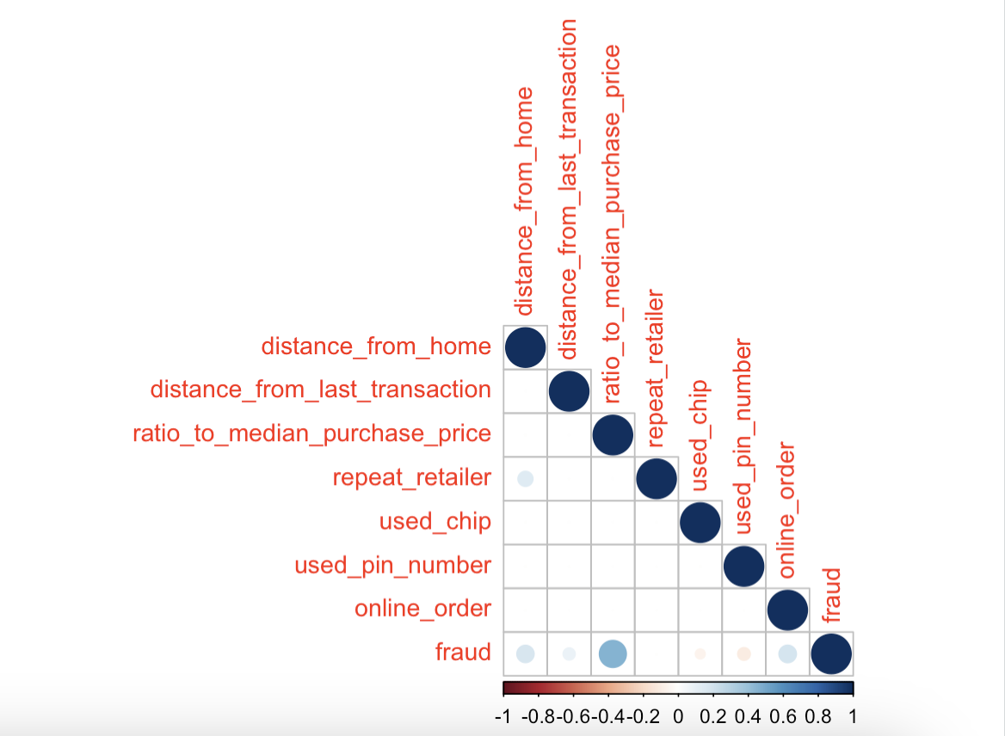
EDA：Correlation
There is a positive correlation with respect to the response variable "fraud" in the variables:
ratio_to_median_purchase_price
distance_from_home
online_order
And a negative relationship with:
used_pin_number

Slide 7
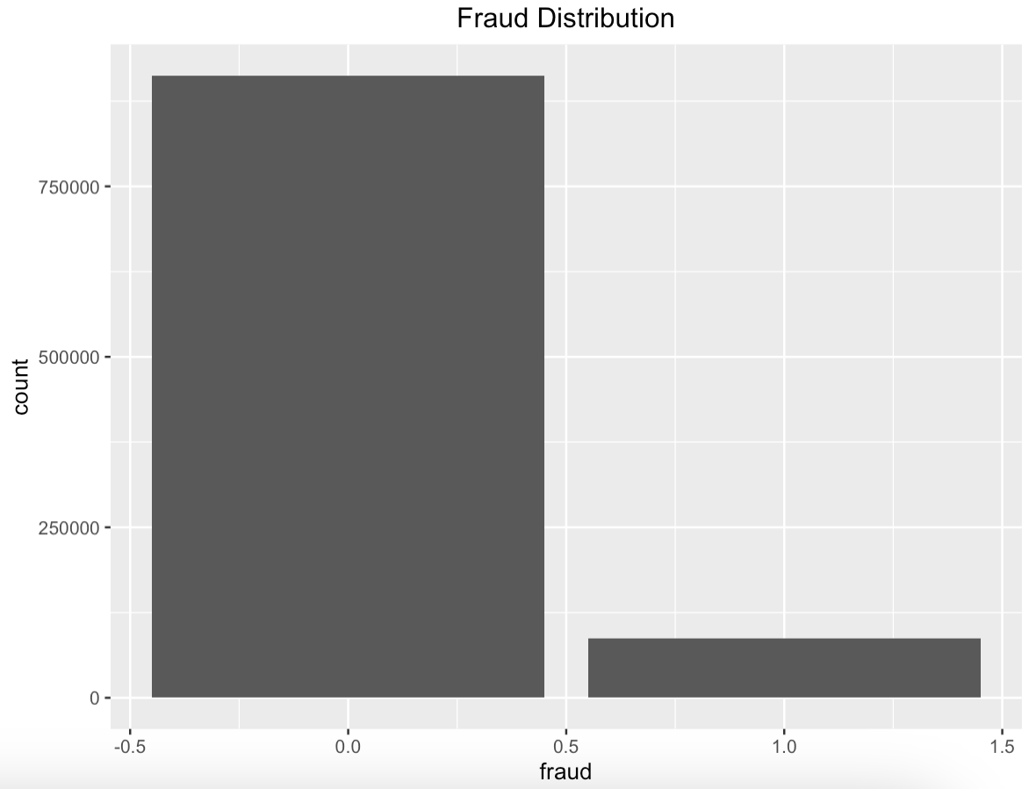
EDA：Imbalance
Around 91% of the transactions are not fraud and 9% are fraud.
There imbalance suggests adapting performance metrics like "true positive rate", "precision" instead of "accurary" to assess the ML model.

Slide 8
Techniques for Balancing Data
Stratified Sampling: Stratified sampling is used to ensure that each subset of your data (training, validation, and test sets) has a similar proportion of fraudulent and non-fraudulent transactions as in the original dataset.
In the Credit-card-fraud dataset, where 8.74% of 1,000,000 transactions are fraudulent, stratified sampling will maintain this ratio in each data split to avoid bias towards the majority class.
Over Sampling: Over Sampling is a technique to balance an imbalanced dataset by increasing the number of instances in the underrepresented class, which is the fraudulent transactions. We are going to apply Over Sampling in the following approach:
Duplicate existing data
Synthetic Minority Over-sampling Technique (SMOTE)

Slide 9
Synthetic Minority Over-sampling Technique
SMOTE is an advanced over-sampling technique used to create synthetic samples for the minority class in an imbalanced dataset. It works by selecting samples that are close in the feature space, drawing a line between the samples in the space and drawing a new sample at a point along that line.
This approach helps us in creating plausible and diverse synthetic samples, rather than just duplicating existing ones.
In R, SMOTE can be applied through package DMwR with the following code:
data_smote <- SMOTE(fraud ~ ., data = data, perc.over = 100, k = 5)
The perc.over parameter controls the amount of oversampling, and k is the number of nearest neighbors to consider.

Slide 10
Evaluate SMOTE on metric
Given the imbalanced nature of the dataset, traditional accuracy might not be an ideal metric. Instead, use metrics like F1-score, Precision, and AUC-PR (Area Under the Precision-Recall Curve), which provide a more nuanced view of the model's performance on minority class prediction.
conf_matrix <- confusionMatrix(factor(predicted_class), factor(test_data$fraud))
precision <- conf_matrix$byClass['Pos Pred Value’]
recall <- conf_matrix$byClass['Sensitivity’]
f1_score <- 2 * (precision * recall) / (precision + recall)
auc_pr <- auc (roc(test_data$fraud, predictions))

Slide 11
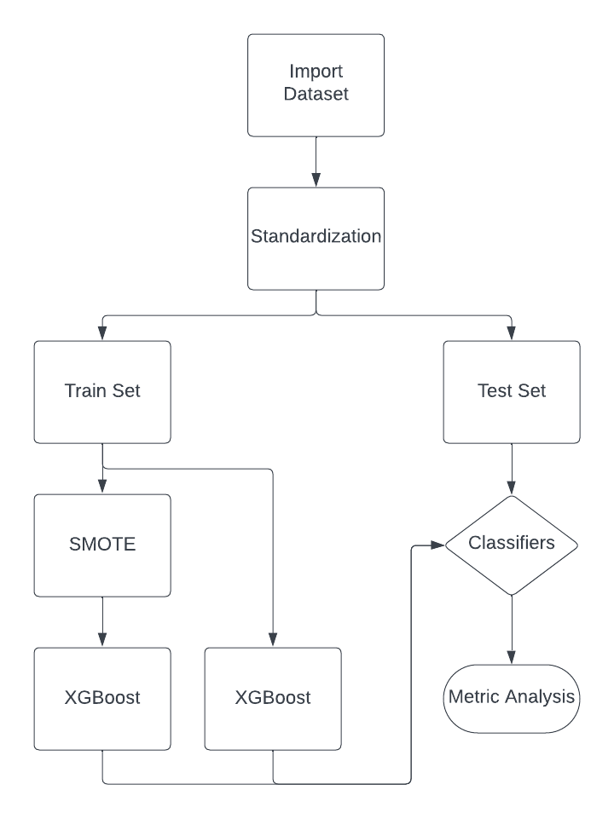
Experiment Performance of SMOTE
After importing the dataset, we standardize the data, ensuring that all variables contribute equally to the analysis, scaling the features so they falls in a range of [0,1].
The standardized data is then split into two sets: one for training the model (Train Set) and one for testing its performance (Test Set).
On the training set, the Synthetic Minority Over-sampling Technique (SMOTE) is applied. And the XGBoost algorithm is trained on the SMOTE-processed training data and raw training set as a comparison.
Then we will evaluation of whether the raw is sufficient for classification, or if SMOTE should be considered for comparison.
A metric analysis is performed, which involves computing performance metrics such as accuracy, precision, F1-score, and AUC-PR to evaluate the model's performance.

Slide 12
Gradient boosting
In Gradient boosted decision tree(GBDT), the k-th tree is used to fit the negative derivative of the loss function with respect to the current model’s prediction.
The current model’s prediction for each observation is the weighted sum of the first k-1 trees.
If we use MSE as the loss function in a regression task, the derivative for each observation is simply the residual between true label value and predicted value.

Slide 13
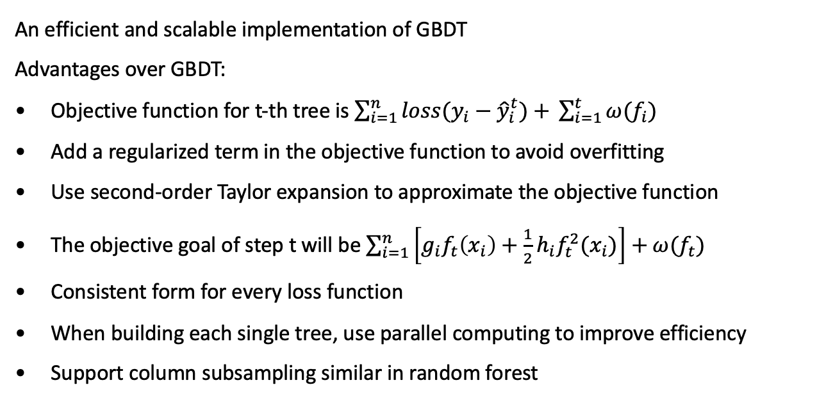
XGBoost
An efficient and scalable implementation of GBDT
Advantages over GBDT:
Objective function for t-th tree is $\sum_{i=1}^{n}{loss(y_{i}−{\hat{y}}_{i}^{t})+} \sum_{i=1}^{t}{ω(f_{i})}$
Add a regularized term in the objective function to avoid overfitting
Use second-order Taylor expansion to approximate the objective function
The objective goal of step t will be $\sum_{i=1}^{n}{\left[g_{i}f_{t}\left(x_{i}\right)+\frac{1}{2}h_{i}f_{t}^{2}(x_{i})\right]+ω(f_{t})}$
Consistent form for every loss function
When building each single tree, use parallel computing to improve efficiency
Support column subsampling similar in random forest

Slide 14
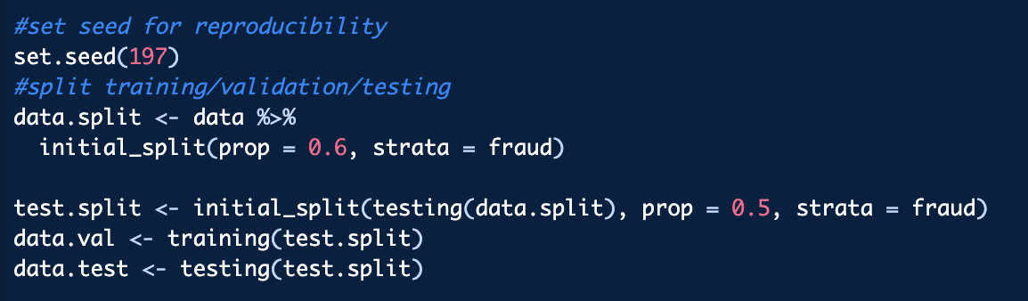
XGBoost in R: Preparation
The first step involves installing and loading the 'xgboost' package in R.
Subsequently, we split the data into 3 parts: training (60%), validation (20%), and testing (20%).
These segments are then transformed into DMatrix objects, an efficient data structure for the xgboost algorithm, by using xgb.DMatrix() function.

Slide 15
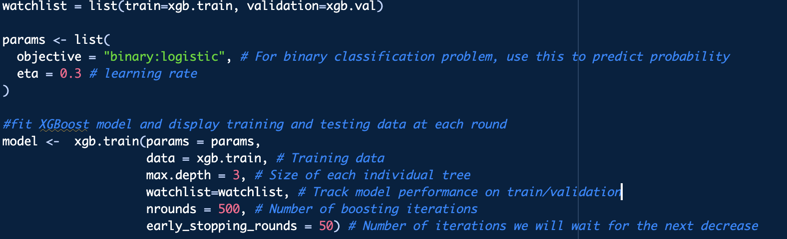
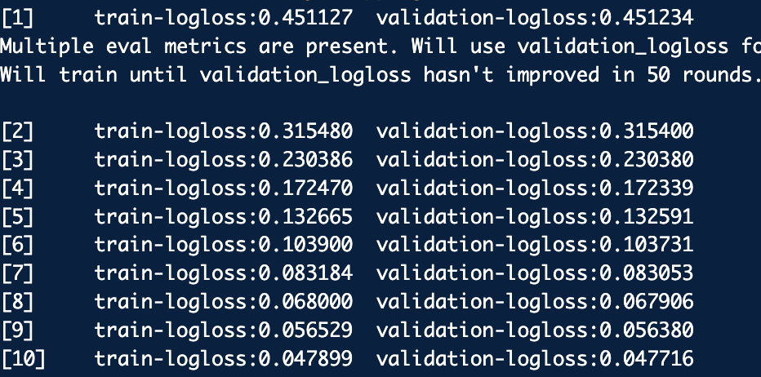
XGBoost in R: Model Training
objective: What’s your goal? In this case, we use ‘binary:logistic’ to predict the probability of having a fraud based on the predictor variables
eta: How fast to learn? default value 0.3
data: Training data in DMatrix structure
max.depth: The size of each tree and a rule of thumb is to use 2 or 3 to prevent overfitting
watchlist: Track model performance on training and validation data during the training process to prevent overfitting
nrounds: number of boosting rounds
early_stopping_rounds: Stop the training process if the model's accuracy on validation set hasn't improved for the specified number of rounds
How watchlist works

Slide 16
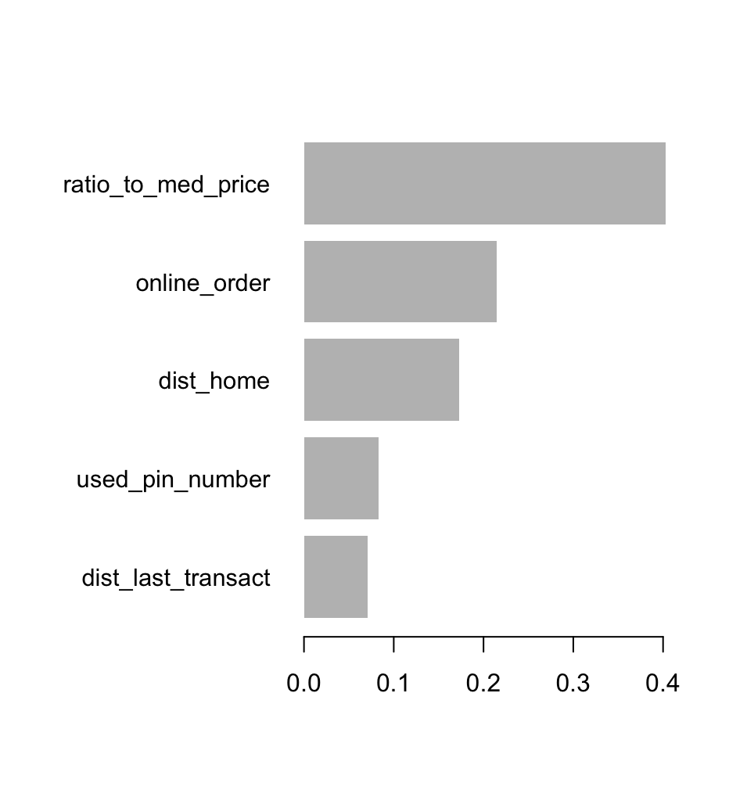
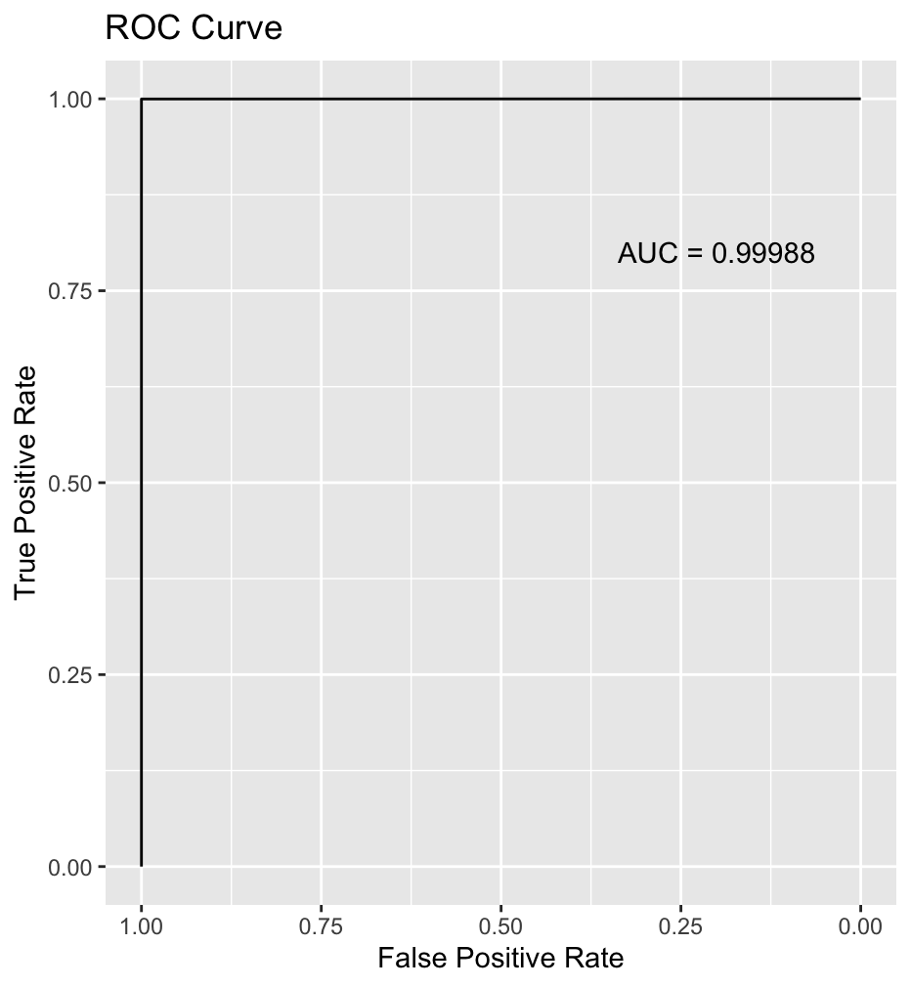
XGBoost in R: Result
Our model stops boosting at #261 round, which means the model accuracy decreases in the next 50 rounds. So we know that overfitting occurs after that. Hence, we changed parameter nrounds to 261 and trained our final model.
The first plot shows the 5 most important features identified by our final XGBoost model
The plot on the right shows a very high AUC score of 0.99988, which means the model is almost a perfect classifier. Such an unusual result is probably because the simulated dataset is designed for practice purposes, so it is easier to classify.

Slide 17
Reference
He, Shen, et al. “An Effective Cost-Sensitive XGBoost Method for Malicious Urls Detection in Imbalanced Dataset.” IEEE Access, vol. 9, 2021, pp. 93089–93096, doi:10.1109/access.2021.3093094.
ULB, Machine Learning Group -. “Credit Card Fraud Detection.” Kaggle, 23 Mar. 2018, www.kaggle.com/datasets/mlg-ulb/creditcardfraud. Accessed 06 Dec. 2023.
“XGBoost Documentation.” XGBoost Documentation - Xgboost 2.0.2 Documentation, xgboost.readthedocs.io/.

Slide 18
THE END
THANKS

