Slide 1

2026 Winter ECE 720
Group Final Project
Group 3
Zixi Chai
Reliable LIME under
Query Budget Constraints
zchai3@ualberta.ca
Wonki Byun
wonki@ualberta.ca
Qihang Feng
qfeng5@ualberta.ca

Slide 2
Background and Motivation
PART 1

Slide 3
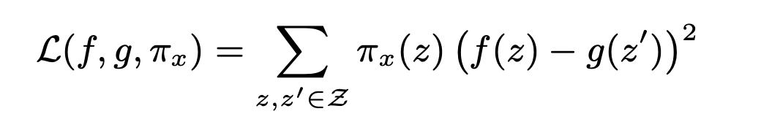
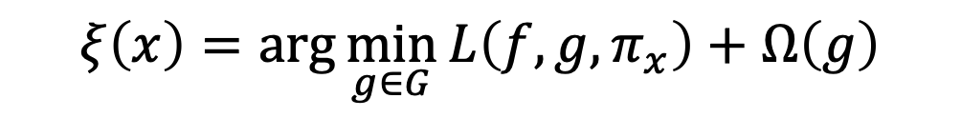
LIME(Local Interpretable Model-agnostic Explanations)
LIME
Interpretable Model
Original Model
Locality-aware weight
$$ξ\left(x\right)=\arg{\min_{g∈G}{L\left(f,g,π_{x}\right)}}+Ω\left(g\right)$$
Why did the model classify this specific data as this category?
Original Input
Sample Input

Slide 4
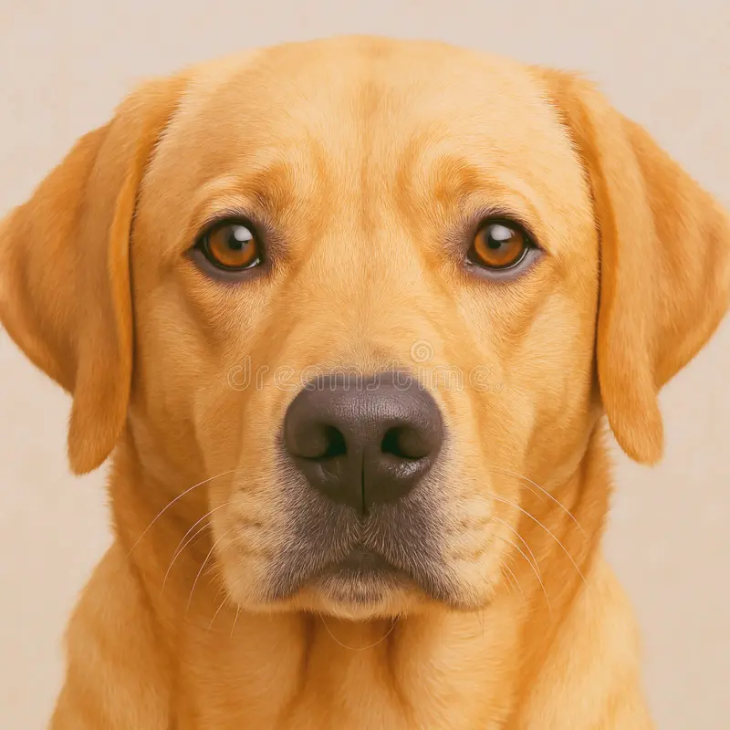
LIME(Local Interpretable Model-agnostic Explanations)
Example. Dog Classifier Model
Original Input
Sampling for Local Exploration (Super-pixels)
Interpretable Data Representations

Slide 5

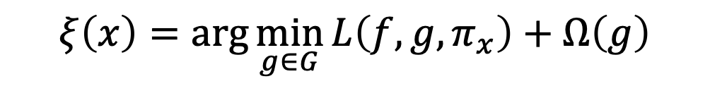
Real-world Limitations
$$ξ\left(x\right)=\arg{\min_{g∈G}{L\left(f,g,π_{x}\right)}}+Ω\left(g\right)$$
It is a time-consuming problem, and our resources(time, money, etc.)
are not infinite.

Slide 6
Motivation
How can we find a more efficient explanation model within the same budget?

Slide 7
Motivation
Possible Directions
Adaptive Budget
Budget Allocation Optimization
Balanced Mask Sampling
Dynamically choose the number of perturbation samples N for each instance, using more queries when the explanation is unstable and stopping early when it becomes stable.
Spend a small budget to quickly find candidate important features first, then use the remaining budget to refine the explanation by focusing perturbations on those candidates.
Split the budget N into R smaller runs, run LIME R times with different seeds, and then aggregate the feature weights (e.g., mean or median) to produce the final explanation.
Design perturbation masks so each feature is turned on and off a similar number of times, reducing sampling variance and making LIME more stable under small N
Coarse-to-Fine Budget Allocation
Repeated LIME with Split Budget and Aggregation

Slide 8
Methodology
PART 2

Slide 9
Numerical Metrics
We defined numerical metrics to evaluate explanations from four perspectives:
Fidelity
Stability
★Faithfulness
Cost: Number of model queries (budget) and runtime per explanation.

Slide 10
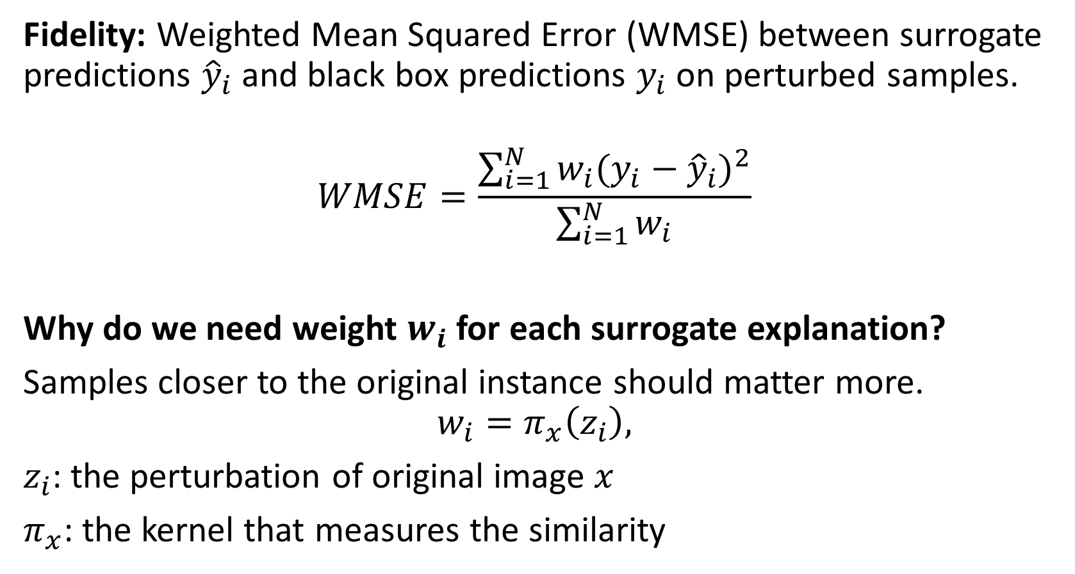
Numerical Metrics
Fidelity: Weighted Mean Squared Error (WMSE) between surrogate predictions ${\hat{y}}_{i}$ and black box predictions $y_{i}$ on perturbed samples.
$$WMSE=\frac{\sum_{i=1}^{N}{w_{i}{(y_{i}−{\hat{y}}_{i})}^{2}}}{\sum_{i=1}^{N}{w_{i}}}$$
Why do we need weight $w_{i}$ for each surrogate explanation?
Samples closer to the original instance should matter more.
$$w_{i}=π_{x}\left(z_{i}\right),$$
$z_{i}$: the perturbation of original image $x$
$π_{x}$: the kernel that measures the similarity

Slide 11
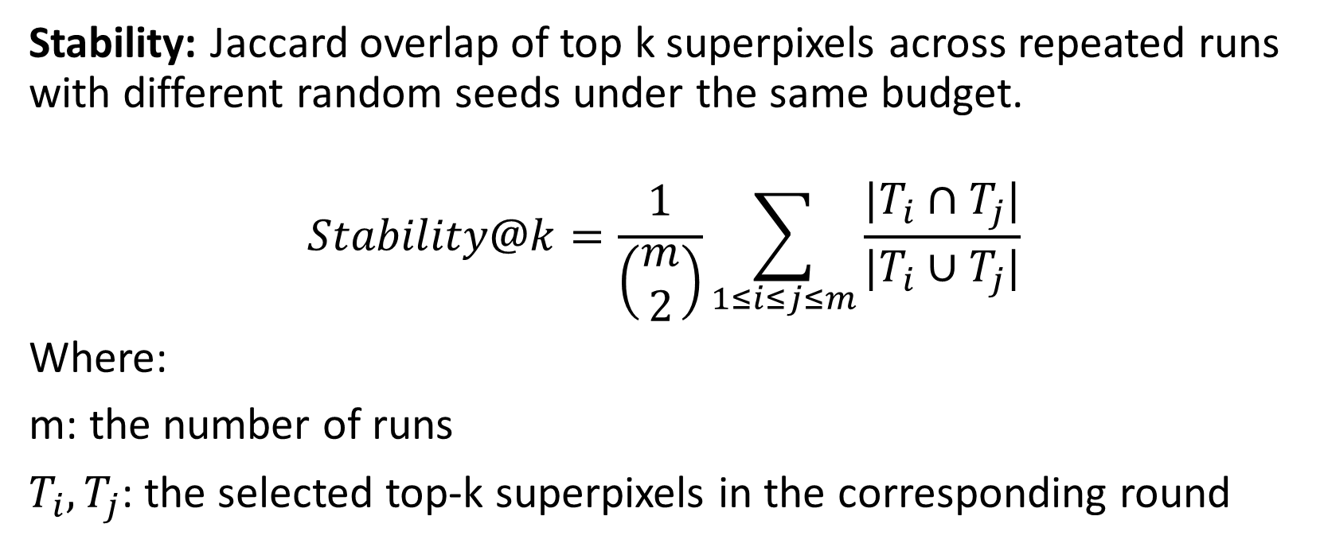
Numerical Metrics
Stability: Jaccard overlap of top k superpixels across repeated runs with different random seeds under the same budget.
$$Stability@k=\frac{1}{\left(\begin{matrix}m \\ 2\end{matrix}\right)}\sum_{1≤i≤j≤m}{\frac{|T_{i}∩T_{j}|}{|T_{i}∪T_{j}|}}$$
Where:
m: the number of runs
$T_{i}, T_{j}$: the selected top-k superpixels in the corresponding round

Slide 12
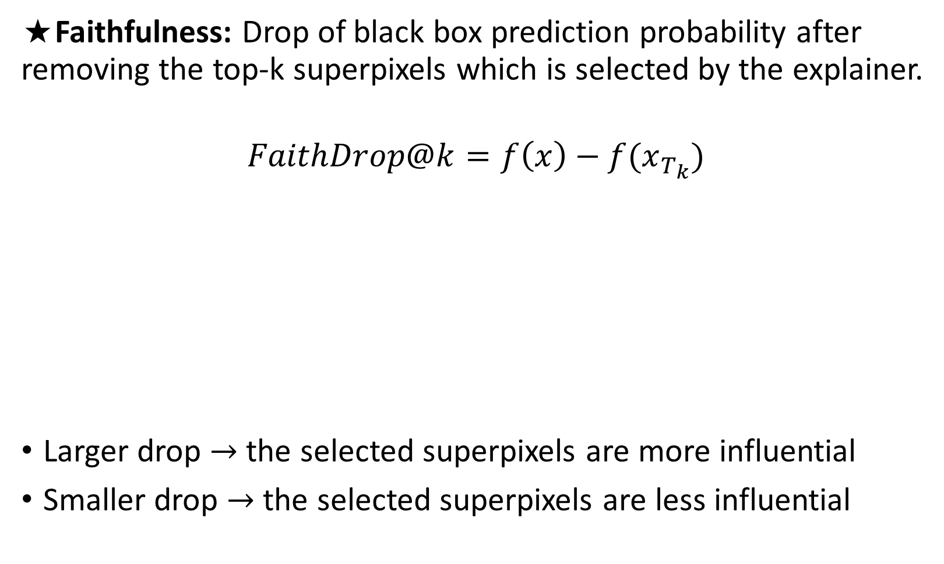
Numerical Metrics
★Faithfulness: Drop of black box prediction probability after removing the top-k superpixels which is selected by the explainer.
$$FaithDrop@k=f\left(x\right)−f(x_{T_{k}})$$
Larger drop → the selected superpixels are more influential
Smaller drop → the selected superpixels are less influential
Original Input
Dog: 0.973
Deletion Test1
Dog: 0.972
FaithDrop≈0
Deletion Test2
Dog: 0.908
FaithDrop=0.065
Deletion Test3
Dog: 0.857
FaithDrop=0.116

Slide 13
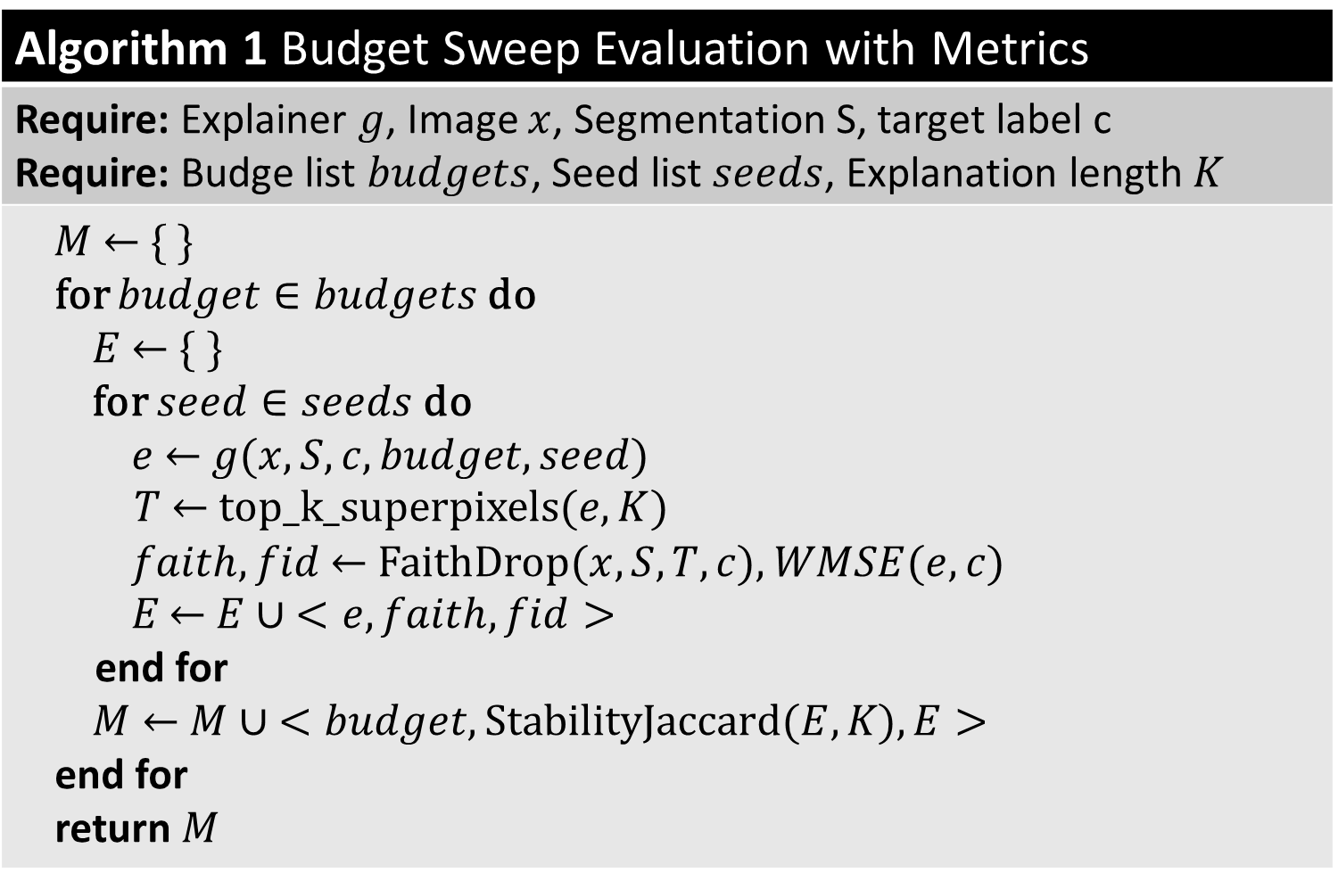
Budget Sweep Pipeline
Algorithm 1 Budget Sweep Evaluation with Metrics
Require: Explainer $g$, Image $x$, Segmentation S, target label c Require: Budge list $budgets$, Seed list $seeds$, Explanation length $K$
$M$ ← { } for $budget∈budgets$ do $E$ ← { } for $seed∈seeds$ do $e$ ← $g(x, S, c, budget, seed)$ $T$ ← top_k_superpixels($e,K$) $faith,fid$ ← FaithDrop($x,S,T,c$), $WMSE(e,c)$ $E$ ← $E∪ <e,faith, fid>$ end for $M$ ← $M∪ <budget,Stability\text{Jaccard}\text{(}E, K\text{)}, E>$ end for return $M$

Slide 14
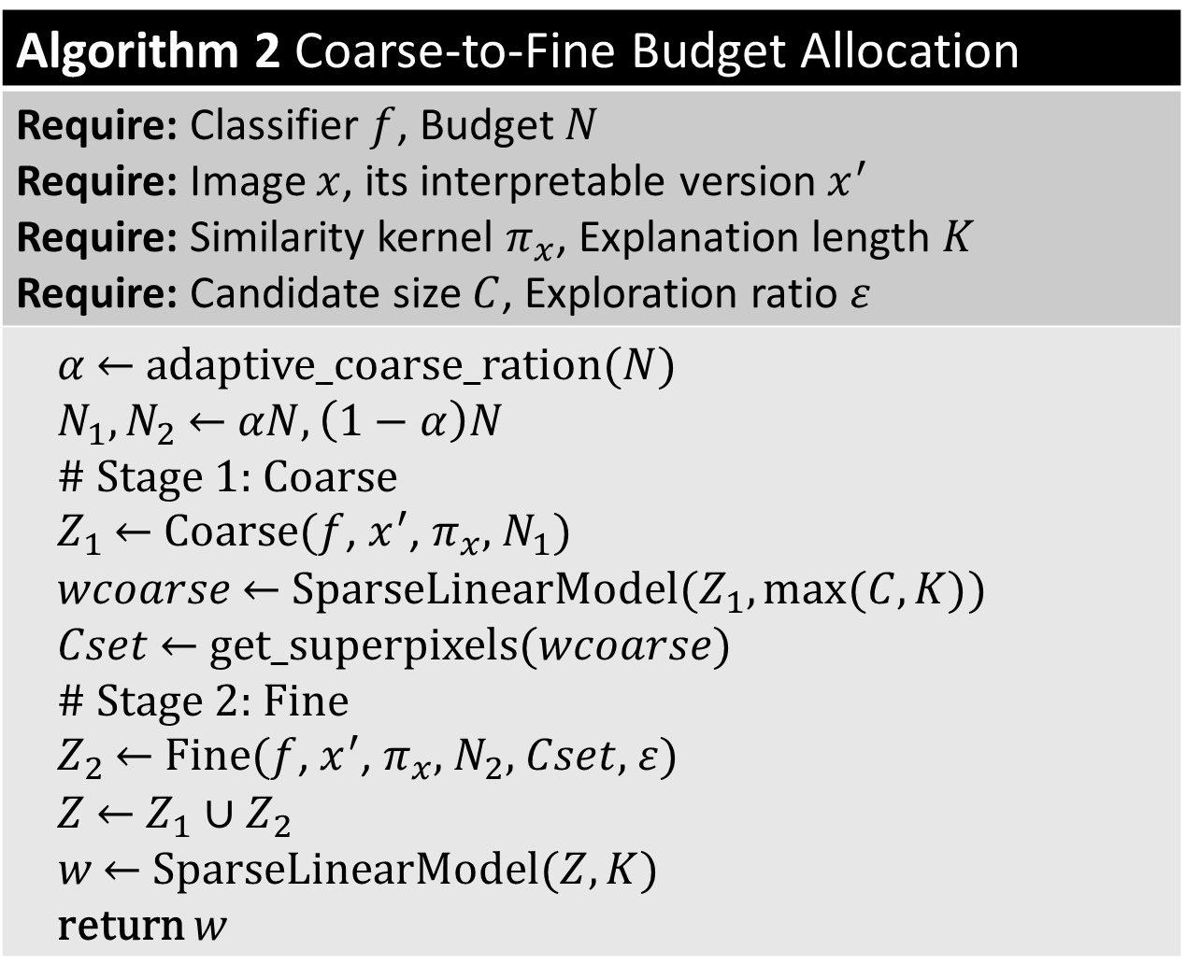
Coarse-to-Fine Budget Allocation
Algorithm 2 Coarse-to-Fine Budget Allocation
Require: Classifier $f$, Budget $N$ Require: Image $x$, its interpretable version $x^{′}$ Require: Similarity kernel $π_{x}$, Explanation length $K$ Require: Candidate size $C$, Exploration ratio $ε$
$α$ ← adaptive_coarse_ration($N$) $N_{1}, N_{2}$ ← $αN, \left(1−α\right)N$ # Stage 1: Coarse $Z_{1}$ ← Coarse($f$, $x^{′}$, $π_{x}$, $N_{1}$) $wcoarse$ ← SparseLinearModel($Z_{1}, max⁡(C,K)$) $Cset$ ← get_superpixels($wcoarse$) # Stage 2: Fine $Z_{2}$ ← Fine($f$, $x^{′}$, $π_{x}$, $N_{2}$, $Cset$, $ε$) $Z$ ← $Z_{1}∪Z_{2}$ $w$ ← SparseLinearModel($Z, K$) return $w$

Slide 15
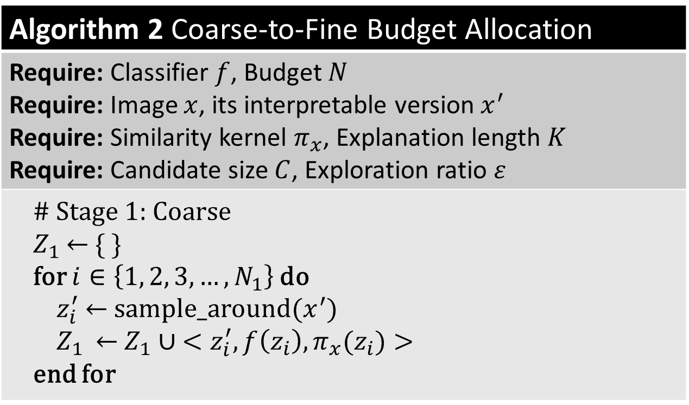
Coarse-to-Fine Budget Allocation
Algorithm 2 Coarse-to-Fine Budget Allocation
Require: Classifier $f$, Budget $N$ Require: Image $x$, its interpretable version $x^{′}$ Require: Similarity kernel $π_{x}$, Explanation length $K$ Require: Candidate size $C$, Exploration ratio $ε$
# Stage 1: Coarse $Z_{1}$← { } for $i∈\left\{1, 2, 3,…, N_{1}\right\}$ do $z_{i}^{′}$ ← sample_around($x^{′}$) $Z_{1}$ ← $Z_{1}∪ <z_{i}^{′}, f\left(z_{i}\right),π_{x}(z_{i})>$ end for

Slide 16
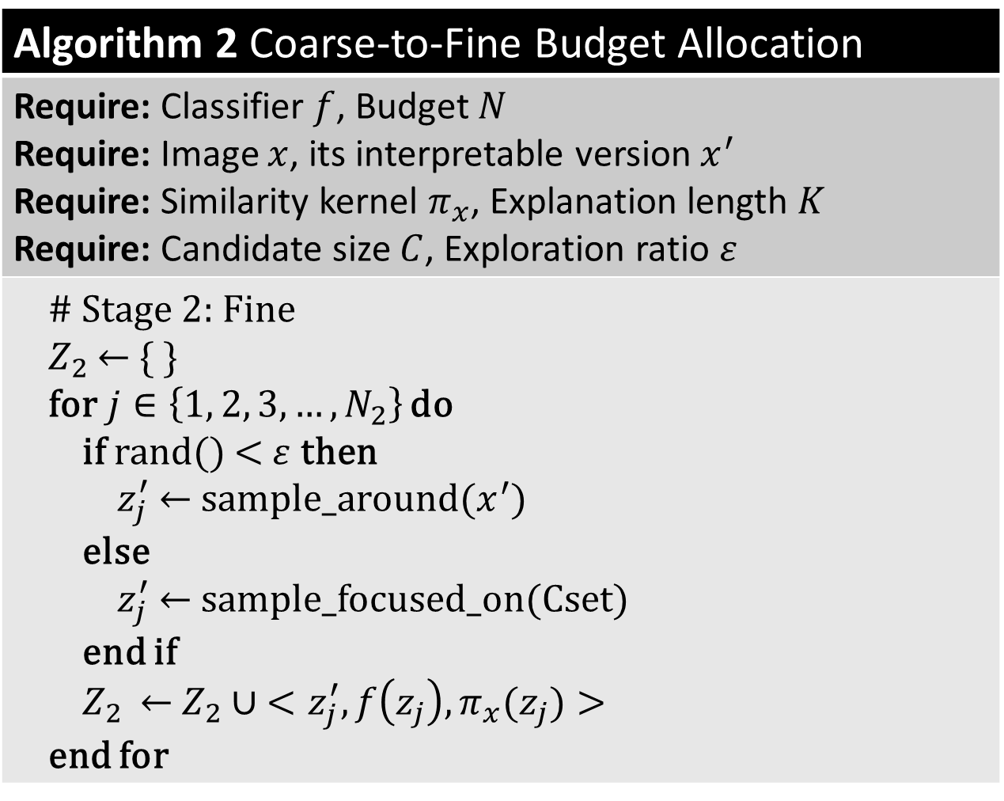
Coarse-to-Fine Budget Allocation
Algorithm 2 Coarse-to-Fine Budget Allocation
Require: Classifier $f$, Budget $N$ Require: Image $x$, its interpretable version $x^{′}$ Require: Similarity kernel $π_{x}$, Explanation length $K$ Require: Candidate size $C$, Exploration ratio $ε$
# Stage 2: Fine $Z_{2}$← { } for$j∈\left\{1, 2, 3,…, N_{2}\right\}$ do if rand() <$ε$ then $z_{j}^{′}$ ← sample_around($x^{′}$) else $z_{j}^{′}$ ← sample_focused_on(Cset) end if $Z_{2}$ ← $Z_{2}∪ <z_{j}^{′}, f\left(z_{j}\right),π_{x}(z_{j})>$ end for

Slide 17
Experiments, Evaluation and Conclusion
PART 3

Slide 18
Experiment Setup
General Settings
Black-box model: ResNet-18 (pretrained, ImageNet)
Test image: skimage.data.cat() → class 285 “Egyptian cat”
Segmentation: SLIC, 100 superpixels, fixed across all runs
Budget levels: N ∈ {200, 500, 1000, 2000, 3000, 5000}
Repetitions: 10 random seeds per budget
Surrogate: Ridge regression (α=1), cosine distance, exp kernel (width=0.25)
Top-k = 10, hide_color = 0 (black)
Coarse-to-Fine Settings
Adaptive coarse fraction:
50% when N ≤ 500
30% when N ≤ 2000
20% otherwise
candidate_k = 20
ε = 0.2
batch_size = 32

Slide 19
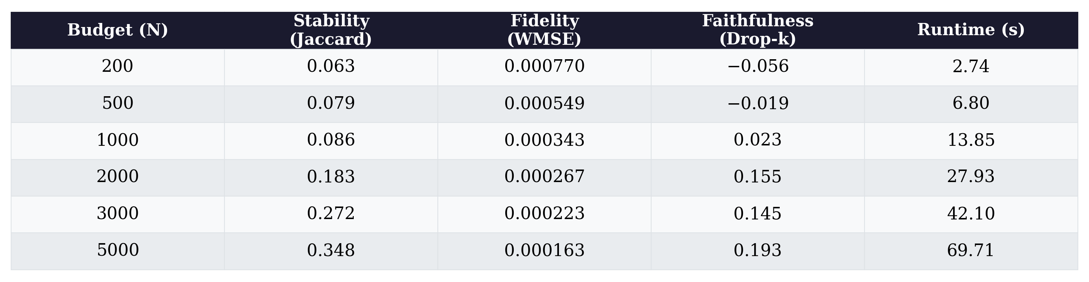
Baseline Results: Vanilla LIME
Key Findings:
At N ≤ 1000: Faithfulness is negative → explanation points to wrong regions
Stability < 0.1 → explanations are not reproducible

Slide 20
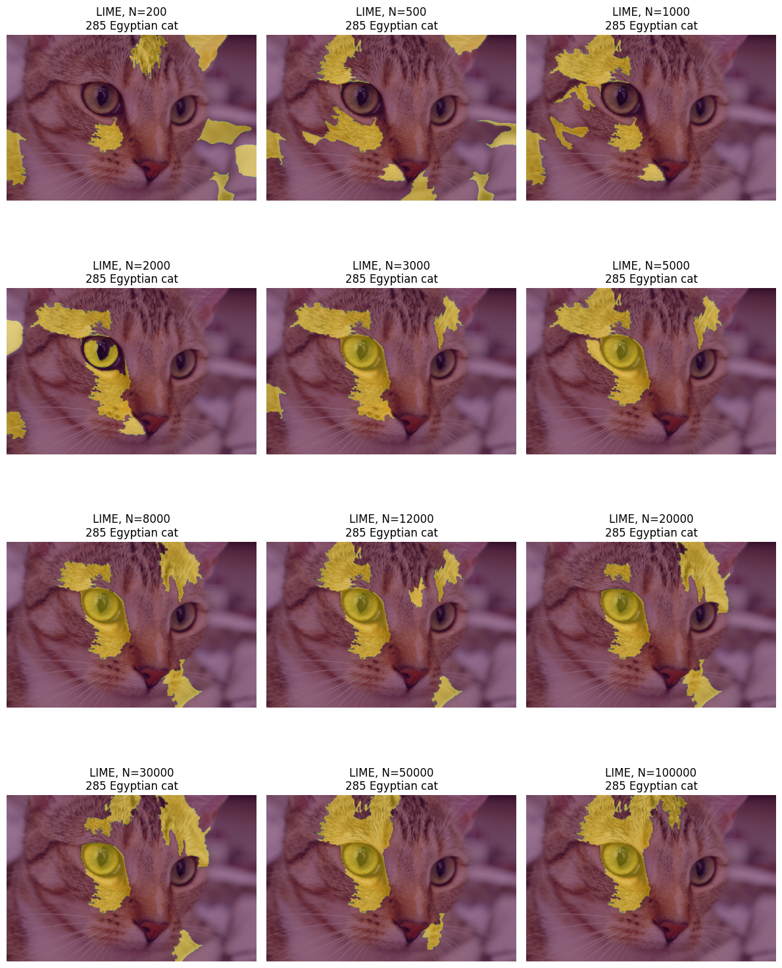
Baseline Results: Visual Explanation Quality

Slide 21
Baseline Results: Visual Explanation Quality

Slide 22
Baseline Results: Visual Explanation Quality
N=200: Scattered, inconsistent highlights — explanation is noise
N=5000: Consistently focuses on cat’s facial features (eyes, nose)

Slide 23
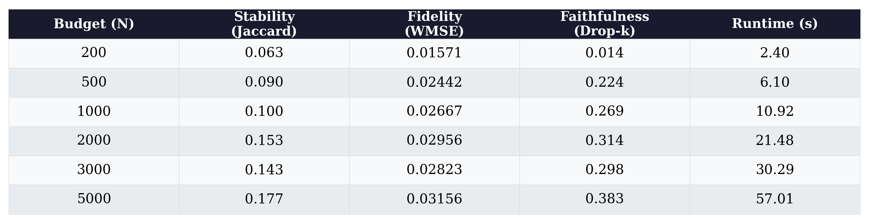
Improvement Results: Coarse-to-Fine
Key Findings:
Faithfulness positive at ALL budgets (vanilla is negative at N ≤ 500)
At N=500: Drop-k improves from −0.019 → 0.224

Slide 24
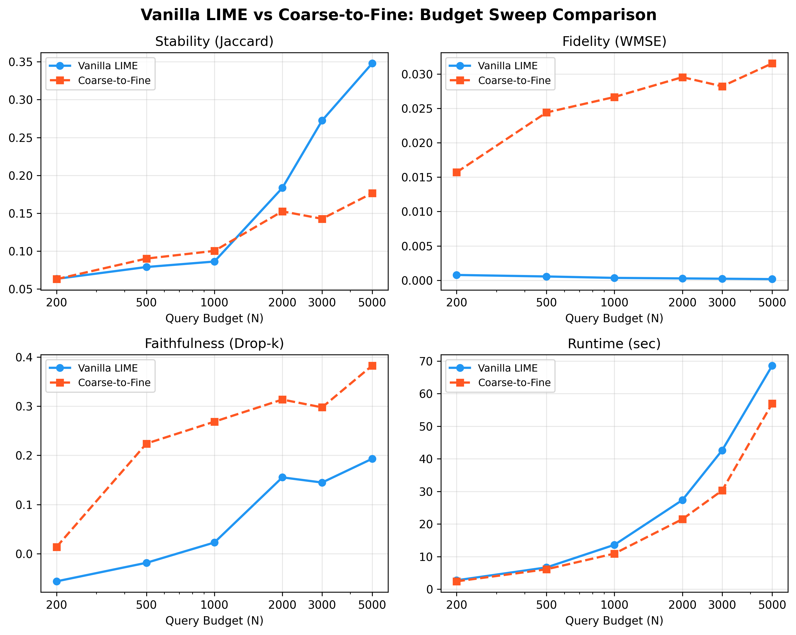
Vanilla LIME vs. Coarse-to-Fine: Metric Comparison
Per-Metric Summary:
Faithfulness
C2F consistently higher
Fidelity (WMSE)
C2F much higher — focuses on harder regions
Stability
Mixed — slightly better at low N, worse at high N
Runtime
Comparable across both methods

Slide 25
Why fidelity become worse than original?
Influential area
Neutral area
Easy to approximate (near-zero)
Critical to distinguish (fine-grained)

Slide 26
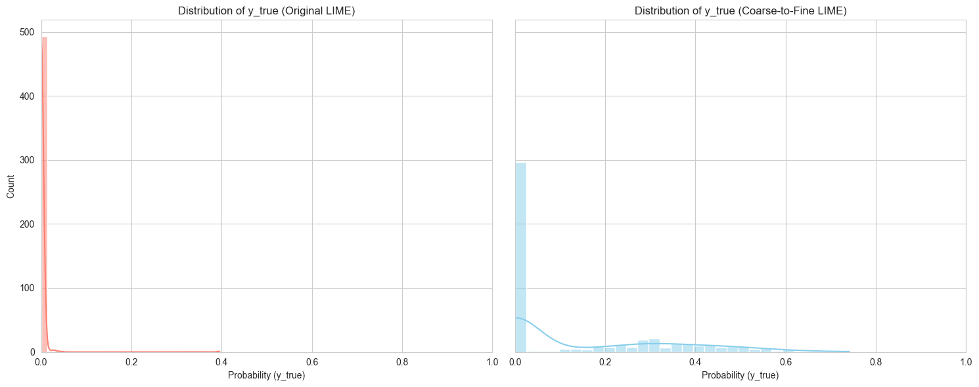
Why fidelity become worse than original?
Coarse-to-Fine LIME focuses on more sensitive area
(N=500)

Slide 27
Conclusion & Future Work
Conclusion
Built budget sweep evaluation framework with 4 metrics
Vanilla LIME is unreliable when N < 1000
Coarse-to-fine improves faithfulness at all budgets, highlights meaningful regions at N=500
No additional query overhead
Future Work
Test on more images and models (VGG, ViT)
Explore alternative sampling strategies for better stability
Automatic hyperparameter tuning (coarse fraction, ε, candidate_k)
Extend to tabular/text LIME

Slide 28
Thank you!

