Slide 1
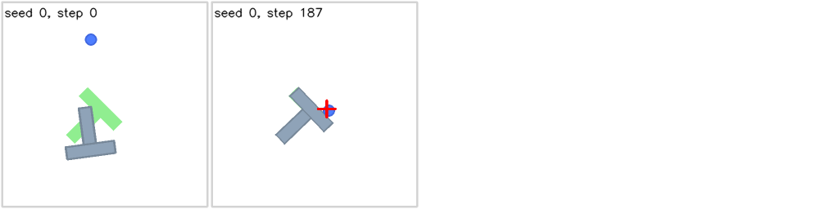
ECE 730 PROJECT PROPOSAL
Effective Prediction
Utilization:
Adaptive Execution and
Self-Imitation-Based Fine-Tuning
for Robotic Pushing
Qihang Feng
1
Notes:
Suggested duration: 30 seconds.
Spoken outline:
This project asks how to make better use of a robot model's own predictions. I will study PushT, where a pusher moves a T-shaped block onto a target. Camera feedback connects physical movement with software decisions in a cyber-physical loop. I propose two approaches: adapt how many predicted movements the robot executes, and fine-tune a small part of the model using its own successful trajectories.
Sources and preparation record (not spoken):
Chi et al. Diffusion Policy: Visuomotor Policy Learning via Action Diffusion. RSS 2023. https://arxiv.org/abs/2303.04137
Hugging Face gym-pusht simulator. https://github.com/huggingface/gym-pusht
Visual: initial PushT scene cropped from results/robotics-baseline-check/seed-0-frames.png. It illustrates the task and makes no performance claim.
This is a prospective proposal. No experimental results are presented. ChatGPT assisted with drafting and presentation preparation; the presenter should review the content and retain the preparation record.

Slide 2
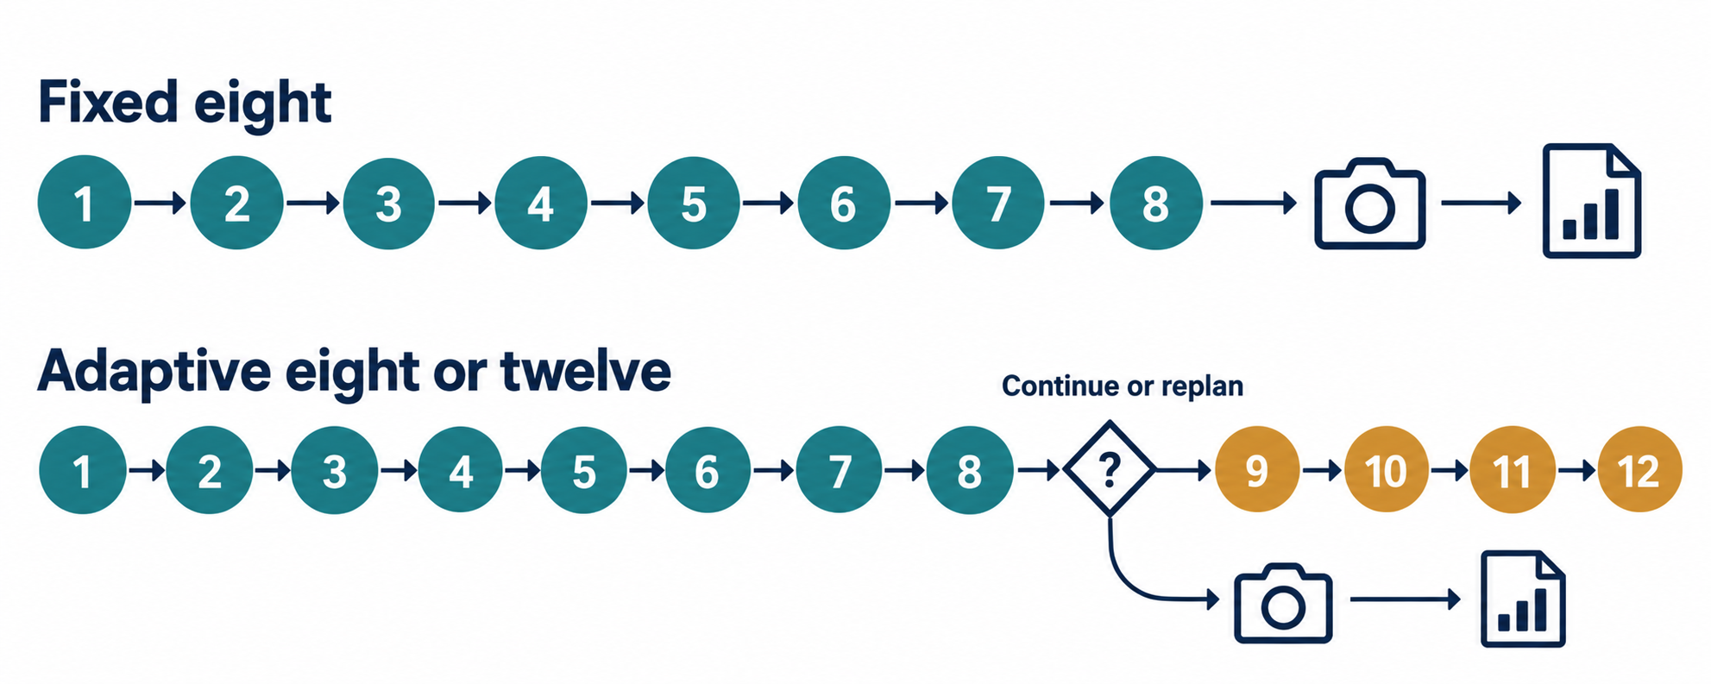
Prediction and execution
Each prediction requires computation. Remaining movements may still be useful.
The model generates the same sequence length in both cases
2
Notes:
Suggested duration: 45 seconds.
Spoken outline:
The original Diffusion Policy already uses visual feedback. It predicts a movement sequence, executes eight movements, and then predicts again using updated observations. This balances coordinated motion with correction, but some remaining movements may still be useful. My controller will decide whether to replan after eight or execute four additional movements. The prediction horizon and inference settings will stay fixed. This changes execution decisions around the model. The aim is to use a prediction longer when feedback supports continuing, without committing to every predicted movement.
Technical clarification (not spoken): the fixed H16 horizon and two-observation convention leave fifteen usable future commands. Eight/twelve refers to execution, not generation.
Sources and preparation record (not spoken):
Chi et al. Diffusion Policy: Visuomotor Policy Learning via Action Diffusion. RSS 2023. https://arxiv.org/abs/2303.04137
Project implementation: experiments/robotics_adaptive_length.py; experiments/robotics_visual_monitor.py; experiments/robotics_recovery_training.py. These describe the proposed configuration, not evidence of future improvement.
Visual: assets/action-reuse.png, an AI-generated conceptual illustration. Camera icons indicate the feedback decision; images are also observed during execution. The diagram simplifies bounded early interruptions, which are explained on the next slide.
This is a prospective proposal. No experimental results are presented. ChatGPT assisted with drafting and presentation preparation; the presenter should review the content and retain the preparation record.

Slide 3
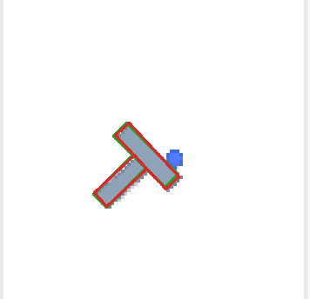
Signals for continuing or replanning
Signals: target coverage, decline, recovery and path smoothness
Continue up to twelve
Clear visual estimate, limited recent decline,
and smooth remaining movements
Replan after eight
Near target, uncertain alignment,
or a failed continuation check
Interrupt early
Repeated warnings, accumulated alignment loss,
and no clear recovery
A temporary alignment drop can be part of a useful adjustment
3
Notes:
Suggested duration: 60 seconds.
Spoken outline:
I will use three groups of signals. First, camera-estimated target coverage tells us how closely the block matches the target and whether the estimate is reliable. Second, recent alignment history gives warning counts, accumulated decline and signs of recovery. Third, the remaining command path shows whether the planned movements stay smooth. At movement eight, reliable feedback and a smooth path can support continuing up to twelve. Near the target or when checks fail, the controller will replan. During execution, repeated deterioration may trigger an early interruption, with confirmation, cooldown and intervention limits. A temporary alignment drop alone will not trigger an early interruption because useful adjustments can briefly worsen alignment.
Sources and preparation record (not spoken):
Hugging Face gym-pusht simulator. https://github.com/huggingface/gym-pusht
Project implementation: experiments/robotics_adaptive_length.py; experiments/robotics_visual_monitor.py; experiments/robotics_recovery_training.py. These describe the proposed configuration, not evidence of future improvement.
Visual: right-hand fitted-object illustration cropped from results/robotics-benefit-pilot/visual-example.png. All measured values are excluded. The illustration shows the estimator mechanism, not a success result.
This is a prospective proposal. No experimental results are presented. ChatGPT assisted with drafting and presentation preparation; the presenter should review the content and retain the preparation record.

Slide 4
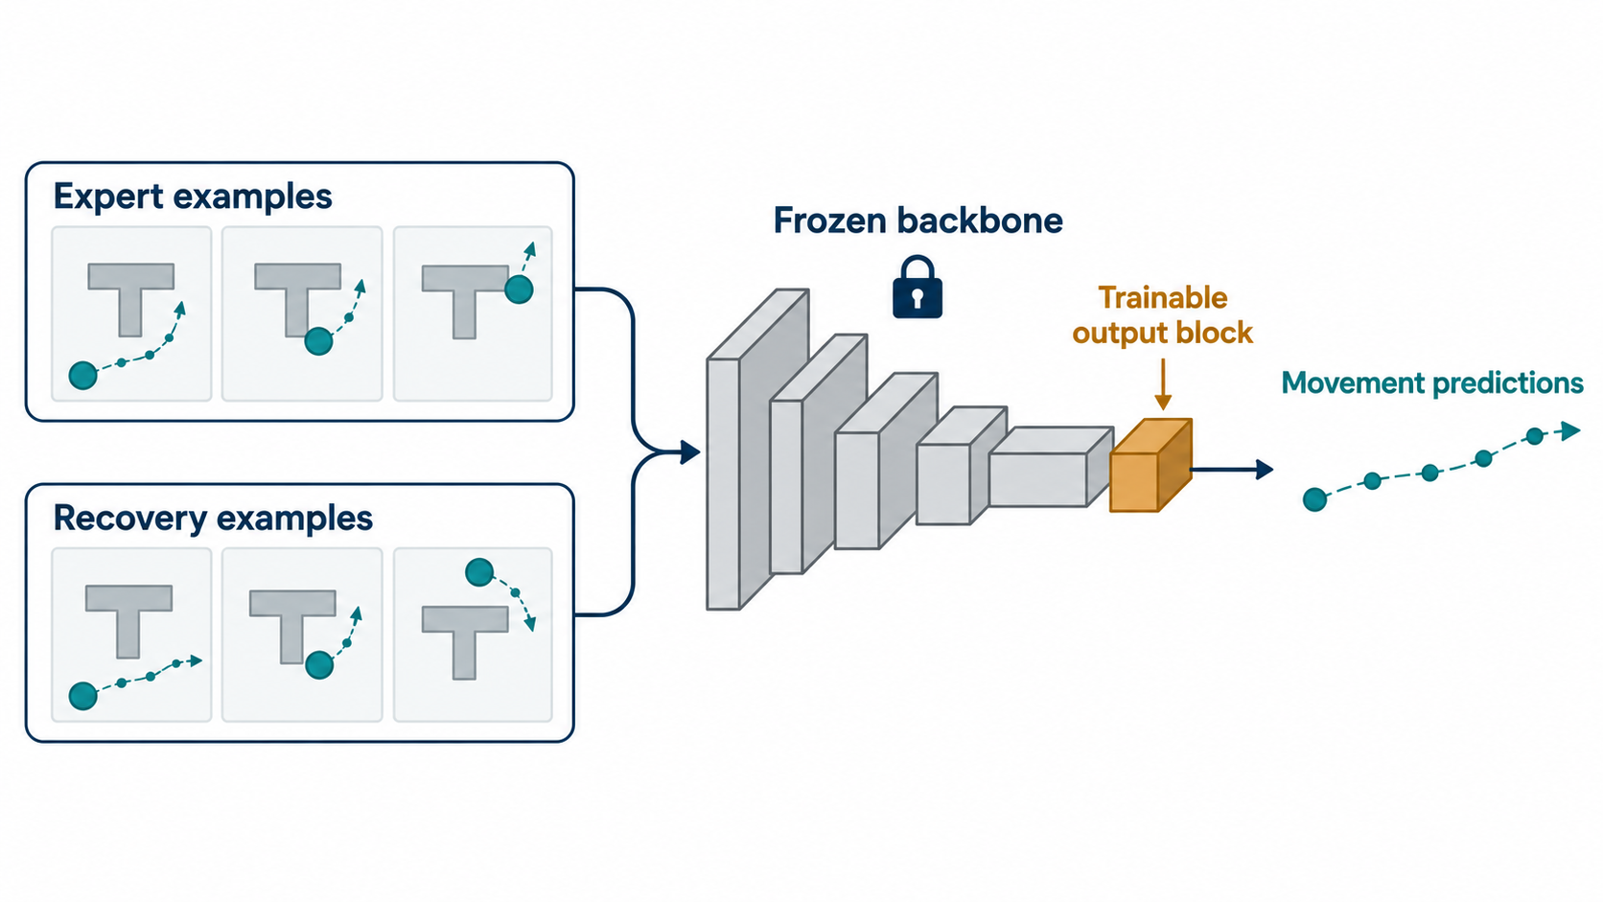
Self-imitation-based fine-tuning
Sample continuations from intermediate states in failed baseline attempts.
Keep successful trajectories generated by the original model.
Update only the final convolution block. Keep other weights frozen.
4
Notes:
Suggested duration: 60 seconds.
Spoken outline:
The same stochastic model can produce different outcomes from the same initial situation. I will return to selected intermediate states in failed baseline attempts and sample several continuations using the original model. I will retain the recorded movements from continuations that eventually complete the task. Success here means finishing the push, rather than just improving alignment briefly. I will mix these trajectories with expert demonstrations and fine-tune only the existing final convolution block. The visual encoder and other model parameters will remain frozen. Training will finish before evaluation, with no weight updates during pushing. I will test the updated model with the same fixed-eight and adaptive execution rules.
Sources and preparation record (not spoken):
Chi et al. Diffusion Policy: Visuomotor Policy Learning via Action Diffusion. RSS 2023. https://arxiv.org/abs/2303.04137
Planned refinement configuration: experiments/robotics_recovery_dataset.py; experiments/robotics_recovery_training.py. Public demonstrations: https://huggingface.co/datasets/lerobot/pusht
Visual: assets/policy-refinement.png, an AI-generated conceptual illustration of offline supervised refinement. It is not an architecture specification or an experimental result.
This is a prospective proposal. No experimental results are presented. ChatGPT assisted with drafting and presentation preparation; the presenter should review the content and retain the preparation record.
[3] Jin et al. SIME: Enhancing Policy Self-Improvement with Modal-level Exploration. IROS 2025. https://arxiv.org/abs/2505.01396
SIME supplies policy-self-improvement precedent. The selected-continuation data and final-block-only update are project-specific adaptations.

Slide 5
Planned evaluation
Configuration | Model | Execution
Original baseline | Original pretrained | Fixed eight
Adaptive execution | Original pretrained | Adaptive 8/12
Fine-tuning | Fine-tuned | Fixed eight
Adaptive execution + fine-tuning | Fine-tuned | Adaptive 8/12
Matched scenes, repeated prediction samples, equal movement limits
Success (>95% coverage) and average final alignment
Average prediction calls and average complete-attempt runtime
Separate fine-tuning and evaluation scenes. Include failed attempts.
5
Notes:
Suggested duration: 75 seconds.
Spoken outline:
The evaluation will compare four configurations. These are the original model with fixed-eight execution, the original model with adaptive execution, the fine-tuned model with fixed-eight execution, and the fine-tuned model with adaptive execution. This design helps separate the effects of execution control and fine-tuning. I will use matched initial scenes, repeated prediction samples and the same movement limit. Fine-tuning and evaluation scenes will remain separate, and I will freeze settings before testing. I will measure success above ninety-five percent target coverage, average final alignment, average prediction calls and average total attempt runtime, including controller overhead. Failed attempts will remain in the averages. I will report uncertainty across scenes and inspect both improvements and regressions.
Sources and preparation record (not spoken):
Hugging Face gym-pusht simulator. https://github.com/huggingface/gym-pusht
Planned paired design and metric definitions follow experiments/robotics_recovery_evaluation.py and experiments/robotics_recovery_confirmation.py. No completed evaluation figures are included.
This is a prospective proposal. No experimental results are presented. ChatGPT assisted with drafting and presentation preparation; the presenter should review the content and retain the preparation record.
Source proposal: course-deliverables/project-proposal.docx, four planned configurations. Fine-tuned fixed-eight is a proposed comparison, not a completed result.

Slide 6
Expected contribution and scope
Target outcome
More successful pushes with fewer
predictions and shorter runtime
Assess the effect on average final alignment
Report improvements, regressions and uncertainty
Scope: PushT simulation on a GTX 1650 laptop
Simulation pauses while the model predicts movements
6
Notes:
Suggested duration: 30 seconds.
Spoken outline:
The target is more successful pushes with fewer predictions and shorter runtime. I will also evaluate final alignment and report cases where performance gets worse. The study uses two-dimensional simulation on a GTX 1650 laptop. Simulation pauses during inference, so real-time control and physical-robot deployment are outside this project's scope.
Sources and preparation record (not spoken):
Chi et al. Diffusion Policy: Visuomotor Policy Learning via Action Diffusion. RSS 2023. https://arxiv.org/abs/2303.04137
Hugging Face gym-pusht simulator. https://github.com/huggingface/gym-pusht
Project implementation: experiments/robotics_adaptive_length.py; experiments/robotics_visual_monitor.py; experiments/robotics_recovery_training.py. These describe the proposed configuration, not evidence of future improvement.
This is a prospective proposal. No experimental results are presented. ChatGPT assisted with drafting and presentation preparation; the presenter should review the content and retain the preparation record.

Slide 7
Thank you!
7
Notes:
Thank you!

