Slide 1
Hidden
(60 units)
Verbal representation (60 units)
Visual representation (60 units)
1-1
1-1
Verbal input
(60 units)
Visual input
(60 units)

Slide 2
Organization of the input/output layer
Category A, 20 units
Category B & C, 40 units
…………
Superordinate
(4 units)
Basic
(8 units)
Subordinate
( 8 units)

Slide 3
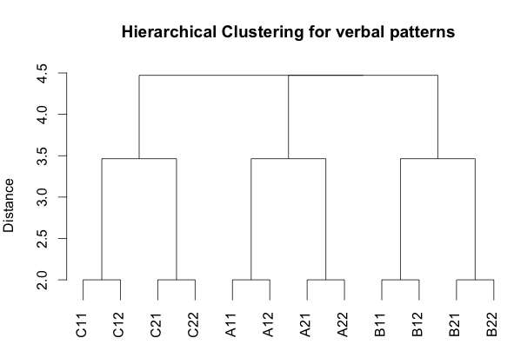

Slide 4
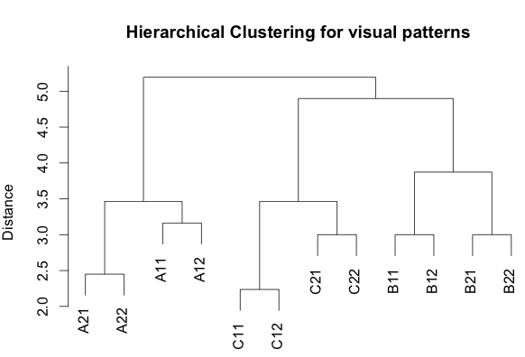

Slide 5
After 10 epochs…

Slide 6
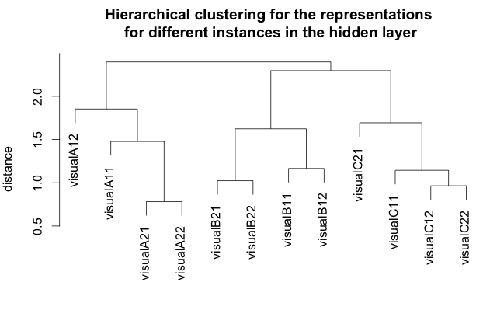

Slide 7
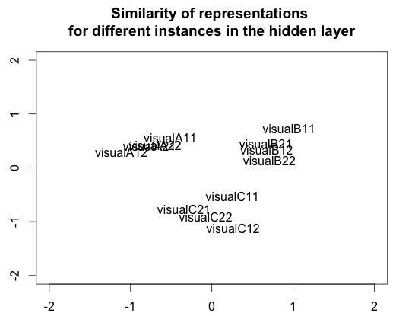

Slide 8
After 3000 epochs…

Slide 9
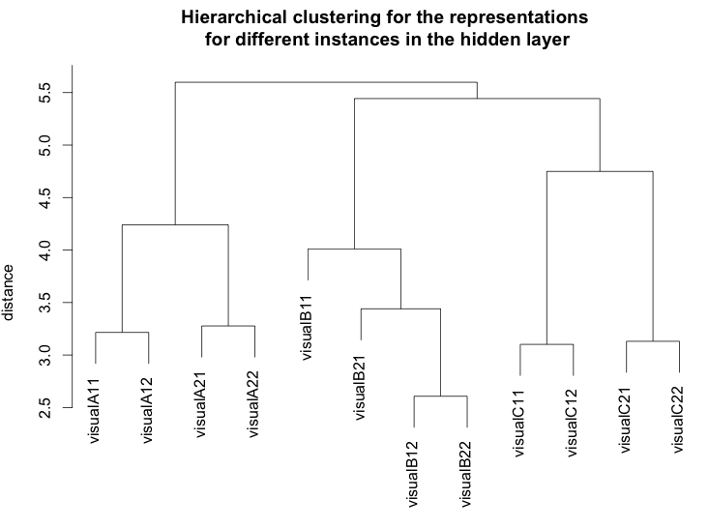

Slide 10
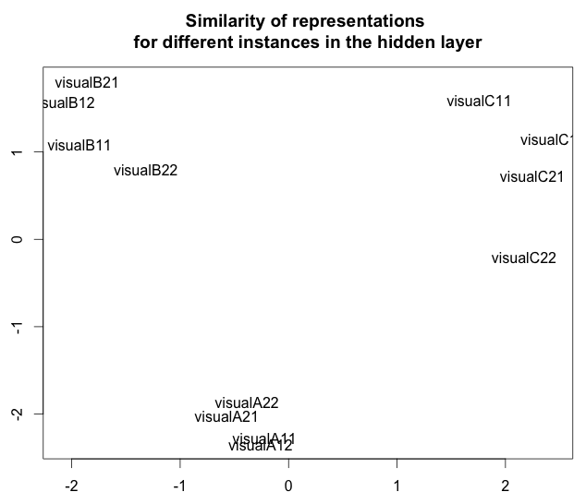

Slide 11
