Slide 1
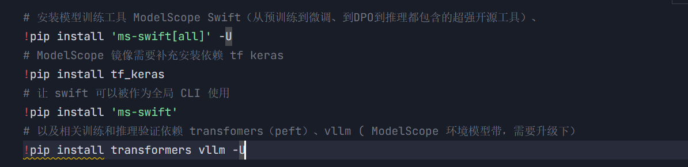
Step1

Slide 2
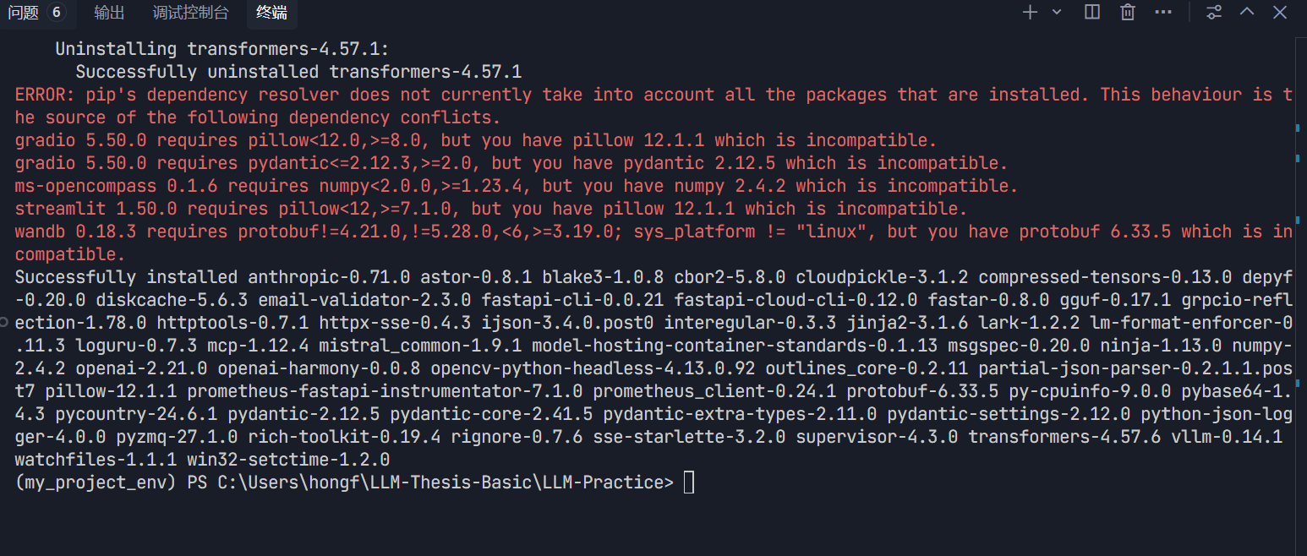
Step1

Slide 3
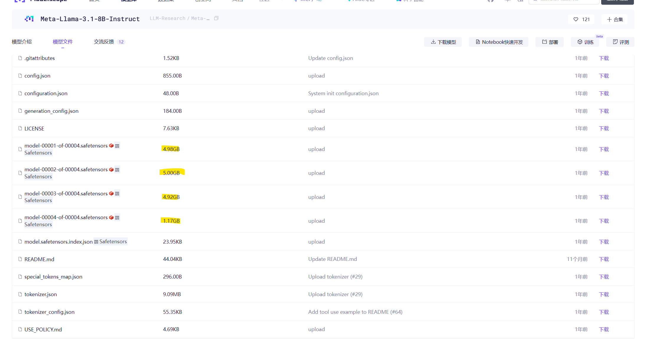
Meta-Llama-3.1-8B-Instruct · 模型库
Step1

Slide 4
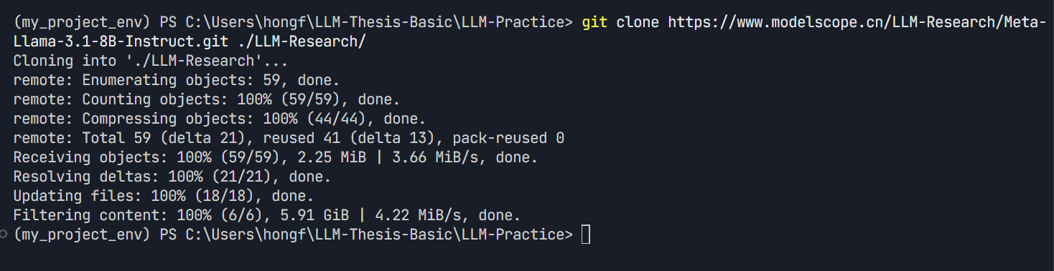
git clone https://www.modelscope.cn/LLM-Research/Meta-Llama-3.1-8B-Instruct.git ./LLM-Research/

