Slide 1

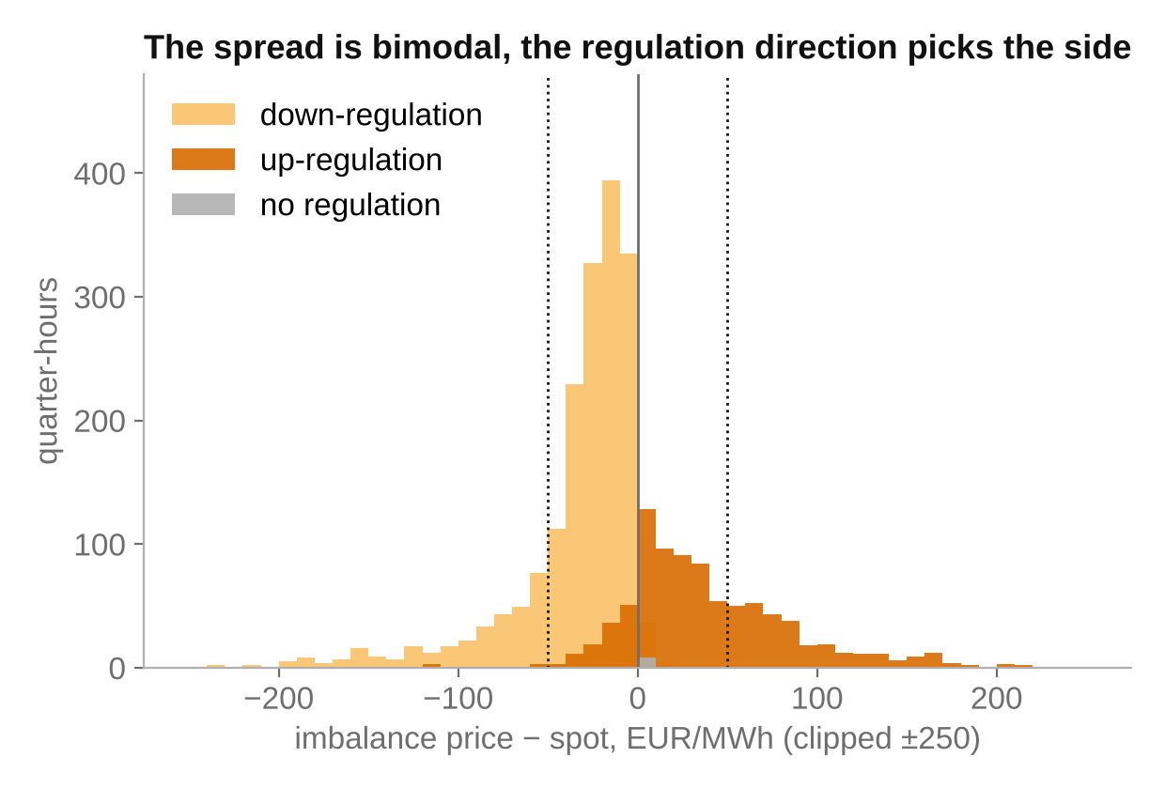
43 EUR per MWh out of balance, nobody knows which way
43 €/MWh
average cost of one MWh of imbalance
mean |imbalance − spot|, validation
25 %
of quarter-hours beyond ±50 EUR/MWh from spot
two price modes, up and down
10 h
ahead a plant must plan, with a full-hour origin
no public forecast of this price exists
Turku Energia runs CHP and electric boilers: both can move power either way, if they know which way the price goes.
Notes:
Validation 7 Sep - 4 Oct 2026, 26,700 quarter-hours. Mean |imbalance - spot| 43.4 EUR/MWh. 25 % of quarter-hours beyond +-50; 1.8 % beyond 200 (max about 3,800). The histogram is coloured by the realised regulation direction: up-regulation prices sit above spot, down-regulation below; the two modes are the whole problem.

Slide 2
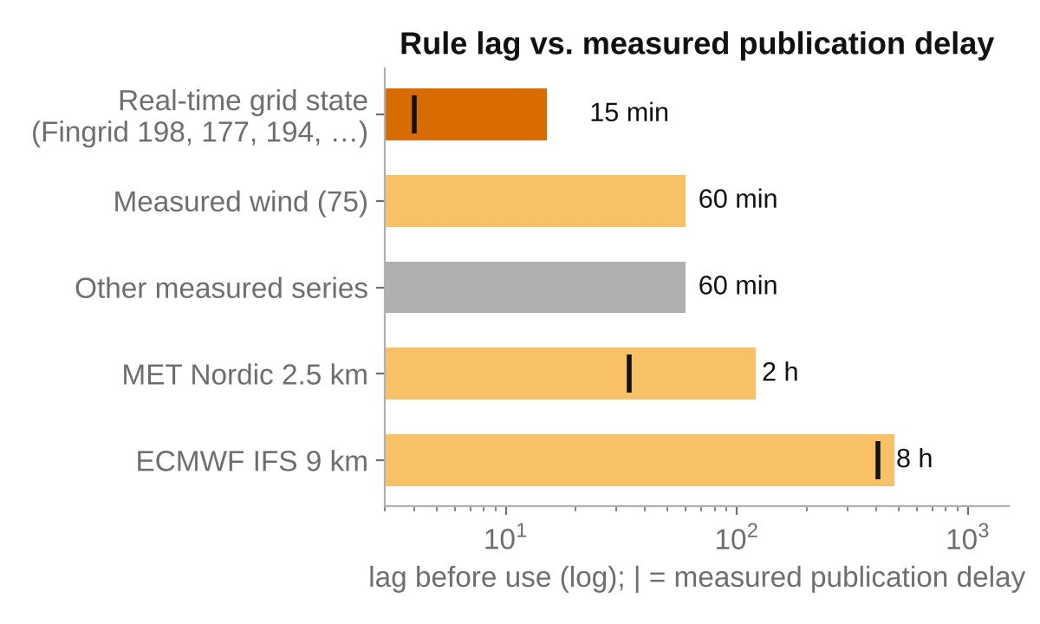
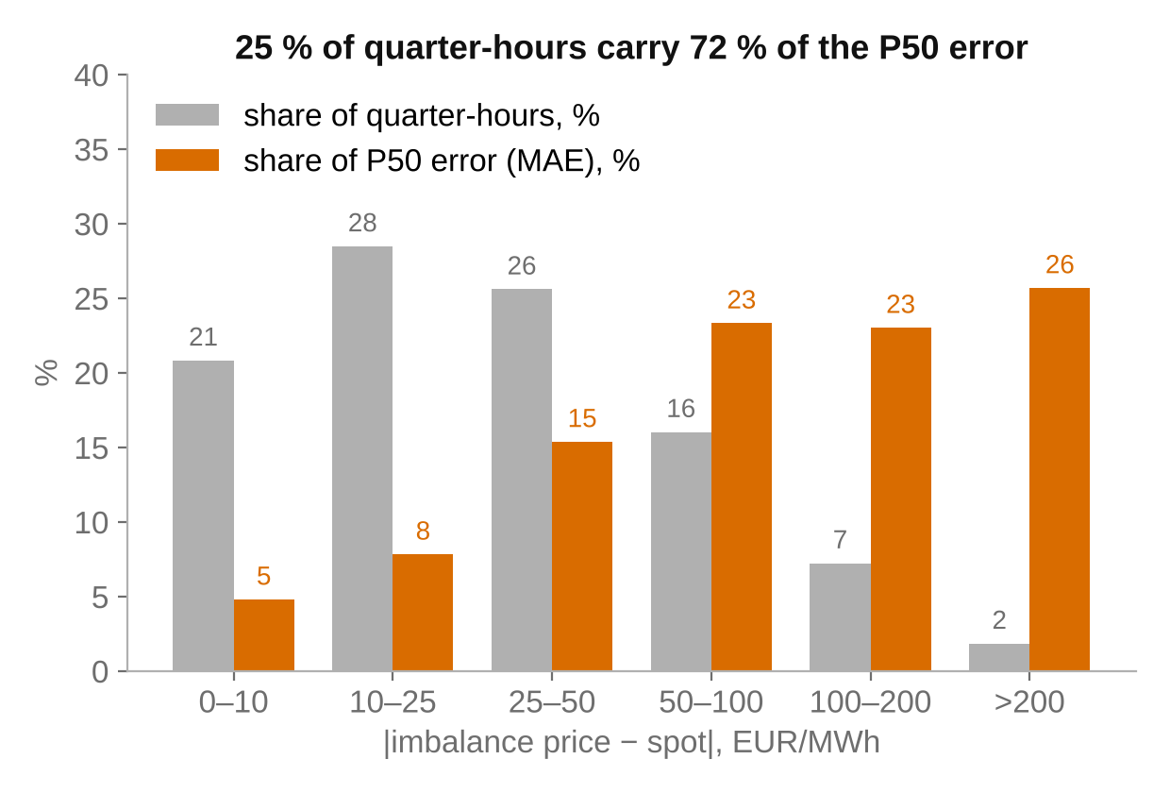
The market is a rule, physics is measurable, one model fails
The price is a rule, not a mystery
Measured weather beats modelled weather
A smooth model cannot see a spike
Fingrid's 1 June 2026 rule rebuilt from public series reproduces 99.6 % of quarter-hours exactly. Only the regulation direction and the balancing price need forecasting; spot is known, so we forecast the spread.
Measured wind minus Fingrid's day-ahead forecast, persisted, beats the forecast itself at 0–2 h (235 vs 320 MW). The grid's own surplus, frequency and flows are public 1–4 minutes after each quarter-hour.
One quantile model: MAE 26 on down-regulated quarter-hours, 77 on up-regulated. 72 % of the error sits in the 25 % of spiky quarter-hours, so the value is in probabilities, not in the point forecast.
Notes:
Market: tools/eval/rebuild_price.py, MAE 0.01 EUR/MWh on the rebuild. Physics: tools/eval/wind_corrector.py; persistence of the observed error 299 vs 321 MW overall, 235 vs 320 MW at 0-2 h; learned correctors 381-403 MW. Fingrid real-time datasets 198, 177, 194, 371, 398/399, 181, 193: measured publication delay 1.1-4.1 min (tools/eval/fingrid_delay.py), used with a 15 min rule (left chart). Models: lgbm_v4s vs mix_v4b on identical features: MAE -3.2 %, pinball -2.3 %, 100 % of resamples. Right chart: share of quarter-hours vs share of P50 error by |spread| bucket. Oracle on direction: MAE 35.6.

Slide 3
Three LightGBM heads mixed into one distribution per member
Feature table
LightGBM classifier
Mixture
Outputs per row
one row per (origin, step)
76–93 features
all read through the availability mask
market state · grid state (15 min) · measured wind − forecast · spot and day-ahead forecasts · NWP · cross-border · calendar
P(up) · 110 trees · P(down), P(none) from it
heads widened ×2 around their medians, then
F = P(up)·F_up
+ P(down)·F_down
+ P(none)·1[x ≥ 0]
P10/P50/P90 = F⁻¹
P(spike) = tail mass beyond ±50
p10, p50, p90
p_up, p_down, p_none
p_spike_high, p_spike_low
top_drivers (TreeSHAP)
data_cutoff_utc
7 LightGBM quantile heads
spread | up-regulation · q05…q95 · 150 trees · trained on up rows only
Explainable: TreeSHAP on every head attributes each forecast to its drivers, a mathematical account of a model that is otherwise a black box.
7 LightGBM quantile heads
spread | down-regulation · same, on down rows only
Full SHAP tables (GitHub)
× 2 lead blocks: steps 1–8 (with grid state) and 9–40
Then the quant layer
8 members
Held-out widths
Hedge
Bootstrap
2 weather sources × {default fit, second seed, last-7-weeks window, asinh target}, averaged at the quantile level
band factor per lead block and direction certainty, fitted on the other four weeks
spike probabilities averaged 50/50 with the previous chain; Brier convexity makes it never worse than the mean
every choice tested on 300 day-block resamples
Notes:
backend/imbalance/mixture.py. Direction head: binary LightGBM for up-regulation, 110 trees, lr 0.03; p_none is the training share scaled by (1 - p_up). Conditional heads: 7 quantiles (5, 10, 25, 50, 75, 90, 95 %) of the spread, 150 trees, min 200 rows per leaf, trained only on rows of their own direction. Widening x2.0 around the conditional medians before mixing restores the coverage the heads lose when trained within a regime (raw 0.67); the separate spike logit shift then went to zero. Lead blocks: steps 1-8 from members on feature sets v9d/v9md (grid state + direction persistence), 9-40 on v4/v4m. Members trained in about 100 s each (tools/training/bag.py). Band widths tools/eval/band_width.py, spike hedge tools/eval/spike_hedge.py, bootstrap tools/eval/bootstrap_compare.py.

Slide 4
Four things no smoothed price model does
1
Sees when the weather model is wrong
2
Multi-head, one pass, built to be extended
Physical measurements from the observation network, not just forecasts. Measured wind against the day-ahead forecast and the grid's own surplus, frequency and flows reach the model 15 min after the quarter-hour. When the regional NWP drifts, the error is a feature before it becomes a price.
Direction and both conditional prices are separate heads over one feature table, so inference is one pass and data is used three times. A plant-specific head (own output, boiler, storage) can be trained on top without touching the price model, and training continues as new weeks arrive.
235 vs 320 MW wind error at 0–2 h
8 members, ~100 s each to train
3
Self-healing when a feed drops
4
Quant-trading machinery on the distribution
Trained with gaps: 9–16 % of grid-state quarter-hours are missing and NaN is a first-class value for the trees. Two independent weather sources, the latest complete value with its age as a feature, and lead blocks that fall back to slower data keep the forecast running when one or several sources go dark.
Bagging over seeds, training windows and target transforms; a hedge between two model chains; widths fitted held out week by week; day-block bootstrap for every decision. The same discipline used on trading books, applied to a physical price.
no single data source is load-bearing
better in 100 / 97 / 92 % of resamples
Notes:
1: tools/eval/wind_corrector.py and the Fingrid real-time ingest with measured delays (tools/eval/fingrid_delay.py). 2: backend/imbalance/mixture.py; heads share the feature table in static_data/processed; a new head is a new config in tools/training/configs. 3: EVALUATION_DETAILS.md section 7: 84-91 % of quarter-hours complete for grid-state series; LightGBM routes missing values natively; the 1 h change features are missing for about a quarter of test rows; two NWP members; step split by lead block. 4: tools/training/bag.py, tools/eval/spike_hedge.py, band_width.py (held out), bootstrap_compare.py.

Slide 5
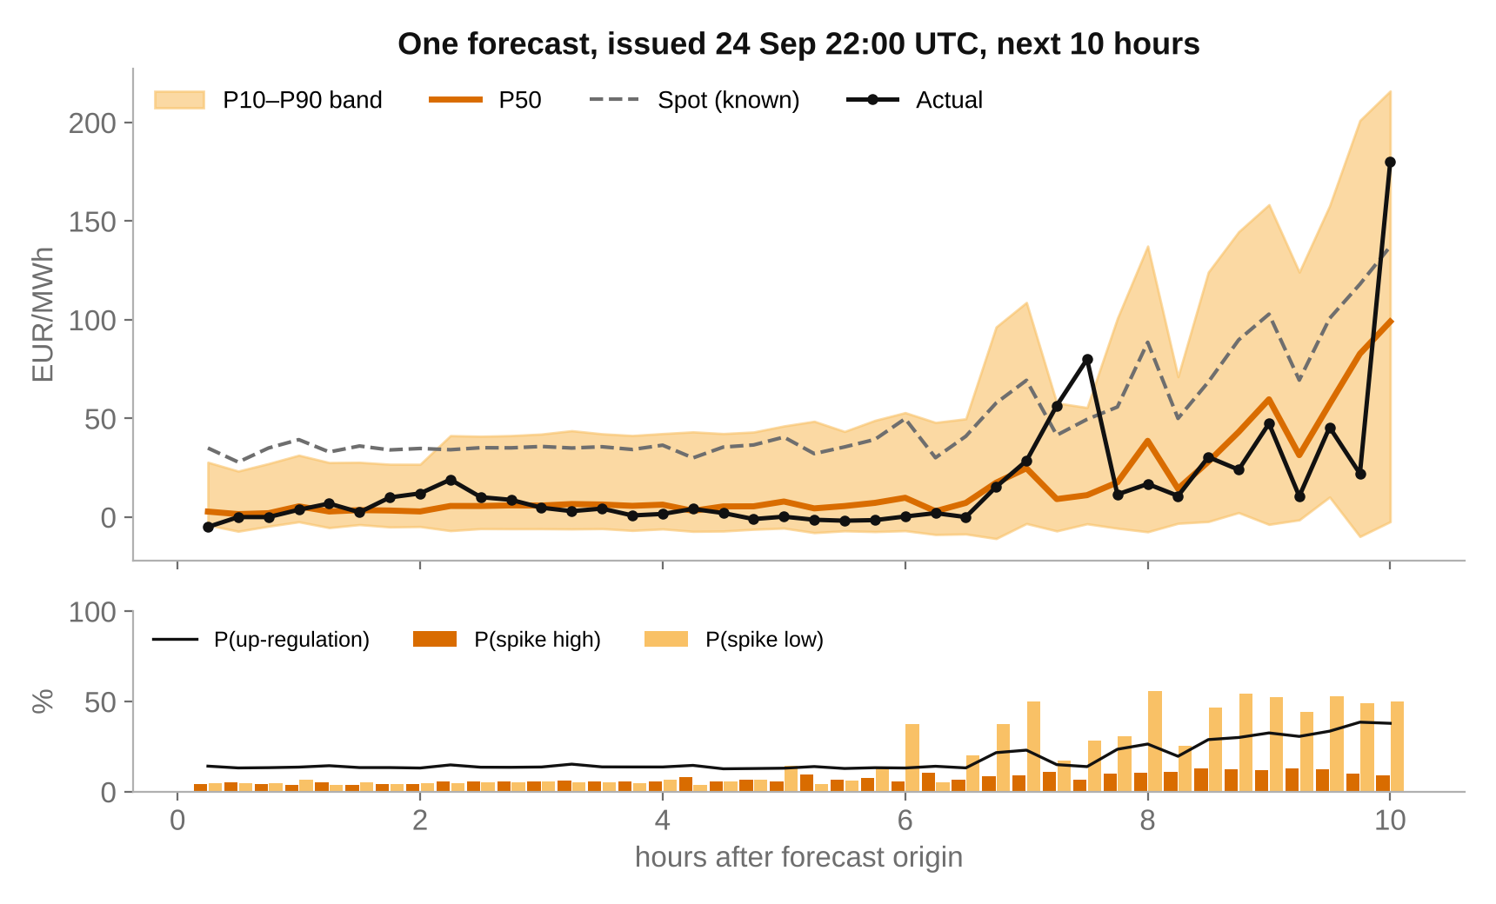
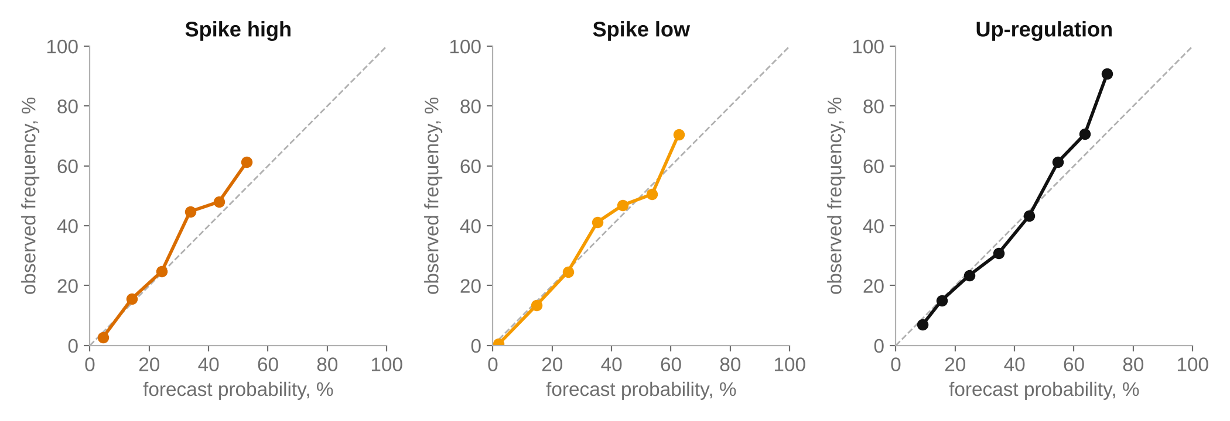
Beats the baseline on every score with honest probabilities
Our model vs. the organiser's baseline, validation 7 Sep – 4 Oct 2026, official score.py
−38 %
P50 error (MAE)
66.2 → 41.0 EUR/MWh
−53 %
band error (pinball P10/P90)
24.2 → 11.3
82 %
band coverage
target 80 %, baseline 68 %
−23 %
spike Brier
0.113 → 0.087
−15 %
direction Brier
0.451 → 0.385
Better in 100 % of day-block resamples on all four metrics. Published 15-min models beat persistence by 12–25 %; we beat it by 38 %.
Notes:
Fan chart: a real validation origin, 24 Sep 22:00 UTC, chosen as a clear case: tight band overnight, band and spike-low probability rising where the evening turns volatile, final spike inside the band. KPI tiles: organiser score.py on the validation period; held-out band widths. Reliability diagrams: 10 bins, at least 30 rows per bin; curves on the diagonal for spike high, spike low and up-regulation. Literature: Belgium 15-min imbalance 2023 (arXiv 2605.17045), Austria t+15 (arXiv 2605.09061).

Slide 6
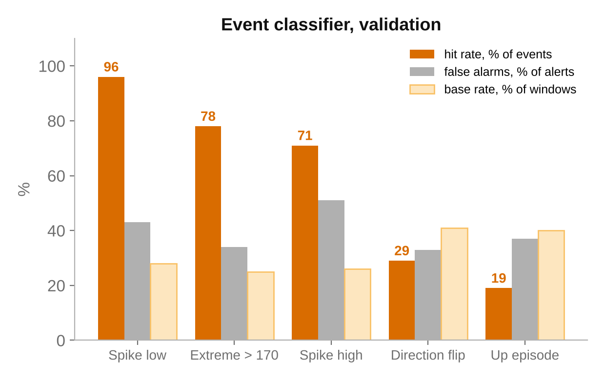
A panel that points at the hours needing attention
16:00–18:00 · P(spike ↑) 34 %, 3× normal, confidence high
Drivers: wind forecast down, consumption above forecast, net import falling.
Check: CHP headroom, boiler load, heat storage.
Price forecast
band, direction, spike risk, top drivers per quarter-hour
Rule alerts
forecast moved, band wide, two weather models disagree, data stale
Event classifier
P(spike episode, extreme price, direction flip) per 0–2 / 2–5 / 5–10 h window, with a Venn–Abers interval and a lift vs. normal
Per event, four candidates (logistic, LightGBM, MLP, a rule on the forecast's own probabilities) compete on validation Brier; the learned model ships only where it clearly wins. Weak events are hidden rather than shown.
Two personas
trader: position and flips · operator: CHP + electric boilers, what to check
Suggestions to review, not operating instructions. The classifier does not change forecast_backtest.csv.
Notes:
Events: >= 2 spike quarter-hours high/low; >= 4 consecutive up-regulated; direction flip >= 4 quarter-hours; price > 170 (P97.5); large mFRR activation; deep negative. Validation hit rate / false alarm: spike low 96/43, extreme 78/34, spike high 71/51, direction flip 29/33, up episode 19/37. BSS val/test: 0.52/0.50, 0.53/0.24, 0.29/0.13, 0.13/0.12, 0.14/0.10. Thresholds from a cost-loss model p >= C/L per persona, user adjustable. The example message is illustrative.

Slide 7
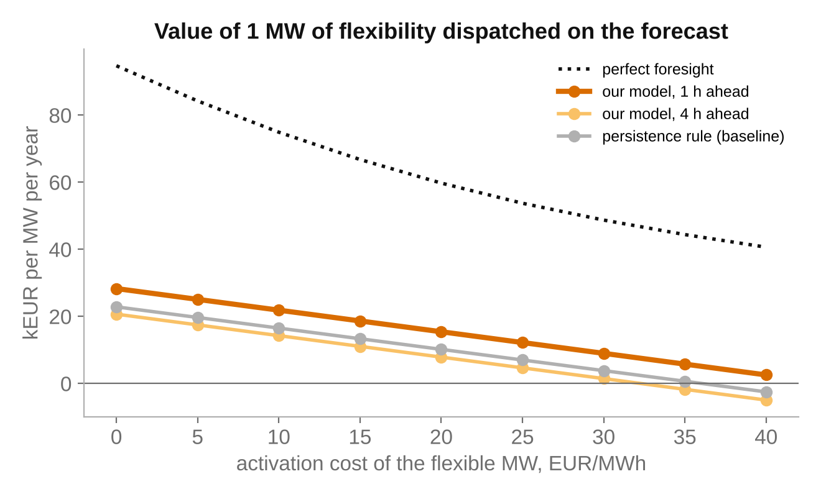
Trains in minutes, transfers to any asset, keeps learning
~100 s
to train a member, one pass to infer
Retrain on every new week. Deploy the same pipeline on a new site or market by pointing it at its data.
One base
shared feature table, heads added on top
A plant-specific head (own CHP, boilers, storage, wind + BESS) trains on the same base without touching the price model.
On-site eyes
benefits from observation systems
Measured weather at the generation site, for example from WeatherSens AI's drone platform, enters as a feature the same way measured wind does today.
Today on public data: 15 k€ per flexible MW per year, 50 % above the naive rule. Perfect foresight: 51 k€. The gap is what asset data and on-site observations can close.
Keeps learning
outcomes become the reward
Every dispatch decision is scored against the realised spread; that signal retrains the heads and can drive reinforcement learning on top.
Value: tools/eval/economic_value.py on the validation forecasts; four weeks annualised, single-price settlement, plant costs not public.
Notes:
Value at 20 EUR/MWh activation cost: our model 1 h ahead 15.4 kEUR/MW/yr, 4 h ahead 7.9, persistence rule 10.2, perfect foresight 50.9. Members train in about 100 s (tools/training/bag.py); inference is one pass over the feature table. A new asset or market is a new feature-set config plus heads on the same mixture code (backend/imbalance/mixture.py). On-site observations enter as features through the same availability-masked store as Fingrid's measured wind. Reinforcement learning: state = forecast distribution and asset state, action = dispatch, reward = realised spread minus activation cost; the economic_value.py rule is the first, fixed policy.

