Slide 1

COVID-19 Health Sign-in System
Group Member: 秦政瀚、戈梓闻、叶凯玮、张玉凡、郑锴

Slide 2

Chapter 01 Background
Chapter 02 Project Analysis
Chapter 03 Project Design
Chapter 04 User Manual
Content
Chapter 05 Data Structure Analysis
Chapter 06 system maintenance
Chapter 07 Division of Work

Slide 3
Part 01
Background

Slide 4

01
Background
Since the outbreak of the new crown epidemic in 2020, our government has actively responded to the epidemic situation, and the measures to prevent and control the epidemic situation have achieved remarkable results. But globally, the epidemic remains grim.

Slide 5
Analysis
PART 02

Slide 6
02
Feasibility Analysis
The front-end technical feasibility
The team selected WeChat Mini Program
as a front-end development program
The back-end technical feasibility Use the Spring Boot framework for development
Use MyBatis as the persistence layer framework
MySQL is selected as the main database
Back-end deployment selection Tencent cloud CentOS lightweight server
Economic feasibility The cost of the project is mainly used for server rental, domain name purchase, related software product subscription.
By using student discount, it costs 108 yuan to buy the right to use the server for one year ,29 yuan to buy domain names ,99 yuan to subscribe to RDM Redis visual management tools, and less labor costs and project maintenance costs at this stage.
The total cost of the project is within the economic reach of the team.
three main
parts

Slide 7
Project Design
PART 03

Slide 8
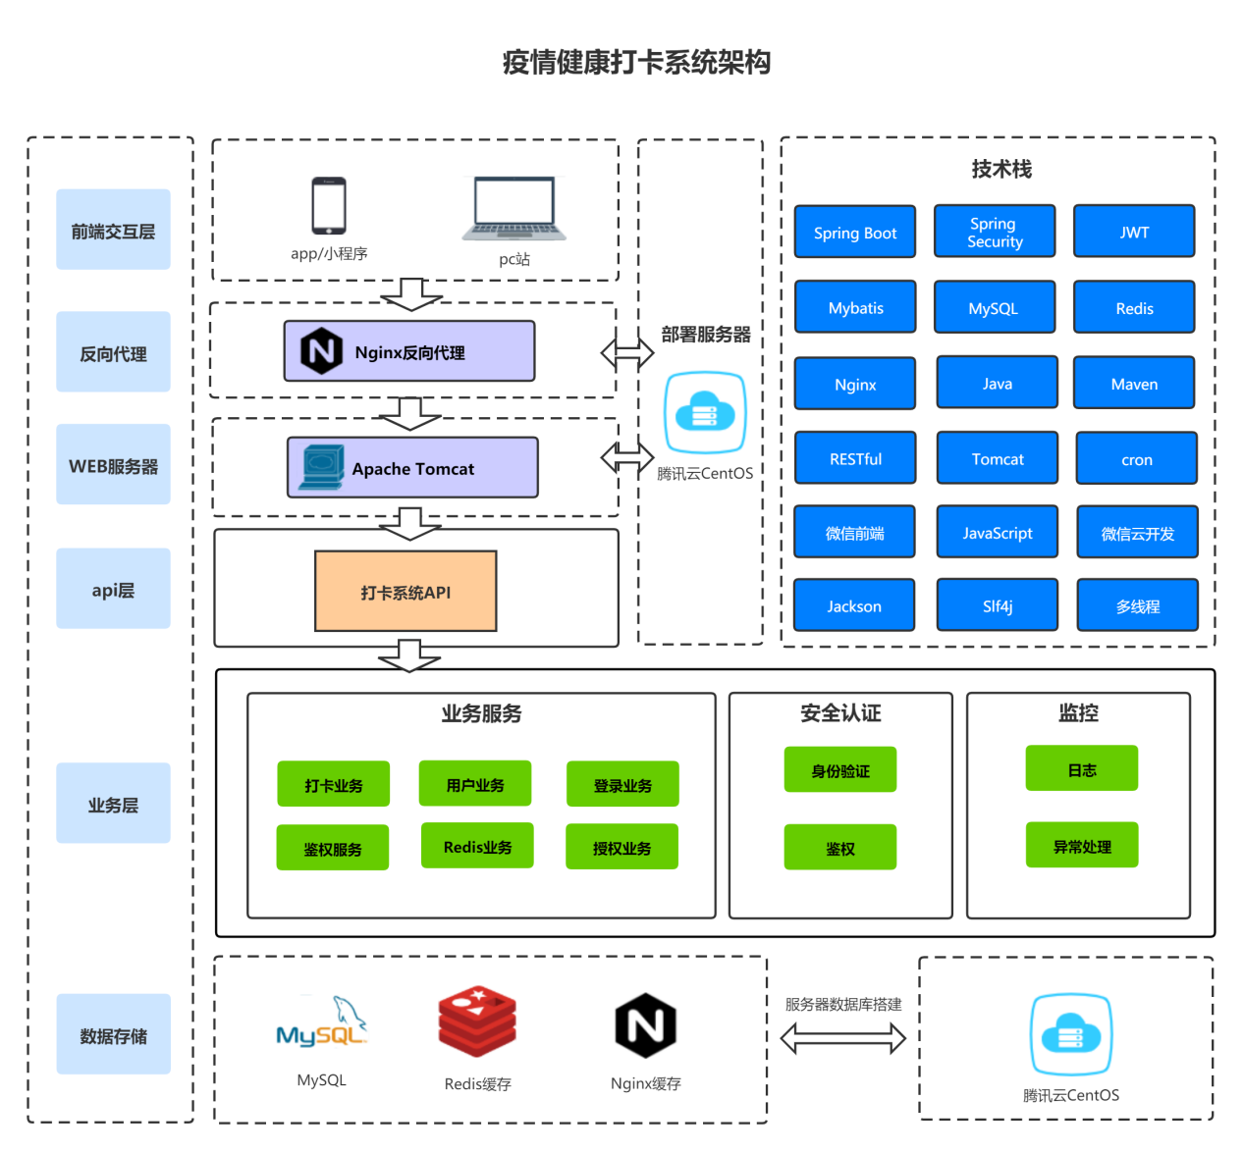
03
Project Analysis and Design
1.Thorough anterior and posterior separation
2.Client uses Mini Programs
3.The back-end service uses Java language to build engineering based on Spring Boot framework
4.Back-end services deployed to Tencent cloud CentOS servers
5.Tomcat server via Nginx reverse proxy
6.All services follow RESTful software architecture style
7.Mobile side based on Oauth、Java Web Token security authentication
8.Client (Mini Programs) acquires server resources by requesting API interface
9.MySQL system will be the main database, save project information and resources
10.By Redis, the system solves the problem of high concurrency and fast data access

Slide 9
03
Project Analysis and Design
Performance Requirement Analysis Instant visible: the user card processing results will be displayed in the interface immediately, users and administrators can quickly obtain card information.
A complete user authentication system is established to encrypt and encapsulate the important data contained in the network request.
Under a certain number of concurrency, the system should run quickly, efficiently, stably and reliably.
The system structure has good expansibility and is convenient for future function maintenance and expansion.
functional requirements analysis WeChat authorized login
Save user login status for a period of time
User requests for authentication
User punch (time, location, body temperature, health code, etc.)
Users view personal punch information (day, month)
User changes personal information (name, gender, class, specialty, etc)
The administrator checks the punch information
Administrator background management users (add, delete, change, check)
three main
parts
Interface Requirements Analysis Simple operation, beautiful interface.
Provides the user each kind of operation prompt information.

Slide 10
03
Summary System Design

Slide 11
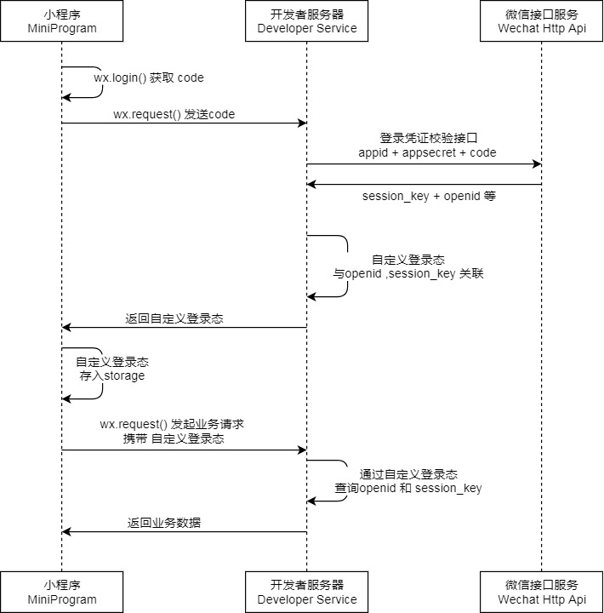
03
System Detail Design

Slide 12
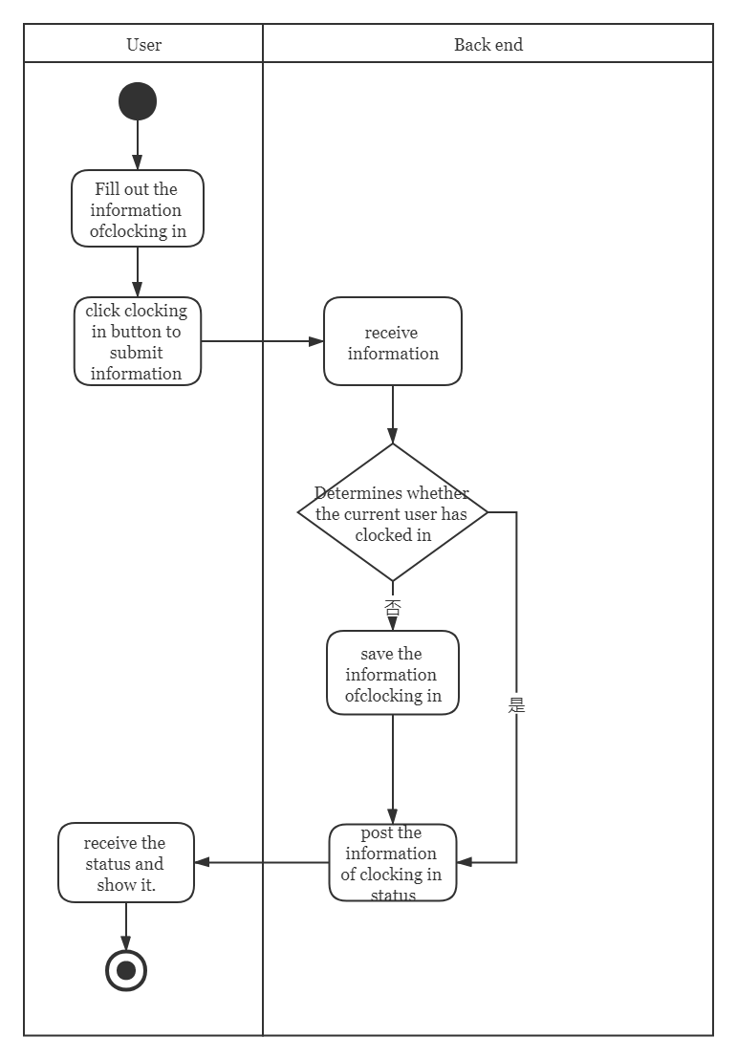
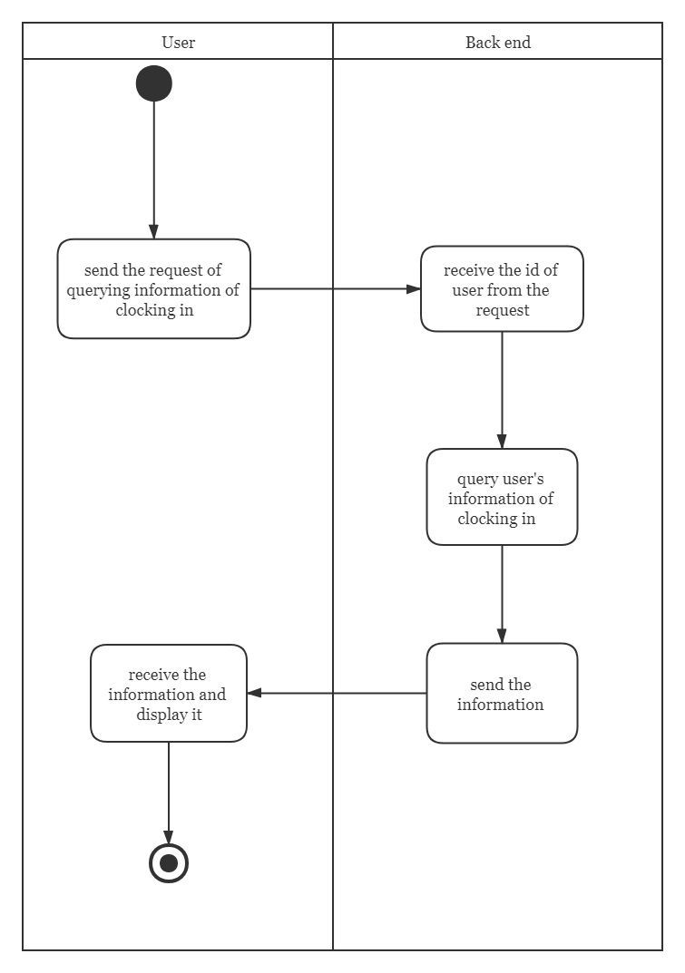
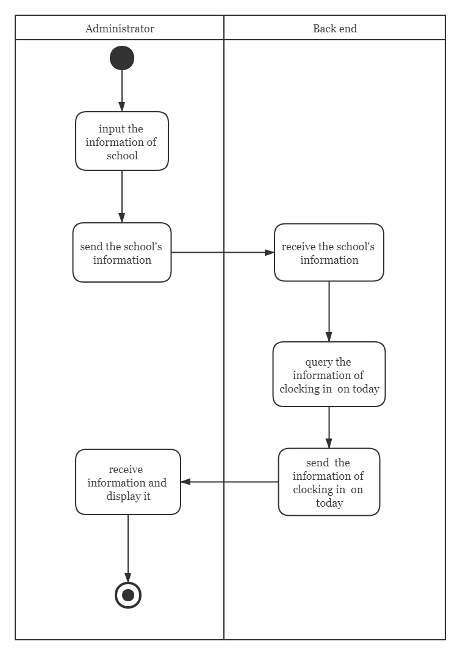
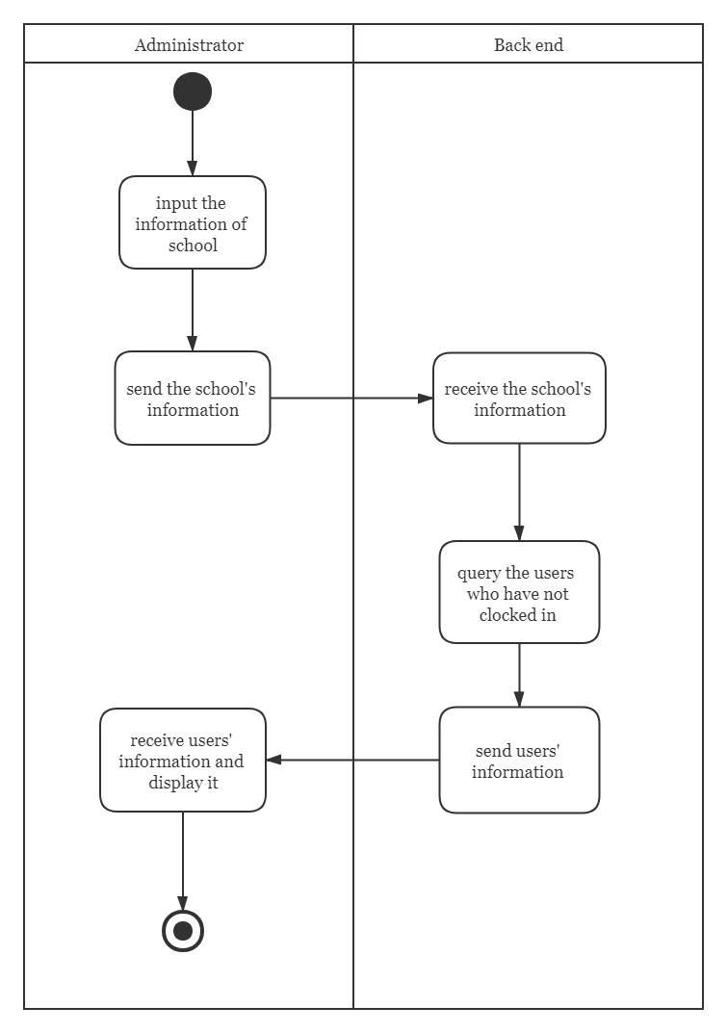
03
Summary System Design

Slide 13
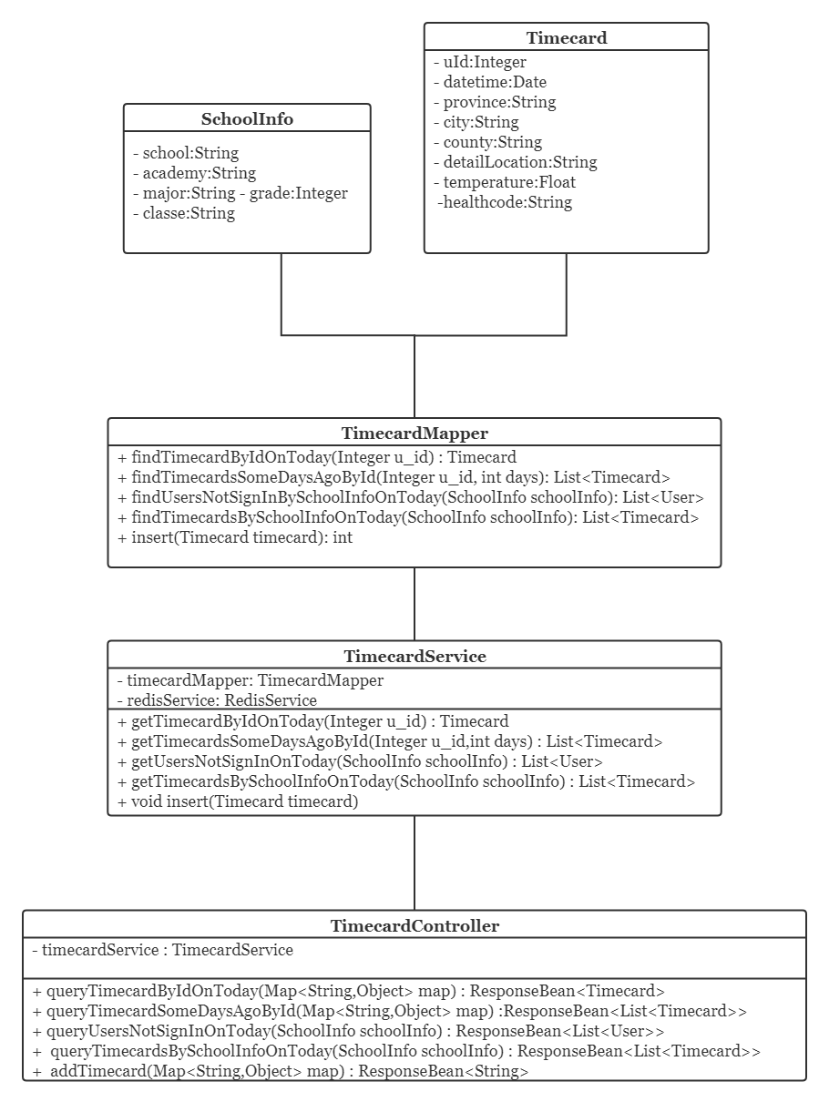
Class and Interface Design
03
1.Timecard
A simple class encapsulates Java punch information.
2.SchoolInfo
A simple class encapsulates Java user campus information.
3.TimeCardMapper
TimecardMapper class implements the basic operation of MySQL data (add card information, query today card information, query user information, etc)
4.TimeCardService
TimecardService class uses the TimecardMapper object to add and delete the data, and uses the RedisUtil to save the data punched today as a cache in the Redis.
5.TimeCardContorller
Timecar dCardContorller class receives data from the front end and encapsulates or judges it to the TImecardService object Process.

Slide 14
03
Methods of High concurrency, high latency
① Access restricted section classes
② Redis high concurrency, high latency
③ Nginx High concurrent processing

Slide 15
03
Data Encryption
HMAC256 3.4.4.1
HMAC256 algorithm is used to encrypt the token signature method JWT the project.
HMAC is a way to construct message authentication using a one-way hash function.
HMAC operation uses Hash algorithm to generate a fixed length message summary as output with a message M and a key K as input.
The key length of the HMAC can be of any size.
If it is less than n (the size of the Hash output value), it will weaken the security of the algorithm.
The method to solve the above defects is to use a strong pseudo random generator to generate the key randomly, and the key needs to be updated periodically, which can reduce the risk of weak key of hash function and the damage caused by key exposure.

Slide 16
User Manual
PART 04

Slide 17
04
User Manual
4.1 Login Mini Programs
4.2 Check-in cards
4.3 Check punch records
4.4 Viewing and modifying user information
4.5 Administrator checks user punch

Slide 18
Data Structure Analysis
PART 05

Slide 19
05
Data Structure Analysis
Redis Data structure：
String type，Hash type，List type，Set type，ZSet type
MySQL Data structure：
B+Tree
ThreadLocal Thread Isolation Data Structure：
ThreadLocalMap

Slide 20
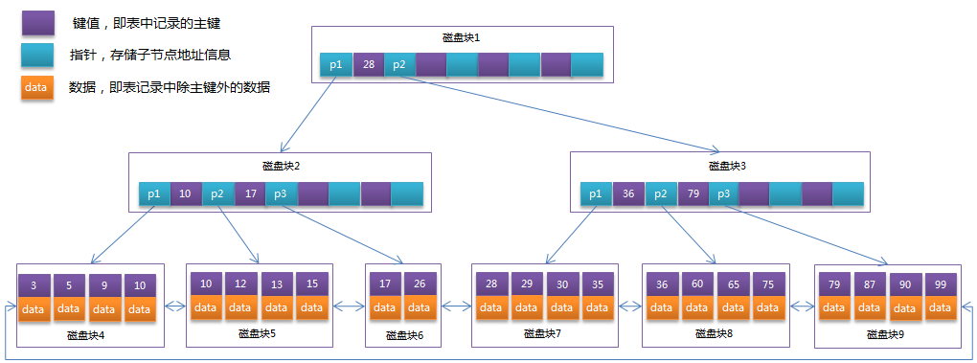
05
Data Structure Analysis
B+Tree

Slide 21
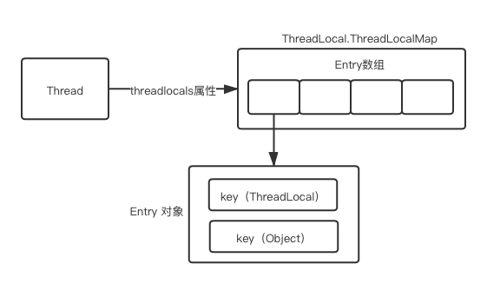
05
Data Structure Analysis
ThreadLocalMap

Slide 22
PART 06
System maintenance

Slide 23
06
System maintenance
Teamwork Platform?
Collaborative development platform: Github
Github address (currently private warehouse): https://github.com/Qin10/Covid19SignInSystem.git
Q1
Project back-end environment?
Integrated development environment: IntelliJ IDEA、Eclipse、Visual Studio Code
Development languages: Java、SQL
Database: MySQL、Redis
Database visualization tools: Navicat Premium 12、RDM
Git tools: Git Bash
Security Terminal Simulation Software: Xshell 6
SFTP /FTP Client: Xftp 7
Web Debugging Tools: Postman
Log output: MDC、Slf4j
Q2

Slide 24
06
System maintenance
Server Configuration?
Server: Tencent Cloud Server
Server operating system: CentOS 7.6 64 bit
Server specifications :1 core 2 G
Server Public Network IP：121.5.115.174
Q3
Server environment?
JDK version :1.8
Database version: MySQL 8.0.25、Redis 5.0.5
Server configuration: Tomcat、Nginx (Nginx reverse proxy Tomcat)
Server domain name: zjutleo.cn
Q4
Project front-end environment?
Integrated development environment: WeChat developer tools
Development languages: JavaScript
Deployment environment: Tencent cloud server
Web Debugging Tools: Postman
Project front-end environment?
Integrated development environment: WeChat developer tools
Development languages: JavaScript
Deployment environment: Tencent cloud server
Web Debugging Tools: Postman
Q5

Slide 25
06
Problems we met and solutions
Project analysis and design
Solutions:
① Requirements analysis.
② Performance analysis.
③ Use software engineering method.
④ With the help of the drawing softwares, such as EA, ProcessOn...
Application of New Technology
Solutions:
① Search solutions on Baidu, CSDN, google...
② Refer to previous projects.
③ Seek help from seniors.
④ Keep trying and testing.
⑤ Read underlying code.
Integration of Project
Solutions:
① Cooperation by Git.
② Write interface document.
③ Meetings.

Slide 26
PART 07
Division of Work

Slide 27
07
Division of Work
project architecture,
SpringBoot+MyBatis+JWT+Redis+Wechat integration,database table design, user-related services,
interface testing and project integration,
server build and deployment： 秦政瀚
front-end project architecture, front-end core business writing,
front-end project docking,
interface beautification： 戈梓闻
back-end core business writing, database table design,
project interface testing： 叶凯玮
Analysis of project requirements: 秦政瀚、戈梓闻、叶凯玮、
front-end project testing： 张玉凡、郑锴
Document writing： 秦政瀚、戈梓闻、叶凯玮、张玉凡、郑锴
PowerPoint： 张玉凡、郑锴

Slide 28
THANK YOU

