Slide 1
Nero
The Cash Flow Accelerator
Your ledger tells you what you're owed. Nero tells you when the cash actually arrives — and acts to bring it forward.
Bounty 03 · Xero App & Agent Hackathon · an AR-intelligence agent for Xero

Slide 2
THE PROBLEM
Charts track money. They don't get you paid.
Due dates are fiction. A small business sees what's due — not when cash actually lands. So they hit cash crunches they could have prevented.
DUE NEXT 30 DAYS
ACTUALLY ARRIVING
THE GAP
£18,000
£9,000
£9,000
what the ledger shows
once you price in late payers
invisible until it's a crisis

Slide 3
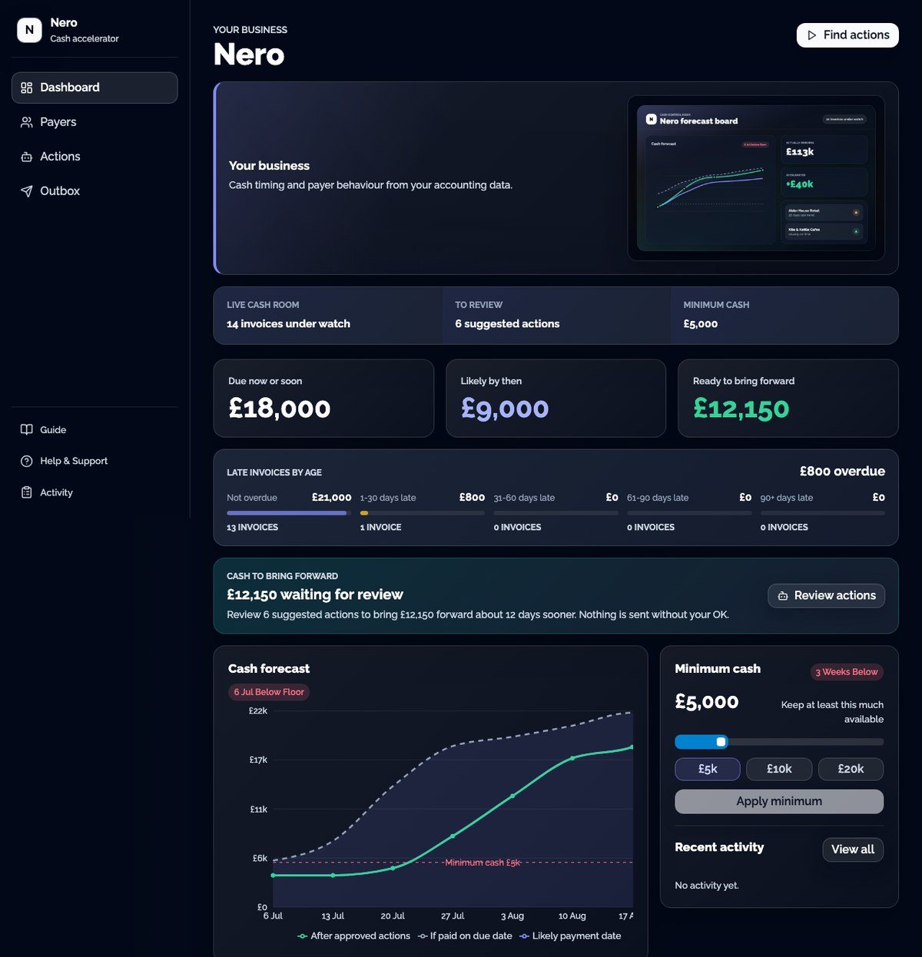
THE PRODUCT · TRUTH → FORECAST
See the real cash picture
Reads your Xero ledger
Contacts, invoices and payment history — no manual entry.
Predicts real payment dates
Each customer's own behaviour, not the due date.
Forecasts against a floor
Flags the exact week cash dips below your minimum.

Slide 4
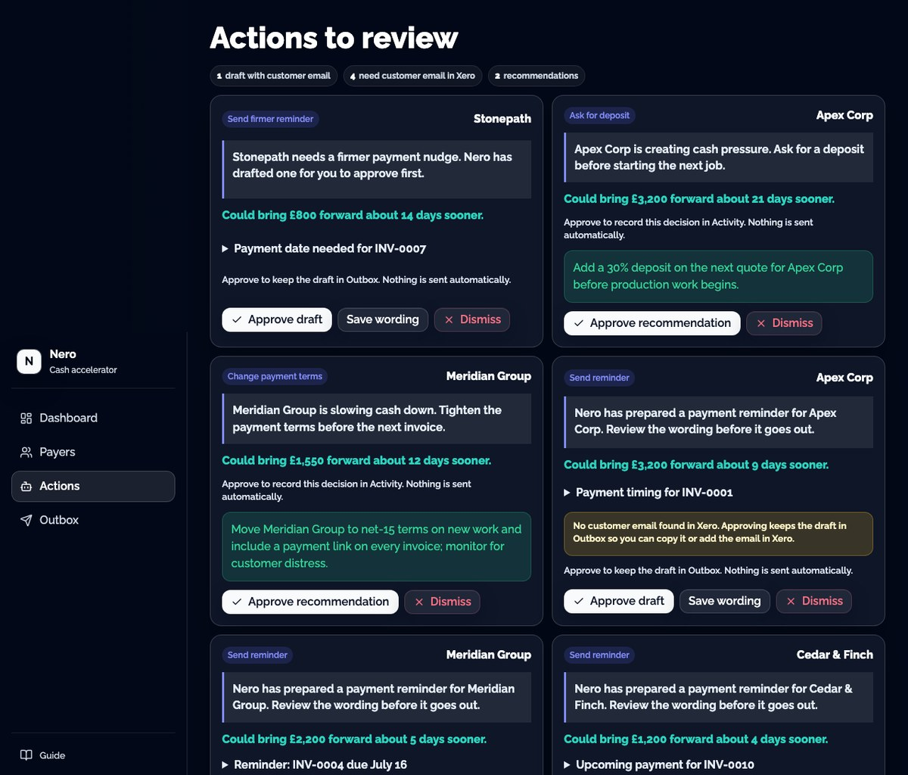
THE AGENT · ACTION, WITH YOUR APPROVAL
An agent that acts — you stay in control
Nero proposes the specific moves — chase this invoice, ask a deposit there, tighten terms — each tagged with the £ it brings forward. You approve; nothing sends automatically.
£13,000 ready to bring forward
~12 days sooner, across 7 approval-gated actions

Slide 5
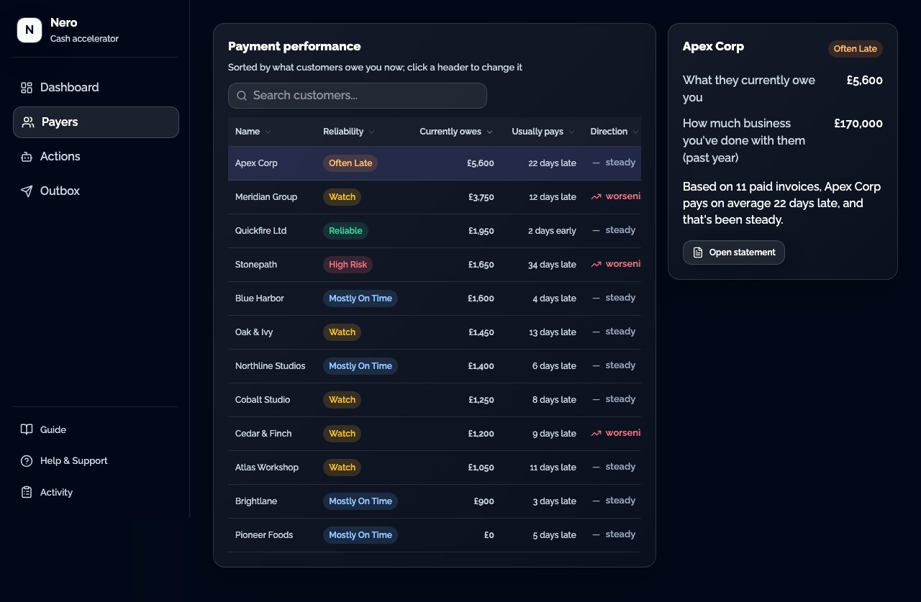
PAYER INTELLIGENCE
Know exactly who's slowing your cash
Every customer graded on their real payment behaviour, ranked by cash at risk — who to chase first.

Slide 6
WHY NERO WINS
Accountable by design, built the Xero way
Built the Xero way
Accountable by design
Validated demand
• Live OAuth to a Xero organisation
• Reads contacts, invoices, payments +
• online invoice links (Accounting API)
• Approved reminders write a history
• note back to the invoice in Xero
• Every action is approval-gated
• Reasoning shown, grounded in real stats
• Nothing sends automatically
• "Cash Accelerated £" = measurable outcome
• Payment-performance report: 351 forum votes
• Deposits on invoices: 507 votes
• …both unbuilt by Xero today
• Chases + forecasts in one loop (nobody else)
What's next: outcome learning · SMS / multi-channel reminders · multi-client advisor view

