Slide 1

Group T02
Code Refactoring for
Carrot Defense
FINAL PRESENTATION
Team members :
2253968 Jia Wenchao
2250397 Qin Cheng
2252042 Zhou Zhengyu
2252215 Peng Jiale

Slide 2
Project Introduction and Motivation for Refactoring
01
CONTENTS
02
Design Patterns in Refactoring
03
Key Issues and Solutions in Refactoring

Slide 3
Project Introduction
PART 1
Overview and Objective
Carrot Defense is a classic tower defense game where players strategically build and upgrade towers to protect the carrot from enemy waves.
Through code refactoring, the game's logic is optimized for better reusability, maintainability, and scalability, enhancing the overall player experience.
Implemented Features
Feature Module | Subfeatures | Feature Module | Subfeatures
Basic Functions |  | Advanced Features | Enemy Creation
Diverse Tower Functions | Build Tower, Delete Tower, Two-level Tower Upgrades | Special Attack Mode | Turret Special Abilities, Activate Special Abilities
Special Effects Display | Tower Attack Effects, Monster Hit Effects | Upgrade Effect Enhancement | Unlock New Effects on Upgrade
Economy System | Earn Gold by Defeating Monsters, Spend Gold to Build and Upgrade Turrets | Flexible Game Flow | Restart During Gameplay, Exit and Select Level
Monsters and Maps | Three Types of Monsters, Two Maps
Health and Background Music | Display Carrot Health, Background Music
Save Function | Save Game Progress

Slide 4
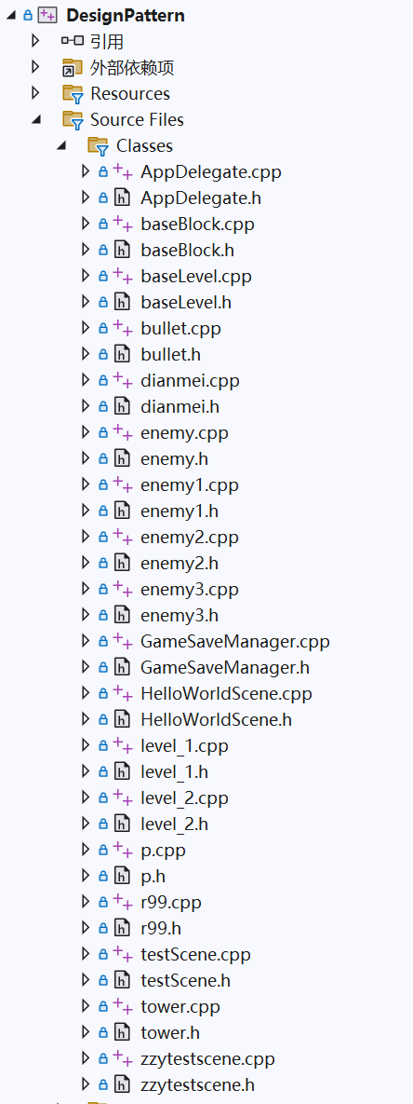
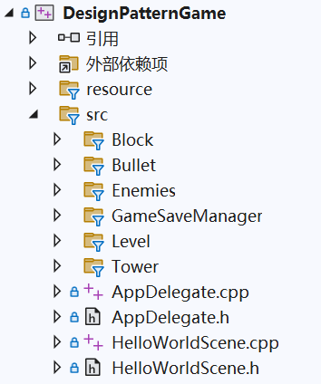
Motivation for Refactoring
PART 1
Code Structure Chaos
Poor Scalability
Performance Bottlenecks
… …
Improve Code Maintainability and Readability
Optimize Performance
Enhance Flexibility and Scalability
… …

Slide 5
Design Patterns in Refactoring
PART 2
Design Patterns Overview
Number | Name | Type | Brief Description
1 | Factory Method | Creational Patterns | Enemy Creation
2 | Singleton | Creational Patterns | Singleton of EnemyNotifyManager
3 | Flyweight | Structural Patterns | Bullet Texture Sharing
4 | Decorator | Structural Patterns | Bullet attack mode expansion
5 | Observer | Behavioral Patterns | Notify Enemies’ Existence for Towers
6 | Template Method | Behavioral Patterns | Level Initialization Process
7 | Object Pool | Others | Bullet Object Pool

Slide 6
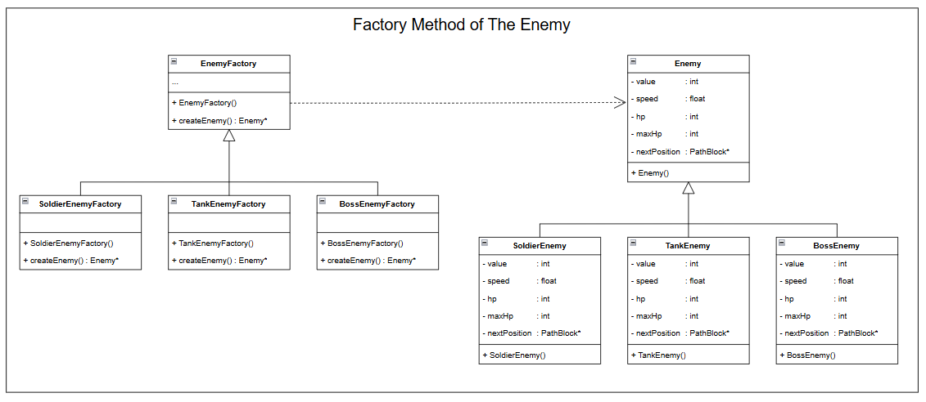

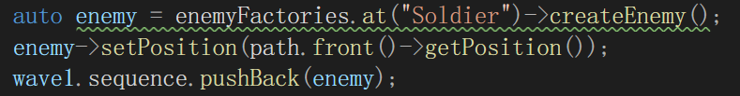
Design Patterns in Refactoring——Factory Pattern
PART 2
Class diagram of Factory Pattern
Reasons :
Benefits :
poor code structure
Direct creation of Enemies
direct visit between Classes
Decouples creation and usage
Easily extends new features
Enhances code readability

Slide 7
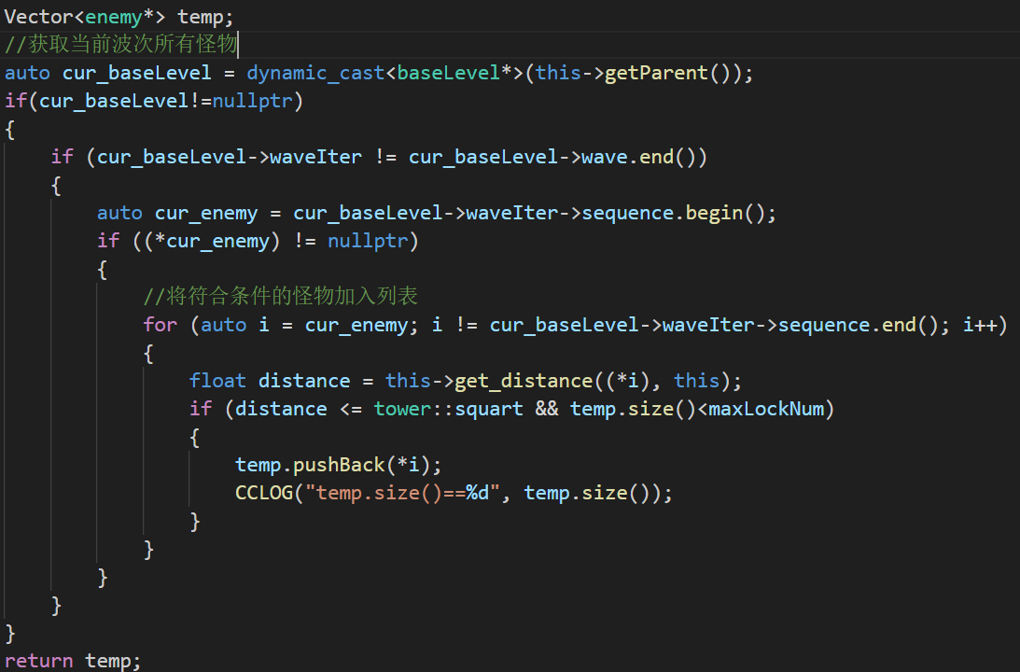
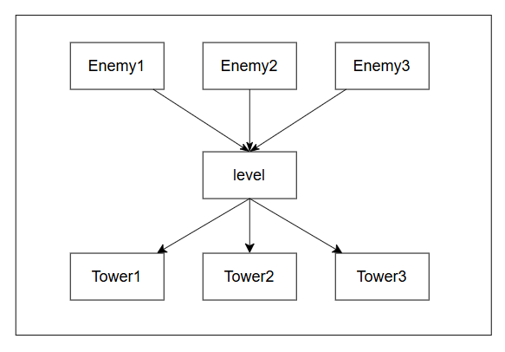
Design Patterns in Refactoring——Observer
PART 2
Original Structure
Original Logic for Tower to Obtain Enemies
The enemies of each wave are stored in the level.
The tower obtains the enemies of each wave by iteration, regardless of whether the enemy has appeared or is already dead.
Disadvantages:
Resource Waste
High Coupling
Not Save

Slide 8
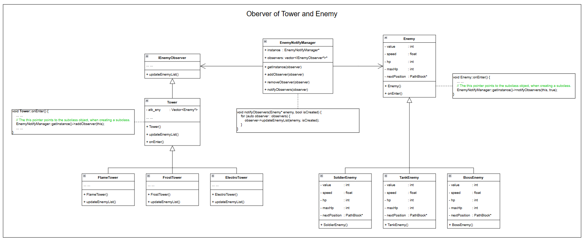
Design Patterns in Refactoring——Observer
PART 2
Class diagram of Observer
Benefits : Improved Security; Reduced Coupling; Cleaner Logic;

Slide 9
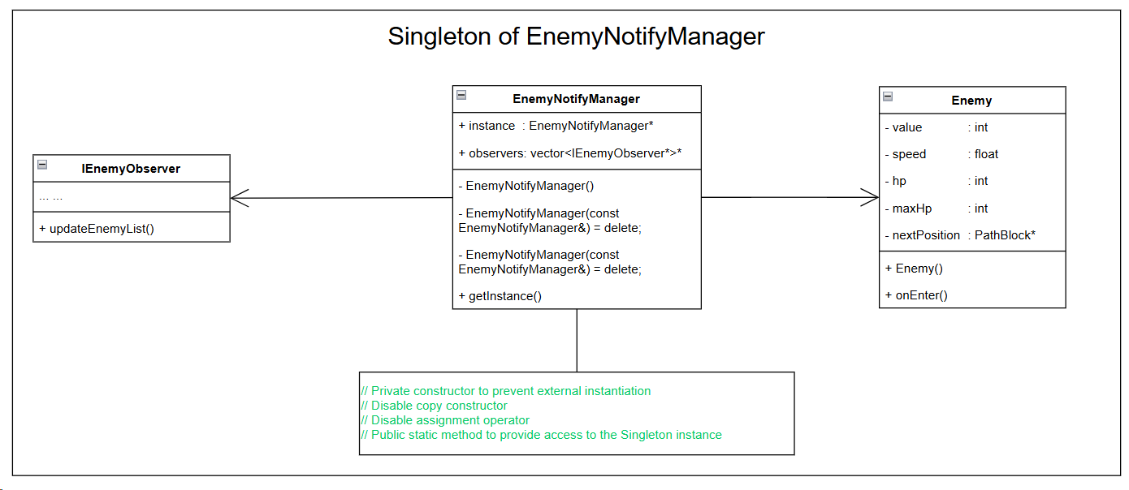
Design Patterns in Refactoring——Singleton
PART 2
Class diagram of Singleton
Benefits :
Avoiding Duplicate Notifications
The Singleton pattern ensures a single instance of EnemyNotifyManager, preventing monsters from notifying the Tower multiple times, thus improving efficiency.
Centralized Notification Management
With the Singleton pattern, all notifications are managed by one instance, simplifying code maintenance and expansion.

Slide 10
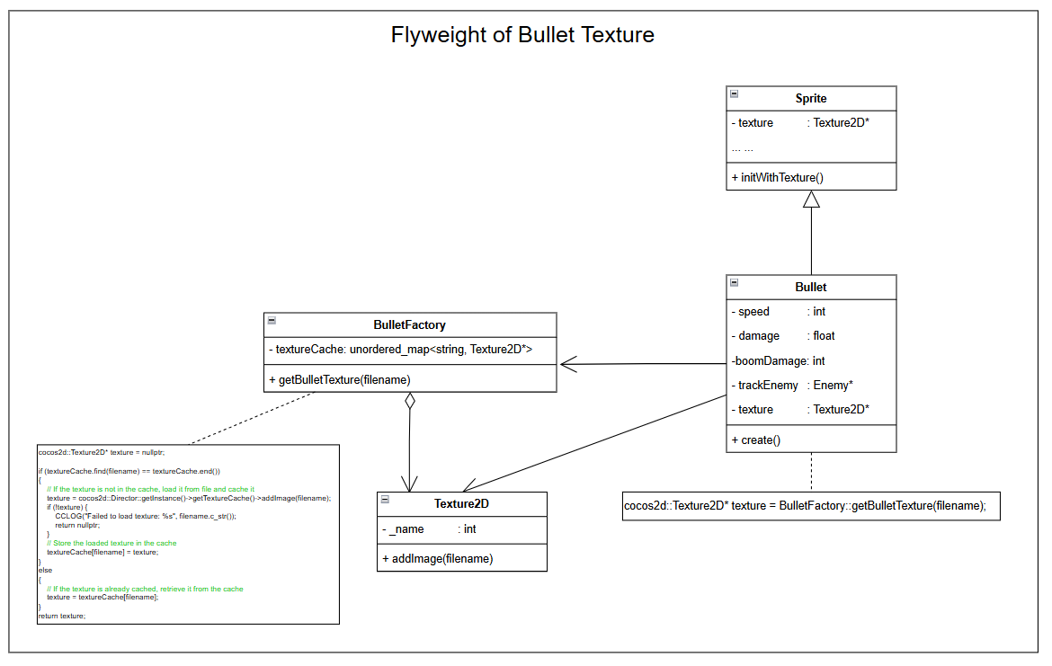
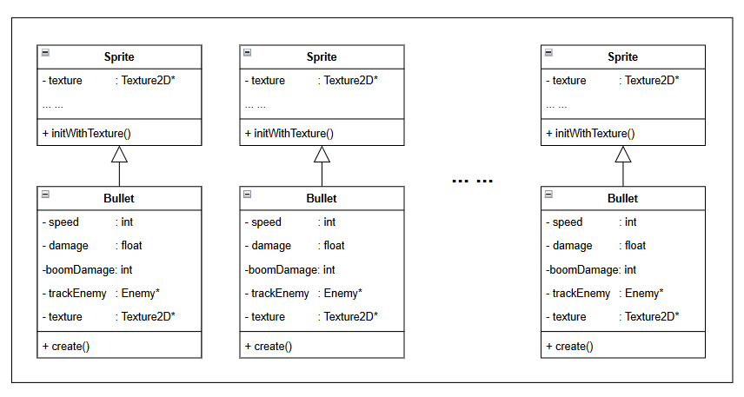
Design Patterns in Refactoring——Flyweight
PART 2
Class diagram of Flyweight
Original Structure
Each time a bullet is created, a texture image that takes up a large amount of space is saved.
Benefits :
Reasons :
Reduces memory consumption
Improves loading efficiency
Facilitates resource management
High memory usage
Low texture loading efficiency

Slide 11
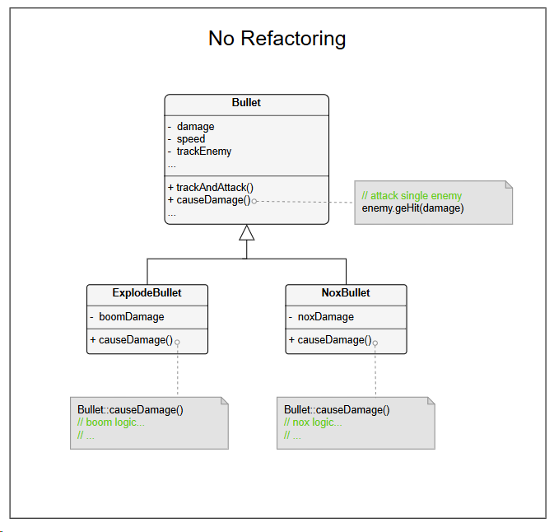
Design Patterns in Refactoring——Decorator
PART 2
Original Structure
Issues or Reason for Refactoring
Rigid Structure:
If new attack types or combinations (e.g., an explosive bullet with poison damage) need to be implemented, the system requires the creation of new subclasses for each combination. This results in a proliferation of subclasses, making the system harder to manage and extend.

Slide 12
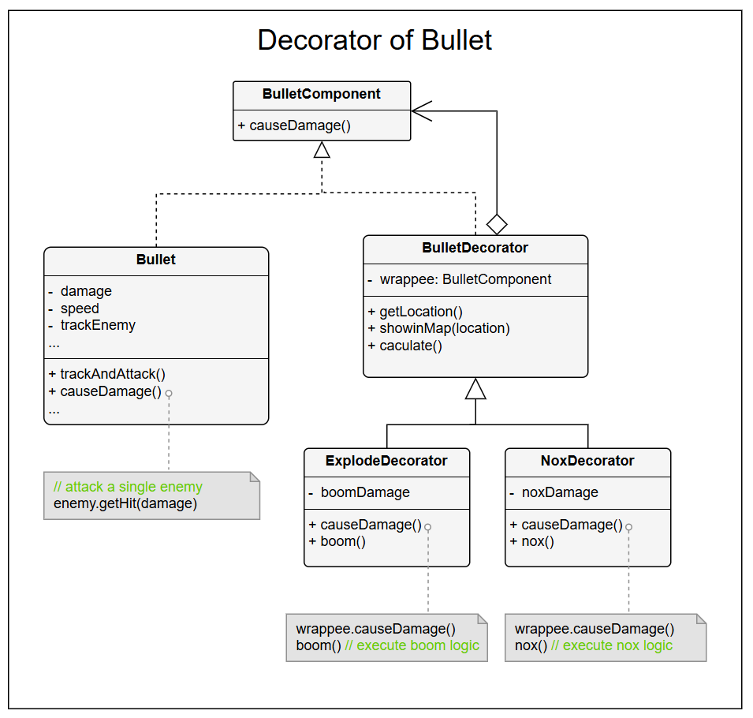
Design Patterns in Refactoring——Decorator
PART 2
Class diagram of Decorator
Benefits :
Flexibility: Dynamically add or combine features (e.g., explosion, toxic damage) without changing existing code.
Extensibility: Add new functionalities via decorators without modifying the Bullet class.
Open/Closed Principle: Extend behavior without altering existing code.
Code Reuse: Reusable decorators reduce duplication and enhance maintainability.

Slide 13
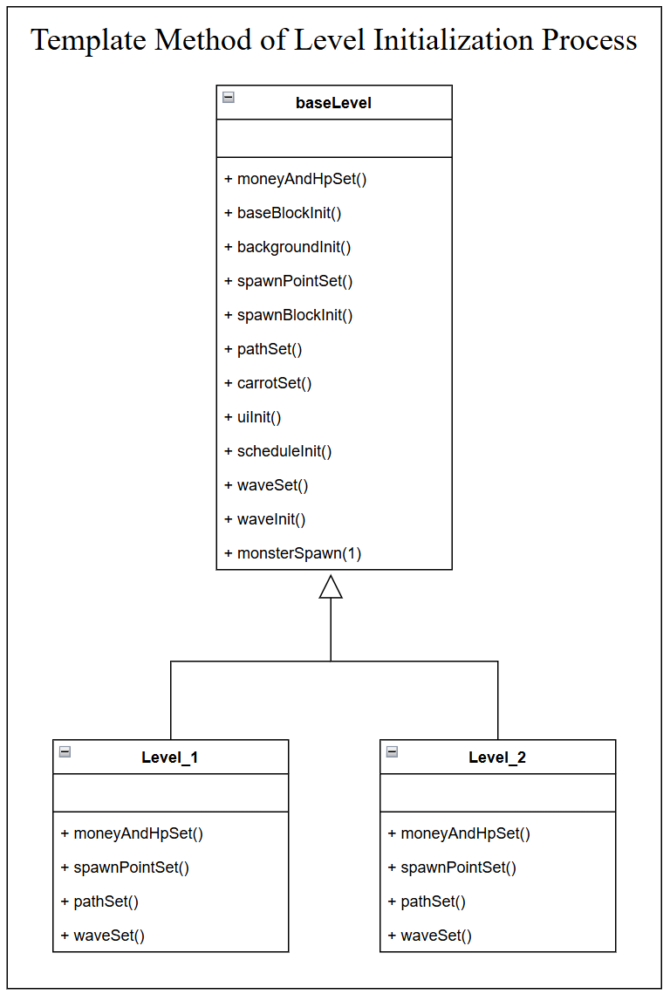
Design Patterns in Refactoring ——Template Method
PART 2
Class diagram of Template Method
Reasons :
Lack of Unified Interface. The level classes don’t have a consistent initialization interface, increasing differences and the risk of errors.
Unclear Control Flow. Each level handles its own initialization, making the code messy and error-prone.
Difficult to Modify Initialization. Changing the initialization process requires modifying each level individually, which is time-consuming and hard to maintain.
// Initialize money and HP
// Initialize empty blocks
// Initialize the background layer
// Initialize enemy spawn point positions
// Initialize spawn point blocks
// Set the enemy movement path
// Add the carrot layer
// Initialize the UI interface
// Initialize the per-frame update logic
// Initialize wave information
// Set up the specific wave details
// Start spawning the first wave of enemies
Benefits :
Higher Reusability. Common logic is reused directly in subclasses, with only unique parts needing overrides.
Easier Feature Expansion. Adding steps like soundInit() only requires updates in the parent class.
Consistency. Ensures all levels follow the same initialization flow, avoiding discrepancies.

Slide 14
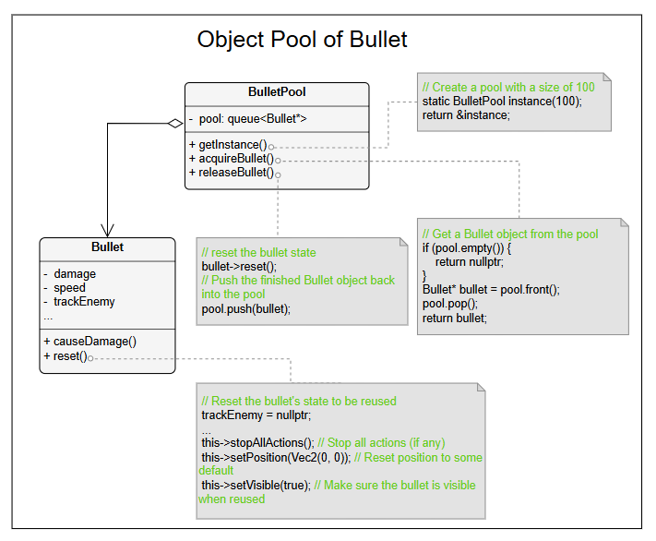
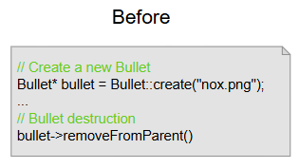
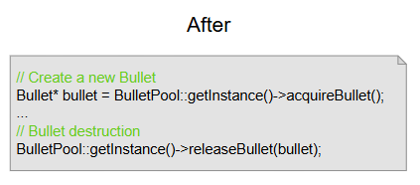
Design Patterns in Refactoring——Object Pool
PART 2
Class diagram of Object Pool
The Way to Create Bullets
Benefits :
Performance Boost
Resource Efficiency
Memory Leak Prevention
Enhanced Game Efficiency

Slide 15
Key Issues and Solutions in Refactoring
PART 3
1
The Flyweight of Bullet
2
Tower cannot attack
Issue: In the Flyweight pattern, since bullet needs to inherit Cocos' sprite class and properties like position are stored in the base class, the entire sprite cannot be shared directly.
Solution: Only the shared part of the bullet, i.e., the texture, can be shared. A texture pool is created to manage the shared textures for all bullets. Different bullet objects will use the same texture when created.
Issue: When a new Tower is created, it cannot attack enemies that have already entered the field.
Solution: When a new Tower is created, it should be able to detect the enemies already present on the field. Therefore, when the Tower is created, the NotifyManager will notify the tower of enemies’ presence, allowing it to become aware of them and immediately start tracking and attacking.

Slide 16
The presentation is over,
Thank you for watching!

