Slide 1
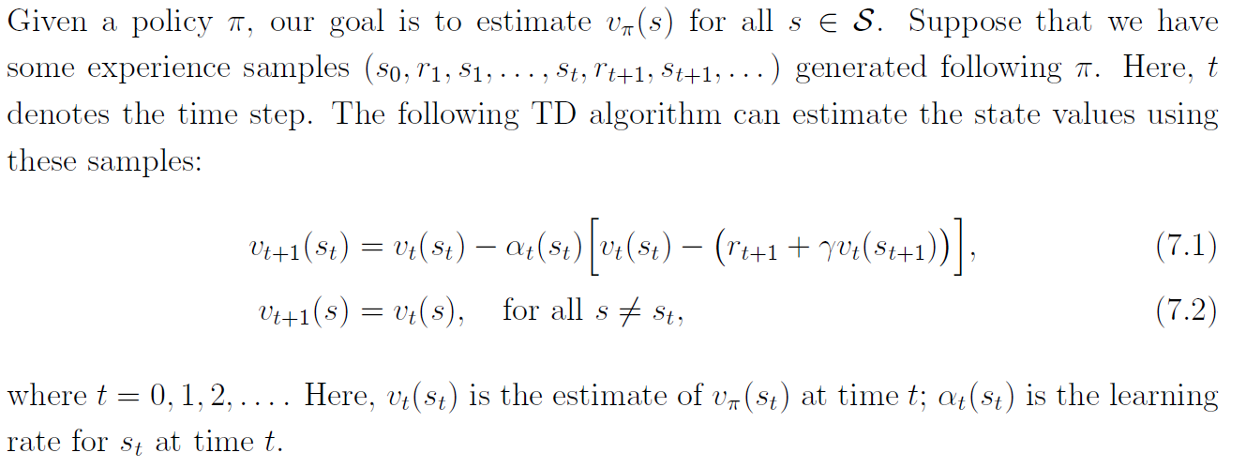
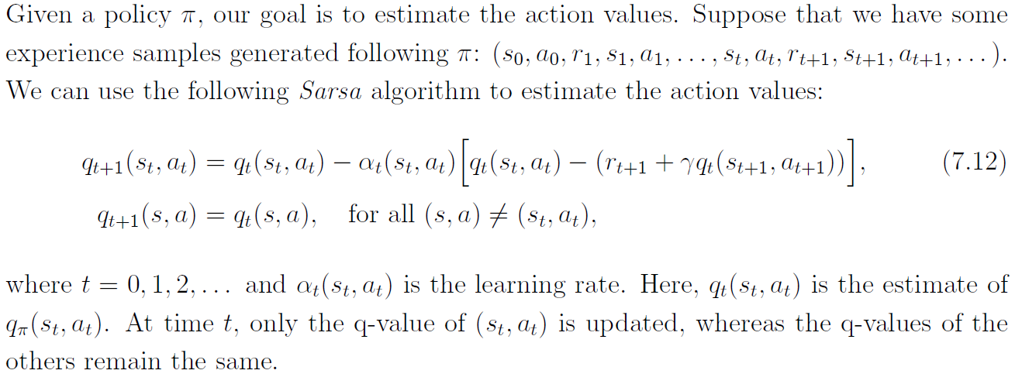
TD learning of state values
TD learning of action values: Sarsa

Slide 2
Value Function Methods
Objective function :

Slide 3
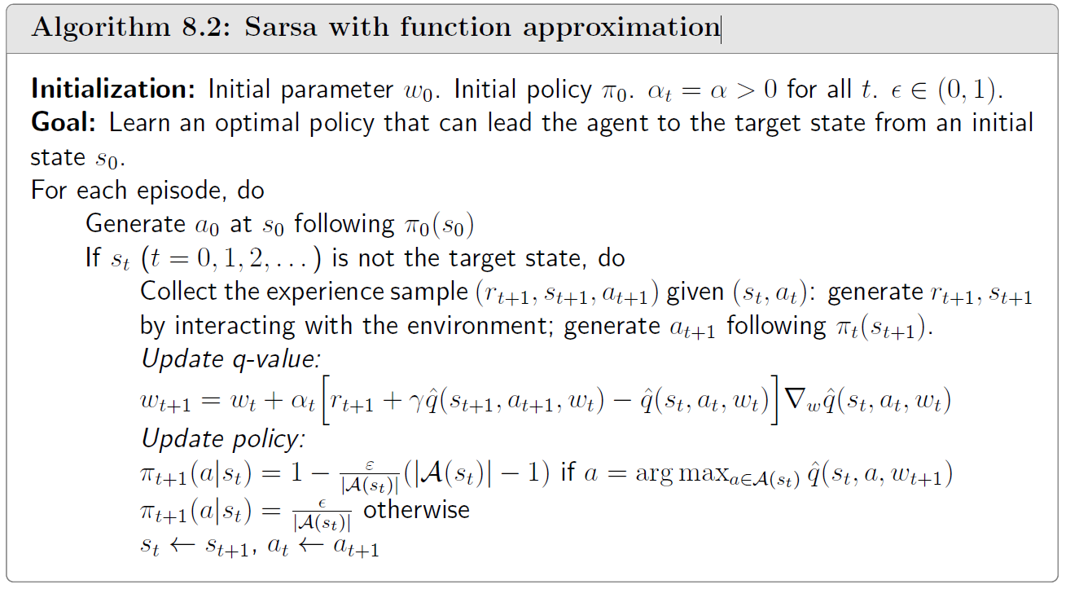
Sarsa with function approximation

Slide 4
Policy Gradient

Slide 5
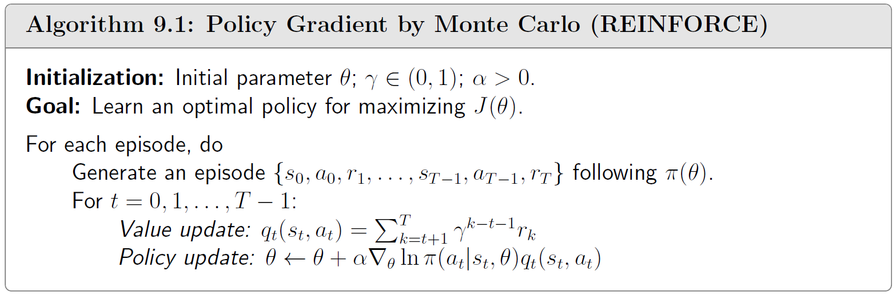
Policy Gradient by Monte Carlo (REINFORCE)
sampling

Slide 6
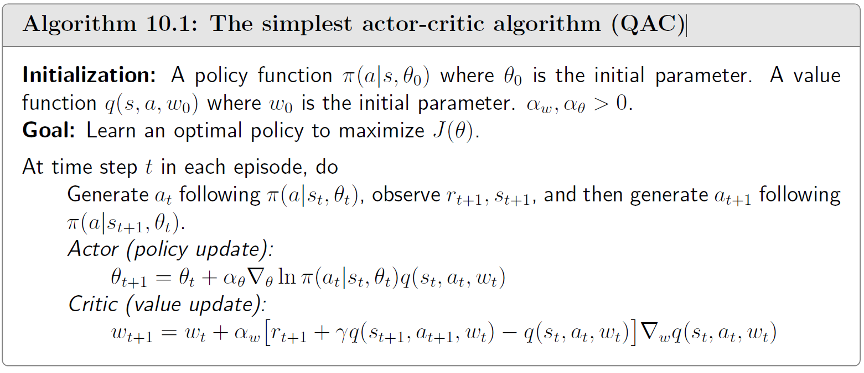
The simplest actor-critic algorithm (QAC)
TD

Slide 7
Importance Sampling

Slide 8
Trust Region Policy Optimization(TRPO)

Slide 9
PPO
Unconstrained
TRPO
PPO
PPO-Penalty
PPO-Clip

Slide 10

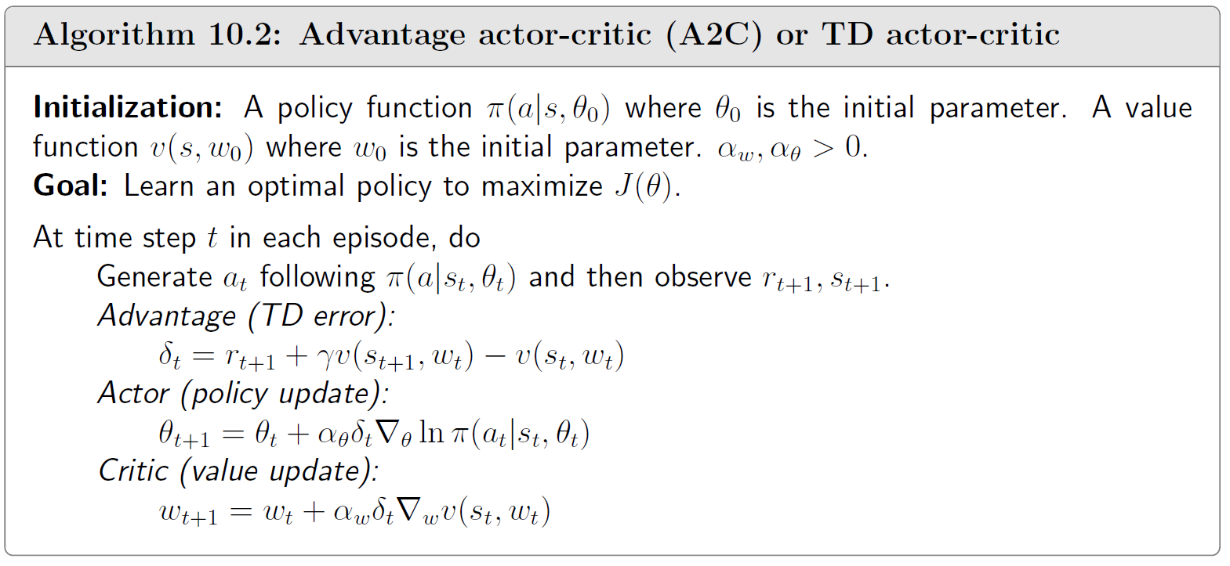
Advantage actor-critic (A2C) or TD actor-critic
Advantage Function :
reduce variance

