Slide 1
Policy Gradient

Slide 2
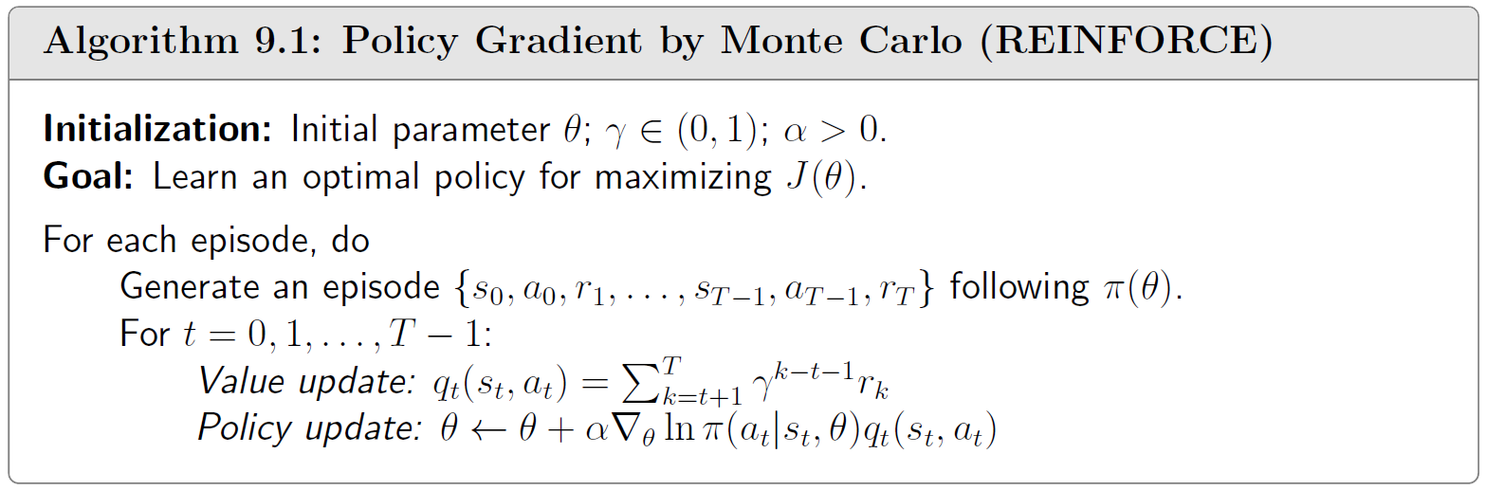
Policy Gradient by Monte Carlo (REINFORCE)
sampling

Slide 3
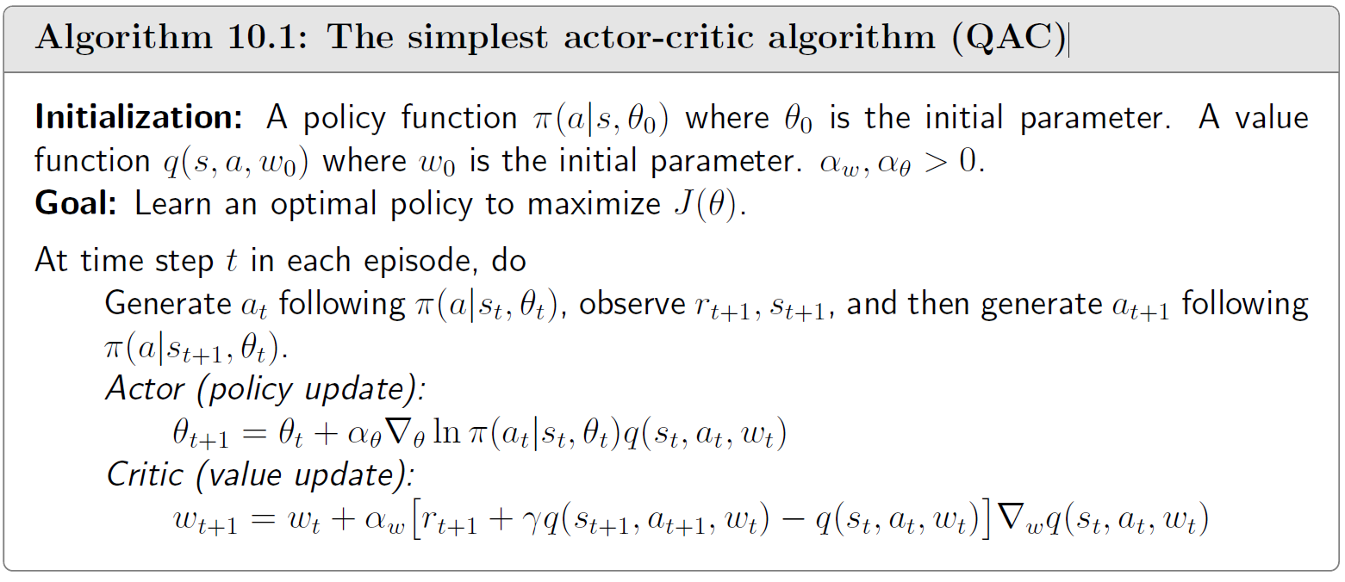
The simplest actor-critic algorithm (QAC)
TD

Slide 4
Importance Sampling

Slide 5
Trust Region Policy Optimization(TRPO)

Slide 6
PPO
Unconstrained
TRPO
PPO
PPO-Penalty
PPO-Clip

Slide 7

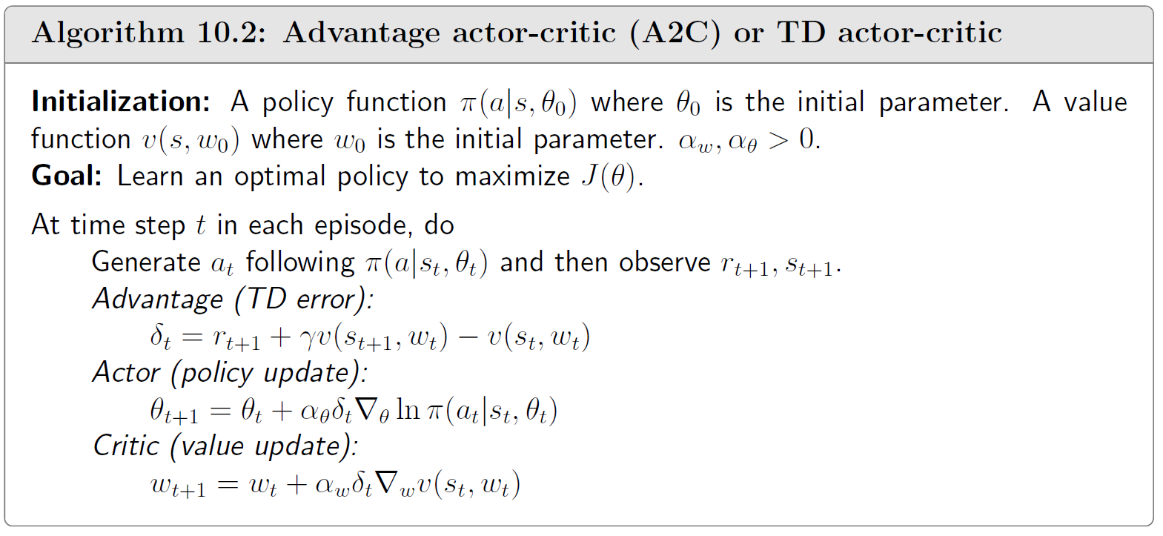
Advantage actor-critic (A2C) or TD actor-critic
Advantage Function :
reduce variance

