Slide 1

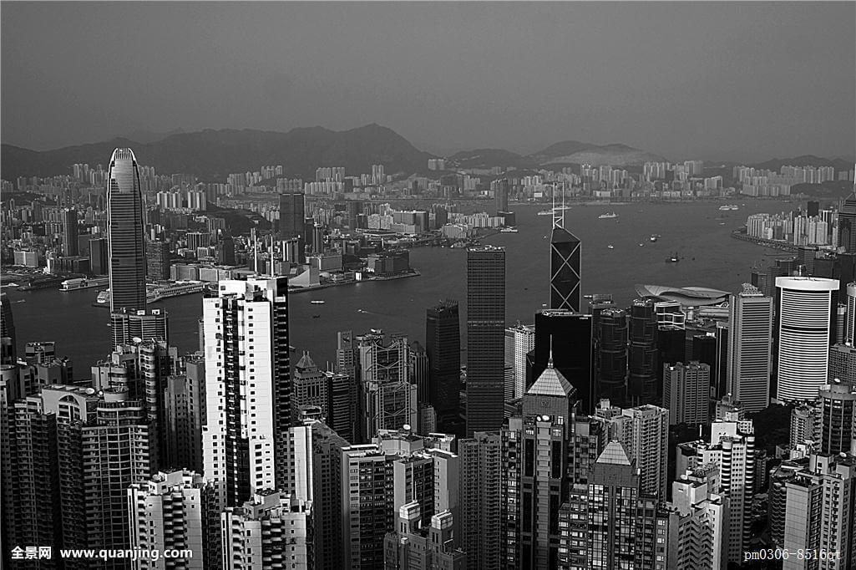
BUSINESS PLAN
2018
感谢您下载包图网平台上提供的PPT作品，为了您和包图网以及原创作者的利益，请勿复制、传播、销售，否则将承担法律责任！包图网将对作品进行维权，按照传播下载次数进行十倍的索取赔偿！
ibaotu.com
简约工作汇报模板
The user can demonstrate on a projector or computer, or print the presentation and make it into a film to be used in a wider field The user can demonstrate

Slide 2
目录/CONTENTS
01
02
03
04
输入标题
输入标题
输入标题
输入标题
点击输入文本内容点击输入文本内容点击输入文本内容点击输入文本内容
点击输入文本内容点击输入文本内容点击输入文本内容点击输入文本内容
点击输入文本内容点击输入文本内容点击输入文本内容点击输入文本内容
点击输入文本内容点击输入文本内容点击输入文本内容点击输入文本内容

Slide 3
01
年度工作概述
The user can demonstrate on a projector or computer, or print the presentation and make it into a film to be used in a wider

Slide 4

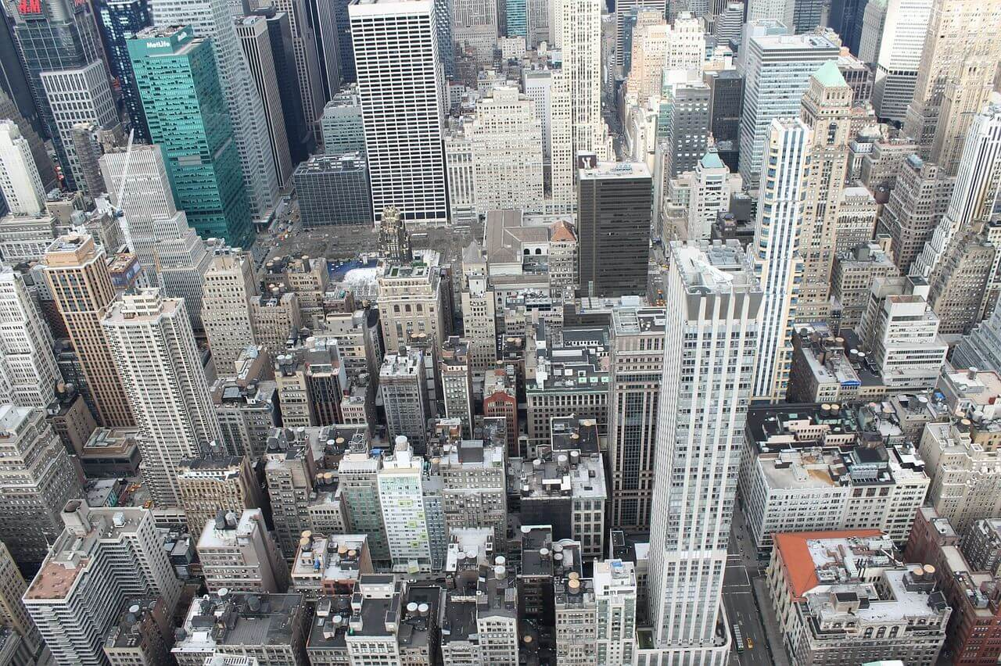
年度工作概述
print the presentation and make it into a film a wider field
标题文字添加
The user can demonstrate on a projector or computer, or print the presentation and make it into a filmThe user can demonstrate on a projector or computer, or print the presentation and make it into a filmThe user can demonstrate on a projector or computer, or print the presentation and make it into a film
文字添加
文字添加
文字添加

Slide 5




年度工作概述
print the presentation and make it into a film a wider field
标题文字添加
标题文字添加
computeror print the presentation and make it film to be used in a wider field
computeror print the presentation and make it film to be used in a wider field
标题文字添加
标题文字添加
computeror print the presentation and make it film to be used in a wider field
computeror print the presentation and make it film to be used in a wider field

Slide 6
年度工作概述
print the presentation and make it into a film a wider field
标题文本预设
标题文本预设
标题文本预设
标题文本预设
标题文本预设
标题文本预设
标题文本预设
标题文本预设
标题文本预设
标题文本预设
标题文本预设
标题文本预设
标题文本预设
标题文本预设
标题文本预设
标题文本预设
标题文本预设

Slide 7
年度工作概述
print the presentation and make it into a film a wider field
关键词
关键词
关键词
标题文字添加此处
The user can demonstrate on a projector or computer, or print the presentation and make it into a film to be used in a wider fieldThe user can demonstrate on a projector or computer, or print the presentation and make it into a film to be used in a wider field

Slide 8




年度工作概述
print the presentation and make it into a film a wider field
标题文字添加
标题文字添加
标题文字添加
标题文字添加
The user can demonstrate on a projector or computer, or presentation and make it film to be used in a wider field
The user can demonstrate on a projector or computer, or presentation and make it film to be used in a wider field
The user can demonstrate on a projector or computer, or presentation and make it film to be used in a wider field
The user can demonstrate on a projector or computer, or presentation and make it film to be used in a wider field

Slide 9
02
工作完成情况
The user can demonstrate on a projector or computer, or print the presentation and make it into a film to be used in a wider

Slide 10




工作完成情况
print the presentation and make it into a film a wider field
标题文字添加
标题文字添加
标题文字添加
标题文字添加
The user can demonstrate on a projector or computer, or presentation and make it film to be used in a wider field
The user can demonstrate on a projector or computer, or presentation and make it film to be used in a wider field
The user can demonstrate on a projector or computer, or presentation and make it film to be used in a wider field
The user can demonstrate on a projector or computer, or presentation and make it film to be used in a wider field

Slide 11

工作完成情况
print the presentation and make it into a film a wider field
标题文字添加
标题文字添加
The user can demonstrate on a projector or computer, or presentation and make it film to be used in a wider field
标题文本预设
The user can demonstrate on a projector or computer, or presentation and make it film to be used in a wider field
标题文本预设
标题文字添加
标题文字添加
The user can demonstrate on a projector or computer, or presentation and make it film to be used in a wider field
标题文本预设
The user can demonstrate on a projector or computer, or presentation and make it film to be used in a wider field
标题文本预设

Slide 12
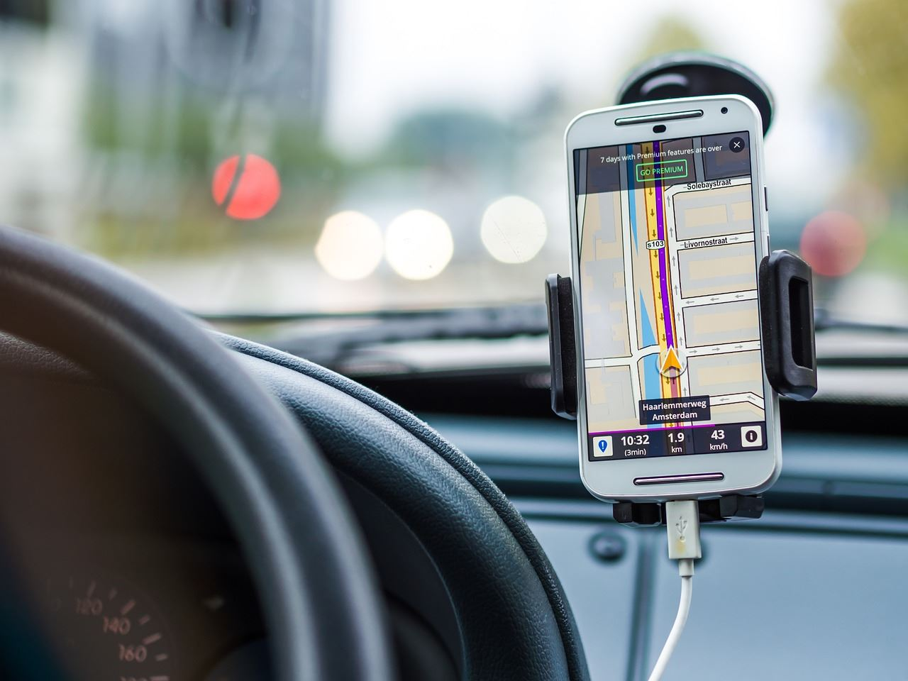
工作完成情况
print the presentation and make it into a film a wider field
标题文字添加
标题文字添加
The user can demonstrate on a projector or computer, or presentation and make it film to be used in a wider field
The user can demonstrate on a projector or computer, or presentation and make it film to be used in a wider field
标题文字添加
标题文字添加
The user can demonstrate on a projector or computer, or presentation and make it film to be used in a wider field
The user can demonstrate on a projector or computer, or presentation and make it film to be used in a wider field

Slide 13

工作完成情况
print the presentation and make it into a film a wider field
47
%
标题文字添加
print the presentation and make it film to be used in a wider field
33
%
标题文字添加
print the presentation and make it film to be used in a wider field

Slide 14
03
工作存在不足
The user can demonstrate on a projector or computer, or print the presentation and make it into a film to be used in a wider

Slide 15
工作存在不足
print the presentation and make it into a film a wider field
标题文字添加
标题文字添加
The user can demonstrate on a projector or computer, or print the presentation and make it film to be used in a wider field
01
The user can demonstrate on a projector or computer, or print the presentation and make it film to be used in a wider field
关键词
标题文字添加
标题文字添加
The user can demonstrate on a projector or computer, or print the presentation and make it film to be used in a wider field
02
The user can demonstrate on a projector or computer, or print the presentation and make it film to be used in a wider field
关键词

Slide 16
工作存在不足
print the presentation and make it into a film a wider field
标题文字添加
print the presentation and make it film to be used in a wider field
标题文字添加
标题文字添加
标题文字添加
print the presentation and make it film to be used in a wider field
print the presentation and make it film to be used in a wider field
print the presentation and make it film to be used in a wider field

Slide 17
工作存在不足
print the presentation and make it into a film a wider field
Text here
Text here
Text here
Text here
Text here
25%
33%
56%
63%
62%

Slide 18
工作存在不足
print the presentation and make it into a film a wider field
63%
42%
80%
88%
标题文字添加
标题文字添加
标题文字添加
标题文字添加
print the presentation and make it film to be used in a wider field
print the presentation and make it film to be used in a wider field
print the presentation and make it film to be used in a wider field
print the presentation and make it film to be used in a wider field

Slide 19
04
明年工作计划
The user can demonstrate on a projector or computer, or print the presentation and make it into a film to be used in a wider

Slide 20


明年工作计划
print the presentation and make it into a film a wider field
标题文字添加
标题文字添加
标题文字添加
标题文字添加
标题文字添加
标题文字添加

Slide 21
明年工作计划
print the presentation and make it into a film a wider field
70%
59%
83%
70%
标题文字添加
标题文字添加
标题文字添加
标题文字添加
2017
2018
2019
2020

Slide 22
明年工作计划
print the presentation and make it into a film a wider field
Step 01
Step 02
Step 03
关键词
关键词
关键词
关键词
关键词
关键词
标题文字添加
标题文字添加
标题文字添加
print the presentation and make it film to be used in a wider field
print the presentation and make it film to be used in a wider field
print the presentation and make it film to be used in a wider field

Slide 23
明年工作计划
print the presentation and make it into a film a wider field
72
82
44
54
53
64
标题文字添加
标题文字添加
标题文字添加
The user can demonstrate on a projector or computer or print
The user can demonstrate on a projector or computer or print
The user can demonstrate on a projector or computer or print

Slide 24
BUSINESS PLAN
2018
感谢您下载包图网平台上提供的PPT作品，为了您和包图网以及原创作者的利益，请勿复制、传播、销售，否则将承担法律责任！包图网将对作品进行维权，按照传播下载次数进行十倍的索取赔偿！
ibaotu.com
非常感谢您的观看
The user can demonstrate on a projector or computer, or print the presentation and make it into a film to be used in a wider field The user can demonstrate

Slide 25
更多精品PPT资源尽在—优品PPT！
www.ypppt.com
PPT模板下载：www.ypppt.com/moban/ 节日PPT模板：www.ypppt.com/jieri/
PPT背景图片：www.ypppt.com/beijing/ PPT图表下载：www.ypppt.com/tubiao/
PPT素材下载： www.ypppt.com/sucai/ PPT教程下载：www.ypppt.com/jiaocheng/
字体下载：http://www.ypppt.com/ziti/ 绘本故事PPT：http://www.ypppt.com/gushi/
Notes:
模板来自于 http://www.ypppt.com

