Slide 1

工作总结 / 工作计划 / 工作汇报
BUSINESS PLAN
时尚工作总结汇报
The user can demonstrate on a projector or computer, or print the presentation and make it into a film to be used in a wider field
汇报人：优品PPT

Slide 2

CONTENTS
1
年度工作概述
print the presentation and make it into a film a wider field
2
工作完成情况
print the presentation and make it into a film a wider field
3
工作存在不足
print the presentation and make it into a film a wider field
4
明年工作计划
print the presentation and make it into a film a wider field

Slide 3
PART 01
年度工作概述
The user can demonstrate on a projector or computer, or print the presentation and make it into a film to be used in a wider field

Slide 4


年度工作概述
print the presentation and make it into a film to be used in a wider field
文字添加
The user can demonstrate on a projector or computer, or presentation and make it film to be used in a wider field
文字添加
文字添加
The user can demonstrate on a projector or computer, or presentation and make it film to be used in a wider field
The user can demonstrate on a projector or computer, or presentation and make it film to be used in a wider field

Slide 5


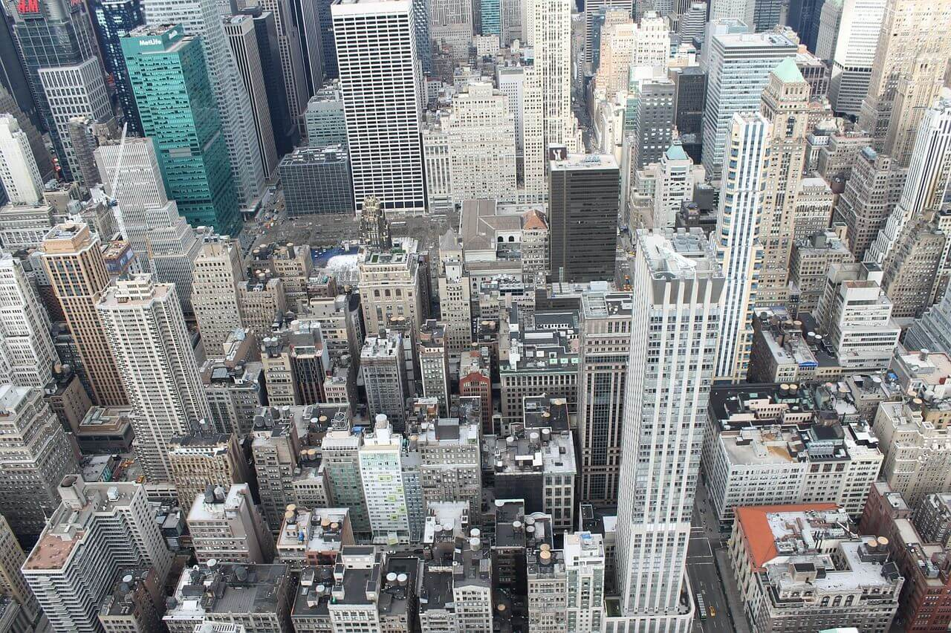

年度工作概述
print the presentation and make it into a film to be used in a wider field
标题文字添加
标题文字添加
The user can demonstrate on a projector or computer, or presentation and make it film to be used in a wider field
The user can demonstrate on a projector or computer, or presentation and make it film to be used in a wider field
标题文字添加
标题文字添加
The user can demonstrate on a projector or computer, or presentation and make it film to be used in a wider field
The user can demonstrate on a projector or computer, or presentation and make it film to be used in a wider field

Slide 6




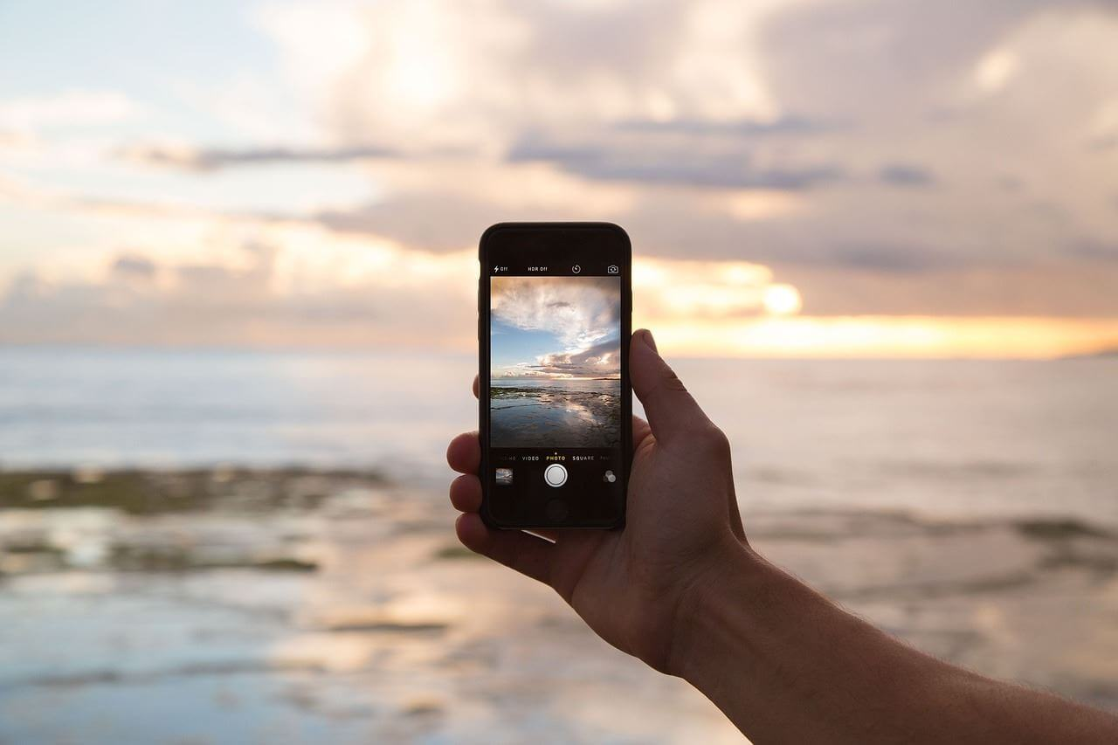
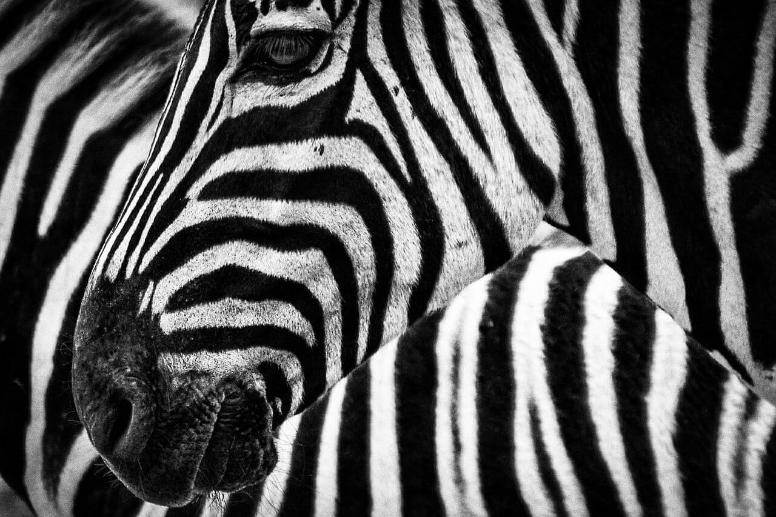
年度工作概述
print the presentation and make it into a film to be used in a wider field
标题文字添加
标题文字添加
标题文字添加
标题文字添加
标题文字添加
标题文字添加

Slide 7
年度工作概述
print the presentation and make it into a film to be used in a wider field
文字添加
文字添加
文字添加
文字添加
文字添加
presentation and make it film to be wider field
presentation and make it film to be wider field
presentation and make it film to be wider field
presentation and make it film to be wider field
presentation and make it film to be wider field

Slide 8
年度工作概述
print the presentation and make it into a film to be used in a wider field
标题文字添加
标题文字添加
presentation and make it film to be used in a wider field
presentation and make it film to be used in a wider field
标题文字添加
标题文字添加
presentation and make it film to be used in a wider field
presentation and make it film to be used in a wider field

Slide 9
PART 02
工作完成情况
The user can demonstrate on a projector or computer, or print the presentation and make it into a film to be used in a wider field

Slide 10
工作完成情况
print the presentation and make it into a film to be used in a wider field
标题文字添加
标题文字添加
print the presentation and make it film to be used in a wider field
print the presentation and make it film to be used in a wider field
标题文字添加
标题文字添加
print the presentation and make it film to be used in a wider field
print the presentation and make it film to be used in a wider field
标题文字添加
标题文字添加
print the presentation and make it film to be used in a wider field
print the presentation and make it film to be used in a wider field

Slide 11
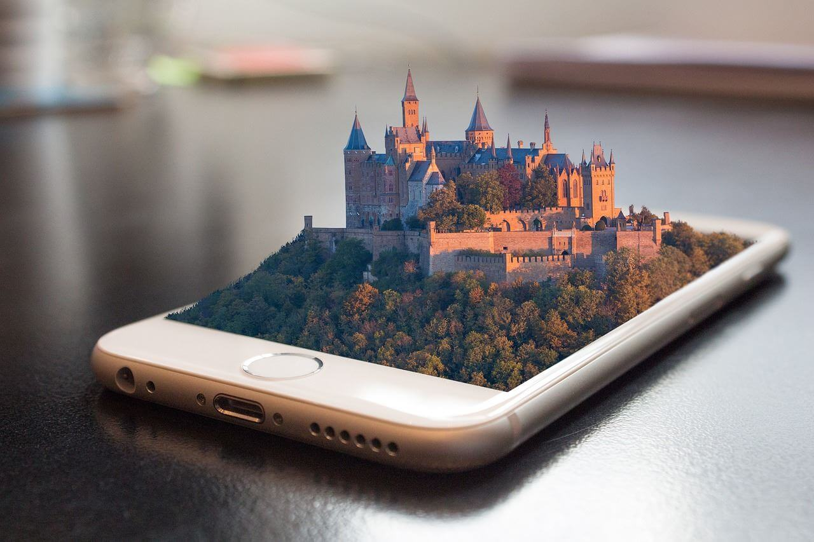
工作完成情况
print the presentation and make it into a film to be used in a wider field
标题文字添加
标题文字添加
The user can demonstrate on a projector or computer
The user can demonstrate on a projector or computer
标题文字添加
标题文字添加
The user can demonstrate on a projector or computer
The user can demonstrate on a projector or computer
标题文字添加
标题文字添加
The user can demonstrate on a projector or computer
The user can demonstrate on a projector or computer

Slide 12
工作完成情况
print the presentation and make it into a film to be used in a wider field
01
标题文字添加
标题文字添加
01
标题文字添加
The user can demonstrate on a projector or computer
The user can demonstrate on a projector or computer
The user can demonstrate on a projector or computer, or presentation and make it film to be used in a wider field
02
标题文字添加
02
标题文字添加
The user can demonstrate on a projector or computer
The user can demonstrate on a projector or computer
标题文字添加
03
标题文字添加
The user can demonstrate on a projector or computer, or presentation and make it film to be used in a wider field
03
标题文字添加
The user can demonstrate on a projector or computer
The user can demonstrate on a projector or computer

Slide 13

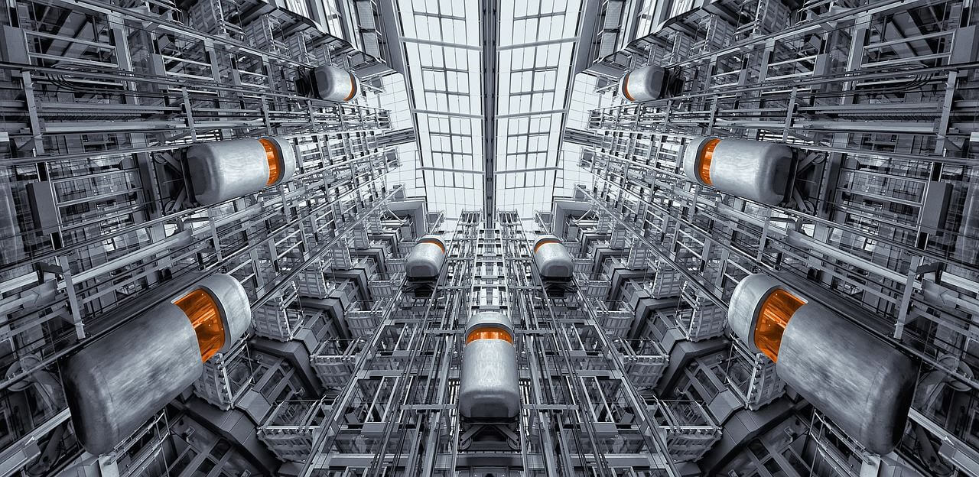

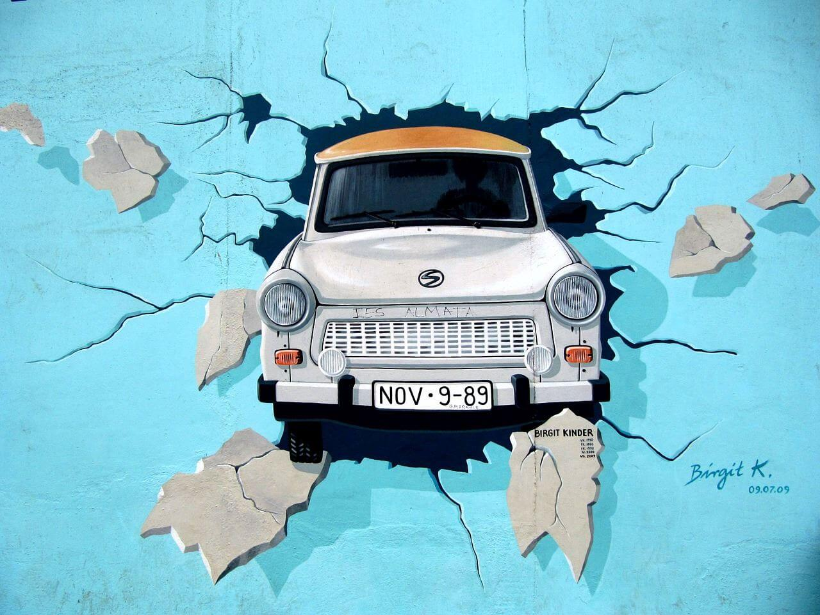
工作完成情况
print the presentation and make it into a film to be used in a wider field
标题文字添加
标题文字添加
The user can demonstrate on a projector or computer, or presentation and make it film to be used in a wider field
The user can demonstrate on a projector or computer, or presentation and make it film to be used in a wider field
标题文字添加
标题文字添加
The user can demonstrate on a projector or computer, or presentation and make it film to be used in a wider field
The user can demonstrate on a projector or computer, or presentation and make it film to be used in a wider field

Slide 14
PART 03
工作存在不足
The user can demonstrate on a projector or computer, or print the presentation and make it into a film to be used in a wider field

Slide 15
工作存在不足
print the presentation and make it into a film to be used in a wider field
标题文本预设
标题文字添加
The user can demonstrate on a projector or computer
标题文本预设
标题文字添加
The user can demonstrate on a projector or computer
标题文本预设
标题文字添加
The user can demonstrate on a computer
标题文本预设
标题文字添加
The user can demonstrate on a projector or computer

Slide 16
工作存在不足
print the presentation and make it into a film to be used in a wider field
文字添加
The user can demonstrate on a projector or computer, or presentation and make it film to be used in a wider field
文字添加
文字添加
The user can demonstrate on a projector or computer, or presentation and make it film to be used in a wider field
The user can demonstrate on a projector or computer, or presentation and make it film to be used in a wider field

Slide 17
工作存在不足
print the presentation and make it into a film to be used in a wider field
文字添加
文字添加
文字添加
文字添加
The user can demonstrate on a projector or computer, or presentation and make it film to be used in a wider field
The user can demonstrate on a projector or computer, or presentation and make it film to be used in a wider field
The user can demonstrate on a projector or computer, or presentation and make it film to be used in a wider field
The user can demonstrate on a projector or computer, or presentation and make it film to be used in a wider field

Slide 18

工作存在不足
print the presentation and make it into a film to be used in a wider field
标题文字添加
标题文字添加
The user can demonstrate on a projector or computer, or presentation and make it film to be used in a wider field
The user can demonstrate on a projector or computer, or presentation and make it film to be used in a wider field
标题文字添加
标题文字添加
The user can demonstrate on a projector or computer, or presentation and make it film to be used in a wider field
The user can demonstrate on a projector or computer, or presentation and make it film to be used in a wider field

Slide 19
工作存在不足
print the presentation and make it into a film to be used in a wider field
文字添加此处
The user can demonstrate on a projector or computer
文字添加此处
The user can demonstrate on a projector or computer
文字添加此处
The user can demonstrate on a projector or computer
文字添加此处
The user can demonstrate on a projector or computer
文字添加此处
The user can demonstrate on a projector or computer

Slide 20
PART 04
明年工作计划
The user can demonstrate on a projector or computer, or print the presentation and make it into a film to be used in a wider field

Slide 21
明年工作计划
print the presentation and make it into a film to be used in a wider field
40%
30%
85%
65%
35%
标题文字添加
标题文字添加
标题文字添加
标题文字添加
标题文字添加

Slide 22
明年工作计划
print the presentation and make it into a film to be used in a wider field
文字添加
文字添加
文字添加
The user can demonstrate on a projector or computer, or presentation and make it film to be used in a wider field
The user can demonstrate on a projector or computer, or presentation and make it film to be used in a wider field
The user can demonstrate on a projector or computer, or presentation and make it film to be used in a wider field

Slide 23
明年工作计划
print the presentation and make it into a film to be used in a wider field
标题文字添加
01
标题文字添加
02
The user can demonstrate on a projector or computer, or presentation and make it film to be used in a wider field
03
The user can demonstrate on a projector or computer, or presentation and make it film to be used in a wider field
04
标题文字添加
标题文字添加
The user can demonstrate on a projector or computer, or presentation and make it film to be used in a wider field
The user can demonstrate on a projector or computer, or presentation and make it film to be used in a wider field

Slide 24
明年工作计划
print the presentation and make it into a film to be used in a wider field
标题文字添加此处
标题文字添加此处
标题文字添加此处
标题文字添加此处
标题文字添加此处
标题文字添加此处
Jan
Feb
Mar
Apr
May
Jun
Jul
Aug
Sep
Oct
Nov
Dec
标题文字添加此处
The user can demonstrate on a projector or computer, or print the presentation and make it into a film to be used in a wider fieldThe user can demonstrate on a projector or computer, or print the to be used in a wider field

Slide 25
工作总结 / 工作计划 / 工作汇报
BUSINESS PLAN
感谢您的观看
The user can demonstrate on a projector or computer, or print the presentation and make it into a film to be used in a wider field
汇报人：优品PPT

Slide 26
更多精品PPT资源尽在—优品PPT！
www.ypppt.com
PPT模板下载：www.ypppt.com/moban/ 节日PPT模板：www.ypppt.com/jieri/
PPT背景图片：www.ypppt.com/beijing/ PPT图表下载：www.ypppt.com/tubiao/
PPT素材下载： www.ypppt.com/sucai/ PPT教程下载：www.ypppt.com/jiaocheng/
字体下载：http://www.ypppt.com/ziti/ 绘本故事PPT：http://www.ypppt.com/gushi/
Notes:
模板来自于 http://www.ypppt.com

