Slide 1
Using YouTube to record a Power point based presentation.
Hong Qin
August 30, 2015

Slide 2

First, set “Slide Show” in PPT slides

Slide 3

First, set “Slide Show” in PPT slides

Slide 4
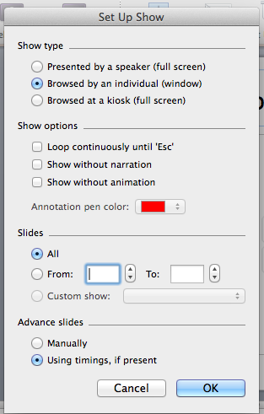

Slide 5
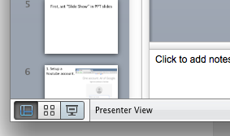
Start slide show in PPT

Slide 6
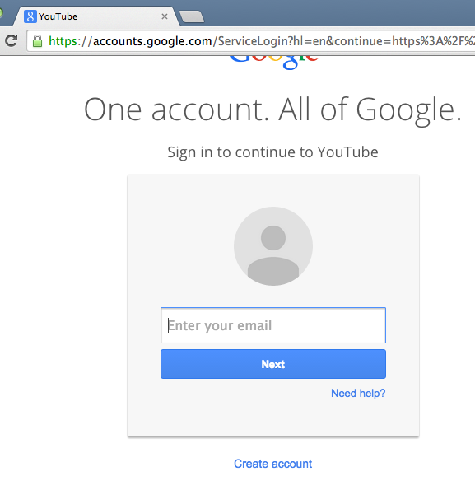
1. Setup a Youtube account.

Slide 7


Slide 8
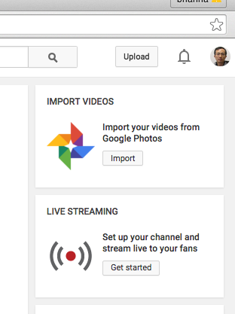

Slide 9
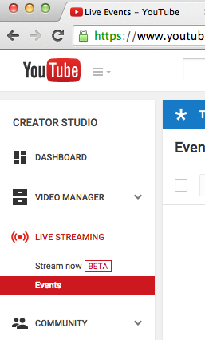

Slide 10
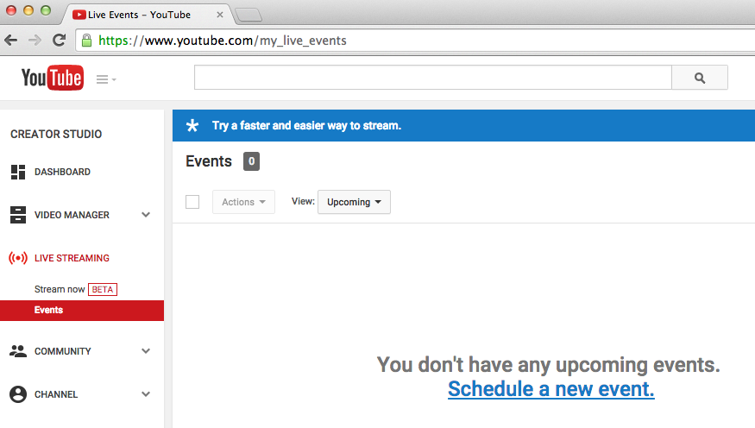

Slide 11
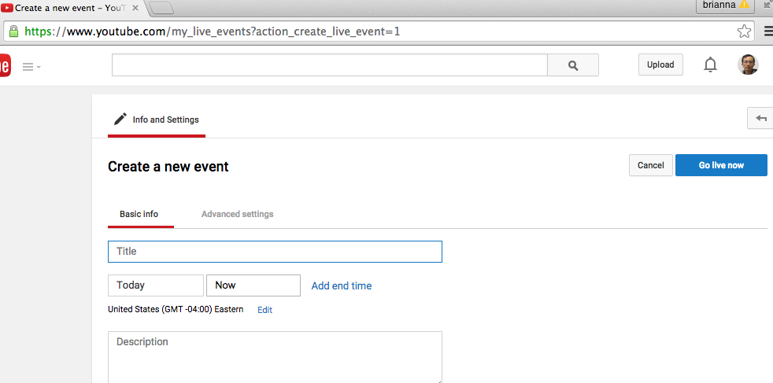
Type a title, and then “Go Live Now”

Slide 12
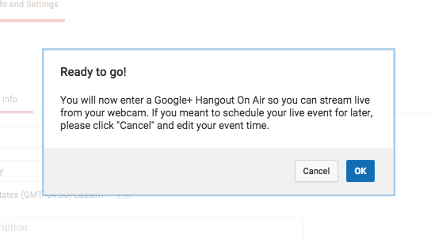

Slide 13
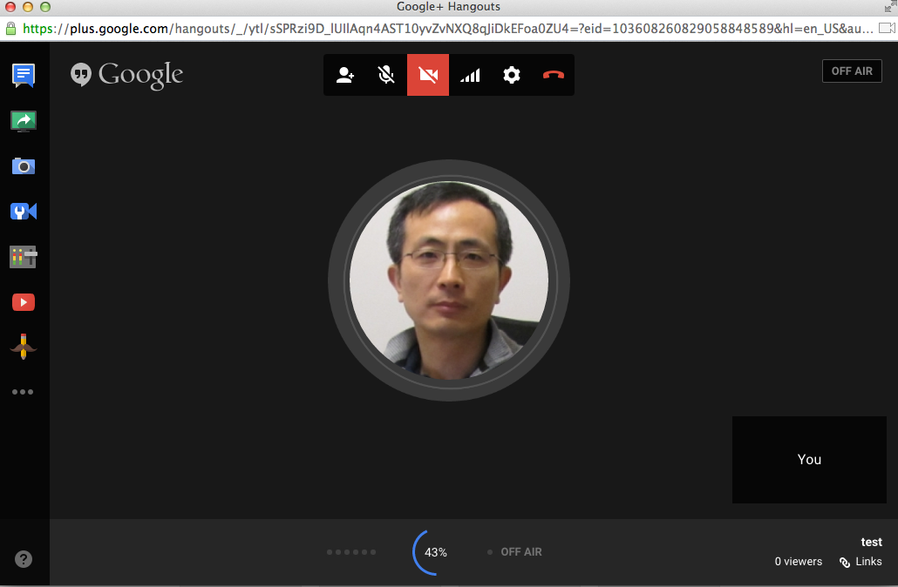

Slide 14
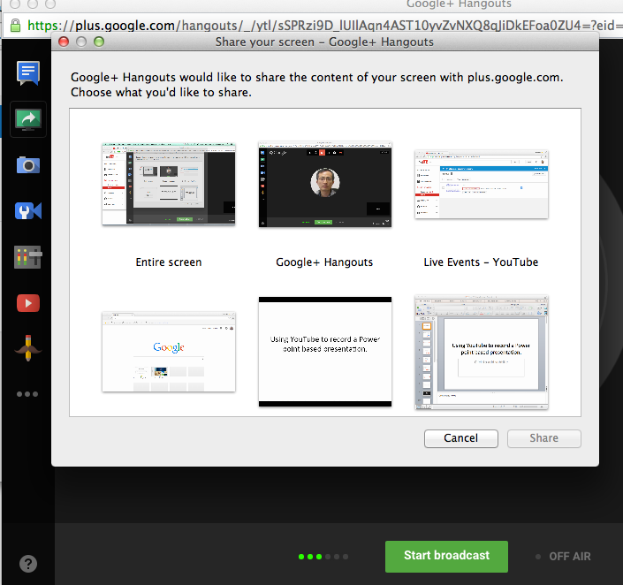
Select the PPT presentation screen.

Slide 15
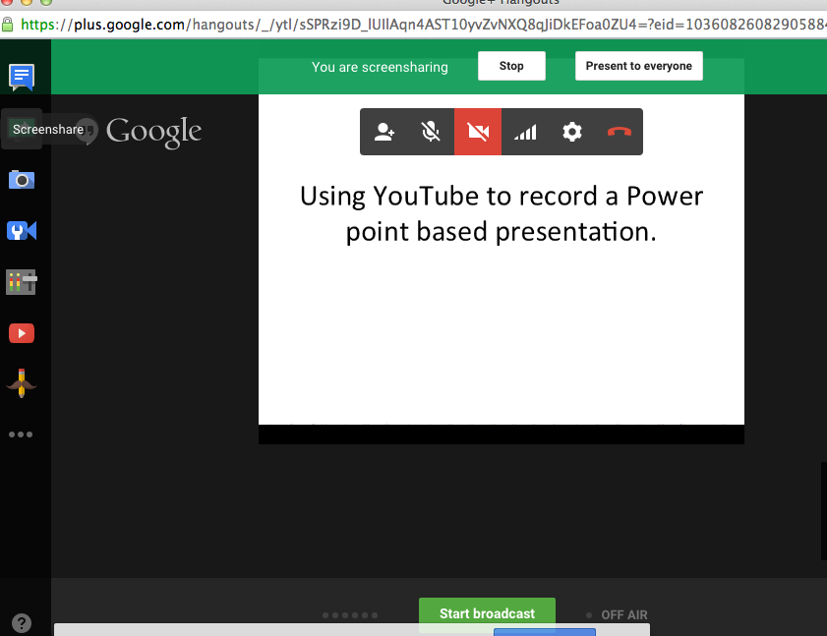

Slide 16
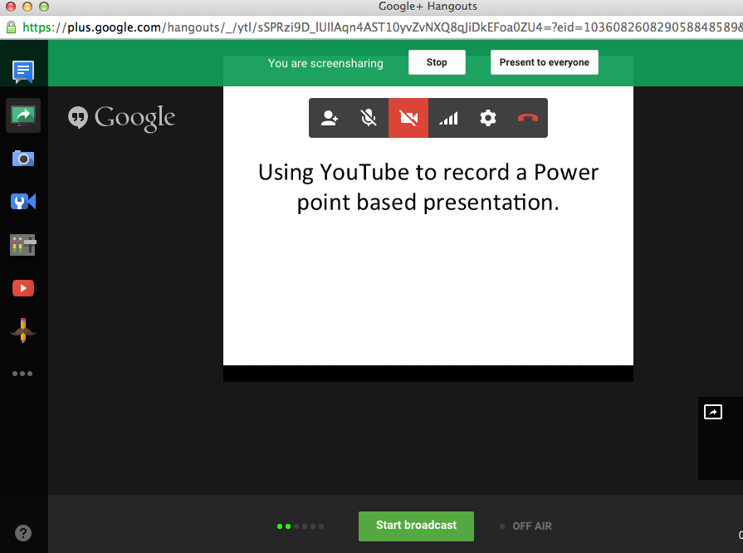

Slide 17
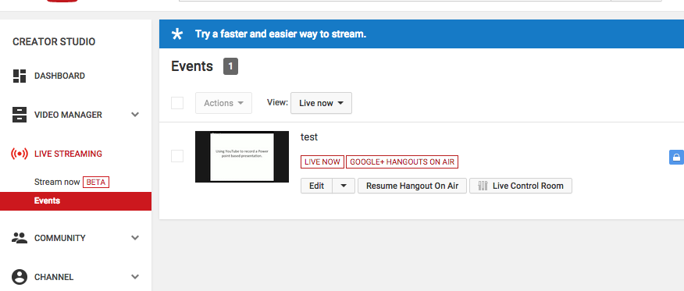

Slide 18
