Slide 1
Why IQ-TREE?
Bui Quang Minh
Australian National University
Workshop on Molecular Evolution
Woods Hole, 24 July 2018

Slide 2
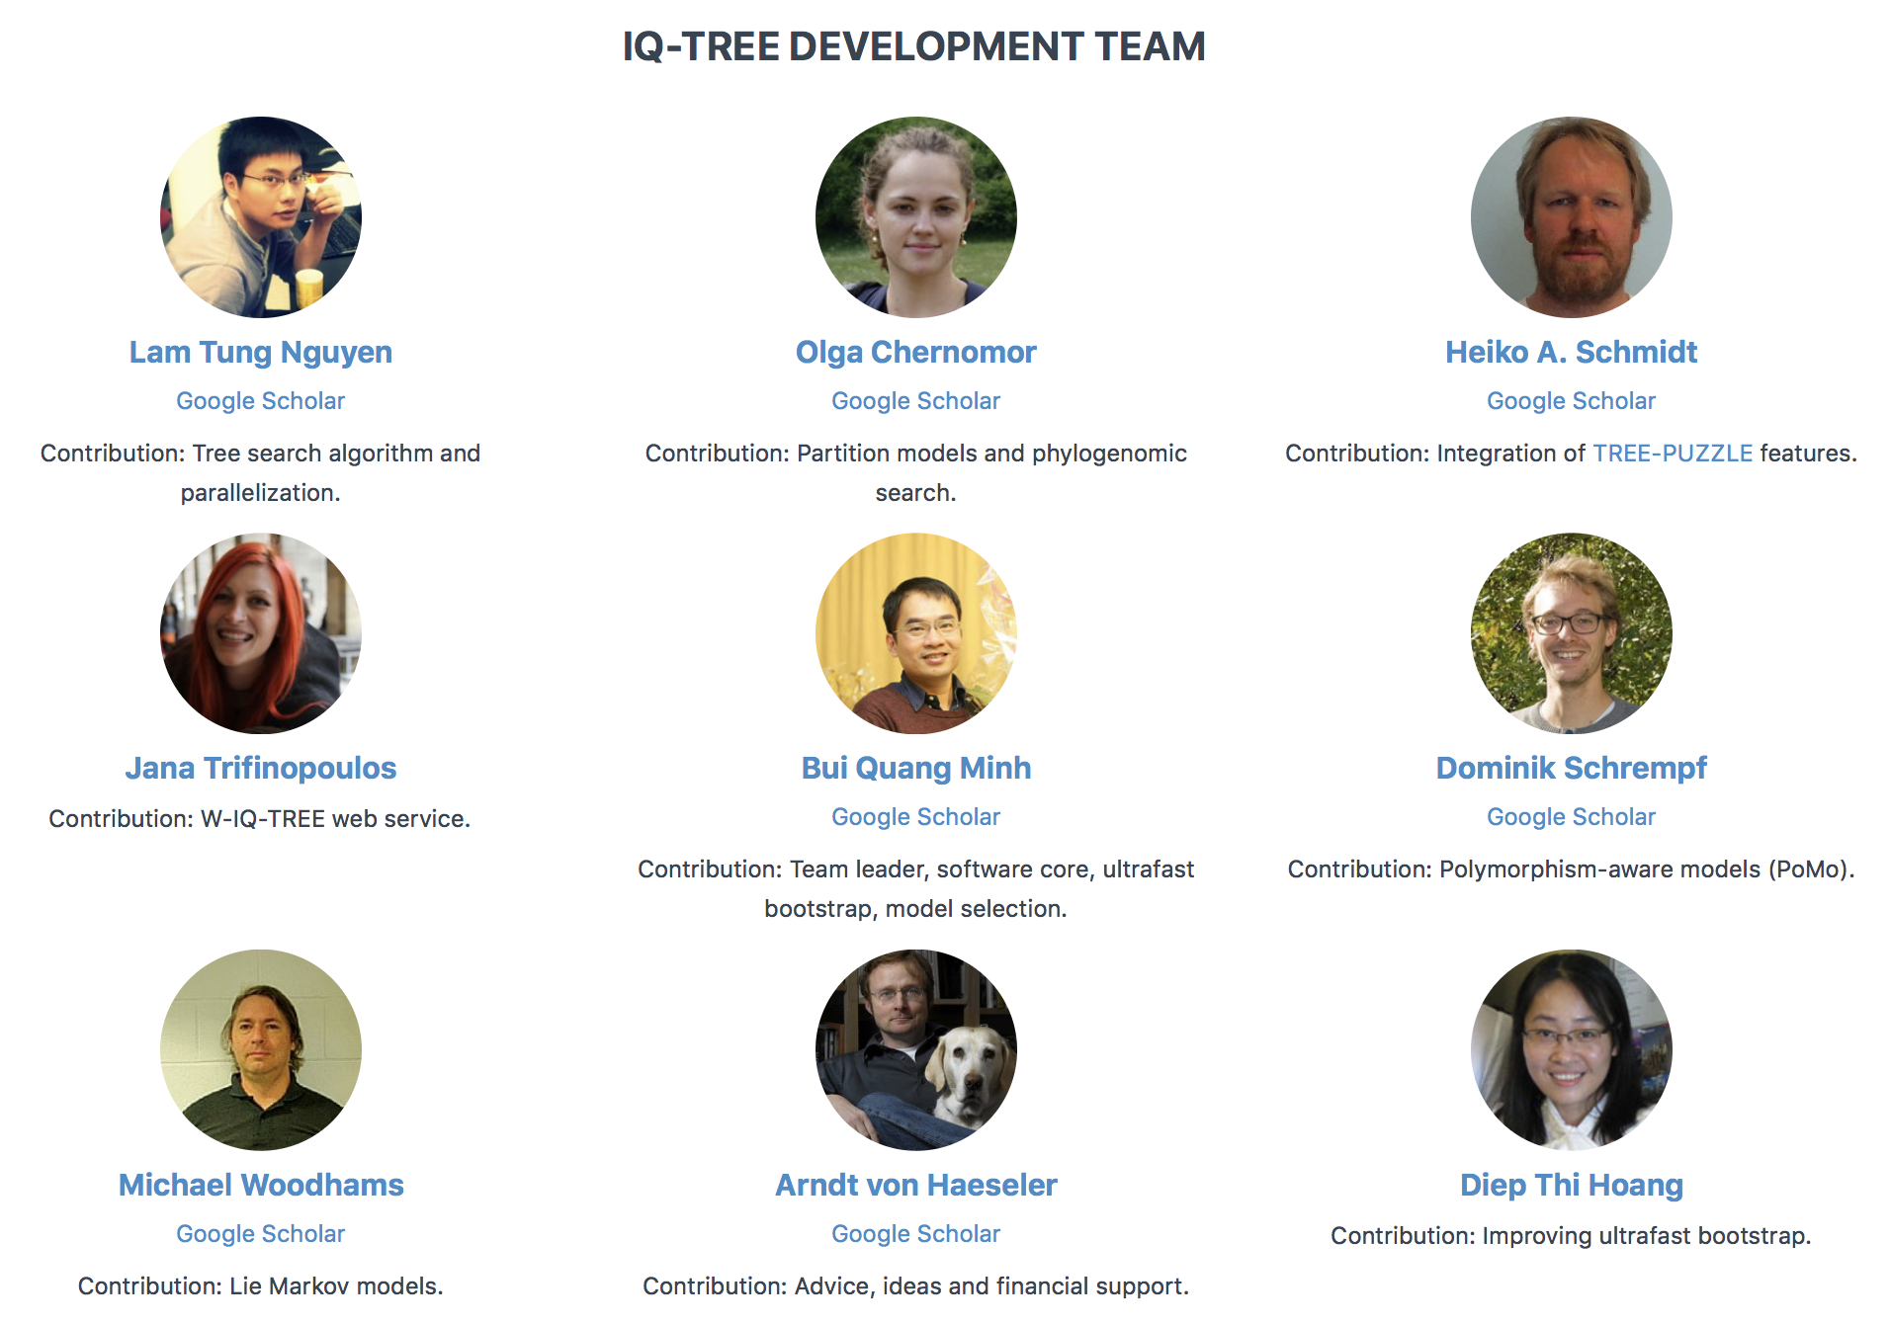
Thanks to plenty of users for feedback and bug reports!

Slide 3
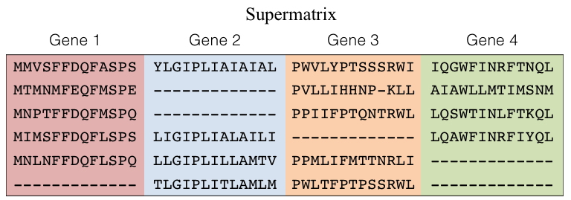
Typical phylogenetic analysis under maximum likelihood
Multiple sequence alignment
Substitution model
ACGGGAT--C--C----CATTAC
ACGGGAT--C--C----CACTAC
CCGGGATAGCTTC----CATTAC
ACCCCCTATC--CACTGGATTAC
ACGACATATC--CACTGGATTCC
Model selection
Challenges
Flood of sequence data
Need for realistic models of sequence evolution
Tree reconstruction
Branch supports
85%
94%
63%
Tree with branch supports
Phylogenetic tree

Slide 4
Typical phylogenetic analysis under maximum likelihood
Multiple sequence alignment
Substitution model
ACGGGAT--C--C----CATTAC
ACGGGAT--C--C----CACTAC
CCGGGATAGCTTC----CATTAC
ACCCCCTATC--CACTGGATTAC
ACGACATATC--CACTGGATTCC
Model selection
ModelFinder
http://www.iqtree.org
Tree reconstruction
IQ-TREE
Ultrafast bootstrap
85%
94%
Branch supports
63%
Tree with branch supports
Phylogenetic tree

Slide 5
Advanced models of sequence evolution
Substitution models
DNA
Protein
Codon
Binary and Morphological
Rate heterogeneity across sites
Invariant sites
Gamma model
FreeRate model (available PhyML, RAxML-NG, IQ-TREE, PAML, BEAST2, RevBayes)
Partition models
Edge-linked (equal or proportional)
Edge-unlinked
Mixture models
Mixture of rate matrices (LG4M, LG4X)
Mixture of state frequencies (C10-C60)
Mixed branch lengths (GHOST – General Heterotachy on Single Trees)
User-defined mixtures
Polymorphism-aware models (PoMo)
Combining phylogenetic (mutations) with population genetics (drift) models.
Site-specific models
Posterior mean site frequency (PMSF)
All models automatically selected with ModelFinder. A lot faster than jModelTest and ProtTest!

Slide 6
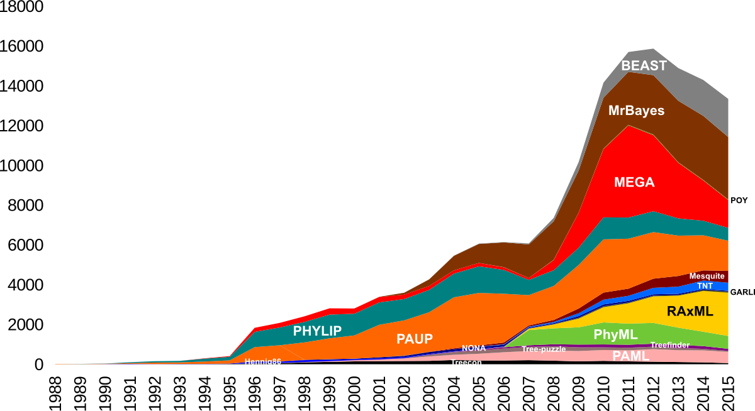
Tree reconstruction: Which tree best explains the data?
Citations per year
Year
Source: phylobotanist.blogspot.com

Slide 7



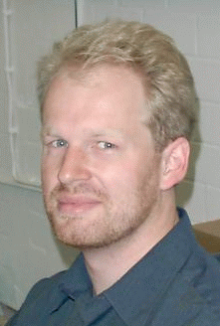


IQ-TREE: A new tree search algorithm
L.T. Nguyen, H. Schmidt, A. von Haeseler
Maximum parsimony
Nearest neighbor interchange (NNI)
Random NNIs

Slide 8
Benchmark: Log-likelihood maximisation
Better
Worse
Independently confirmed by Zhou, Rokas et al. (2018)

Slide 9
Runtimes
Slow
Fast

Slide 10
Branch supports: How reliable are branches of the tree?
ML tree
Consensus tree
Bootstrap analysis is extremely time-consuming!
Notes:
For X replicates we need 1000 times the computing time as for the original data.

Slide 11

UFBoot: Ultrafast bootstrap approximation
M.A.T. Nguyen, A. von Haeseler
Use UFBoot >= 95% instead of 70% !

Slide 12
Other features
Bootstrap resampling
Resampling partitions
Resampling partitions and sites
Single branch tests
SH-aLRT (Shimodaira-Hasegaw-like approximate likelihood ratio test)
aBayes
Tree topology tests
Shimodaira-Haegawa (SH) test
Expected Likelihood Weight (ELW)
Post-analysis
Ancestral sequence reconstruction
Inferring site-specific rates
IQ-TREE forum: https://groups.google.com/d/forum/iqtree
for questions, complaints, etc.

Slide 13
Exercises
Single model on a DNA data set (obtained from Phylogenetic Handbook)
First running example
Choosing the right substitution model
Assessing branch supports (UFBoot, SH-aLRT)
Utilizing multi-core CPUs
Partition model on a 248-gene Turtle DNA data set (kindly provided by J. Brown)
Partitioned analysis for multi-gene alignments
Choosing the right partitioning scheme (*optional)
Bootstrap resampling partitions
Tree tests
Identifying most influential genes (*optional)
Mixture model on a 10-gene Microsporidia protein data set (kindly provided by L. Eme)
Protein mixture model analysis
http://www.iqtree.org/doc/molevol

