Slide 1
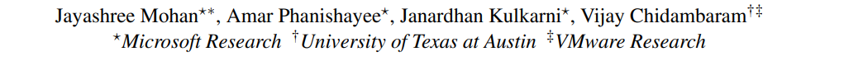
Looking Beyond GPUs for DNN Scheduling
on Multi-Tenant Clusters
OSDI’22

Slide 2
Background and Motivation

Slide 3
Background of ML jobs scheduling
Common process of DNN jobs’ scheduling:
Scheduling Policy (FIFO, SRTF, LAS…)
Scheduling Mechanism
GPU Number
& Placement
Set of submitted jobs
Set of jobs to be run
CPU Number
& Placement
Mem Size
& Placement

Slide 4
Background of ML jobs scheduling
Specified by user
Common process of DNN jobs’ scheduling:
GPU Number
Scheduling Policy (FIFO, SRTF, LAS…)
Scheduling Mechanism
Set of submitted jobs
Proportional to GPU allocation
Set of jobs to be run
CPU Number
Memory Size
Existing DNN schedulers [Tiresias(NSDI’19), Gavel(OSDI’20), Themis(NSDI’20), etc.] all use GPU-proportional allocation for CPU and memory allocation:
A user requests a fixed number of GPUs, other resources such as CPU and Memory are allocated proportional to the number of GPUs assigned to the job.
e.g. A server with 4 GPUs, 16 CPUs, and 200GB memory
A job : 1 GPU => 4 CPUs and 50GB memory

Slide 5
Background of ML jobs scheduling
Problem of GPU-proportional allocation: cause data stalls for cpu/mem sensitive jobs
Fetched from storage to memory
Data Stall
Preprocessed at CPU
Copied over to GPU for processing
Figure: Training of a mini-batch of data

Slide 6
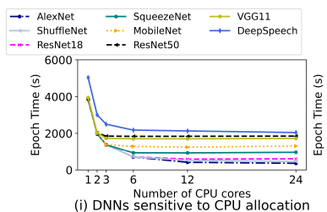
Background of ML jobs scheduling
Problem of GPU-proportional allocation: cause data stalls for cpu/mem sensitive jobs
Fetched from storage to memory
Data Stall
Preprocessed at CPU
Copied over to GPU for processing
Figure: Training of a mini-batch of data

Slide 7
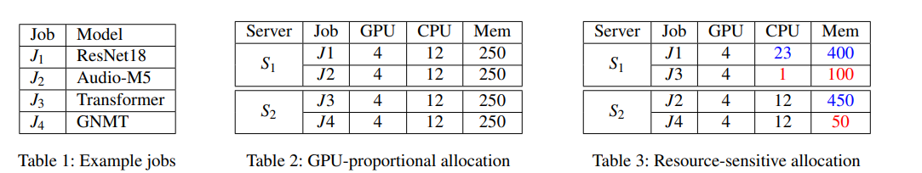
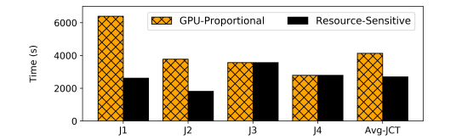
Motivation
GPU-proportional allocation V.S. resource sensitive allocation: up to 3x speedup

Slide 8
Goal and Challenges

Slide 9
Goal & Challenges
Main Goal:
Replace GPU-proportional allocation by a workload-aware allocation, which maximize throughput while ensuring that every job’s throughput is at least that of GPU-proportional allocation.
Require to solve:
Challenges 1: What is the ideal resource requirement for each job? How can this be determined with low overhead?
A profiling strategy - 1. good estimation, 2. reasonable time
Challenges 2: How should we pack these jobs onto servers along multiple resource dimensions efficiently, especially when we can tune the job’s demand for these resources?
A scheduling algorithm – 1. contend with fungible resource demands (instead of fixed resource demands)
2. maximize throughput
3. fair allocation
4. feasible packing

Slide 10
Overview of Synergy’s design

Slide 11
Overview of Synergy’s design
Common process of DNN jobs’ scheduling:
Scheduling Policy (FIFO, SRTF, LAS…)
Scheduling Mechanism
(GPU-proportional allocation)
GPU Allocation
Jobs
Set of jobs to be run
CPU Allocation
Mem Allocation

Slide 12
Overview of Synergy’s design
Optimistic Profiling
Scheduling Policy (FIFO, SRTF, LAS…)
Scheduling Mechanism
(Synergy-OPT/Synergy-Tune)
GPU Allocation
Jobs
Jobs with
sensitivity matrices
Set of jobs to be run
CPU Allocation
Mem Allocation
Identify the job’s best case
CPU and memory requirements
Pack the jobs onto the available server

Slide 13
Designs
1. Optimistic Profiling
2. Synergy-OPT & Synergy-Tune

Slide 14
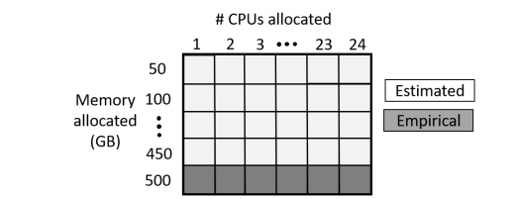
Designs - Optimistic Profiling
Dilemma: Profiling performance under different combinations of CPU and memory very expensive.
Foundation that enables Optimistic Profiling: MinIO cache
Use of MinIO cache
Job gets a fixed number of cache hits per epoch.
Predictivity of job performance to vary memory allocation at fixed CPU allocation
Optimistic Profiling: Empirically evaluates the sensitive of a model to vary #CPUs with maximum memory. The rest of the matrix is completed using estimation.

Slide 15
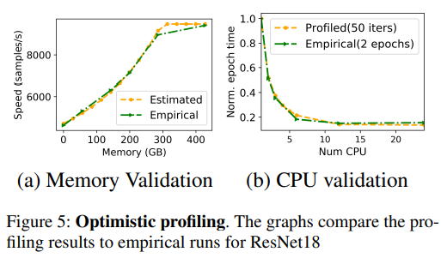
Designs - Optimistic Profiling
The profiling time reduce from 240 mins to 8 mins
After profiling, the job along with its resource sensitivity matrix is enqueued into the main scheduling queue.

Slide 16
Designs
1. Optimistic Profiling
2. Synergy-OPT & Synergy-Tune

Slide 17
[1] Synergy-OPT
Goal of this step: maximize overall throughput, while guaranteeing each job’s throughput is as good as using GPU-proportional allocation.
LP problem formulation:
Objective: Maximize the summation of throughput of the set of runnable jobs (1)
Constraints: 1. Total CPU and Mem allocated to jobs is no more than the total available capacity. (2)
2. The allocation is at least as good as GPU-proportional allocation. (3)

Slide 18

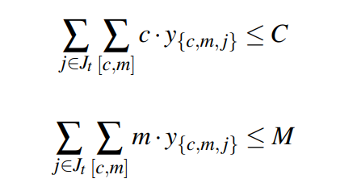

[1] Synergy-OPT
LP problem formulation:
Objective: Maximize the summation of throughput of the set of runnable jobs (1)
Constraints: 1. Total CPU and Mem allocated to jobs is no more than the total available capacity. (2)
2. The allocation is at least as good as GPU-proportional allocation. (3)
(1)
Wj[c,m]: the amount of progress made by job j, if c units of CPU and m units of memory are allocated
s.t.
y_{{c,m,j}} = 1 means in LP solution, c units of CPU and m units of memory are allocated to job j.
(2)
C: amount of CPU
M: amount of Memory
(3)
C_{g}, M_{g}: the GPU-proportional allocation allocation of CPU and memory

Slide 19
[1] Synergy-OPT
(1)
Wj[c,m]: the amount of progress made by job j, if c units of CPU and m units of memory are allocated
s.t.
y_{{c,m,j}} = 1 means in LP solution, c units of CPU and m units of memory are allocated to job j.
(2)
C: amount of CPU
M: amount of Memory
(3)
C_{g}, M_{g}: the GPU-proportional allocation allocation of CPU and memory
Computational expensive – increase exponentially as cluster size in and #jobs increase.
For allocation on Multiple Machines: add x_{i,j}
X_{i,j} = 1 denotes resources of job j are allocated on machine I (X_{i,j} can be fractional)

Slide 20
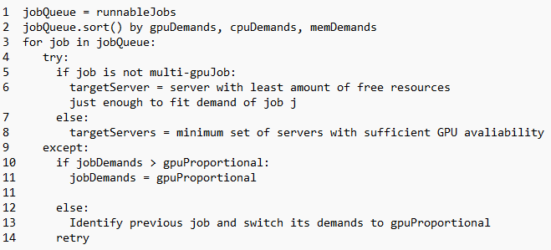
Designs – Scheduling mechanisms
[2] Synergy-Tune
Allocation requirements:
Single GPU job: GPU, CPU and memory resources requested by a job must be allocated on the same server.
Multi-GPU job (split across multiple machines): CPU and memory allocations must be proportional to GPU allocations across servers.
Greedily packs jobs along multiple resource dimension.
Minimize fragmentation.
Switch demands to GPU-proportional.
Identify the job/set of jobs on server, switch their demands to GPU-proportional.
Synergy-Tune gives allocation that are within 10% of the optimal value. 200x faster than Synergy-OPT

Slide 21
Evaluation

Slide 22
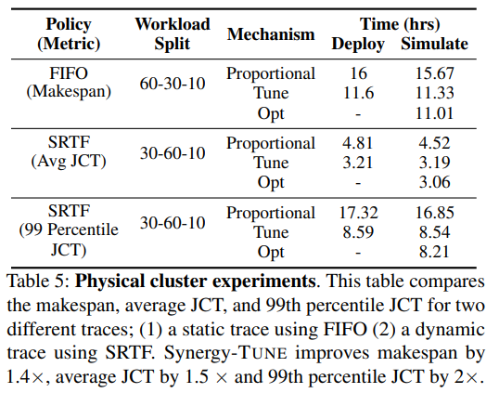
Evaluation [1]
Question[1]: Does Synergy’s resource sensitive scheduling improve cluster objective(average JCT and makespan) in a physical cluster?
Run Synergy-Tune and GPU-proportional allocation for two different workloads traces:
(1) static production-derived trace. (2) dynamic production-derived trace.

Slide 23
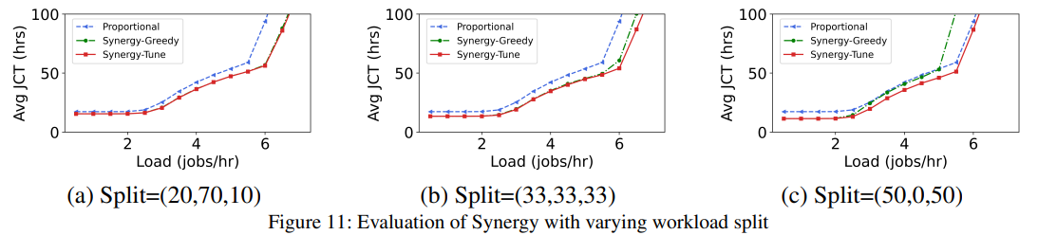
Evaluation [2]
Question[2]: Workload split decides the percentage of resource sensitive jobs. What’s the impact of workload split on Synergy?
()
Split = (image, language, speech)
In the worst case c (speech and image models are mostly CPU- and memory- hungry), Synergy-Tune performs as good as GPU-proportional allocation.

Slide 24
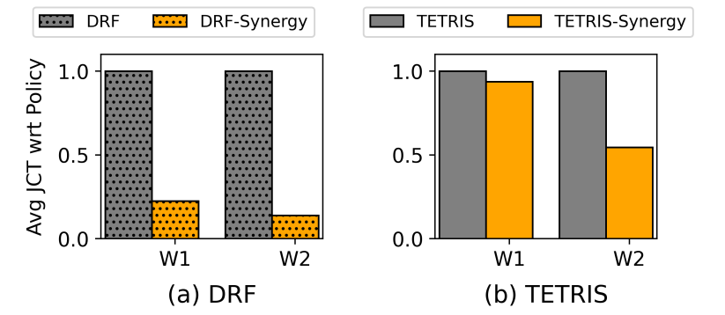
Evaluation [3]
Question[3]: Compare Synergy to big data scheduling policies(DRF, Tetris)?
()
Reduce average JCT of DRF by 7.2x and of Tetris by 1.8x.

Slide 25
Discussion

Slide 26
Contributions
Insight of the importance and need for resource-sensitive scheduling of DNN jobs.
Optimistic profiling + Synergy-Tune performs disproportional allocations such that no job achieve lower than GPU-proportional throughput.
Improve CPU- / memory-sensitive jobs, and also improve average JCT by upto 3.4x.
General enough to improve a wide range of scheduling policies (LAS, FIFO, SRTF, FTF, DRF, Tetris, etc.)

Slide 27
Limitations
Heterogeneous Clusters(appliable with additional cost)
Depend on use of MinIO
GPU elasticity and sharing
Model and Pipeline parallelism

Slide 28
Workload – aware allocation & DMLProfiling
Two problems left in Synergy: how ideas of Synergy can also be extended to reason about demands that each job place on storage and network bandwidths.
The profiling cost will increase heavily if adding more resource dimensions.
Predicting depends on MinIO.
Unable to model the DNN jobs’ behavior if MinIO is absent
Call for a method to model DNN jobs’ sensitivity to resources in reasonable time.
Whether our work can provide heuristic for profiling jobs’ sensitivity to resources?

Slide 29
Thanks!

