Slide 1

Inferring Motif-based Diffusion Models for Social Networks
Qing Bao, William K. Cheung and Jiming Liu
Department of Computer Science
Hong Kong Baptist University

Slide 2
Content
1. Introduction
2. Problem Formulation
3. Experiment
4. Conclusion and Future Work
Notes:
.

Slide 3
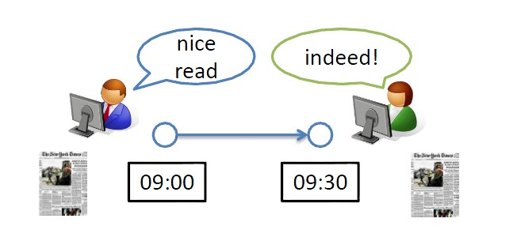
Introduction – Diffusion Models
Network: social network, information network
Diffusion
Action/information spreads among nodes via edges over a network.
Cascade
The chain reaction of the action/information in the diffusion.
Diffusion Models
The Independent Cascade Model (IC Model)
The Linear Threshold Model (LT Model)
Notes:
Diffusion Models
To understand how information spreads
To infer underlying diffusion networks

Slide 4
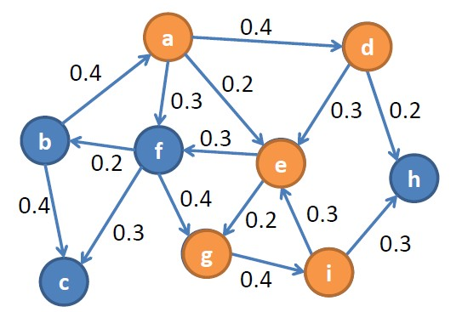
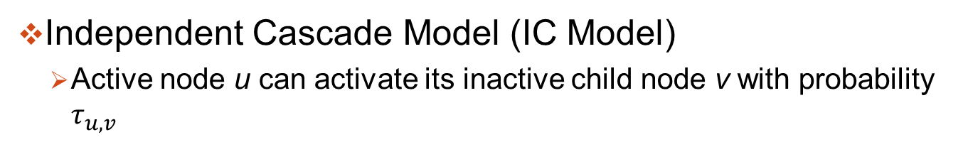
Introduction – IC Model as example
Independent Cascade Model (IC Model)
Active node u can activate its inactive child node v with probability $τ_{u,v}$
Notes:
Diffusion Process:
At time $t$, node u active at time $t−1$ can
activate its inactive child node v with a probability of $τ_{u,v}$

Slide 5
Motivation
Limitations of IC Model
Dependency of parents NOT modeled
Extensions of IC Model on dependency
Structural dependency [1], Behavioral dependency [2]
Interactions of parent nodes’ activations still NOT modeled
We propose to model interactions of parent nodes’ activations
Latent temporal activation motifs of parent nodes
Motif-based diffusion model interprets observed information cascades
[1] Q. Bao, W.K. Cheung, and Y. Zhang. Incorporating structural diversity of neighbors in a diffusion model for social networks. In Proceedings of the 2013 IEEE/WIC/ACM International Joint Conference on Web Intelligence, pages 431–438, Atlanta, GA, USA, 2013.
[2] Q. Bao, W.K. Cheung, J. Liu, and Y. Song. Inferring latent co-activation patterns for information diffusion. In Proceedings of the 2015 IEEE/WIC/ACM International Joint Conference on Web Intelligence, pages 485–492, Singapore, 2015.

Slide 6
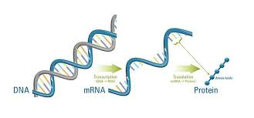
Motifs
Motifs: over-represented patterns [1]
Sequence motif: class of subsequences occurring more frequently in sequential data compared with the randomized sequences.
Subsequences interpretable. E.g., Genes to proteins
So, How about motifs in friends’ activation sequence?
S: so-so friends R: reputable friend
SS…..SR : people’s attention not caught until a reputable friend steps in
[1] N. Kim, K. Tharakaraman, L. Mari˜no-Ram´ırez, and J. L. Spouge. Finding sequence motifs with Bayesian models incorporating positional information: an application to transcription factor binding sites. BMC Bioinformatics, 9:1–11, 2008..

Slide 7
Content
1. Introduction
2. Problem Formulation
3. Experiment
4. Conclusion and Future Work
Notes:
.

Slide 8
Problem Formulation - Social Roles
Motifs are attributed with social roles
e.g., People’s attention may not be caught by just discussion of some
so-so friends until a reputable friend steps in.
Social role based on structure information:
“BF = Big Fish”
1
2
“L = Loner”
w
“B = Bridge”
3
4
“A = Ambassador”

Slide 9
Activation Sequence and Subsequence
Temporal Activation Sequence
for node w at time t = (4,4,2,3,4,3)
“BF”
1
“L”
2
“B”
3
“A”
4
w
?
time = t
Sampled Subsequences:
(4,4,2,3) -> (A,A,L,B)
(4,2,3) -> (A,L,B)
(4,2,3) -> (A,L,B)
(4,3) -> (A,B)
. . .

Slide 10
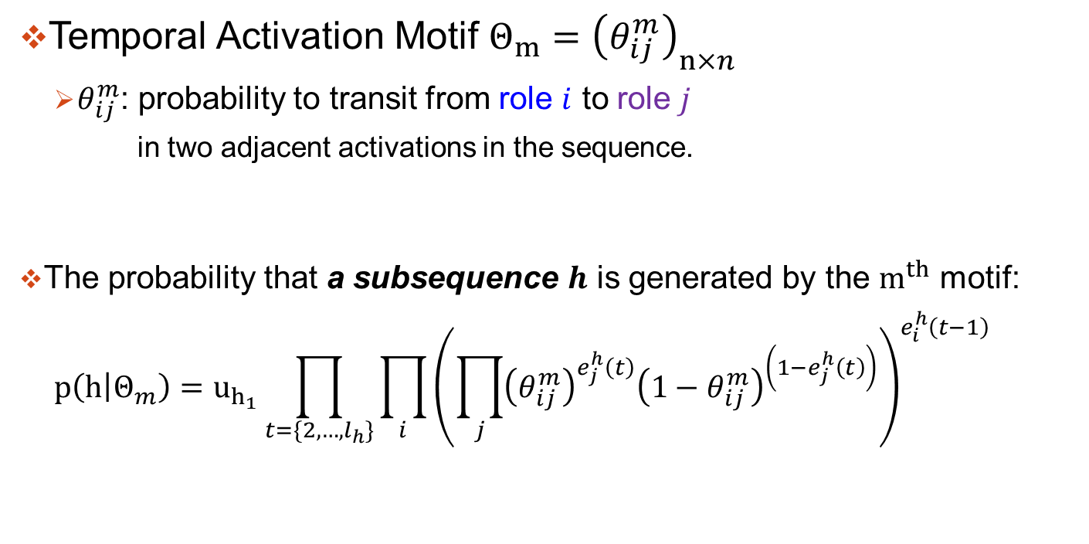
Temporal Activation Motif
Temporal Activation Motif $Θ_{m}={\left(θ_{ij}^{m}\right)}_{n×n}$
$θ_{ij}^{m}$: probability to transit from role $i$ to role $j$
in two adjacent activations in the sequence.
The probability that a subsequence $h$ is generated by the $m^{th}$ motif:
$$p\left(h | Θ_{m}\right)=u_{h_{1}}\prod_{t=\{2,…,l_{h}\}}{{\prod_{i}{{\left(\prod_{j}{{\left(θ_{ij}^{m}\right)}^{e_{j}^{h}\left(t\right)}{\left(1−θ_{ij}^{m}\right)}^{\left(1−e_{j}^{h}\left(t\right)\right)}}\right)}^{e_{i}^{h}\left(t−1\right)}}}^{}}$$
role j is activated from role i
role j is not activated

Slide 11
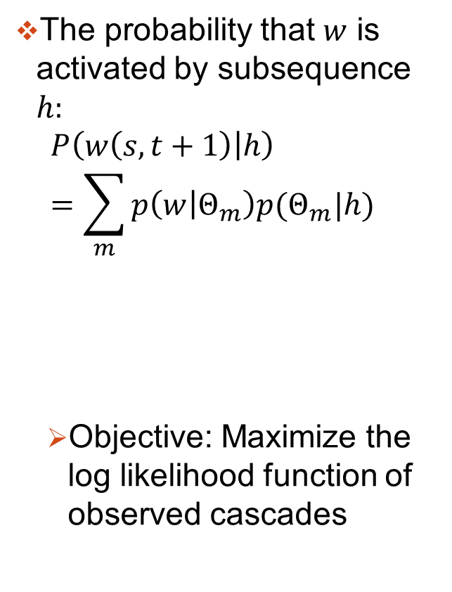
Motif-based Information Diffusion
A mixture of activation motifs
The probability that $w$ is activated by subsequence $h:$
$$P\left(w\left(s,t+1\right) | h\right)=\sum_{m}{p\left(w | Θ_{m}\right)p(Θ_{m}|h)}$$
Objective: Maximize the log likelihood function of observed cascades
Motif 1
Motif 2
. . . .
Motif k
Motif-based
Diffusion
Probabilities
w
motif-based diffusion prob.
Prob. that motif m is in effect

Slide 12
Content
1. Introduction
2. Problem Formulation
3. Experiment
4. Conclusion and Future Work
Notes:
.

Slide 13
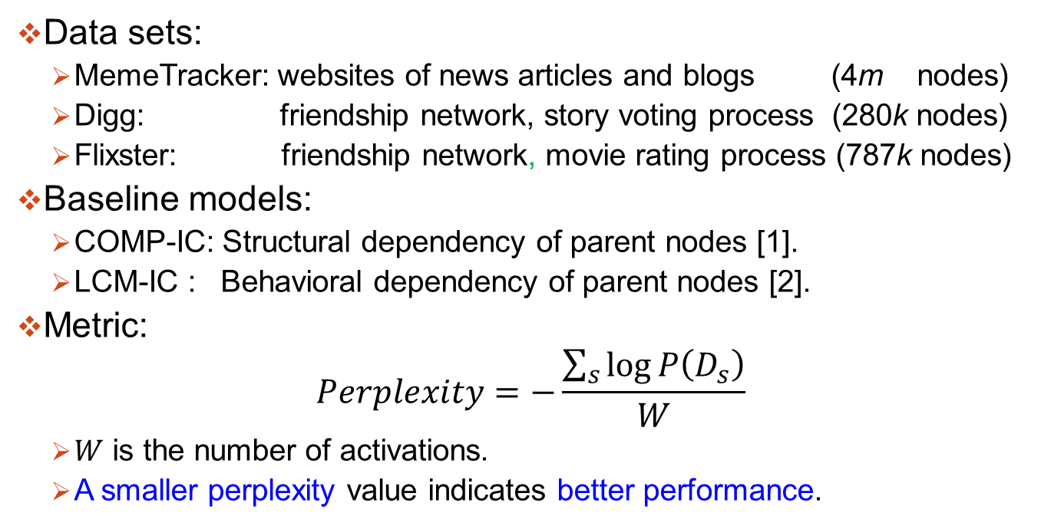
Experiment: Setup
Data sets:
MemeTracker: websites of news articles and blogs (4m nodes)
Digg: friendship network, story voting process (280k nodes)
Flixster: friendship network, movie rating process (787k nodes)
Baseline models:
COMP-IC: Structural dependency of parent nodes [1].
LCM-IC : Behavioral dependency of parent nodes [2].
Metric:
$$Perplexity=−\frac{\sum_{s}{\log{P\left(D_{s}\right)}}}{W}$$
$W$ is the number of activations.
A smaller perplexity value indicates better performance.
[1] Q. Bao, W. Cheung, and Y. Zhang, “Incorporating structural diversity of neighbors in a diffusion model for social networks,” in Proceedings of the 2013 IEEE/WIC/ACM International Joint Conference on Web Intelligence, Atlanta, GA, USA, 2013, pp. 431–438.
[2] Q. Bao, W.K. Cheung, J. Liu, and Y. Song. Inferring latent co-activation patterns for information diffusion. In Proceedings of the 2015 IEEE/WIC/ACM International Joint Conference on Web Intelligence, pages 485–492, Singapore, 2015.
Notes:
We use generative ability to measure the performance as the ground-truth is unknown, and use the perplexity over cascades as

Slide 14
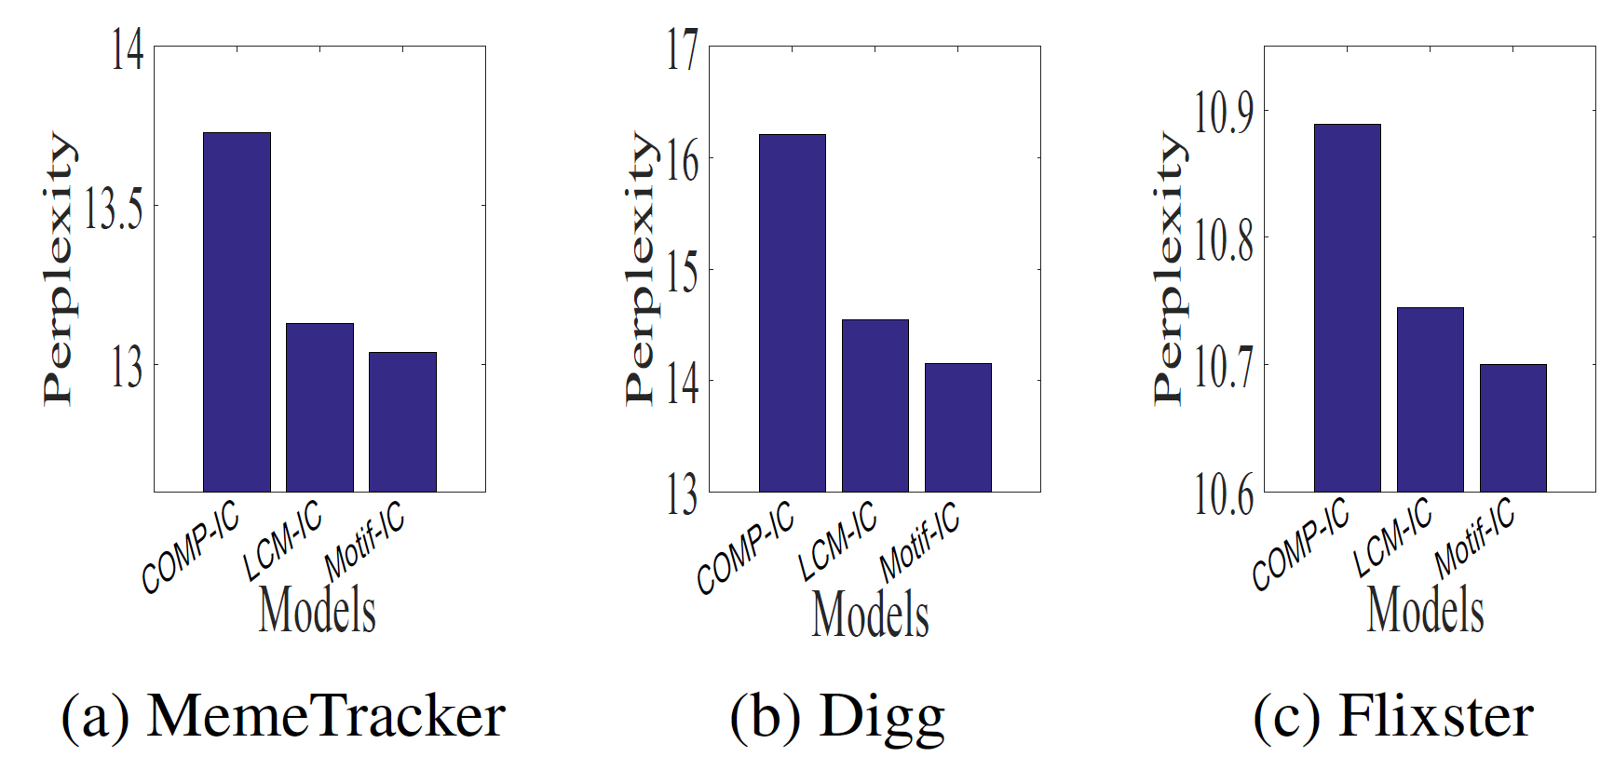
Experiment: Real Data Results
Notes:
Results:
Under Meme and Digg, LCM-IC outperforms all baseline models
With decrease in perplexity value of at least 0.54 and 1.66 respectively.
Under Flixster, give comparable performance.
Encouraging results: Since the structural information for modeling detailed relation of parent nodes is not used

Slide 15
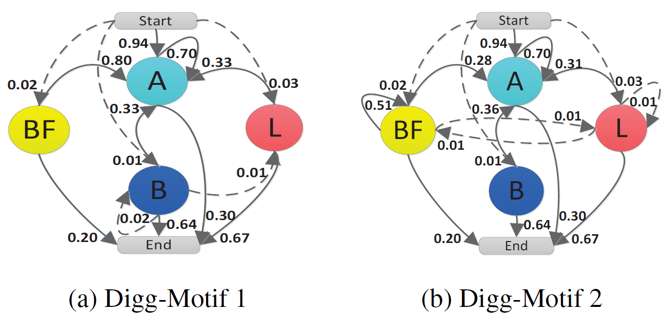

Inferred Motifs – Digg friendship network
Temporal Activation Motifs $Θ_{m}$:
Frequent subsequences generated by $Θ_{m}$:
Digg-Motif 1: A….A
started and followed up mostly by global influential users
Digg-Motif 2: BF BF…BF A
some story votings among big fish users first
Ambassador (A):
global influential users
Big Fish (BF):
leaders in a small field

Slide 16
Conclusion and Future Work
Propose a motif-based information diffusion model
Latent temporal activation motifs are inferred together with diffusion model under a unified framework.
The inferred temporal activation motifs can be interpreted as the underlying interaction mechanisms for the diffusion.
Future work
How the inferred diffusion specific motifs are related to the different types of events under different topics?

Slide 17
Thank you!
Q&A

