Slide 1

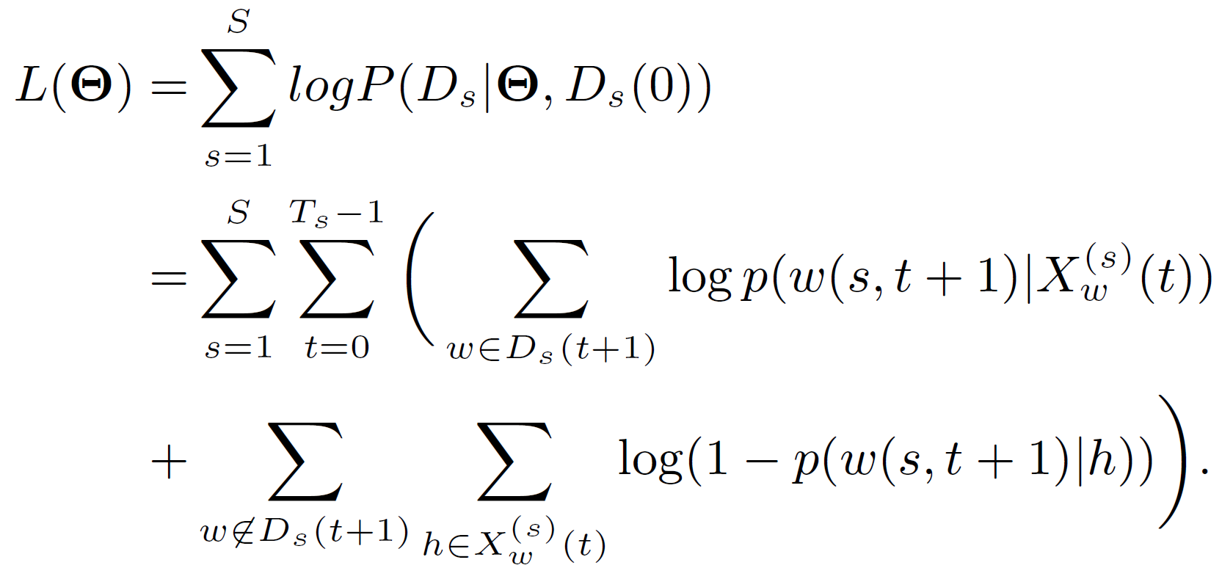
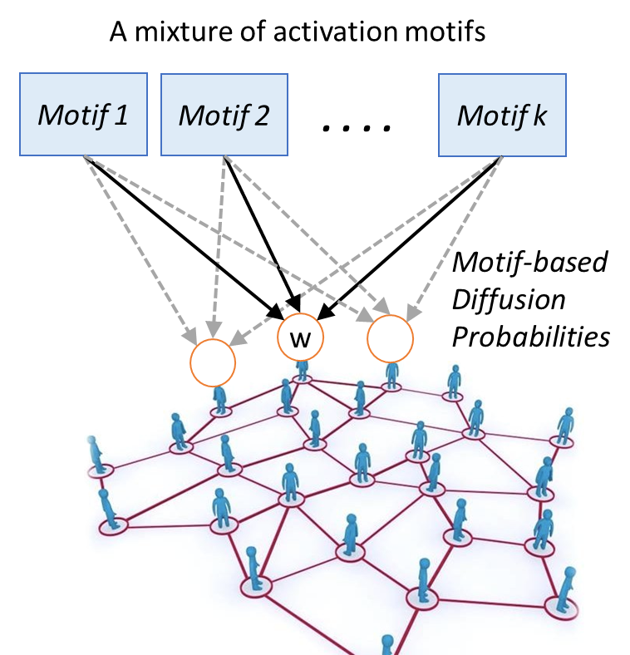
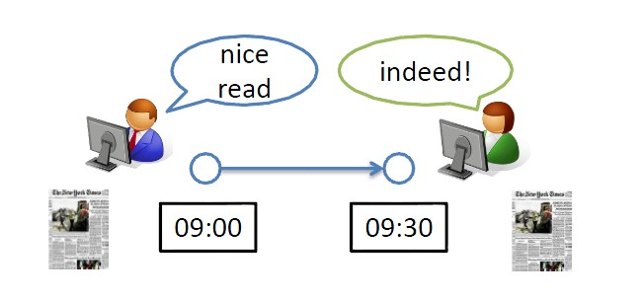
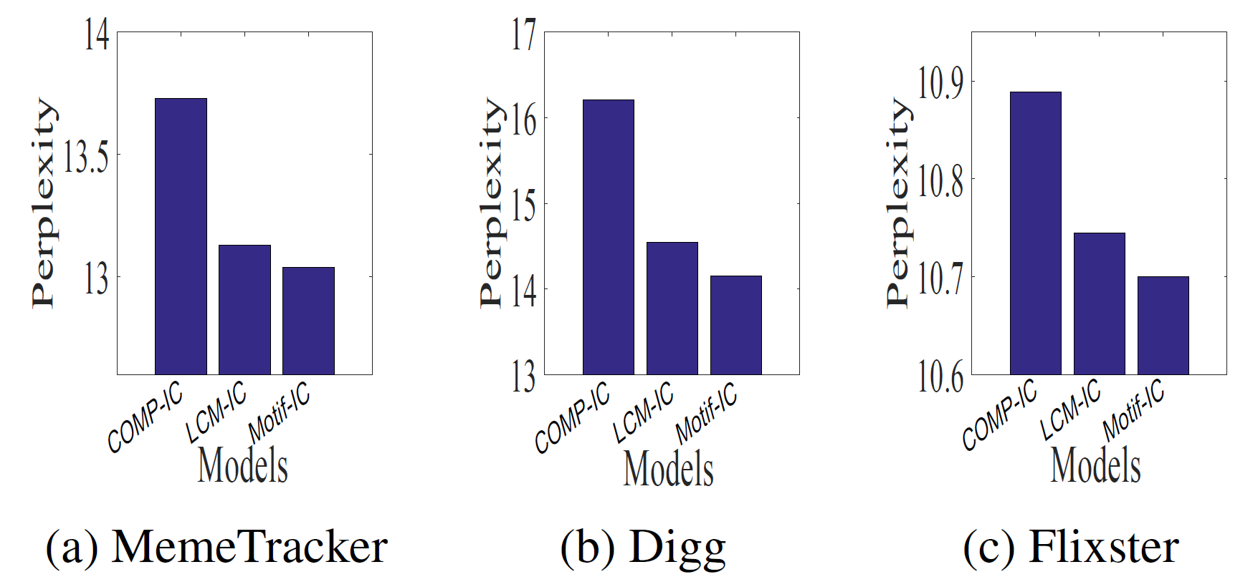
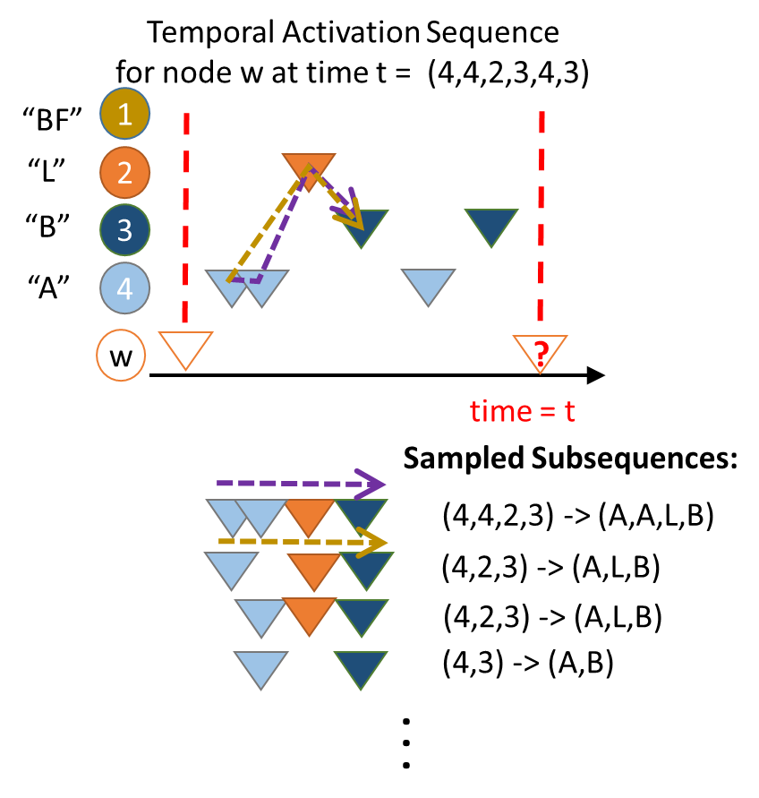
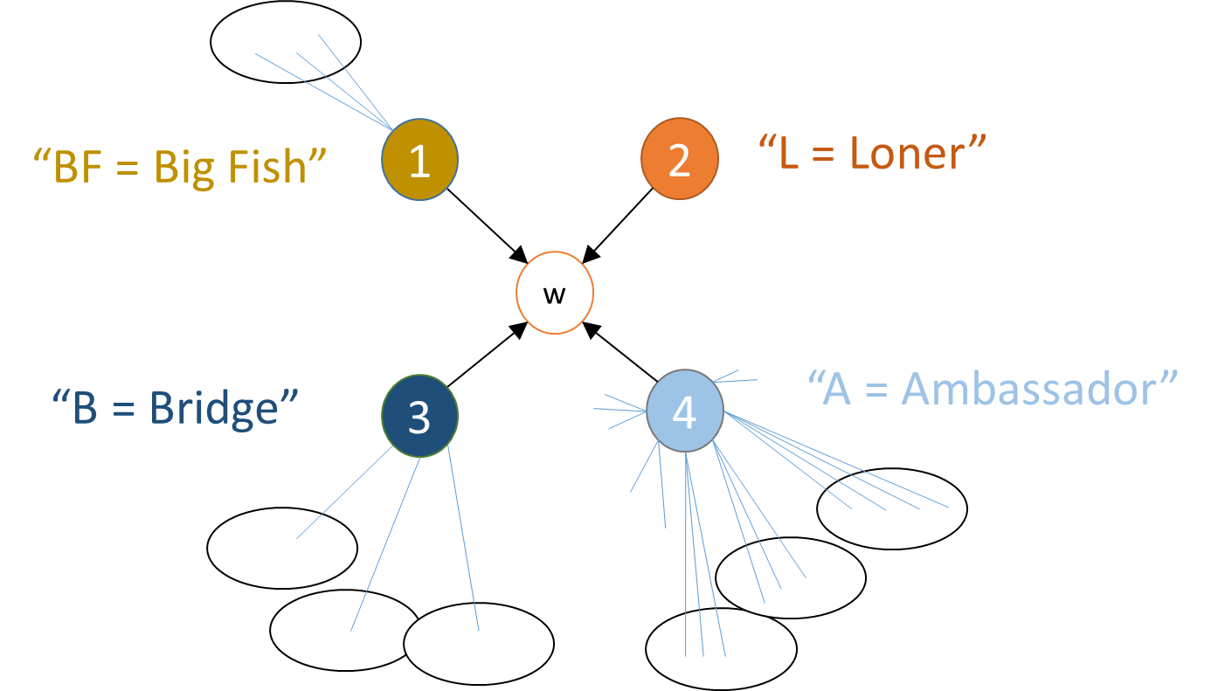
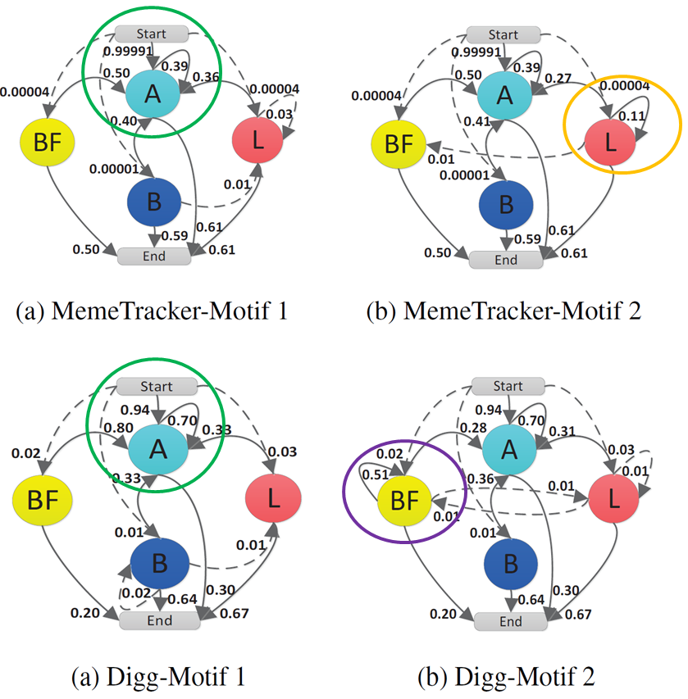
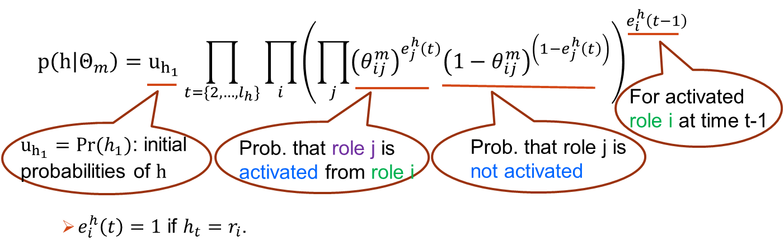



Inferring Motif-based Diffusion Models for Social Networks
Qing Bao, William K. Cheung and Jiming Liu
Department of Computer Science, Hong Kong Baptist University
{qingbao,william,jiming}@comp.hkbu.edu.hk
Motivation
4) Motif-based Information Diffusion
The probability that $w$ is activated by subsequence $h:$
$$P\left(w\left(s,t+1\right) | h\right)=\sum_{m}{p\left(w | Θ_{m}\right)p(Θ_{m}|h)}$$
The probability that $w$ is activated at time step $t+1$ in the $s^{th}$ cascade: $P\left(w\left(s,t+1\right) | X_{w}^{\left(s\right)}(t)\right)=1 −\prod_{h∈X_{w}^{\left(s\right)}(t)}{(1−p(w(s,t+1)|h))}$
Log Likelihood function:
5) Methodology: maximize log likelihood function (EM algorithm)
Diffusion: the phenomenon that an action or information spreads from one node to another via edges in a network.
Diffusion models: to understand how information spreads, with applications like influence maximization.
We propose that the activations of parent nodes of each node form latent over represented temporal interaction patterns (or called motifs) serving as underlying mechanisms causing the observed information cascades.
Experiments
Data sets:
MemeTracker: websites of news articles and blogs (4m nodes)
Digg: friendship network, story voting process (280k nodes)
Flixster: friendship network, movie rating process, (787k nodes)
Baseline models:
COMP-IC: Structural dependency of parent nodes
LCM-IC: Behavioral dependency of parent nodes
Metric:$Perplexity=−\frac{\sum_{s}{\log{P\left(D_{s}\right)}}}{W}$. Smaller perplexity better.
Results:
Inferred Motifs:
Similar Motif1: started and followed up mostly by major news websites/global influential users.
Different Motif2: MemeTracker. some posting interactions among weblogs first. Digg, some story votings among big fish users first.
Proposed Method
1) Social roles $R\left(v\right)≔\left\{r_{1},…,r_{n}\right\}$ with structure information.
Motifs attributed with social roles: Peoples’ attention may not be caught by just discussion of some so-so friends until a reputable friend steps in.
2) Activation sequence and subsequence from parent nodes’ activations attributed with social roles.
3) Temporal Activation Motifs generating the sequence:
$k$ stochastic temporal activation motifs, $Θ=\left\{Θ_{1},…,Θ_{k}\right\}$ , $Θ_{m}={\left(θ_{ij}^{m}\right)}_{n×n}$, ${ θ}_{ij}^{m}$: probability to transit from role $i$ to role $j$.
Probability that subsequence $h$ is generated by the $m^{th}$ motif:
 | High degree | Low degree
Connected to many communities | Ambassador High Global Influence | Bridge Bridging knowledge exchange of communities
Connected to less communities | Big Fish High Local Influence | Loner Being alone
Ambassador (A): various topics
Big Fish (BF):
specific domains
Bridge (B):
several domains
Loner (L):
weblog sites
Ambassador (A):
global influence
Big Fish (BF):
leaders in a small field
Bridge (B):
bridging knowledge exchange among communities
Loner (L):
playing alone

