Slide 1
Incorporating Structural Diversity of Neighbors in a Diffusion Model for Social Networks
Qing Bao, William K. Cheung, and Yu Zhang
Department of Computer Science
Hong Kong Baptist University

Slide 2
Content
1. Introduction
2. Problem Formulation
3. Methodology
4. Experiment
5. Conclusion and Future Work
Notes:
.

Slide 3
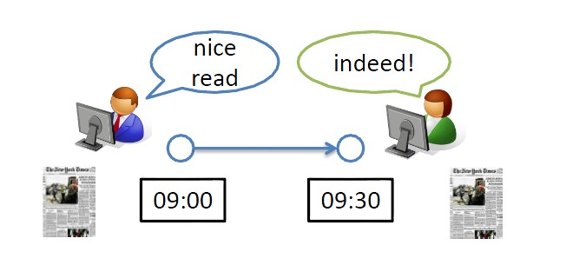

Introduction - Background
Diffusion
The phenomenon that an action or information spreads from one node to another via edges in a network.
Network environments
E.g., social networks, contact networks
Models
The Independent Cascade Model (IC Model)
The Linear Threshold Model (LT Model)
Applications
Viral-marketing (influence maximization)
Disease control (influence minimization)
Notes:
Find key target consumers who can spread the information to as many consumers as possible. Make product promotions to them.
Find key patients. Eliminate disease on them to prevent them spread the disease to as many people as possible
Given the models, have some applications

Slide 4
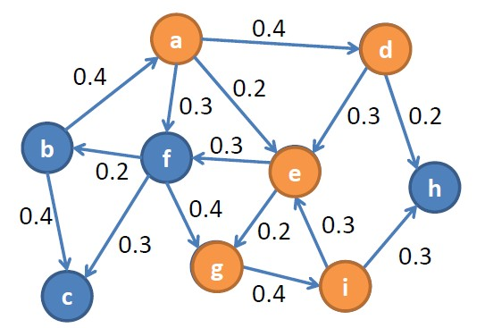
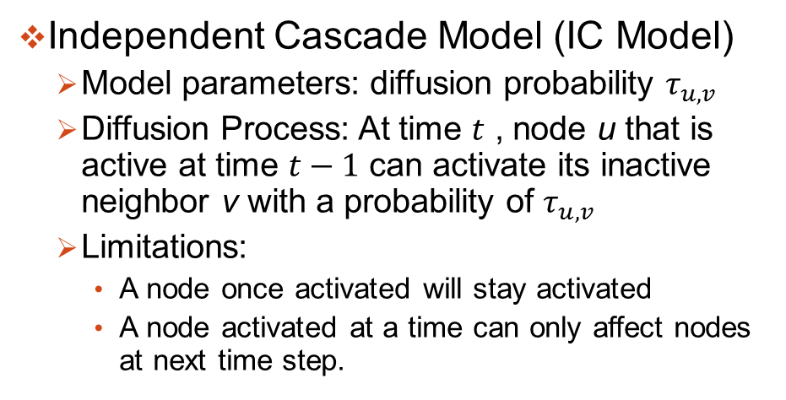
Introduction – Related Work
Independent Cascade Model (IC Model)
Model parameters: diffusion probability $τ_{u,v}$
Diffusion Process: At time $t$ , node u that is active at time $t−1$ can activate its inactive neighbor v with a probability of $τ_{u,v}$
Limitations:
A node once activated will stay activated
A node activated at a time can only affect nodes at next time step.
Notes:
The assumption in IC Model is simple, extensions for more accurately modeling:
1) The influence of a node activation follows an exponential decay. (W. Lee etc.)
2) A node is allowed to activate multiple times (M. Kimura etc.).
3) Allowing continuous tries by neighbors (S. Foster etc.).
However, most of the existing work does not consider the effect of structural diversity of the neighbors on node activation.
Base on example of blogs (more interested in recent news)
(can post several posts)
Not just once, when you revisit the post again, you may be motivated by the idea although you are not motivated before.

Slide 5
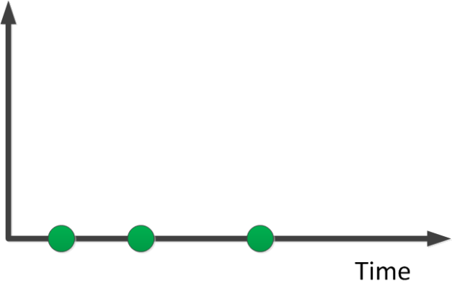
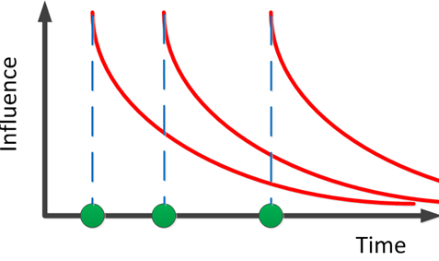
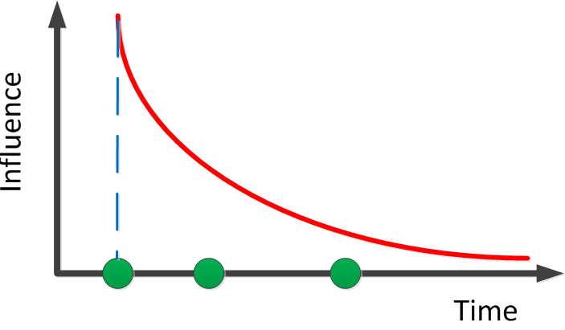
Introduction – Related Work
IC extensions considered in this work
Multiple times of being activated [1]
Exponential decay of activation influence [2]
Activation influence over subsequent time steps [3]
[1] M. Kimura, K. Saito, and H. Motoda, “Efﬁcient estimation of inﬂuence functions for sis model on social networks,” in Proceedings of the 21st International Joint Conference on Artiﬁcial Intelligence (IJCAI’09), San Francisco, CA, USA, 2009, pp. 2046–2051.
[2] W. Lee, J. Kim, and H. Yu, “CT-IC: Continuously activated and time-restricted independent cascade model for viral marketing,” in Proceedings of the 12th International Conference on Data Mining (ICDM’12), Brussels, Belgium, 2012, pp. 960–965.
[3] S. Foster, W. Potter, J. Wu, B. Hu, and Y. Zhang, “A history sensitive cascade model in diffusion networks,” in Proceedings of the 2009 Spring Simulation Multiconference (SpringSim’09), San Diego, CA,USA, 2009.

Slide 6
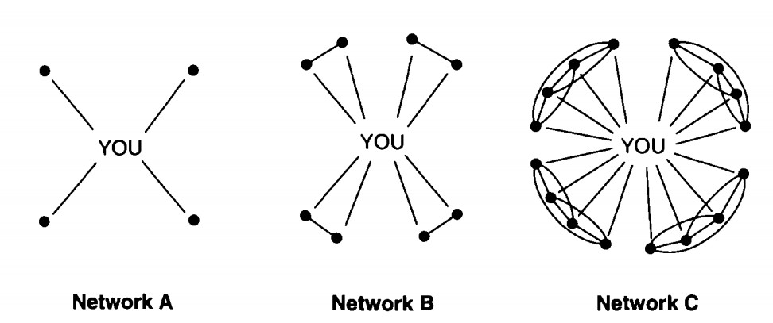
Introduction – Motivation
Neighborhood Structure [1]
Contacts are redundant to the extent that they lead to the same people and so provide the same information benefits [1]
It is the number of non-redundant contacts matters!!
[1] R. S. Burt, Structural Holes: The Social Structure of Competition. Cambridge, MA: Harvard University Press, 1992.
Notes:
Number of non-redundant contacts that matters, not how many friends

Slide 7
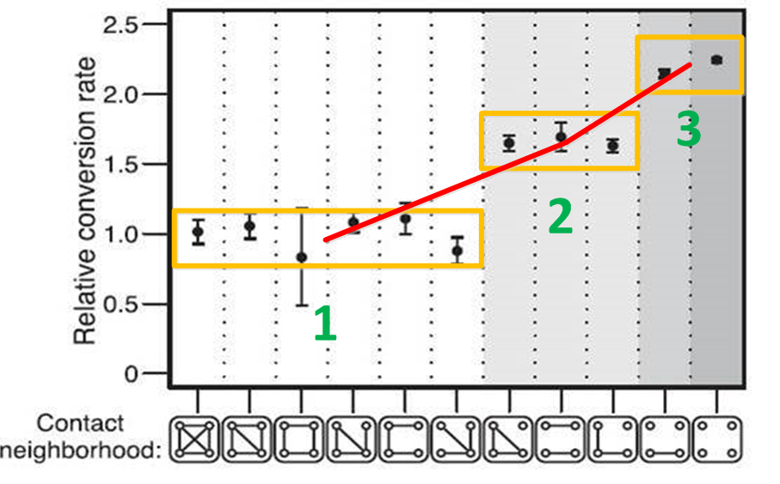
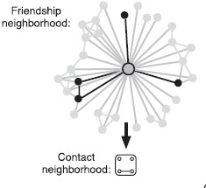

Introduction – Motivation
Positive correlation with the number of connected components [1]
A striking stratification of acceptance probabilities by the number of connected components in Facebook contact neighborhood.
IC Model assumes independent influence of each neighbor.
We consider structure diversity for independent influence of components.
[1] J. Ugander, L. Backstrom, C. Marlow, and J. Kleinberg, “Structural diversity in social contagion,” Proceedings of the National Academy of Sciences, vol. 109, pp. 5962–5966, Apr. 2012.
Notes:
Contact neighborhood: users possessing the person’s e-mail address.
We loose the assumption by considering structure diversity.
Facebook users invites friends to use Facebook by invitation.
For a person A, we define this set of Facebook users possessing A’s e-mail address to be A’s contact neighborhood in Facebook.

Slide 8



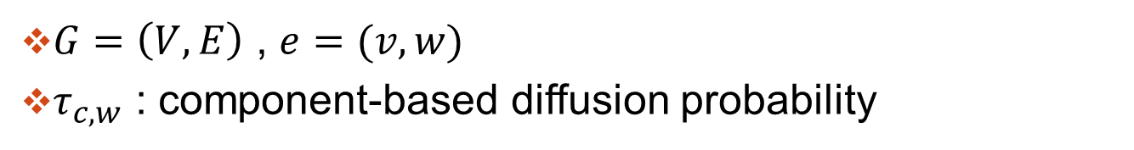

Problem Formulation
$G=\left(V,E\right)$ , $e=(v,w)$
$τ_{c,w}$ : component-based diffusion probability
$$τ_{c_{1},w}$$
$$τ_{c_{2},w}$$
$$C_{1}$$
$$C_{2}$$
Notes:
Fig. 1 illustrates a node w and its neighborhood b(w) = {v1; v2; v3; v4; v5; v6}. The neigh-
borhood form two components, which is B(w) = {B1(w) = C1;B2(w) = C2}. And each
component consists of interconnected nodes, i.e., C1 = {v1; v2; v3} and C2 = {v4; v5; v6}. Thus,
the component-based diusion probability are C1;w and (C2;w) respectively.

Slide 9
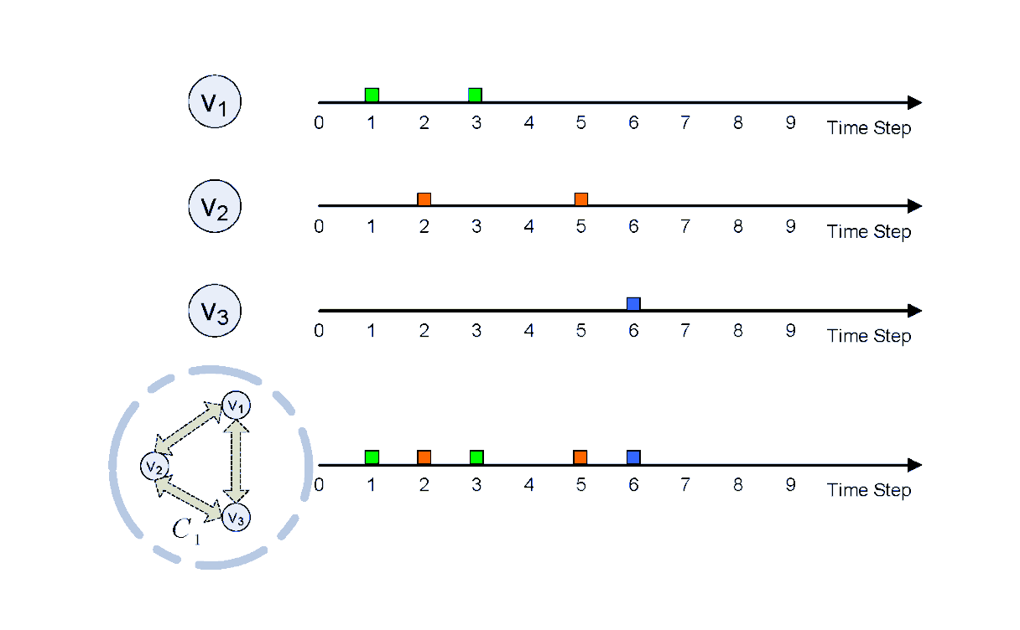
Problem Formulation
The activations within a component: The union of activations of each node
Notes:
From the view of component, we consider the activations of all nodes inside the component.
Then, based on the diffusion probabilities {c;w} associated to the active components, some of the corresponding nodes w will be activated accordingly.
To infer an accurate diffusion model, it is expected that the
overall probability of generating all the observed cascades {Ds} should be maximized.

Slide 10
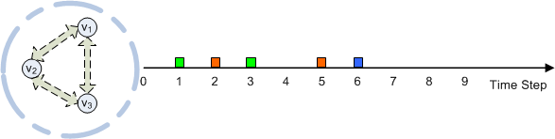
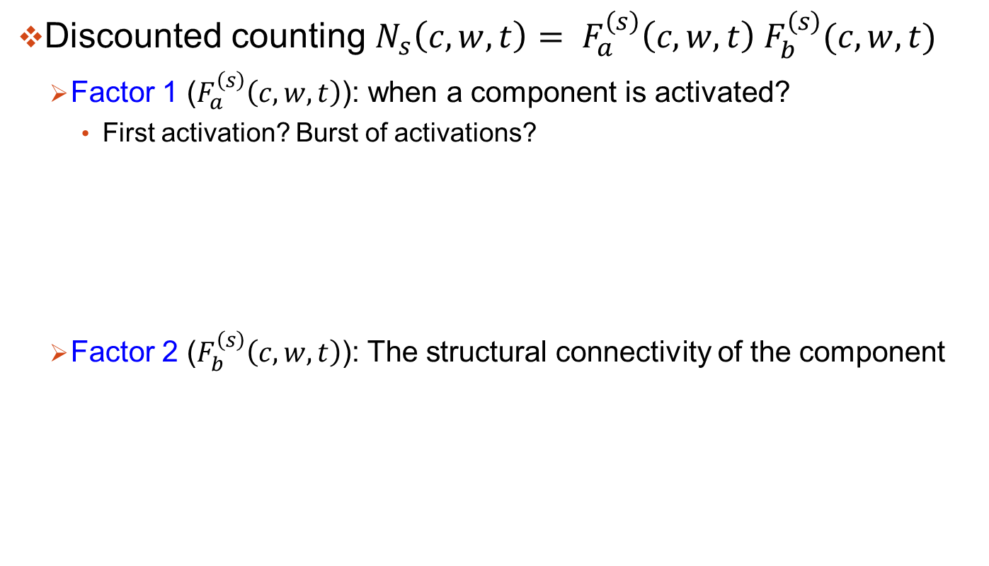
Problem Formulation - component activation
Discounted counting ${N_{s}\left(c,w,t\right)= F}_{a}^{\left(s\right)}\left(c,w,t\right) F_{b}^{\left(s\right)}(c,w,t)$
Factor 1 ($F_{a}^{\left(s\right)}\left(c,w,t\right)$): when a component is activated?
First activation? Burst of activations?
Factor 2 ($F_{b}^{\left(s\right)}\left(c,w,t\right)$): The structural connectivity of the component
Notes:
The degree of influence on the node with the component as its parent could be affected by
we allow the counting of each activation to be discounted by${ N}_{s}^{}\left(c,w,t\right)$ ,

Slide 11
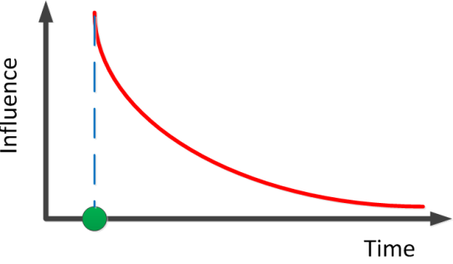
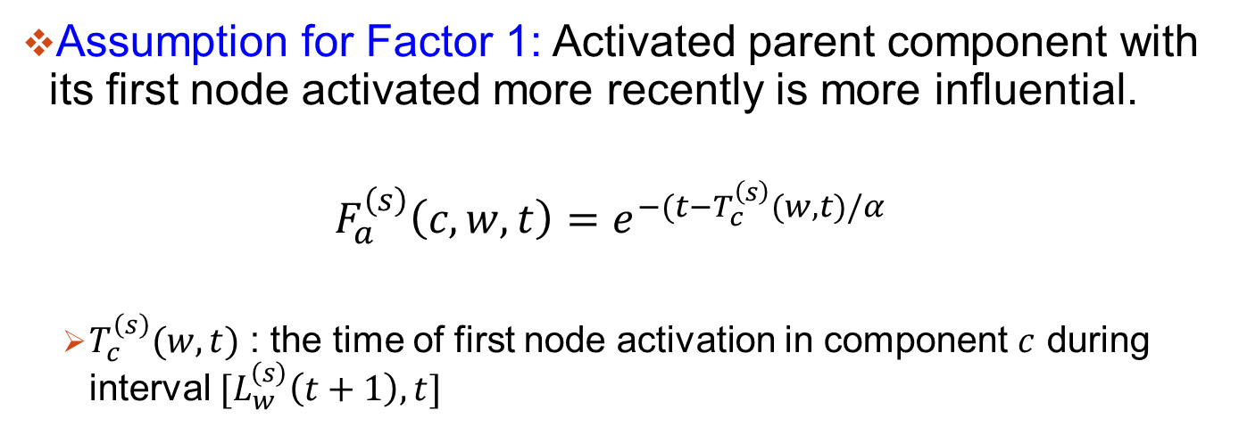
Problem Formulation
Assumption for Factor 1: Activated parent component with its first node activated more recently is more influential.
$$F_{a}^{\left(s\right)}\left(c,w,t\right)=e^{−(t−T_{c}^{\left(s\right)}(w,t)/α}$$
$T_{c}^{\left(s\right)}(w,t)$ : the time of first node activation in component $c$ during interval $[L_{w}^{\left(s\right)}\left(t+1\right),t]$
Notes:
We define for a node $w$which may get activated at time step $t+1$using an exponential decay, as

Slide 12
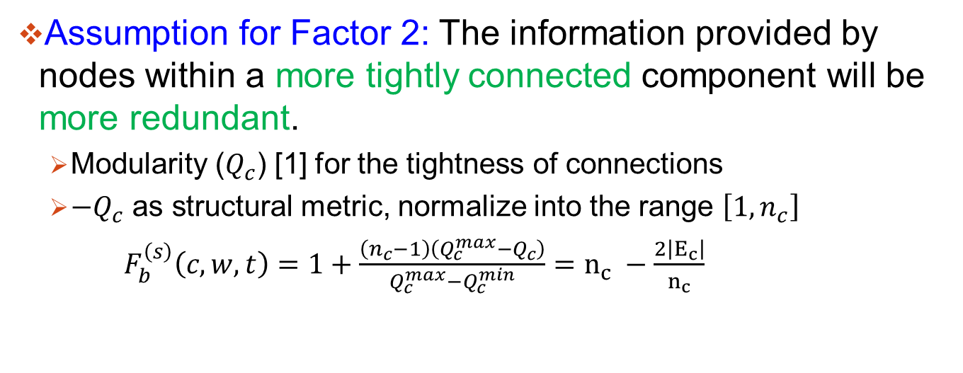
Problem Formulation
Assumption for Factor 2: The information provided by nodes within a more tightly connected component will be more redundant.
Modularity ($Q_{c}$) [1] for the tightness of connections
$−Q_{c}$ as structural metric, normalize into the range $\left[1,n_{c}\right]$
$F_{b}^{\left(s\right)}\left(c,w,t\right)=1+\frac{\left(n_{c}−1\right)\left(Q_{c}^{max}−Q_{c}\right)}{Q_{c}^{max}−Q_{c}^{min}}=n_{c} −\frac{2\left|E_{c}\right|}{n_{c}}$
[1] A. Clauset, M. E. J. Newman, and C. Moore, “Finding community structure in very large networks,” Physical Review E, vol. 70, Dec.2004.
Notes:
We use $−Q_{c}$ as structural metric, and normalize the values into the range $\left[1,n_{c}\right].$

Slide 13
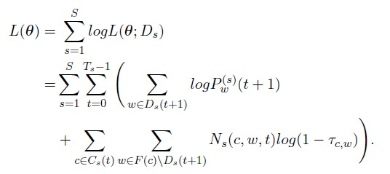

Problem Formulation
Log likelihood function:
Node $w$ becomes active at time $t + 1$ with probability:
$P_{w}^{\left(s\right)}(t+1)=1−\prod_{c∈B\left(w\right)∩C_{s}(t)}{{\left(1−τ_{c,w}\right)}^{N_{s}(c,w,t)}}$
Objective: Estimating $θ=\{τ_{c,w}\}$ to maximize the log likelihood function
Notes:
The problem for inferring the diffusion network thus becomes estimating the set of information diffusion probabilities, $θ=\{τ_{v,w}\}$ which maximizes the log likelihood function.

Slide 14

Methodology
We derive an EM algorithm to infer the model parameters.
E-step: Estimating $P_{w}^{\left(s\right)}(t)$
M-step: Update $θ=\{τ_{c,w}\}$

Slide 15
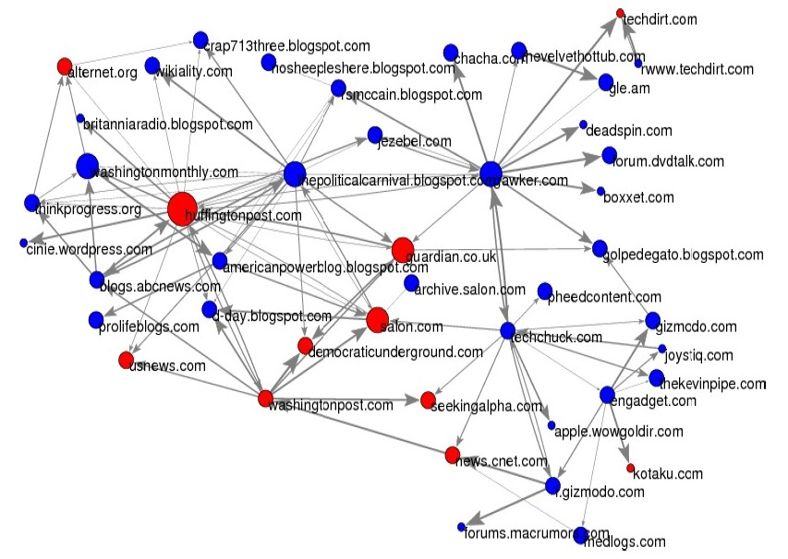

Experiment: Data Set
MemeTracker: websites of news articles and blogs http://www.memetracker.org/
$4$million nodes, $13$ million edges, $71568$ cascades

Slide 16
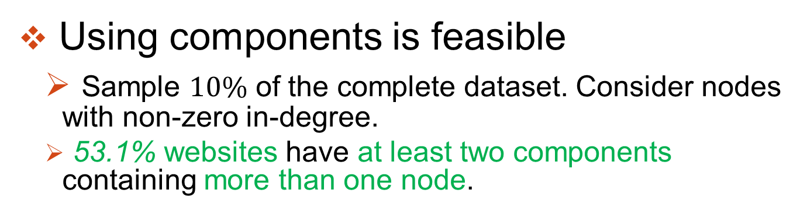
Experiment: Structural Diversity Valid?
Using components is feasible
Sample $10\%$ of the complete dataset. Consider nodes with non-zero in-degree.
53.1% websites have at least two components containing more than one node.

Slide 17
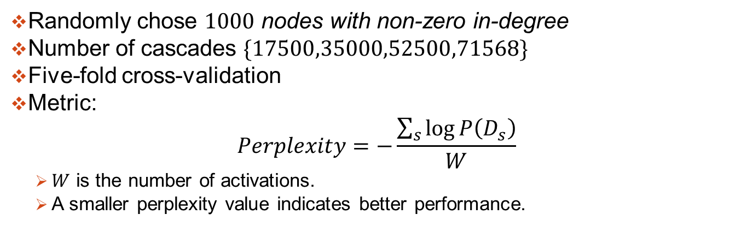
Experiment: Setup
Randomly chose $1000$ nodes with non-zero in-degree
Number of cascades $\{17500,35000,52500,71568\}$
Five-fold cross-validation
Metric:
$$Perplexity=−\frac{\sum_{s}{\log{P\left(D_{s}\right)}}}{W}$$
$W$ is the number of activations.
A smaller perplexity value indicates better performance.
Notes:
We use generative ability to measure the performance as the ground-truth is unknown, and use the perplexity over cascades as

Slide 18
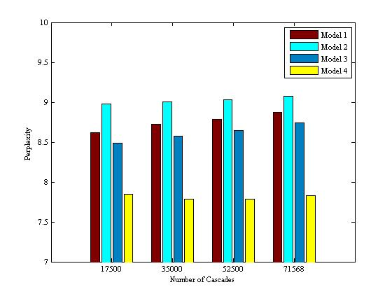
Experimental Results
1: IC
2: decay
3: decay+
component
4: decay+
component structure
Perplexity
# Cascades
The performance was improved significantly after adding the component modularity.
Notes:
Fig. 5 showed the average perplexity under ve-fold cross validation for the above four models
with dierent numbers of cascades. For each model, the performance remained stable with
a slight decrease with dierent numbers of cascades. This showed that the dierence caused
by dierent numbers of activations doesn't lead to apparent decrease in performance.

Slide 19
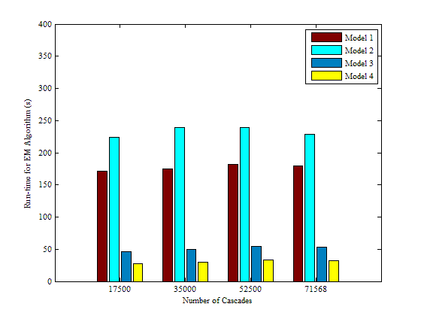
Experiment
1: IC
2: decay
3: decay+
component
4: decay+
component structure
Time for EM(s)
# Cascades
The run-time for the EM algorithm is reduced significantly:
The number of parent components no more than the number of parent nodes.

Slide 20
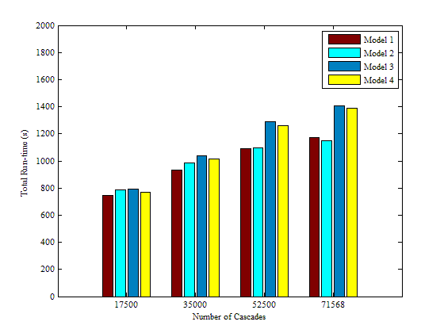
Experiment
Overall run-time is increased：
The calculation involves integration of nodes‘ activations in each parent component.
1: IC
2: decay
3: decay+
component
4: decay+
component structure
Total Time (s)
# Cascades
Notes:
And a reasonable increase in run-time for the models with parent components is due to the calculation of which involves integration of nodes' activations in each parent component.
The run-time was comparably longer
because calculation of the discounted counting Ns(c;w; t) from the activation logs occupied large
part of run-time.

Slide 21
Conclusion and Future Work
Extension of IC Model with the structure diversity of neighbors incorporated
An EM algorithm to estimate the model parameters
The new model can more accurately model diffusion process in social networks
Future work
Application of the model in other diffusion-based data sets
Extension of the model with detailed diffusion mechanism
Notes:
Our empirical result on a real dataset shows that after incorporating structural diversity, there is a significant improvement in the generative ability of the proposed model. The new model can more accurately model diffusion process in social networks.

Slide 22
Thank you!
Q&A

