Slide 1
Latent Co-activation Patterns for Information Diffusion
Qing Bao¹, William K. Cheung¹, Jiming Liu¹ and Yunya Song²
¹Department of Computer Science, ²Department of Journalism
Hong Kong Baptist University

Slide 2
Content
1. Introduction
2. Problem Formulation
3. Methodology
4. Experiment
5. Conclusion and Future Work
Notes:
.

Slide 3


Introduction - Diffusion
Diffusion
The phenomenon that an action or information spreads from one node to another via edges in a network.
Cascade
The chain reaction of the action/information in the diffusion.
Network environments
E.g., social networks, information networks
Models
The Independent Cascade Model (IC Model)
The Linear Threshold Model (LT Model)
Network of news media websites.
Hyperlinks as edges.
Notes:
Find key target consumers who can spread the information to as many consumers as possible. Make product promotions to them.
Find key patients. Eliminate disease on them to prevent them spread the disease to as many people as possible
Given the models, have some applications

Slide 4
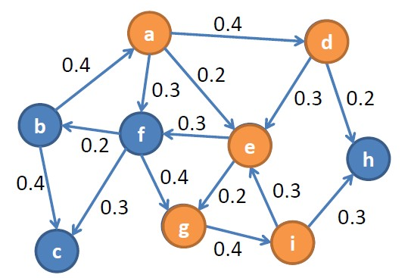
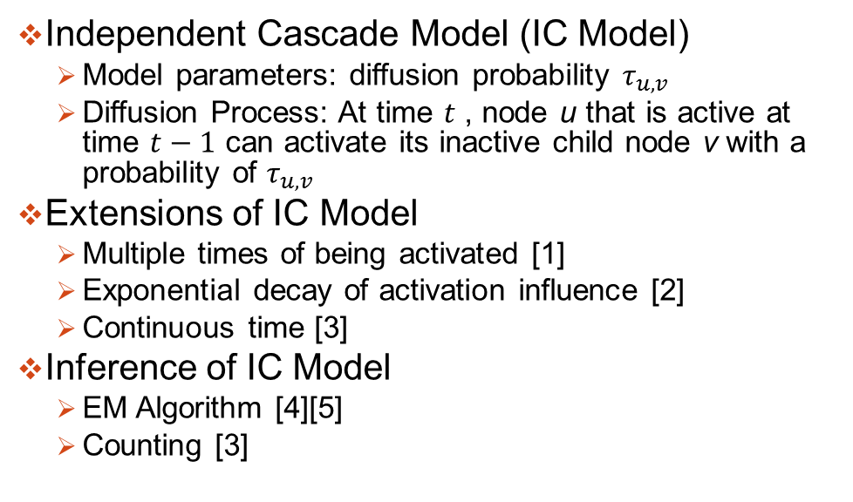
Introduction – IC Model
Independent Cascade Model (IC Model)
Model parameters: diffusion probability $τ_{u,v}$
Diffusion Process: At time $t$ , node u that is active at time $t−1$ can activate its inactive child node v with a probability of $τ_{u,v}$
Extensions of IC Model
Multiple times of being activated [1]
Exponential decay of activation influence [2]
Continuous time [3]
Inference of IC Model
EM Algorithm [4][5]
Counting [3]
[1] M. Kimura, K. Saito, and H. Motoda, “Efﬁcient estimation of inﬂuence functions for sis model on social networks,” in Proceedings of the 21st International Joint Conference on Artiﬁcial Intelligence (IJCAI’09), San Francisco, CA, USA, 2009, pp. 2046–2051.
[2] W. Lee, J. Kim, and H. Yu, “CT-IC: Continuously activated and time-restricted independent cascade model for viral marketing,” in Proceedings of the 12th International Conference on Data Mining (ICDM’12), Brussels, Belgium, 2012, pp. 960–965.
[3] A. Goyal, F. Bonchi, and L. V. Lakshmanan, “Learning influence probabilities in social networks,” in
proceedings of the 3rd ACM International Conference on Web Search and Data Mining, New York, NY, USA, 2010, pp. 241–250.
[4] K. Saito, R. Nakano, and M. Kimura. Prediction of information diffusion probabilities for independent cascade model. In Proceedings of the 12th International Conference on Knowledge-Based Intelligent Information and Engineering Systems (KES’08).
[5] N. Barbieri, F. Bonchi, and G. Manco, “Influence-based network-oblivious community detection,” in Proceedings of the 13th IEEE International Conference on Data Mining, Dallas, TX, USA, 2013, pp. 955–960.
Notes:
The assumption in IC Model is simple, extensions for more accurately modeling:
1) The influence of a node activation follows an exponential decay. (W. Lee etc.)
2) A node is allowed to activate multiple times (M. Kimura etc.).
3) Allowing continuous tries by neighbors (S. Foster etc.).
However, most of the existing work does not consider the effect of structural diversity of the neighbors on node activation.
Base on example of blogs (more interested in recent news)
(can post several posts)
Not just once, when you revisit the post again, you may be motivated by the idea although you are not motivated before.

Slide 5
Introduction – Motivation
Limitations of IC Model:
The influence of each parent node u on v is assumed to be independent
Related work on dependency: Connected Components
The user engagement in Facebook affected by number of connected components of user instead of individual users [1]
A component-based diffusion model, the influence of parent nodes exerted by connected components. Better prediction results [2]
Limitation: The grouping of parent nodes is merely based on structure.
We propose to group parents nodes based on cascades.
[1] J. Ugander, L. Backstrom, C. Marlow, and J. Kleinberg, “Structural diversity in social contagion,” Proceedings of the National Academy of Sciences, vol. 109, pp. 5962–5966, Apr. 2012.
[2] Q. Bao, W. Cheung, and Y. Zhang, “Incorporating structural diversity of neighbors in a diffusion model for social networks,” in Proceedings of the 2013 IEEE/WIC/ACM International Joint Conference on Web Intelligence, Atlanta, GA, USA, 2013, pp. 431–438.

Slide 6
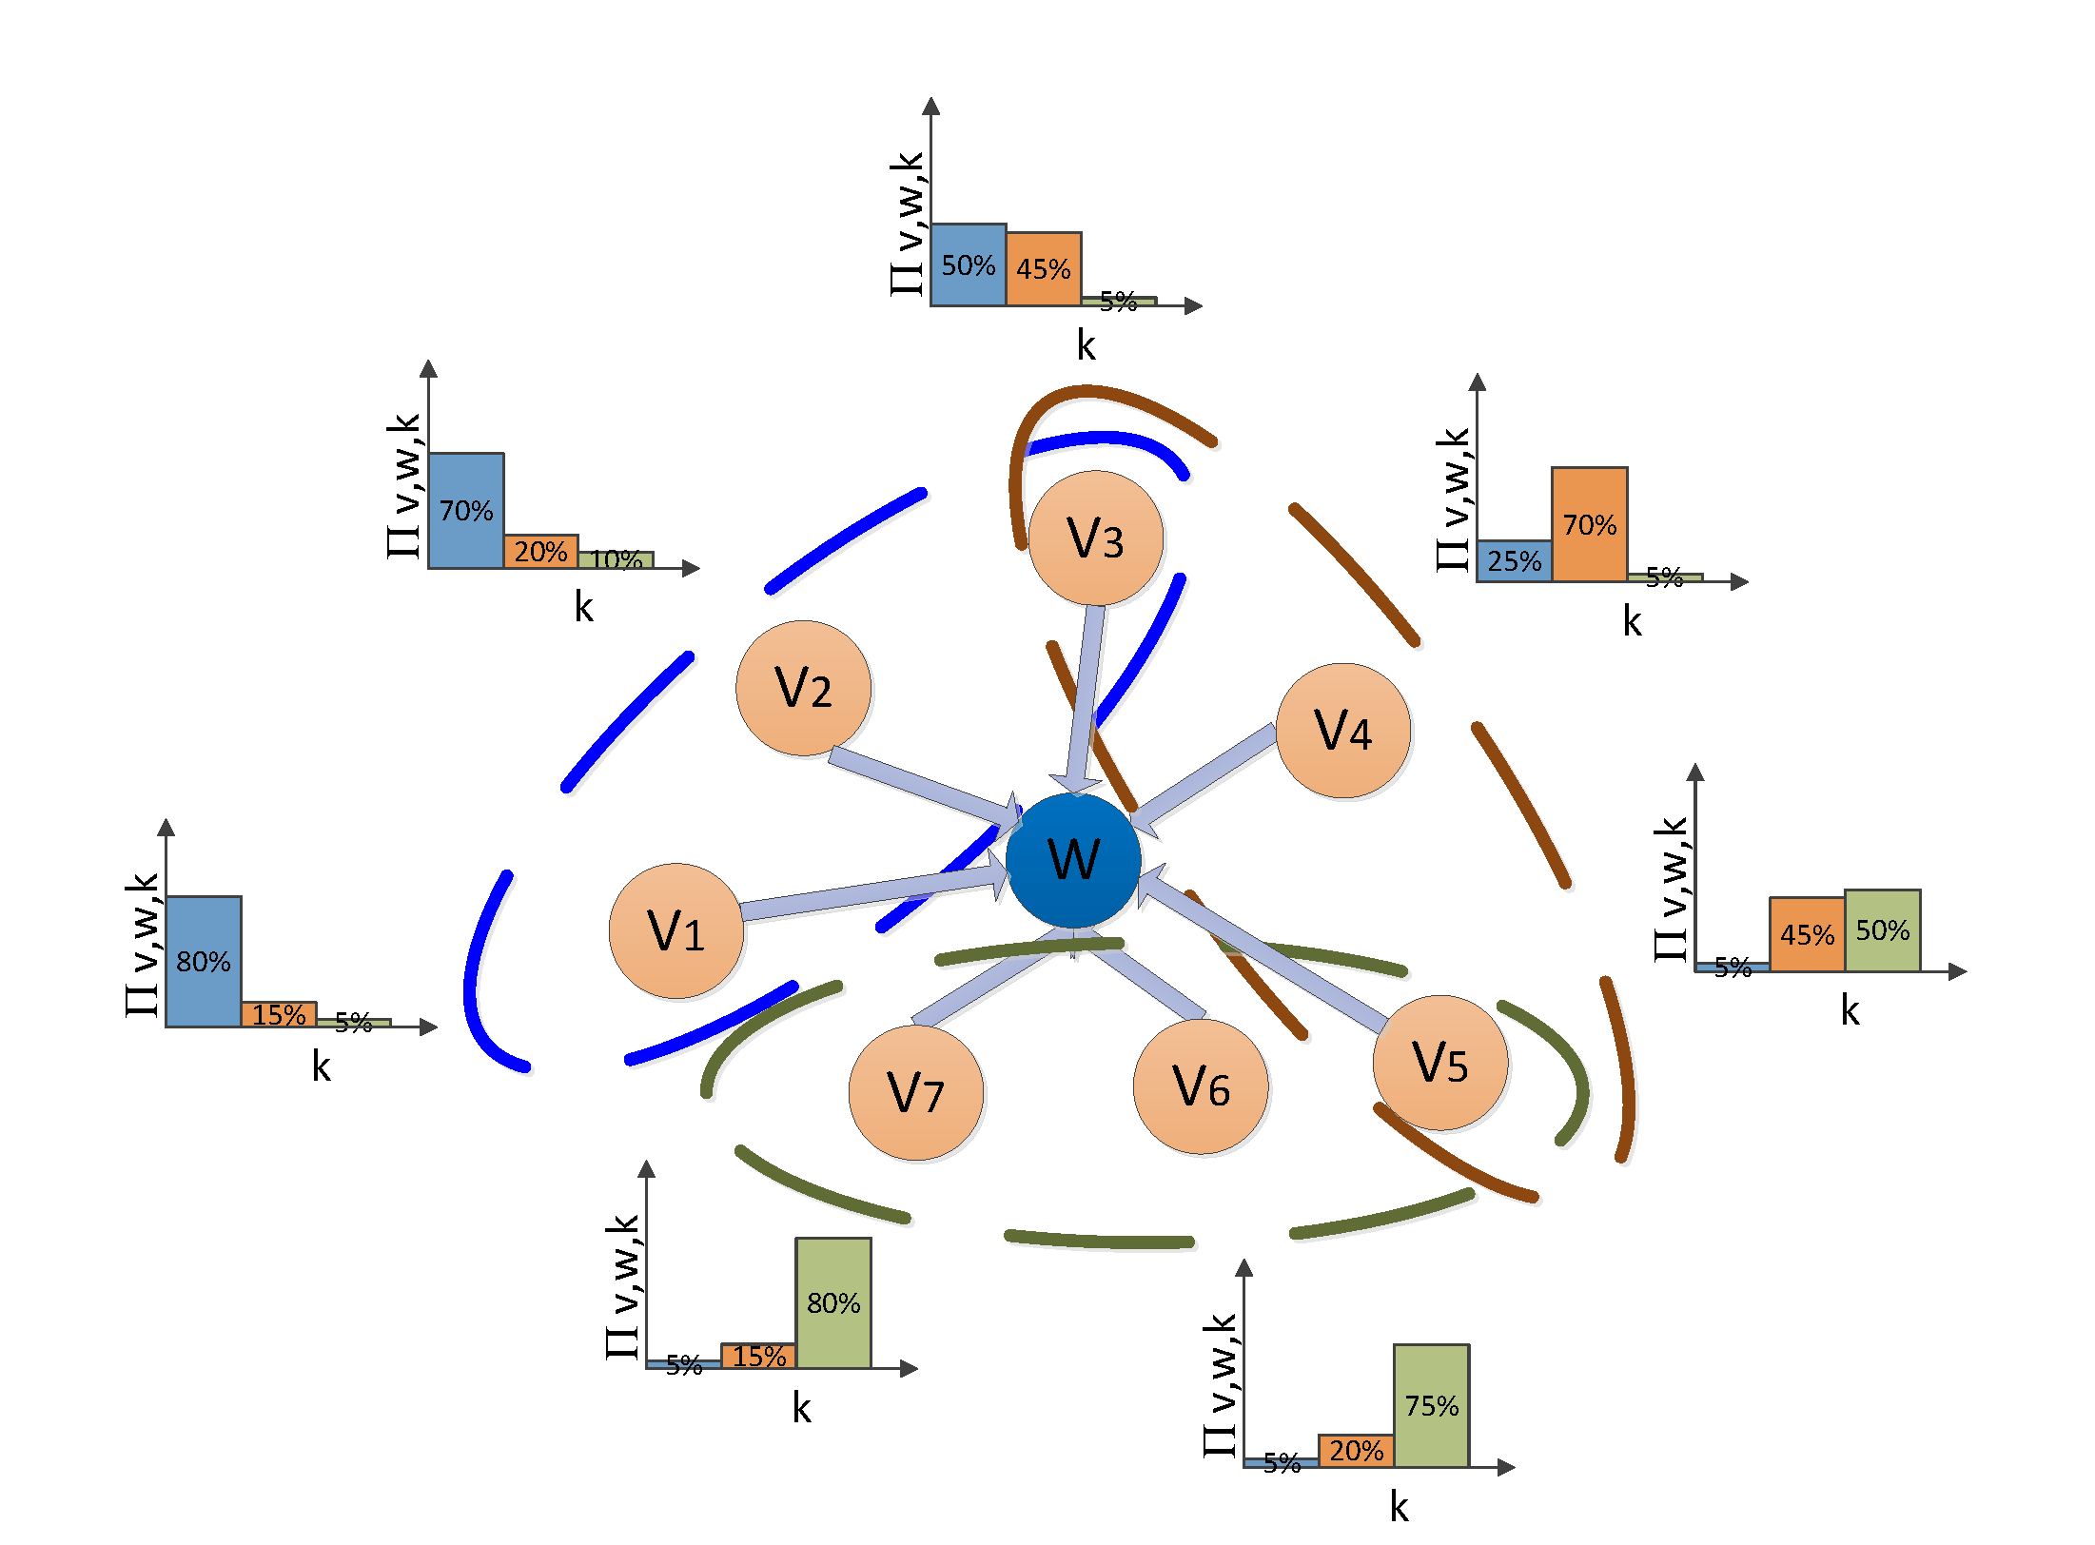
Problem Formulation – Our Proposed Model
The activation of a node is caused by latent co-activation patterns of parent nodes.
The co-activation patterns can overlap.
The probabilities to belong to different patterns.
Use a latent class model:
For each parent node activation, first projection to latent patterns, then projection to node w.
Better prediction results: robust with missing data and noise
Recovered latent structure meaningful
Co-activation patterns

Slide 7
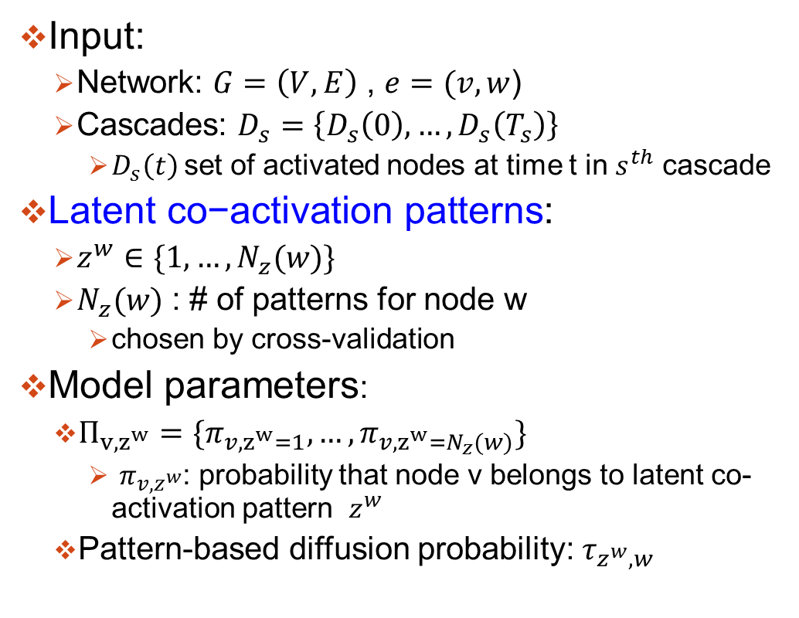
Problem Formulation
Input:
Network: $G=\left(V,E\right)$ , $e=(v,w$)
Cascades: $D_{s}=\left\{D_{s}\left(0\right),…,D_{s}\left(T_{s}\right)\right\}$
$D_{s}\left(t\right)$set of activated nodes at time t in $s_{}^{th}$ cascade
$\text{Latent} \text{co}\text{−}\text{activation} \text{patterns}$:
$z^{w}∈\{1,…,N_{z}(w)\}$
$N_{z}(w)$ : # of patterns for node w
chosen by cross-validation
Model parameters:
$Π_{v,z^{w}}=\{π_{v,z^{w}=1},…,π_{v,{z^{w}=N}_{z}(w)}\}$
$π_{v,z^{w}}$: probability that node v belongs to latent co-activation pattern $z^{w}$
Pattern-based diffusion probability: $τ_{z^{w},w}$

Slide 8
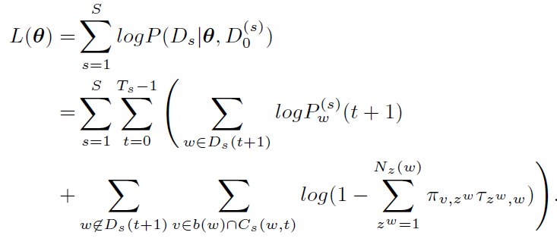
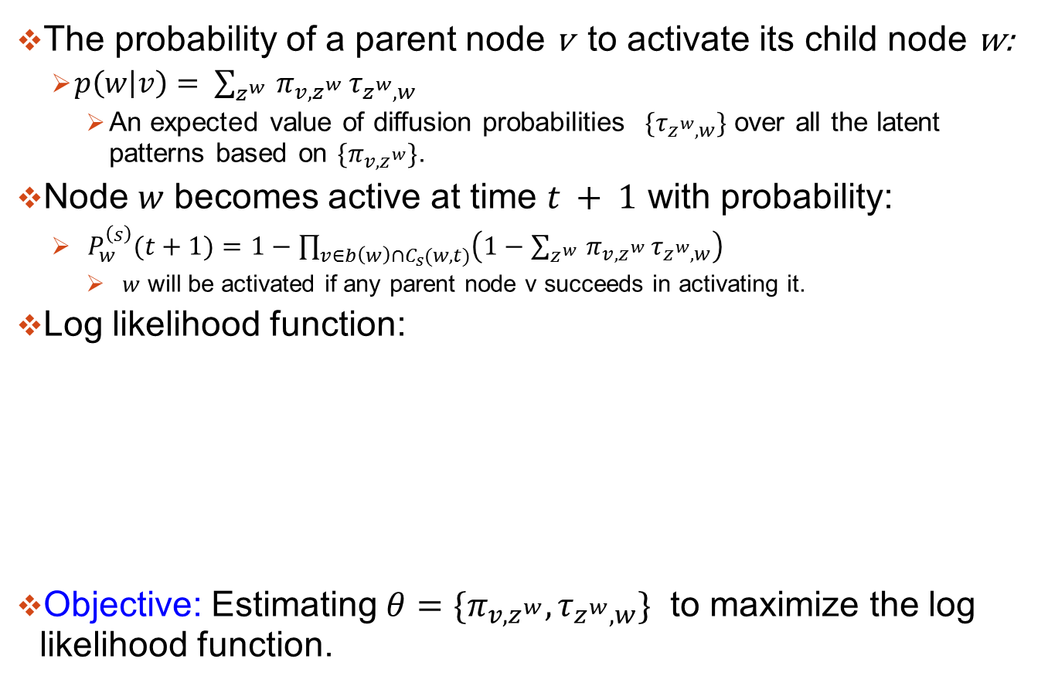
Problem Formulation
The probability of a parent node v to activate its child node w:
${p\left(w | v\right)= \sum_{z^{w} }{π_{v,z^{w}}}τ}_{z^{w},w}$
An expected value of diffusion probabilities $\{τ_{z^{w},w}\}$ over all the latent patterns based on ${\{π}_{v,z^{w}}\}$.
Node $w$ becomes active at time $t + 1$ with probability:
$P_{w}^{\left(s\right)}(t+1)=1−\prod_{v∈b\left(w\right)∩C_{s}(w,t)}{\left(1−{\sum_{z^{w} }{π_{v,z^{w}}}τ}_{z^{w},w}\right)}$
$w$ will be activated if any parent node v succeeds in activating it.
Log likelihood function:
Objective: Estimating $θ=\{π_{v,z^{w}},τ_{z^{w},w}\}$ to maximize the log likelihood function.
v fails to activate w
Successful activations observed
Unsuccessful activations observed

Slide 9
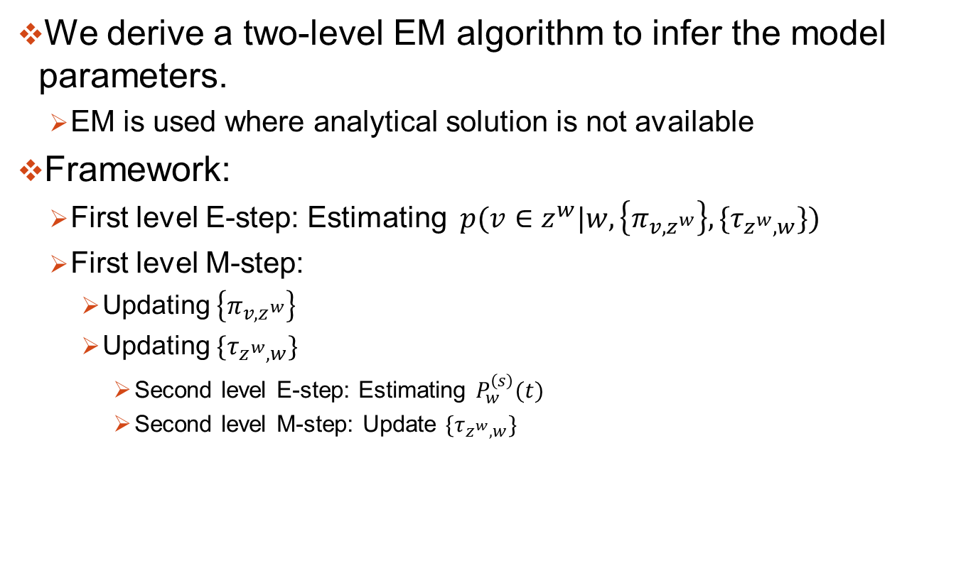
Methodology
We derive a two-level EM algorithm to infer the model parameters.
EM is used where analytical solution is not available
Framework:
First level E-step: Estimating $p(v∈z^{w}|w,\left\{π_{v,z^{w}}\right\},\{τ_{z^{w},w}\})$
First level M-step:
Updating $\left\{π_{v,z^{w}}\right\}$
Updating ${\{τ}_{z^{w},w}\}$
Second level E-step: Estimating $P_{w}^{\left(s\right)}(t)$
Second level M-step: Update ${\{τ}_{z^{w},w}\}$

Slide 10
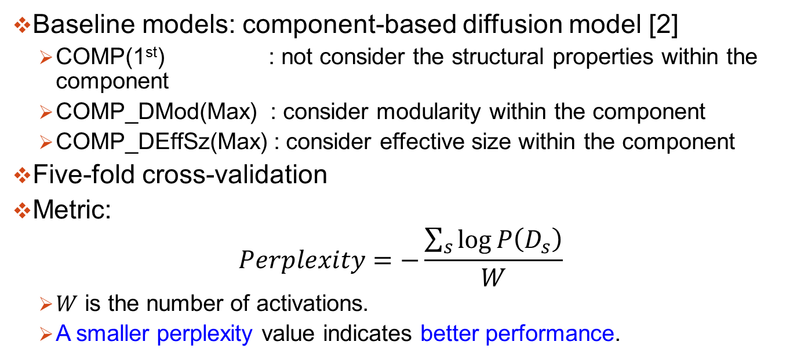
Experiment: Setup
Baseline models: component-based diffusion model [2]
COMP(1st) : not consider the structural properties within the component
COMP_DMod(Max) : consider modularity within the component
COMP_DEffSz(Max) : consider effective size within the component
Five-fold cross-validation
Metric:
$$Perplexity=−\frac{\sum_{s}{\log{P\left(D_{s}\right)}}}{W}$$
$W$ is the number of activations.
A smaller perplexity value indicates better performance.
[2] Q. Bao, W. Cheung, and Y. Zhang, “Incorporating structural diversity of neighbors in a diffusion model for social networks,” in Proceedings of the 2013 IEEE/WIC/ACM International Joint Conference on Web Intelligence, Atlanta, GA, USA, 2013, pp. 431–438.
Notes:
We use generative ability to measure the performance as the ground-truth is unknown, and use the perplexity over cascades as

Slide 11
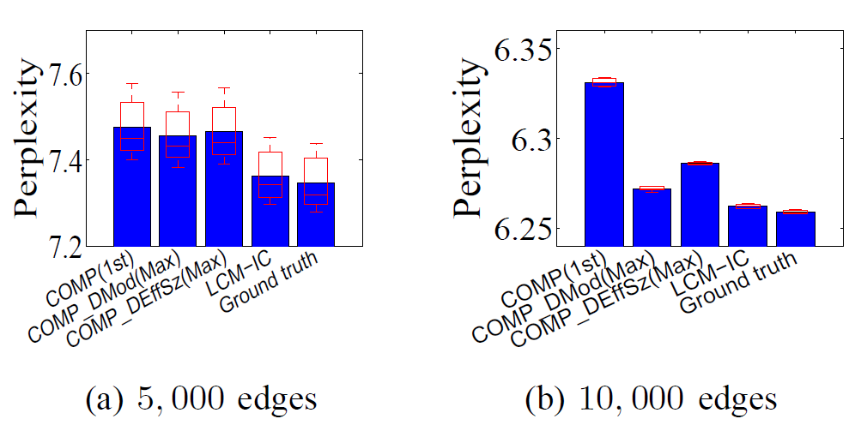
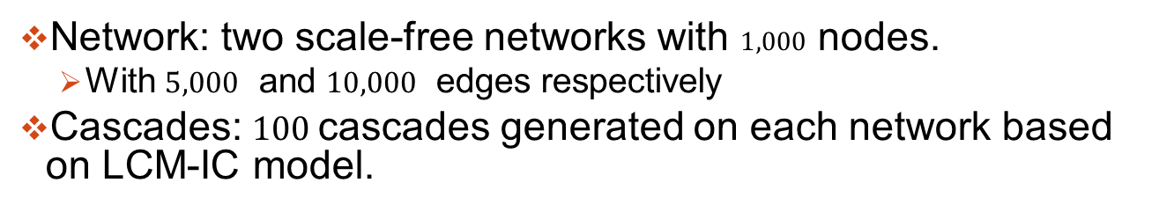
Experiment: Synthetic Data Results
Network: two scale-free networks with $1,000$ nodes.
With $5,000$ and $10,000$ edges respectively
Cascades: $100$ cascades generated on each network based on LCM-IC model.
Notes:
Smaller value: better performance
Results:
The performance of LCM-IC model
can approach the ground truth
apparent better than baseline models.

Slide 12
Experiment: Real Data Sets
MemeTracker: websites of news articles and blogs http://www.memetracker.org/
Digg: friendship network with story voting process
Flixster: friendship network with movie rating process
 | Node | #Node | Edge | #Edge | Activation | #cascades
MemeTracker | website | 4,000,000 | hyperlink | 13,000,000 | posting | 71,568
Digg | user | 280,000 | friendship | 2,600,000 | voting | 3,553
Flixster | user | 787,000 | friendship | 5,900,000 | rating | 5,318

Slide 13
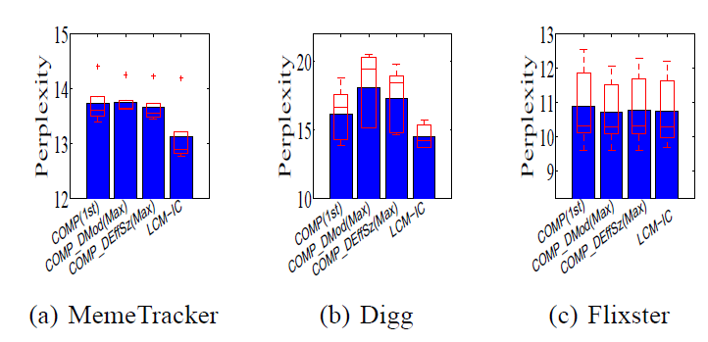
Experiment: Real Data Results
Notes:
Results:
Under Meme and Digg, LCM-IC outperforms all baseline models
With decrease in perplexity value of at least 0.54 and 1.66 respectively.
Under Flixster, give comparable performance.
Encouraging results: Since the structural information for modeling detailed relation of parent nodes is not used

Slide 14
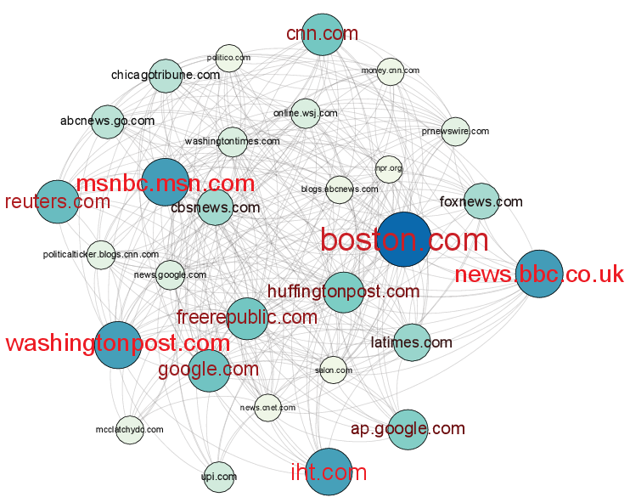

NYTimes: Overall News Sources Inferred
$$P(v|w)$$
The NYTimes is biased towards liberal news sources.
most important parents are mainstream news media, MSNBC, Washington Post, BBC, all are liberal, so is NYTimes [1].
Liberal websites | Neutral Websites | Conservative websites
MSNBC, BBC, CNN, Washington Post, New York Times, International Herald Tribune… | USA Today, US News an World Report, Foreign Affairs | Fox News, Wall Street Journal, National Review, Economist, Washington Times, Time Magazine …
[1] R. H. Davis, Typing Politics : The Role of Blogs in American Politics. Oxford University Press, USA, 2009.
Notes:
The neighborhood network for New York Times (NYTimes) (as node w)
Algorithm not use the connection, just for reference in visualization
Node: web/blog site, Edge: hyperlinks
Importance of parents v:$P(v|w)$
Size of node and label: proportional to the probability $P(v|w)$
The labels of the most probable nodes shown in red.

Slide 15
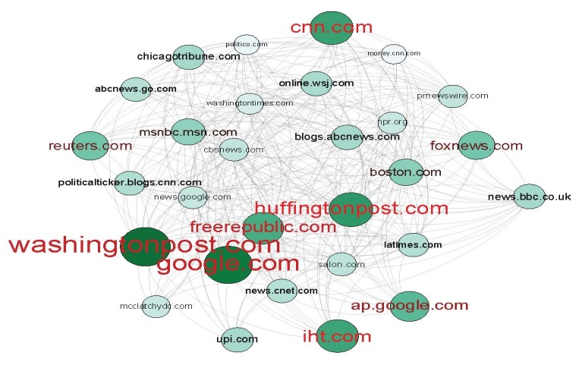
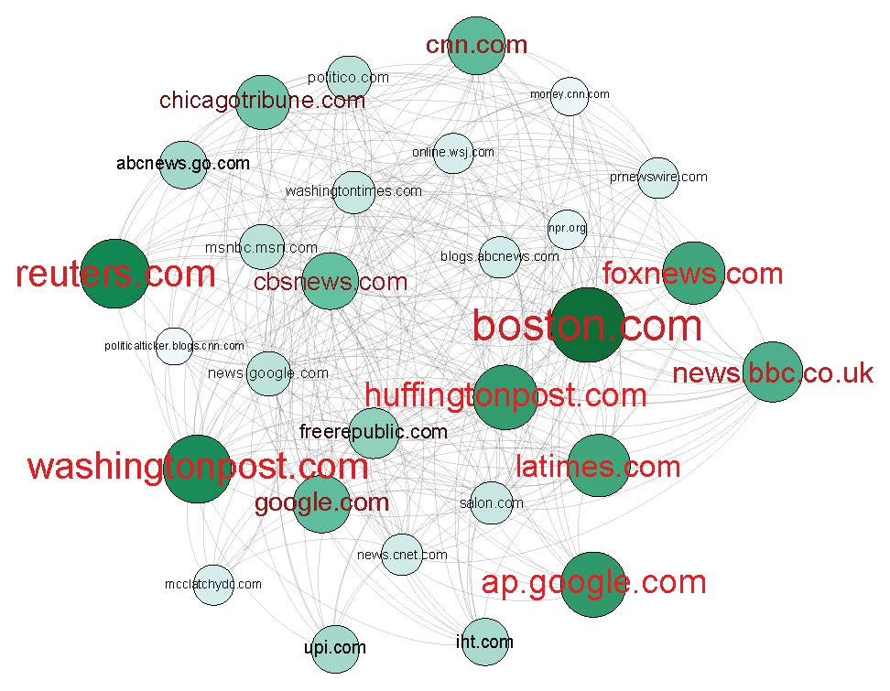


Analysis of Dependency among News Media
For NYTimes,
Pattern specific influential news sources inferred
Each parent co-activation pattern corresponds to a specific semantic context of the news sources.
$P(v|z_{1})$
$P(v|z_{2})$
Pattern | Pattern 1 | Pattern 2
Context | National Political News | Big Events
resources | Washington Post | Both Liberals and Conservatives
Meme | [1] the chant is drill baby drill (drilling oil makes America Stupid, politics) [2] reckless conduct corruption and unbridled greed (politics) | [1] hope over fear unity of purpose over conflict and discord (Obama inauguration) [2] angel at the fence the true story of a love that survived (a popular book)
Notes:
Select nodes with larger $P(v|z)$ : the probability of parent v given each pattern z
Select the meme mentioned by both influential sources (larger value of $P(v|z)$ and specific sources (large value of $P(z|v)$), then manually check the content.

Slide 16
Conclusion and Future Work
Propose a pattern-based information diffusion model
latent co-activation patterns of parents for each node are inferred together with the pattern-based diffusion probabilities.
A two-level EM algorithm to estimate the model parameters
The new model can more accurately model diffusion process in social networks
The inferred co-activation patterns can be used to estimate the dependency among different online news media in terms of news diffusion.
Future work
Incorporation of the cascades’ context for context-aware parent co-activation patterns
Evolution of the latent patterns in the diffusion model
Notes:
Our empirical result on a real dataset shows that after incorporating structural diversity, there is a significant improvement in the generative ability of the proposed model. The new model can more accurately model diffusion process in social networks.

Slide 17
Thank you!
Q&A

Slide 18
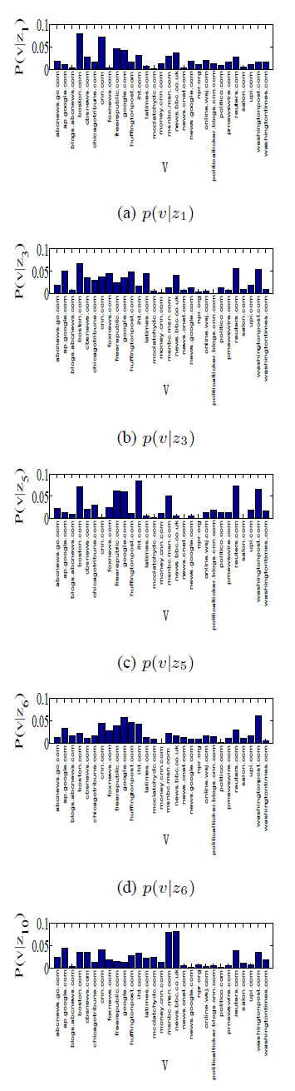
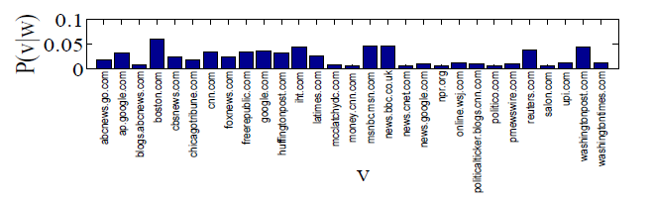
Analysis of Dependency among News Media
The major news sources are more reliably detected by referring to the latent co-activation patterns.
Huffington Post and Free Republic.
Notes:
Distin
Reasons behind:
Free Republic is an online forum with frequent discussions, co-activates with most of the major news sources.
Huffington Post is a news aggregator and blog, co-activates with Washington Post.
guished in terms of overall influence (p(v|w) ), but are not pattern specific influential nodes (p(v|z))

