Slide 1
Hospital Inpatient Total Costs Predictive Model
- Qing Snyder

Slide 2
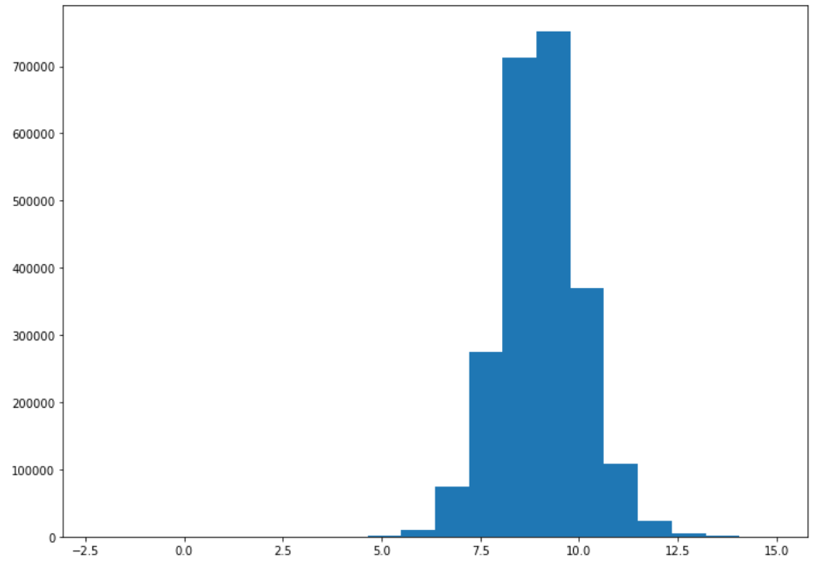
Instruction and Data EDA
Key motivations: Use predictive model and feature analysis techniques to determine which variables impact Total Costs for hospital inpatients.
Data Structure: There are ~2.6 millions rows and 35 columns.
Process of EDA:
Checked duplicates and removed them.
Checked missing values.
Created histogram of log Total Costs.

Slide 3
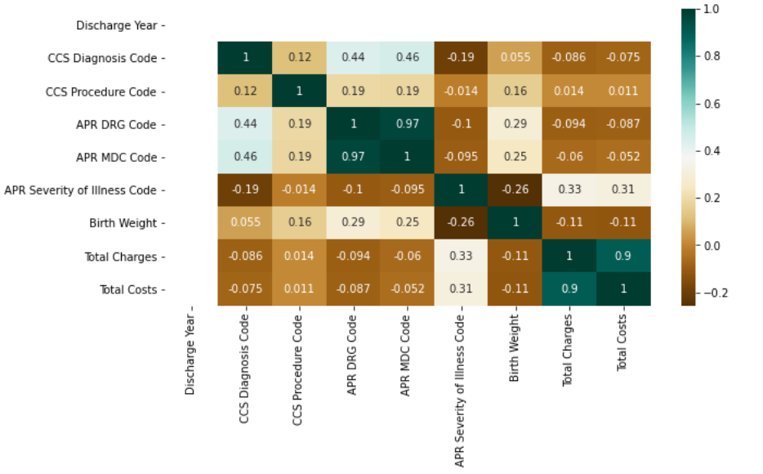
Feature Association
Examined the association between the variables’ mean values and Total Costs.
Example of Categorical Variables: - Mean Value of Type of admission and Total Costs.
Heatmap shows associations between numeric variables and Total Costs:
Type of admission | Elective | Emergency | Newborn | NA | Trauma | Urgent
Total Costs | 17,838 | 14,899 | 6,080 | 16,241 | 23,248 | 16,703

Slide 4
Pre-Processing
Remove some variables:
Removed variables that has missing values over 50%.
Removed variables will be duplicate with other variables (Code).
Removed categorical variables has too many levels that severely impact computing time (Since I am running model on my own computer).
Clean and pre-process data for fitting the model:
Removed rows with rarely observed levels.
Changed Length of Stay from categorical to numeric.
Did One-hot encoding for categorical data for modeling steps.
Final Data Structure for modeling:
Feature Matrix X : Health Service Area, Age Group, Gender, Race, Ethnicity, Type of Admission, Patient Disposition, CCS Diagnosis Description, CCS Procedure Description, APR Severity of Illness Description, APR Risk of Mortality, APR Medical Surgical Description, Payment Typology 1, Emergency Department Indicator.
Response Matrix Y: Total Costs

Slide 5
Modeling - Random Forest
A random forest model was built to predict the total costs.
10%/90% training/test data split.
For computational purposes (personal hardware)
Fit via sklearn in Python.
Model parameters:
150 trees
Bootstrapped sampling
4822 test median absolute error:
Improvement over 12047 from a null model
Using the mean total cost in training data
~60% pseudo R²

Slide 6
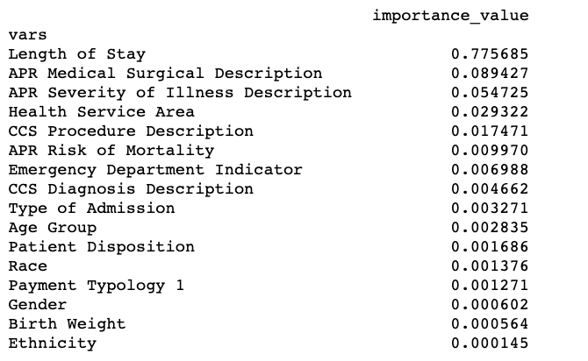
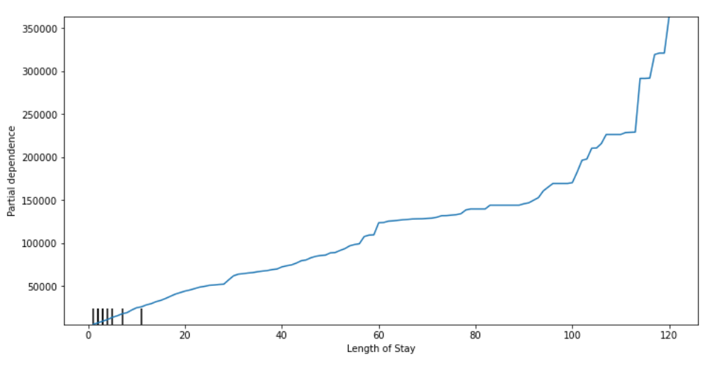
Feature impact and insights
Feature Importance (sorted descending):
Most impactful variable: Length of Stay.
Partial Dependence Plot of Length of Stay and Total Costs:
There is a linear increase in cost up to 175,000 after 100 days, after that the increase becomes exponential.

Slide 7
Model hyperparameter optimization – K folds Cross Validation
Cross Validated Hyperparameters:
Trees: 200, 650, 1100, 1550, 2000
Max depth: 10, 32, 55, 77, 100, None
Max features: auto, sqrt
Min samples leaf: 1, 2, 4
Min samples split: 2, 5, 10
Best model:
Tress=650
Max depth=32
Min samples leaf=2
Model median absolute error with best hyperparameters: 3762

