Slide 1
Using - test
V0.0
Qing Wu
8/11/2026

Slide 2
8/12/2026
Visualization of v_coin

Slide 3
C-code
Transaction ID: business department – [series code formation] * unknown
Merchandise Accounting Information – json file: {InboundInfo{};
OutboundInfo{}}
Customer Information – json file: {registration{purchaseAmount{}, items{}, quantities{}, unitPrice{}, deductedAmounts{},paymentInfo {}, totalExpenses, accumulatedRewards}}
PaymentInfo – json file: {transaction currency{}, exchanging rates{}, timestamp, paymentProtocol{}}
a0004100105
{{ST#: Systane UPF},
{OP#: 300651432060},
{TE#: H},
{TR#: 12.98},
{IS#: ITEMS SOLD},
{TC#:X},
{OI#:}}
C

Slide 5
8/11/2026

Slide 6
README.md
1. Generate a node and its net
2. An observer, without voting rights
3. A participant, with voting rights, agreed by node to join the net
4. The observer applies to join the net as a participant
5. If both nodes agree, the observer becomes a participant with voting rights
-- else, observer without voting rights

Slide 7
Blockchain Review
Discussions:
-1- If all members of blockchain are identically given rights, including voting and trading, the outliers are non-member
-2- Above mechanism is similar to RR-formation in space coin distribution algorithms

Slide 8
C-code
Transaction ID: business department – [series code formation] * unknown
Merchandise Accounting Information – json file: {InboundInfo{};
OutboundInfo{}}
Customer Information – json file: {registration{purchaseAmount{}, items{}, quantities{}, unitPrice{}, deductedAmounts{},paymentInfo {}, totalExpenses, accumulatedRewards}}
PaymentInfo – json file: {transaction currency{}, exchanging rates{}, timestamp, paymentProtocol{}}
C

Slide 9
1. Generate a node and its net

Slide 10
Virtual coin definition
Virtual Coin Information
Node state (live, hibernate, busy, suspension, deprecated)
Node network (correspondences, expansion, updates, operations, etc.)
Piled applications (required voting up to date, network modifications, etc.)
Voting reports (listed votes, update current members, update network, etc.)
Rewards updates (obtaining gains, reviewing costs/loss, etc.)
Node activities (generations, protocol updates, etc.)
Trading coin codes
Security Search
- submission table
- search logs
- Prevent over search

Slide 11
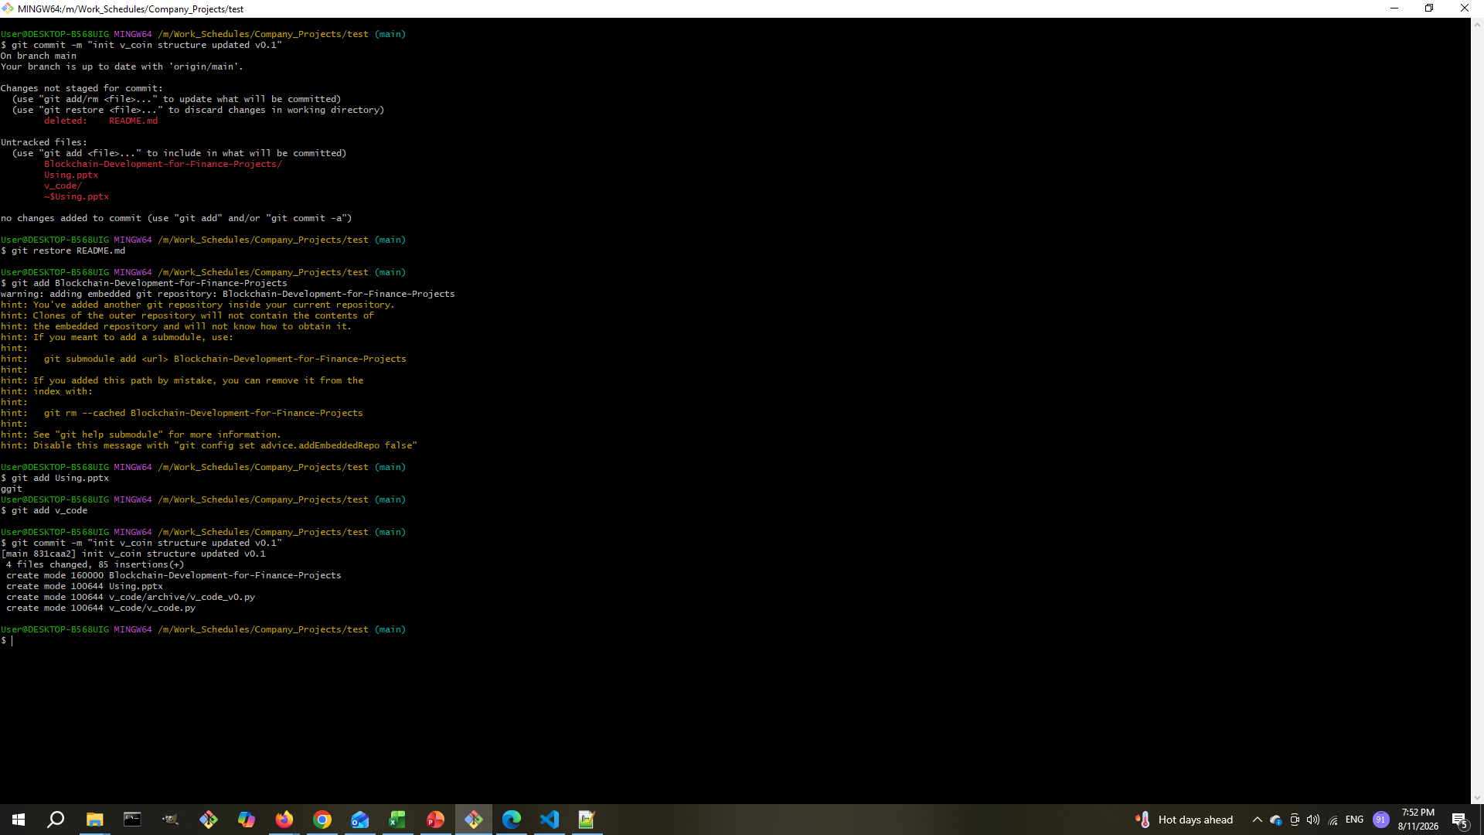

Slide 12
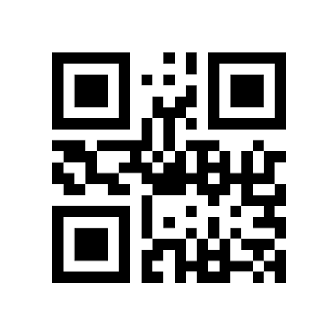
QR-Code

