Slide 1
Using - test
V0.1
Qing Wu
8/14/2026

Slide 2
Vendors Information
company code
- vendors: 003xxx
- 3rd partners: 002xxx
- customers: 001xxx
- sub-companies: 005xxx
company_information (company name, company code, company managers, company employees (sales/marketing), company contact information (office number/cell phone), company address, company website, company licenses, company certificates, etc.)
vendor_grades (vending merchandises, vending quantities, vending periods, vending stage-price ranges, vending contracts, grades/rewards, vendor_grades, etc.)
vending_permits (valid permits, filed bureaucracies, past-due permits, renewed ranges, serving ranges, covered merchandises, etc.)
vending_license (valid licenses, filed agencies, relationships, past-due licenses, renewed ranges, serving ranges, covered merchandises, etc.)
grocery_information (grocery_name, grocery_name_code, unit_price, code_coupons, code_promotions, code_samples, recent_sample_tests, recent_yield_rate, order_decisions, order_information, etc.)
grocery_code (grocery_name, grocery_name_code, sample_test_code, yield_rate_code, code_equipments_information, etc.)
unit_price (currency, exchange_rates, exchange_rates_references, exchange_rates_calculator, exchange_rates_precision, trading_dates, ordering_dates, stage_prices, price_ranges, unit_price, price_fluctuations, sales_contract_information, etc.)
Quantities (quantity_unit, sampling_rate_per_unit, yield_rates, exchange_rates, stage_prices, etc.)
vending_period (delivery_period, vending_contract, order_contract, vending_contact, yield_rates, exchange_rates, return_rates, precision_rates, etc.)
Order Decisions
- Continue orders
- Increased orders
- Reduced orders
- Canceled orders
- Returned orders
- Sampled orders
- Defected orders

Slide 3
Order System

Slide 4
Sales Table
Sales Department
Sales Contract
Partners Information

Slide 5
Marketing Table
Marketing Department
Customers Information
Partners Information

Slide 6
grocery_name code
V0.5 Varied-name-gen Current version Tested by 8/13/2026
V0.4 Static-name-gen
-Future Testing Work (1) merge test with other functions (2) intensive test with more products
8/14/2026

Slide 7
8/12/2026
Visualization of v_coin

Slide 8
C-code
Transaction ID: business department – [series code formation] * unknown
Merchandise Accounting Information – json file: {InboundInfo{};
OutboundInfo{}}
Customer Information – json file: {registration{purchaseAmount{}, items{}, quantities{}, unitPrice{}, deductedAmounts{},paymentInfo {}, totalExpenses, accumulatedRewards}}
PaymentInfo – json file: {transaction currency{}, exchanging rates{}, timestamp, paymentProtocol{}}
a0004100105
{{ST#: Systane UPF},
{OP#: 300651432060},
{TE#: H},
{TR#: 12.98},
{IS#: ITEMS SOLD},
{TC#:X},
{OI#:}}
C

Slide 9
README.md
1. Generate a node and its net
2. An observer, without voting rights
3. A participant, with voting rights, agreed by node to join the net
4. The observer applies to join the net as a participant
5. If both nodes agree, the observer becomes a participant with voting rights
-- else, observer without voting rights

Slide 10
Blockchain Review
Discussions:
-1- If all members of blockchain are identically given rights, including voting and trading, the outliers are non-member
-2- Above mechanism is similar to RR-formation in space coin distribution algorithms

Slide 11
C-code
Transaction ID: business department – [series code formation] * unknown
Merchandise Accounting Information – json file: {InboundInfo{};
OutboundInfo{}}
Customer Information – json file: {registration{purchaseAmount{}, items{}, quantities{}, unitPrice{}, deductedAmounts{},paymentInfo {}, totalExpenses, accumulatedRewards}}
PaymentInfo – json file: {transaction currency{}, exchanging rates{}, timestamp, paymentProtocol{}}
C

Slide 12
1. Generate a node and its net

Slide 13
Virtual coin definition
Virtual Coin Information
Node state (live, hibernate, busy, suspension, deprecated)
Node network (correspondences, expansion, updates, operations, etc.)
Piled applications (required voting up to date, network modifications, etc.)
Voting reports (listed votes, update current members, update network, etc.)
Rewards updates (obtaining gains, reviewing costs/loss, etc.)
Node activities (generations, protocol updates, etc.)
Trading coin codes
Security Search
- submission table
- search logs
- Prevent over search

Slide 14
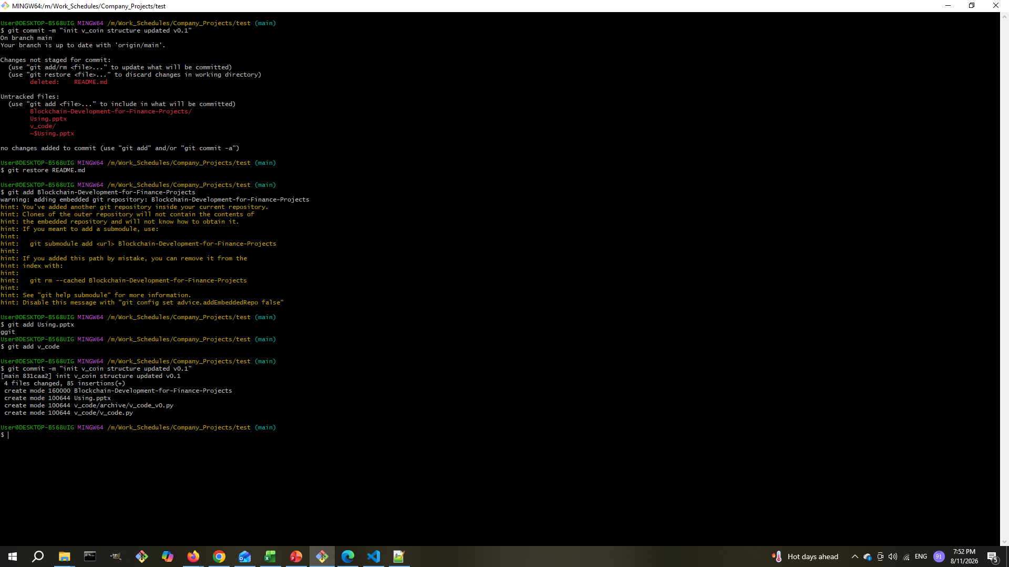

Slide 15
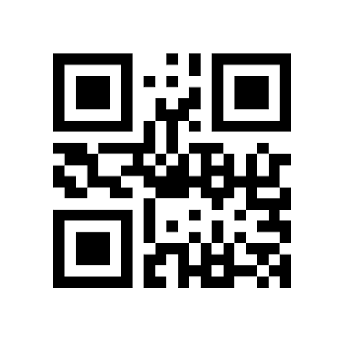
QR-Code

