Slide 1
OASiS: Off-the-ball Action Significance Score
Qingbo Wang
PhD candidate in
Bioinformatics and Integrative Genomics
Harvard University

Slide 2
10 players, 1 ball
Only <10% of the time you touch the ball

Slide 3
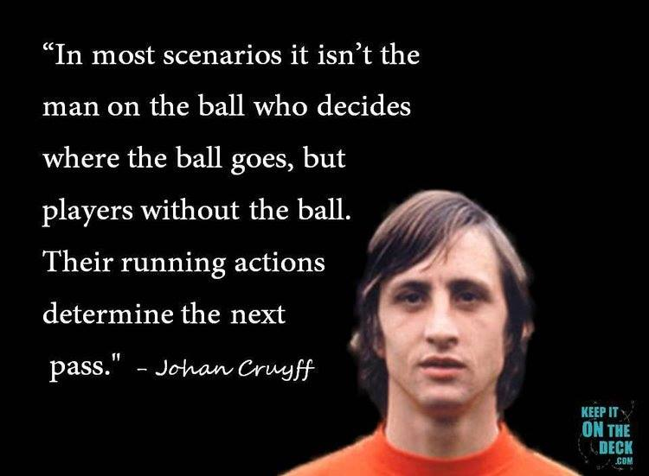
10 players, 1 ball
Only <10% of the time you touch the ball

Slide 4
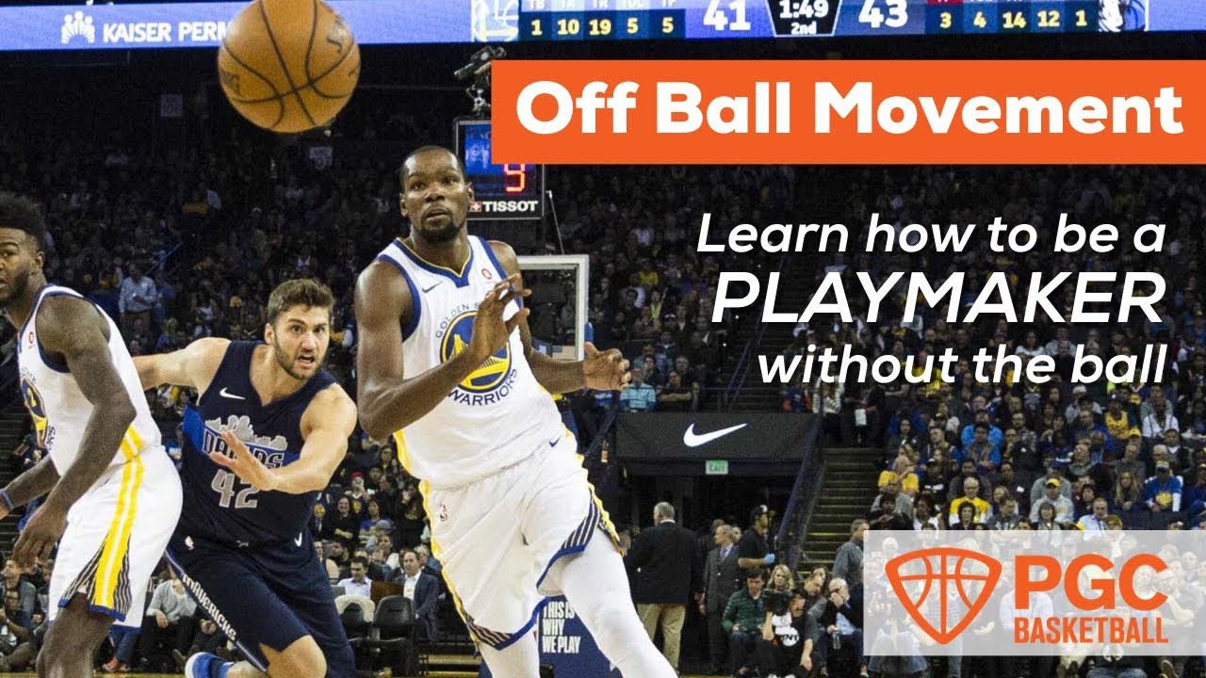
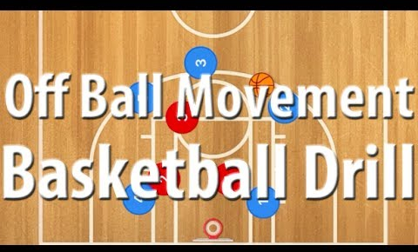
Off the ball movement is important
(youtube)

Slide 5
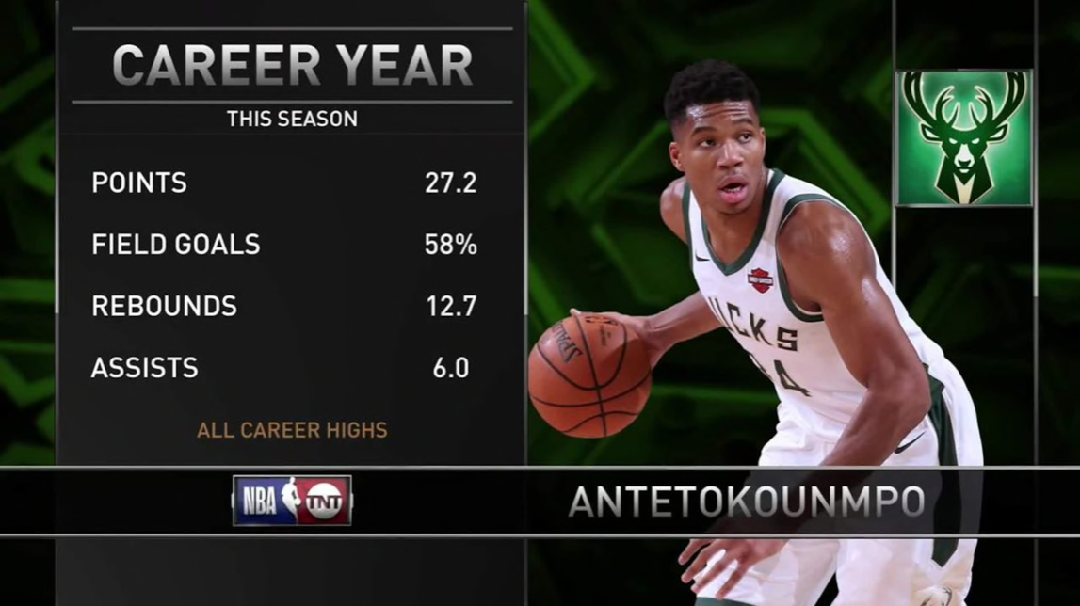
Off the ball movement is important
(youtube)
However, we evaluate players by …
Number of shots / shot accuracy
Assists, dribble success …
What about off-the-ball creativity?
(nba.com)

Slide 6





OASiS: Off-the-ball Action Significance Score
For each action of a player NOT having the ball, we score the consequence of the action
Action starting at time
Consequence (e.g. 3pt / turnover) right after
Significance score of the consequence

Slide 7


OASiS: Off-the-ball Action Significance Score
Integrate all the actions in a certain time period (e.g. 1 game) to get the final significance score
Action starting at time
Consequence (e.g. 3pt / turnover) right after
Significance score of the consequence

Slide 8
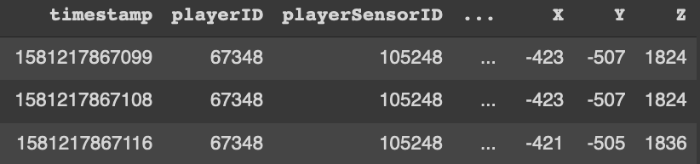
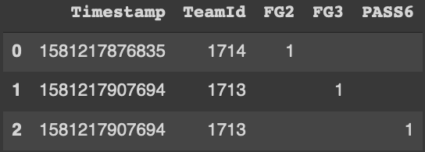
Dataset:
Player and ball location
(2 mm spatial and 0.01 second time resolution)
Events log with timestamp (e.g. score / foul)
...
...
...
...
Data provided by Shottracker
Hackathon supported by ESPN and Shottracker

Slide 9
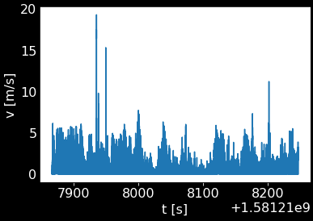
Extracting the off-the-ball action
Plot the velocity of each player (e.g. ID 67351)

Slide 10
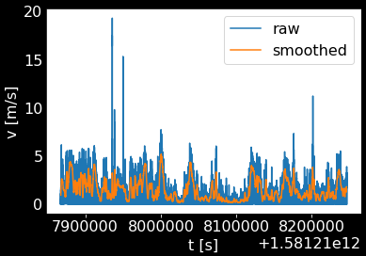
Extracting the off-the-ball action
2. Make it smooth (rolling window, 0.1second)

Slide 11
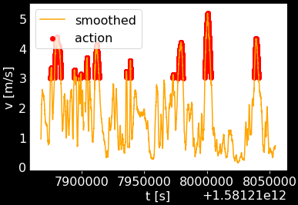
Extracting the off-the-ball action
3. Detect action
(v>3 for >1 second, >0.5 meter from the ball)

Slide 12
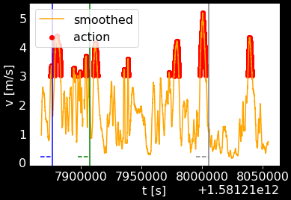
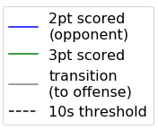
Quantifying the significance of the action

Slide 13
Quantifying the significance of the action
If we see major event within 10s of the action start, we add score:
(e.g.)
3PT in: +3
2PT in: +2
(Opponent) Foul: +1
Offensive Rebound: +0.5
>6 passes: +0.4
Turnover: -1
(Score signis flipped when it is opponent’s action)

Slide 14
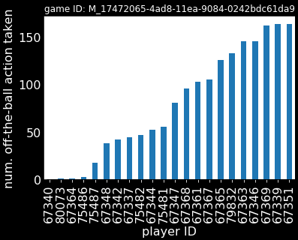
Number of action is quite different per players

Slide 15
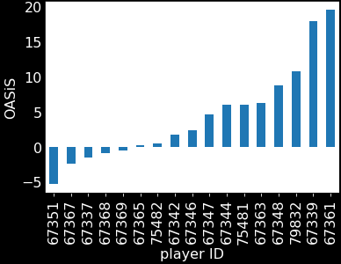
Distribution of OASiS:

Slide 16
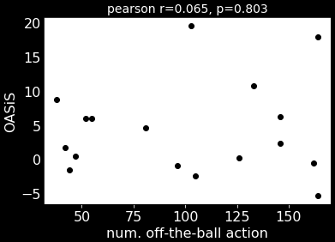
OASiS does not strongly correlate with the number of off-the-ball action itself

Slide 17
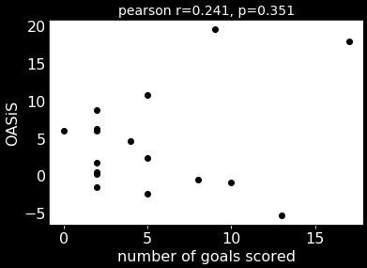
OASiS does not strongly correlate with goals or assists (= providing new metric)

Slide 18
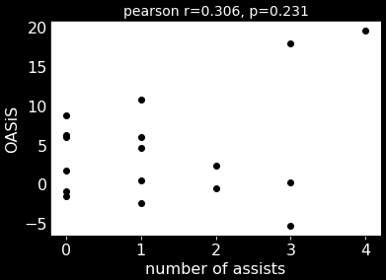
OASiS does not strongly correlate with goals or assists (= providing new metric)

Slide 19
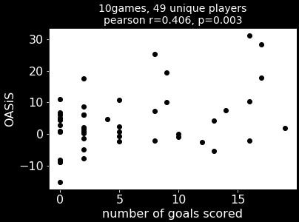
OASiS does not strongly correlate with goals or assists (weakly, with more sample size)

Slide 20
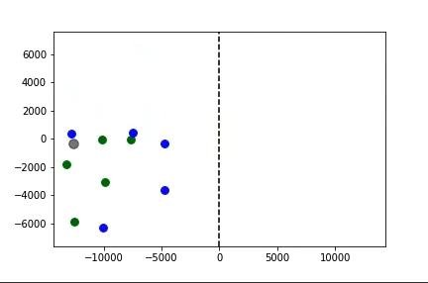

Visualizing an significant off-the-ball movement

Slide 21
Future work 1. More visualization
Auto-crop and visualize off-the-ball actions and their consequences
On-the-screen annotation in TV highlights
Learn what kind of actions are effective

Slide 22
Future work 2. Algorithm
Different scores for different consequences
(e.g. action specifically useful for 3pt shot)
More classification of the actions (e.g. directions / angles / distance from the ball / offensive or defensive) / parameter tuning
Predictive model (“Will this players movement be effective?”)

Slide 23
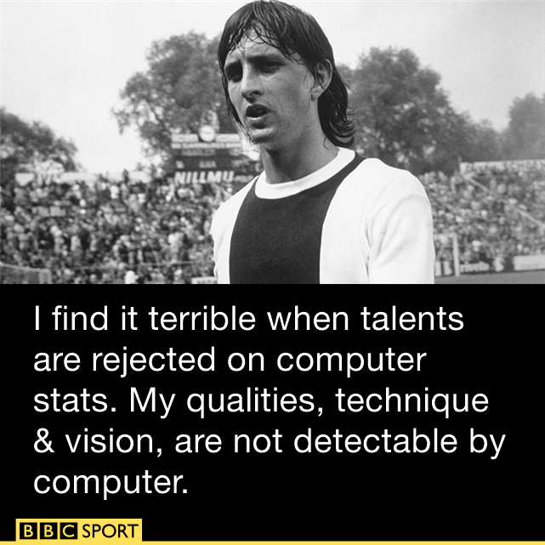
Future work 3. Beyond basketball
Any sports with 1 ball and many players
E.g. Soccer
(quote, again by johan cruyff)

Slide 24
Thank you for your (off-the-stage) participation
Twitter: @qbw_128
Code available at github
https://github.com/QingboWang/ssac_2020_oasis

