Slide 1
A Research Centered Approach to Sharing Patient Data While Protecting Patient Privacy
Qingbo Wang, Gaurav Luthria

Slide 2
Goals
Objective: Identify a solution for sharing patient data while maintaining patient privacy
Our Approach (Two Fold)
Advanced Querying Language
Group_by / aggregation / custom filtering / statistical test
Custom threshold to exclude outliers
Keeps the raw data secure in the cloud
Realistic Synthetic Data Generation from the Query
Robust
Produce Realistic data
Suppress Outliers (outliers are the most easily identifiable)
Does not require model complexities or parameters
Work with smaller datasets

Slide 3
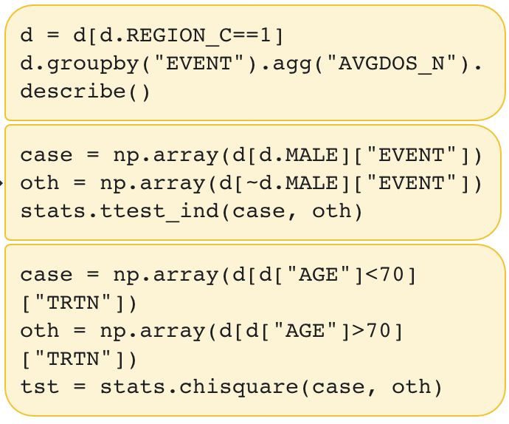

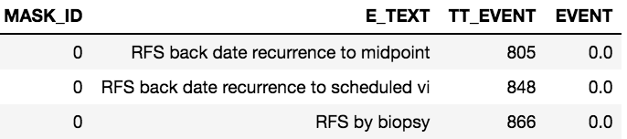
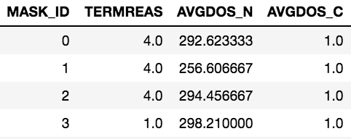
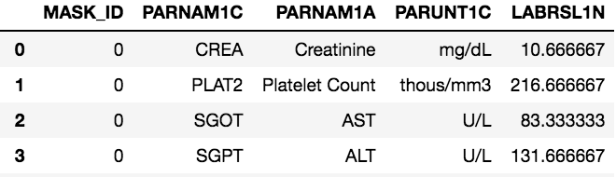
Query the Original Data
(Cloud)
Downstream Analysis
Use Vivli Platform to validate analysis on real data
Generate Synthetic Data from Query
Real Data
Efficacy Sensitivity Analysis
Lab Results
Drug Exposure Data

Slide 4
Generating Synthetic Data
Want to Generate Synthetic Data that is Robust, Realistic, Suppresses Outliers
Method: Permutation Test
Regenerate another “synthetic” ID
Original Data
Randomly Sample User IDs
Aggregate into one “synthetic ID”
Output Synthetic data to CSV formal

Slide 5
Demo

