Slide 1
Model-based inference of reward identity in sensory preconditioning
Testing identity-specific vs. value-based inference in humans
Qingfang Liu
April 8, 2026

Slide 2
Model-based inference supports flexible decision making
Many decisions rely on inferring outcomes that have not been directly experienced.
This process — model-based inference — allows individuals to mentally simulate likely outcomes using learned associations.
Impairments in inference-based decision making may contribute to psychiatric disorders, including addiction and substance use disorder (SUD).
Evidence across species suggests the orbitofrontal cortex (OFC) plays a critical role in guiding behavior based on inferred outcomes.
Kahnt & Schoenbaum (2022),
Behav Neurosci

Slide 3
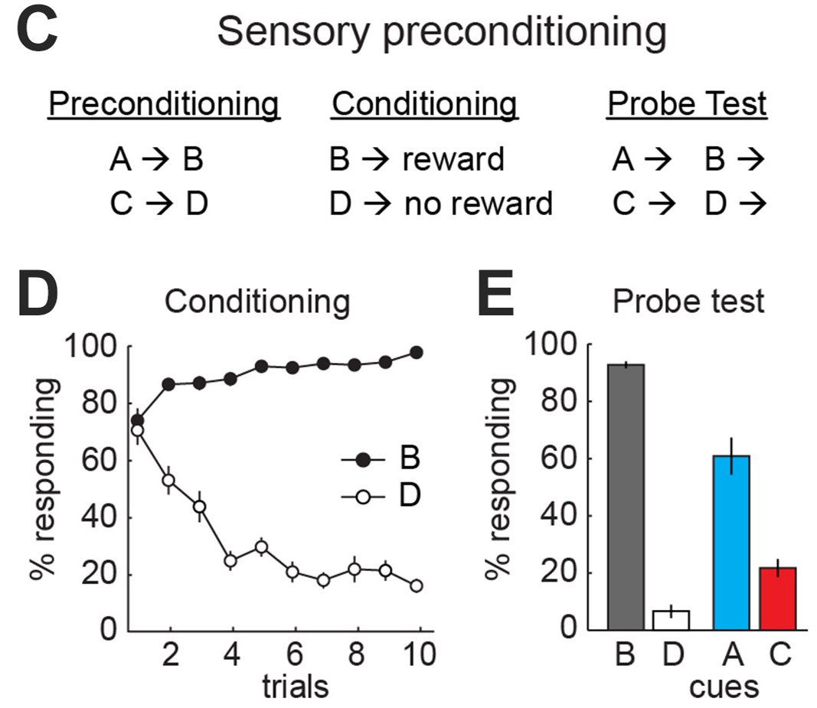
Kahnt (2023),
Biological Psychiatry
Notes:
A common paradigm used to study inference is sensory preconditioning.
In the first phase, subjects learn associations between neutral cues, such as A predicting B.
In the conditioning phase, B is paired with reward.
At test, A is presented alone.
If subjects respond to A as if it predicts reward, they must infer the outcome through the associative chain A → B → reward, because A was never directly paired with reward.

Slide 4
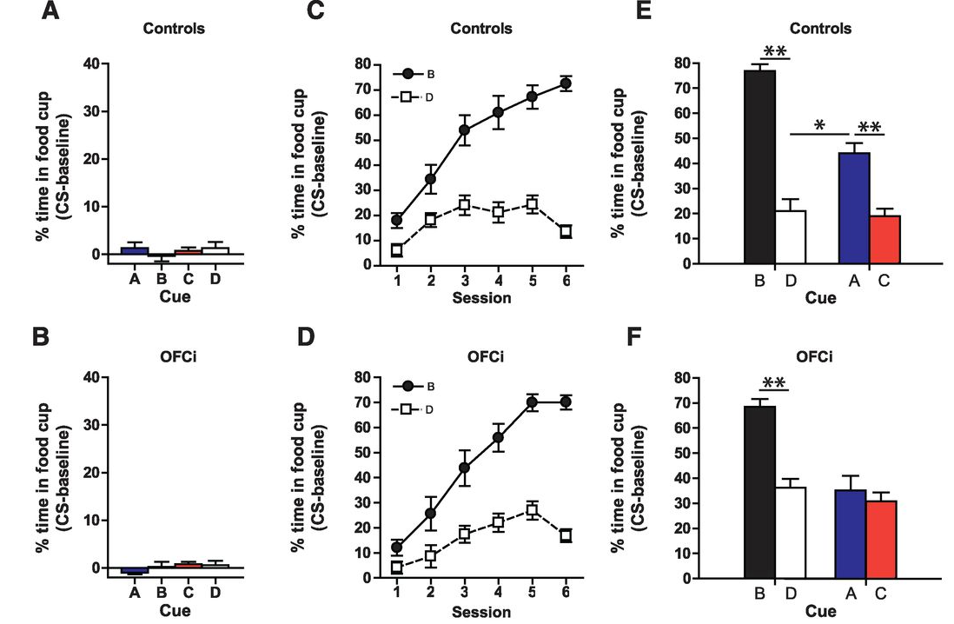
Orbitofrontal cortex supports inference-based behavior in rats
Jones et al. (2012), Science
OFC lesion
Notes:
They inactivated OFC only during the probe test, after learning had already occurred.
Importantly, animals still responded normally to B, the cue directly associated with reward.
However, responding to A, which requires inferring reward through the chain A → B → reward, was strongly impaired.
This suggests that the OFC is specifically required when behavior depends on inferred outcomes.

Slide 5
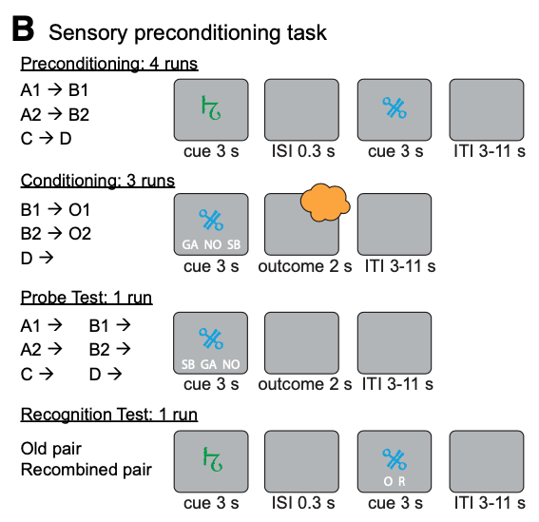
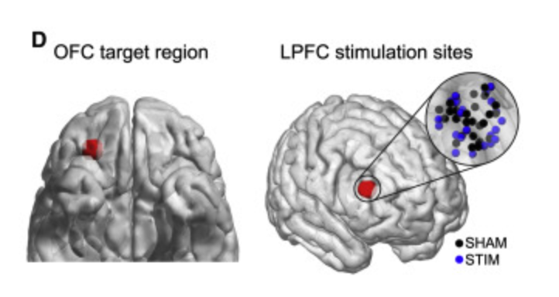
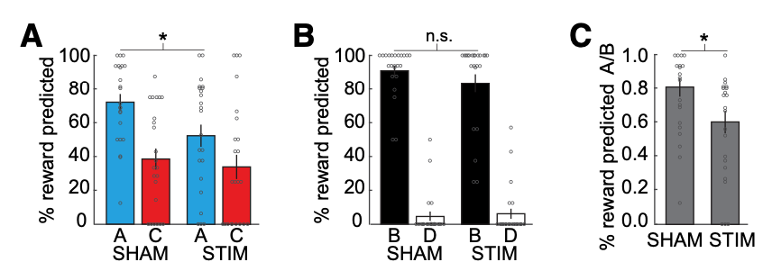
OFC network disruption impairs inference in humans
Wang et al. (2020), JN
TMS-behavior study
Notes:
Similar findings have been observed in humans.
This is a study that was conducted in our lab previously. They used a sensory preconditioning task together with transcranial magnetic stimulation targeting the OFC network.
Disrupting this network selectively impaired inference-based responding during the probe test, while leaving direct reward learning intact.
These results suggest that the OFC network plays a role in inference across species.

Slide 6
Research question
What information is inferred during sensory preconditioning?
Does inference in SPC rely only on reward value, or also on reward identity?
If identity-specific inference occurs, which brain systems support it?
Cue A → Cue B → Reward
Value inference:
A → ”something good"
Identity inference:
A → "chocolate odor"
Notes:
Together, these studies show that the OFC supports inference-based value predictions.
However, it remains unclear what exactly is being inferred during sensory preconditioning.
Is the inferred representation simply that a cue predicts something valuable, or does it also include the specific identity of the expected reward?
In this project, we investigate whether inference in SPC is identity-specific, and how this process may involve the OFC and hippocampus.
To address this question, we used selective outcome devaluation to test whether inferred responses depend on the specific identity of the reward.

Slide 7
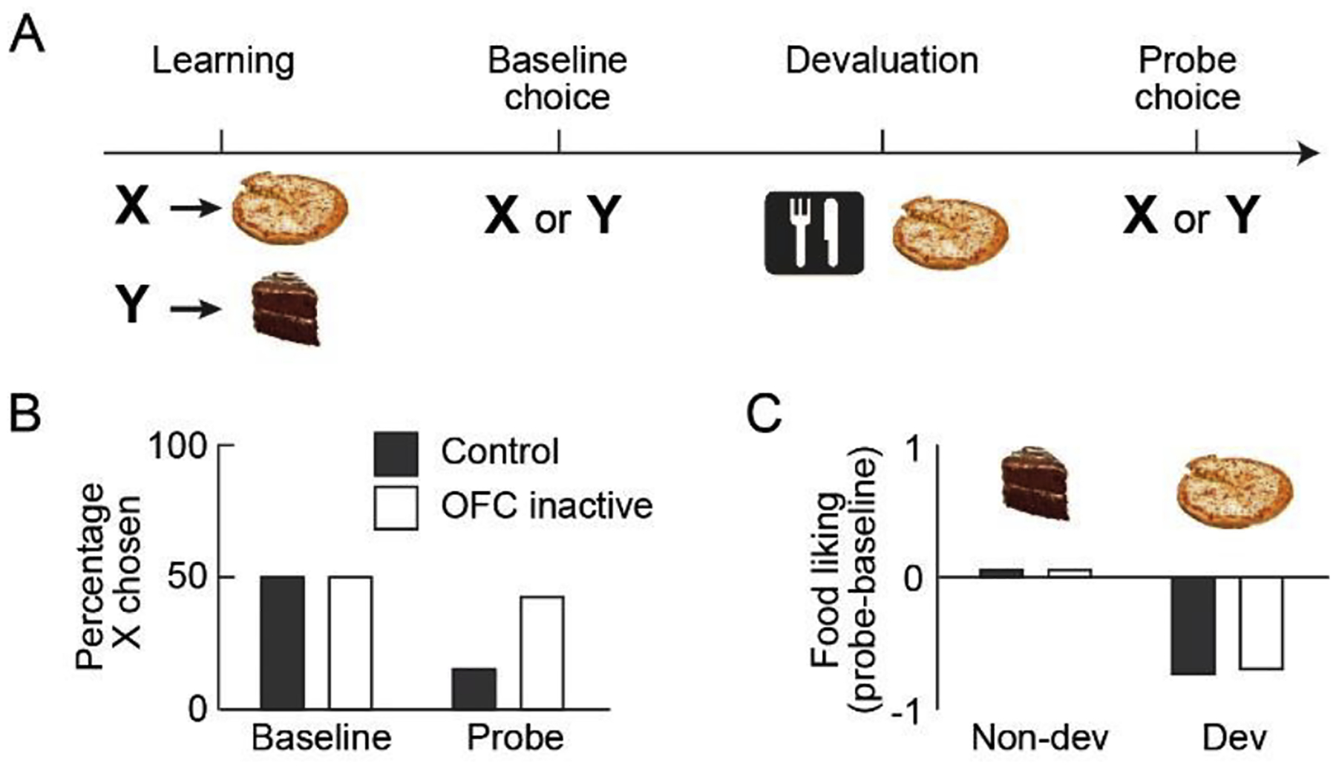
Outcome-specific devaluation using food odors in humans
Howard et al. (2020), Current Biology
Howard & Kahnt (2021), Curr Opin Behav Sci.
Liu et al. (2025), Current Biology
Notes:
Previous studies from our lab developed a method to study outcome-specific devaluation in humans using food odors as rewards.
From a set of sweet and savory odors, two are selected and matched in pleasantness.
Participants then learn associations between visual cues and these specific odors.
Because the identity of each odor is known, its value can later be selectively reduced using sensory-specific satiety, allowing researchers to test how behavior depends on the current value of specific predicted outcomes.
We adapted this approach to test whether inferred outcomes in sensory preconditioning include reward identity.

Slide 8
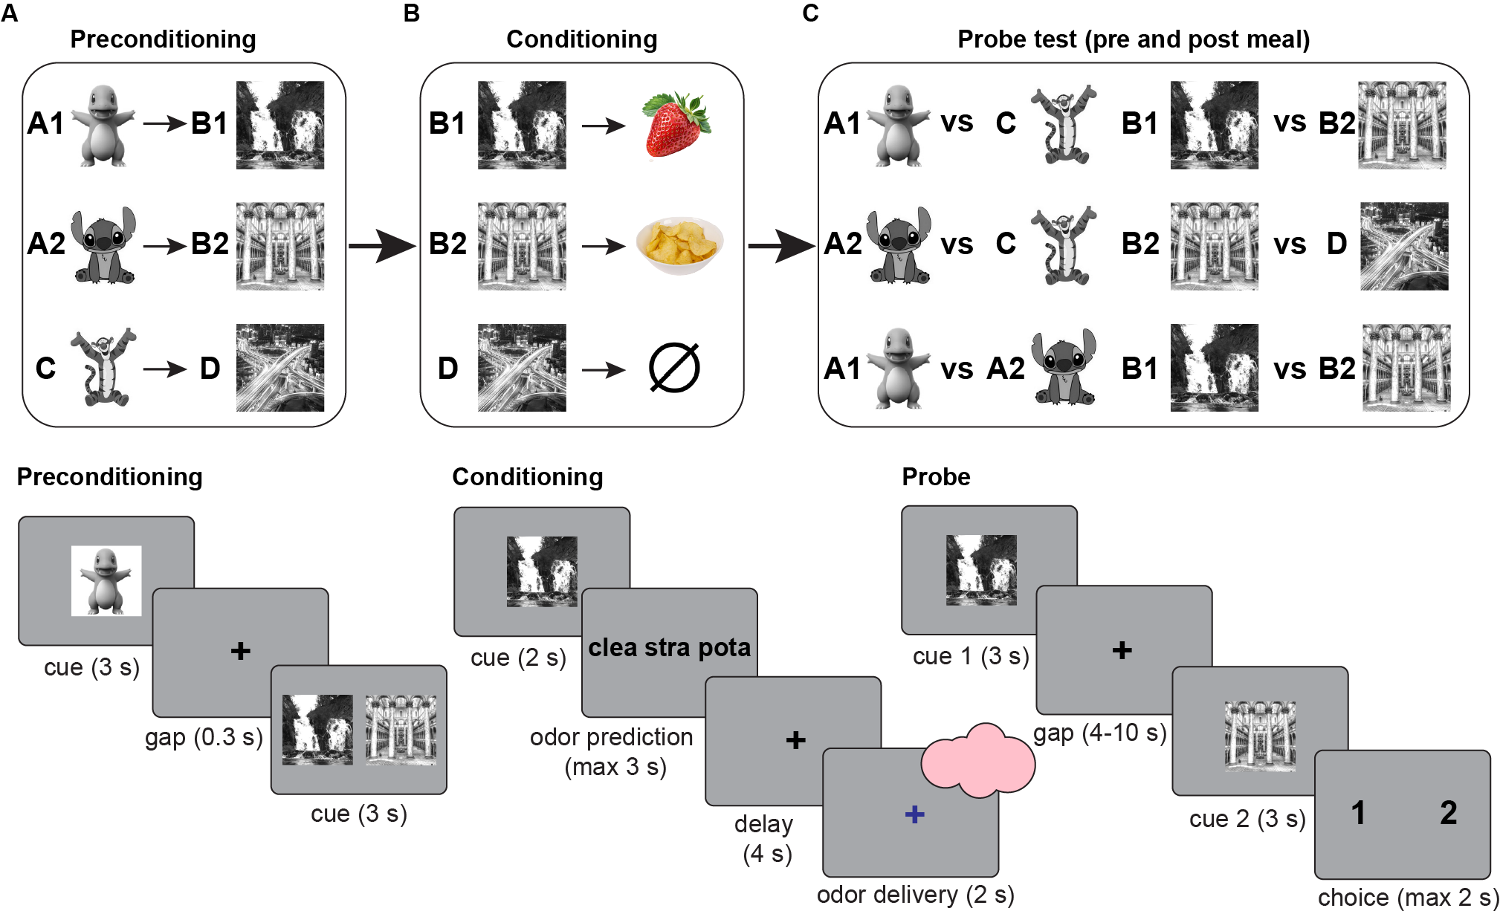
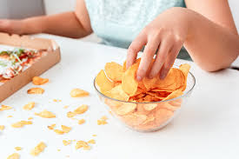
Experimental design: Sensory preconditioning with outcome-specific devaluation
Selective satiation meal occurs between two probe tests
N = 32 participants
Notes:
The experiment consists of three phases.
In the preconditioning phase, participants learn associations between neutral cues, such as A predicting B and C predicting D.
In the conditioning phase, B and D are paired with specific food odors.
During the probe test, participants make choices between the preconditioned cues, such as A versus C, allowing us to measure inference.
Importantly, participants complete a probe test before and after a meal that selectively devalues one odor.
If inference includes reward identity, then responses to the preconditioned cue predicting the devalued odor should decrease after the meal.
Ppts were inside the scanner during the conditioning and probe tests.

Slide 10
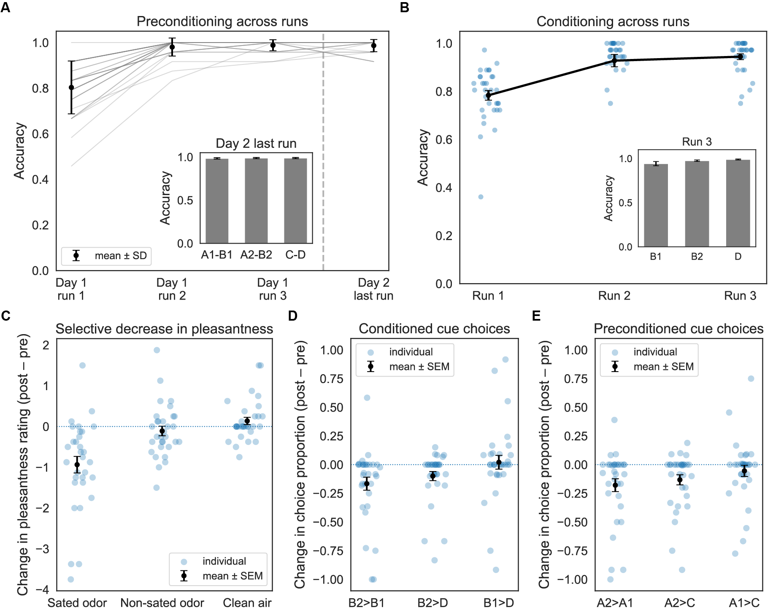
Participants successfully learned the cue–cue associations during preconditioning.

Slide 11
Participants successfully learned the cue–odor relationships during conditioning.

Slide 12
Selective satiation reduced pleasantness of the sated odor only, confirming successful devaluation.
Notes:
Panel C shows the change in odor pleasantness ratings from before to after the meal.
Negative values indicate reduced pleasantness.
As expected, the odor corresponding to the consumed meal shows a significant decrease in pleasantness, whereas the non-sated odor and clean air remain stable.
This confirms that the selective satiation manipulation successfully devalued one odor.
With the manipulation confirmed, we next asked how devaluation affected choice behavior in the probe test.

Slide 13
Choices for conditioned cues shifted away from the devalued odor predictor after the meal.
B2: Sated-odor predictor
A2: Sated-odor predictor
Notes:
Panel D shows the change in probe choices for conditioned cues from pre- to post-meal.
Here we look at choices between cues that directly predicted the two odors.
The change in choice proportion reflects whether participants shifted their preference after the meal.

Slide 14
Choices for preconditioned cues changed after devaluation, indicating inference about the expected outcome.
B2: Sated-odor predictor
A2: Sated-odor predictor
Notes:
Finally, Panel E shows the change in probe choices for preconditioned cues.
These cues were never directly paired with odors, so responding to them requires inference through the associative chain.
The key question is whether devaluation also affects these inferred choices.

Slide 15
Choice behavior tracks the relative pleasantness of predicted odors, even for preconditioned cues that require inference.
Notes:
Here we examine the relationship between participants’ odor value ratings and their choice behavior. Each panel plots the difference in odor pleasantness against the probability of choosing the corresponding cue. Across both conditioned cues and preconditioned cues, we observe a positive correlation: cues predicting more pleasant odors are chosen more often. Importantly, this relationship is present both before and after the meal, indicating that participants’ choices track the current value of the predicted odor, even when the outcome must be inferred.

Slide 16
Changes in odor value predict changes in probe choices, linking devaluation to decision behavior.
Notes:
Here we relate changes in odor pleasantness after the meal to changes in probe choices. Participants who showed larger decreases in odor value also showed larger shifts in choice behavior. This relationship is evident for conditioned cues and also appears for preconditioned cues, suggesting that changes in outcome value influence both direct and inferred decisions.

Slide 17
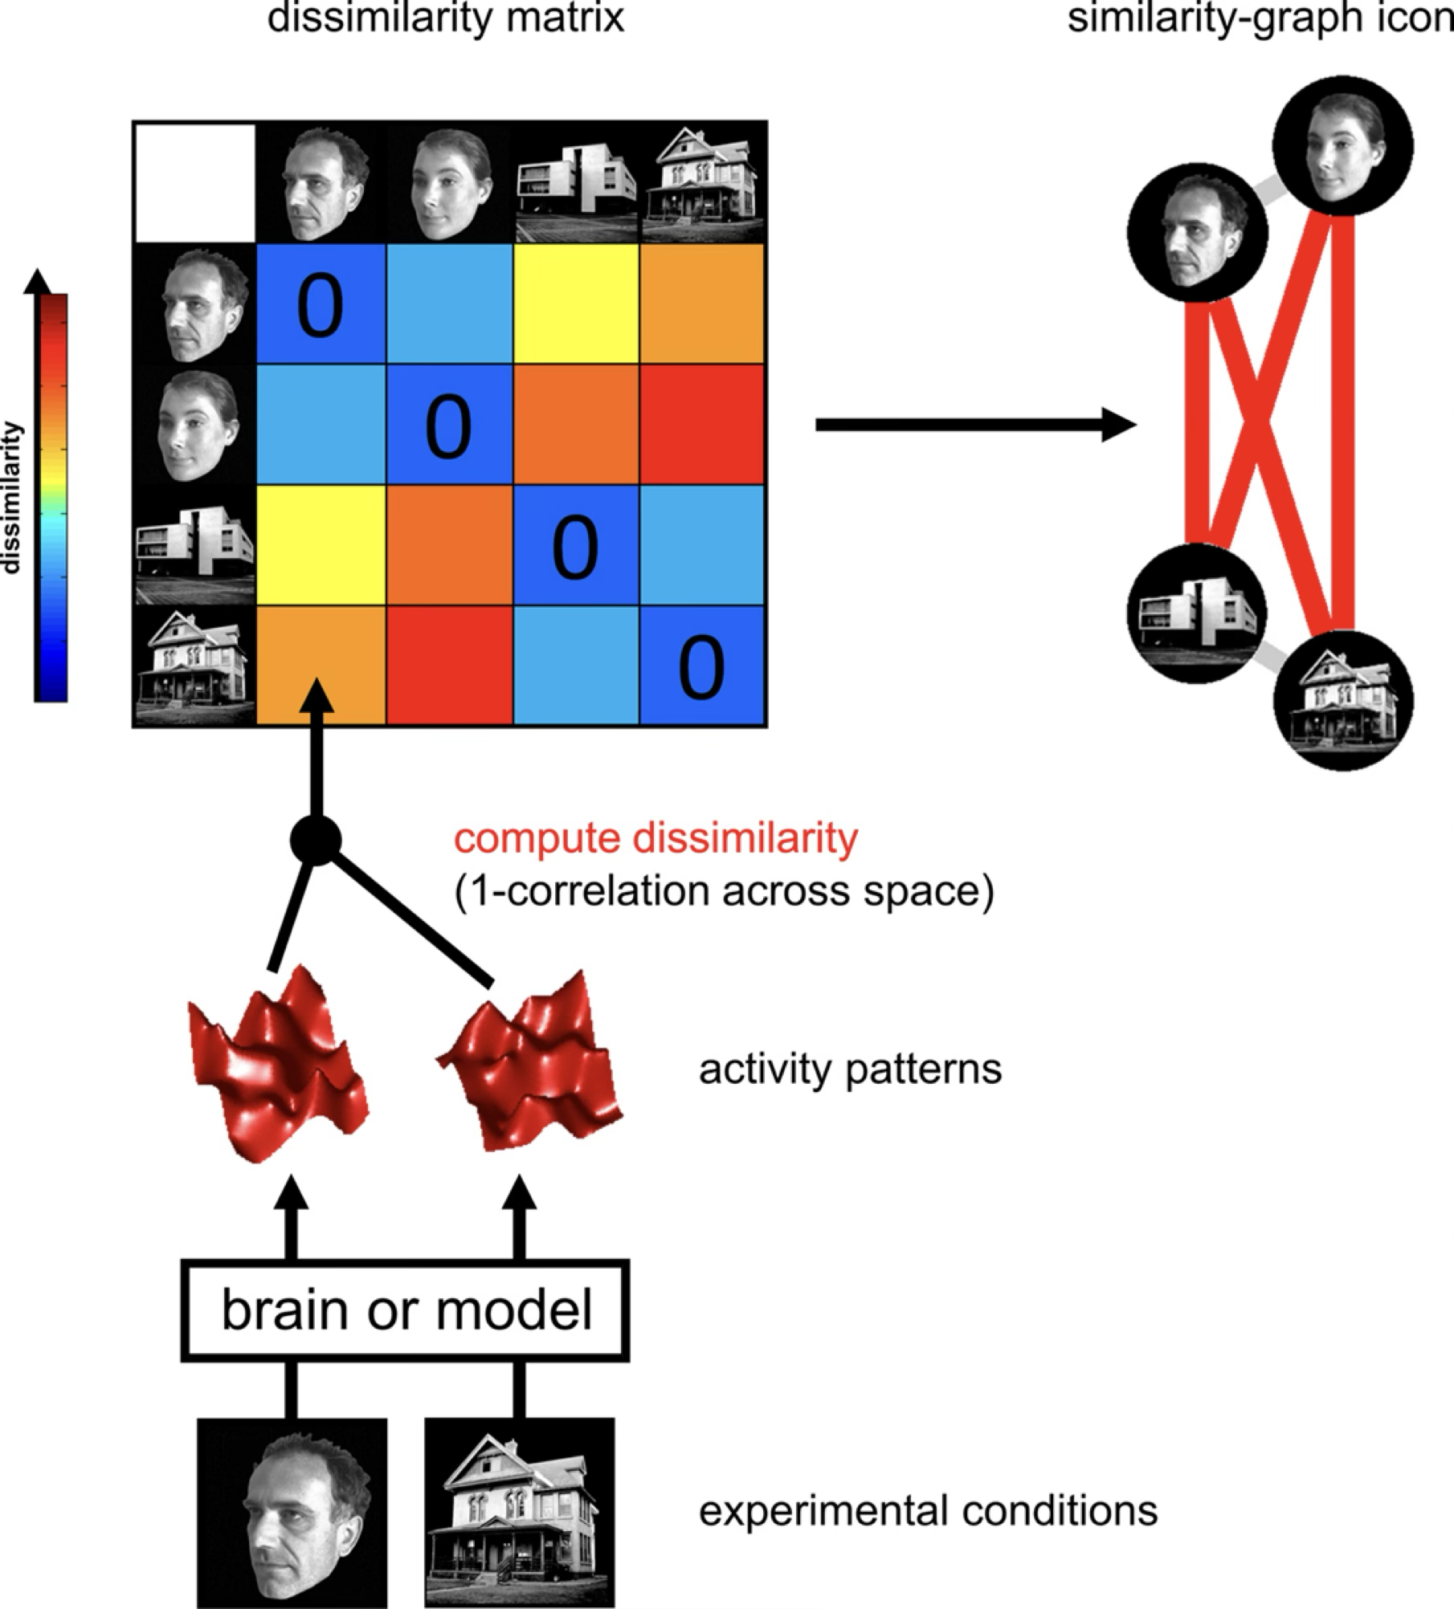
Kriegeskorte et al., 2008

Slide 18
Ongoing fMRI data analysis
Where are value and identity representations encoded in the brain?
Do neural representations differ for inferred vs. directly learned value?
Do neural representations differ for inferred vs. directly learned identity?
How are these representations modulated by selective satiation?
Notes:
In parallel, we are analyzing the fMRI data to examine where value and identity representations are encoded in the brain, and whether neural representations differ for inferred versus directly learned outcomes, particularly in OFC and hippocampus.

Slide 20

Acknowledgments
Thorsten Kahnt, Ph.D.
Geoffrey Schoenbaum, M.D., Ph.D.
Angela Langdon, Ph.D.
Avinash Vaidya, Ph.D.
Phil Witkowski, Ph.D.
Clara Raithel, Ph.D.
Lindsay Shaffer, Ph.D.
Cassidy Schweibenz
Jaylen Worthy
Vasudha Attanti
Rhianna Sullivan
Salma Younis
Center on Compulsive Behaviors (CCB) Fellowship Program
Special thanks to CNSB members who assisted with odor/food testing and study piloting.

