Slide 1
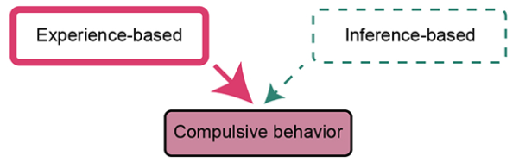
Roles of the human orbitofrontal cortex and hippocampus in inference-based decision-making
Qingfang Liu, NIDA IRP
September 20, 2024
Mentor: Thorsten Kahnt, Ph.D., NIDA IRP
Co-mentor: Geoffrey Schoenbaum, Ph.D., NIDA IRP
Co-mentor: Angela Langdon, Ph.D., NIMH IRP

Slide 2
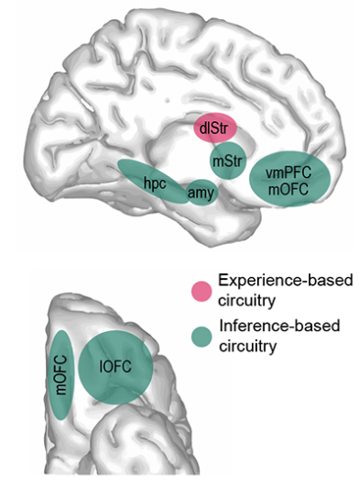
Inference-based decision-making refers to making decisions on novel stimuli, without knowing their outcomes.
The inability to infer potential outcomes is a hallmark of substance use disorder (SUD) and obsessive-compulsive disorder (OCD).
The orbitofrontal cortex (OFC) and hippocampus (HPC) are implicated in inference-based behaviors.
Kahnt, 2023, Biol Psy
Notes:
I’d like to begin by introducing two types of decision-making. The first is experience-based, where decisions are made based on past experiences. The second is inference-based, where decisions are made on novel stimuli, requiring us to infer potential outcomes.
This distinction is important in understanding compulsive behavior. When individuals become overly reliant on past experiences and struggle to make inferences in novel situations, compulsive behaviors can emerge.
Because OFC and HPC have been considered important in inference-based behaviors

Slide 3
Goal: To investigate causal roles of human OFC and HPC to inference-based decision-making
Notes:
In this project, I want to study the causal roles of XXX

Slide 4
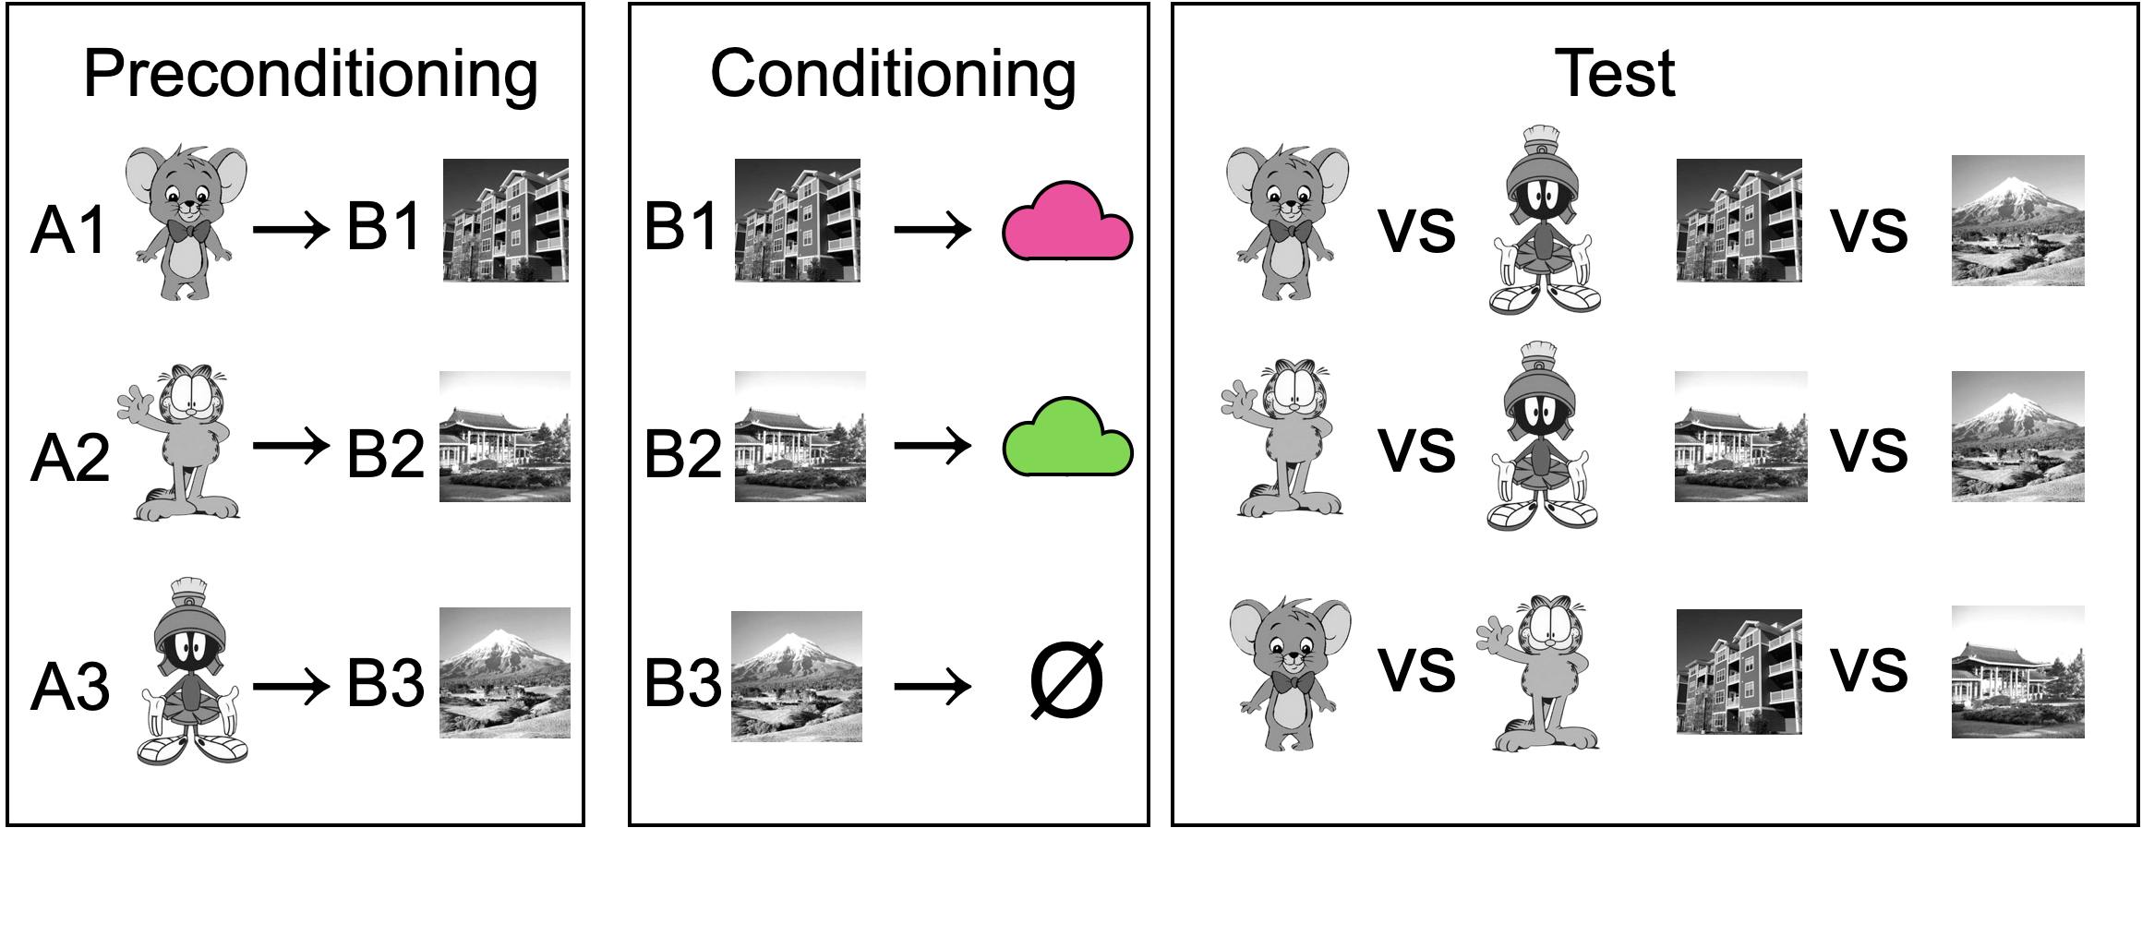
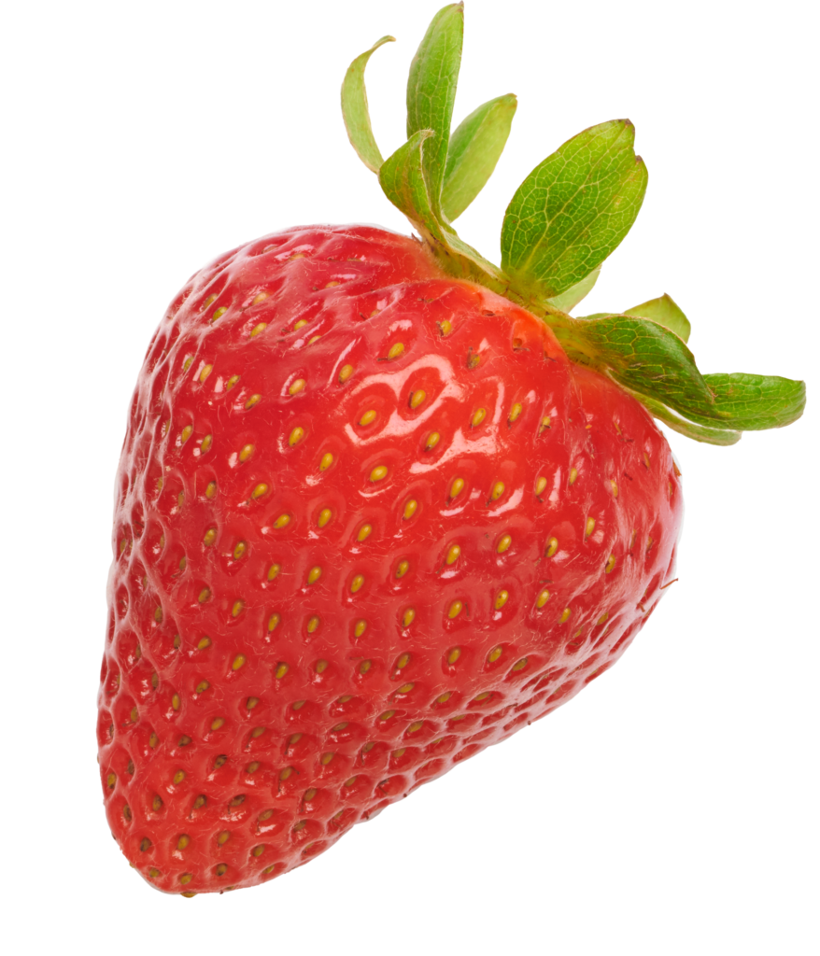
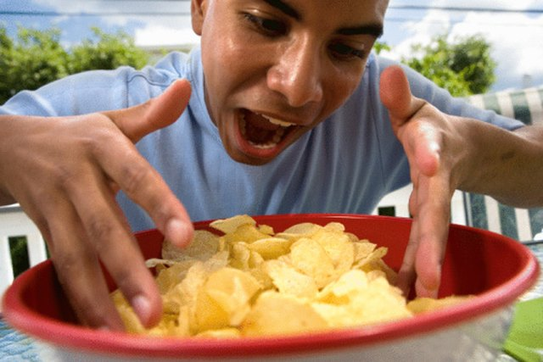
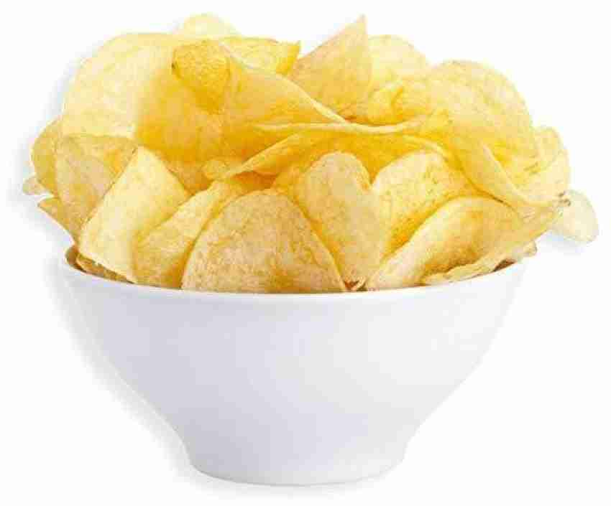
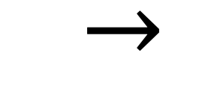

Repeat the Test
  $→$
  $→$
  $→$
Eat a meal paired with B2
Notes:
To achieve this goal, I use a modified version of sensory pre-conditioning task and invite hungry healthy human ppts come to my study.

Slide 5
Repeat the Test
  $→$
  $→$
  $→$
Eat a meal paired with B2
Notes:
As a ppt, you will first learn the associations between some characters and some places.
Then you will be asked to learn to predict what food odor each place has. I use food odors as a type of rewarding outcome for hungry ppts.
After that, you will be asked to select between different characters or between different places.
This is followed by a selective satiation procedure where I overfeed the ppt with food corresponding to one food odor, and the goal is to reduce their preference to the corresponding odor relative to the other one.
Then the ppt will do the test again.

Slide 6
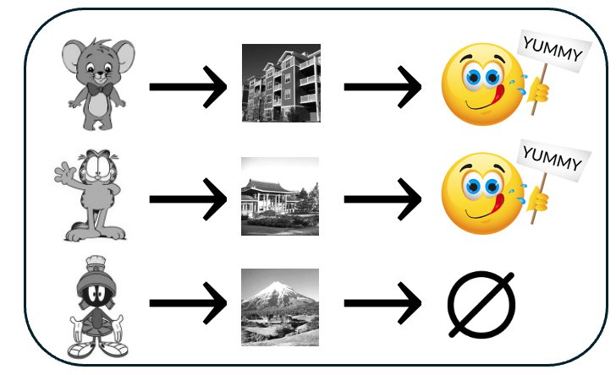
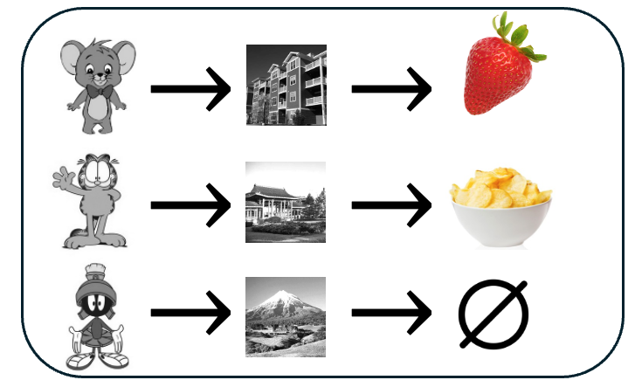
Repeat the Test
  $→$
  $→$
  $→$
Eat a meal paired with B2
Inference of general value
Inference of specific outcomes
Assess through pre-meal test
Assess through post-meal test
Notes:
The critical part of this task is that ppts never directly learn what odors are paired with the characters and ppts need to infer their potential outcomes.
Two slightly different inference mechanisms might be involved. One mechanism is that people form some chaining structure which tells them whether the character may predict some rewarding outcome or not. This is apparently very important for hungry people. And I want to assess this inference mechanism from the pre-meal test.
Another inference mechanism is that people form more detailed chaining structure that allows them to infer specific rewarding outcomes of those characters. And I want to assess this inference mechanism from the post-meal test.

Slide 7
Repeat the Test
  $→$
  $→$
  $→$
Eat a meal paired with B2
Inference of general value (pre-meal)
Hypothesis:
OFC only contributes to the inference of specific outcomes
HPC contributes to the inference of both general value and specific outcomes
Inference of specific outcomes (post-meal)
Notes:
The two inference mechanisms may both exist, but they may be supported by different brain regions. In this project, I want to test different contributions of the OFC and HPC, such that XXX

Slide 8
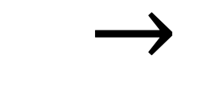
Use TMS to modulate brain activity
Repeat the Test
  $→$
  $→$
  $→$
Eat a meal paired with B2
Notes:
Specifically, I want to use TMS to modulate brain activity during the conditioning phase, because this is when the chaining structures may have developed.

Slide 9
Repeat the Test
  $→$
  $→$
  $→$
Eat a meal paired with B2
Preliminary behavioral data
Notes:
I’ve collected preliminary behavioral data from 5 pilot ppts, without using TMS yet.
Before the meal, ppts showed a preference for choosing place stimuli associated with food odors. A similar pattern was observed with character stimuli.
This indicates that ppts are able to infer general value based on the associative structure.

Slide 10
Repeat the Test
  $→$
  $→$
  $→$
Eat a meal paired with B2
Preliminary behavioral data
Notes:
After the meal, ppts shifted their preference toward place stimuli predicting the non-sated odor, reflecting the standard devaluation effect.
Ppts also have shifted their preference on character stimuli. This suggests that ppts can infer specific outcomes of the character stimuli based on their associations.

Slide 11
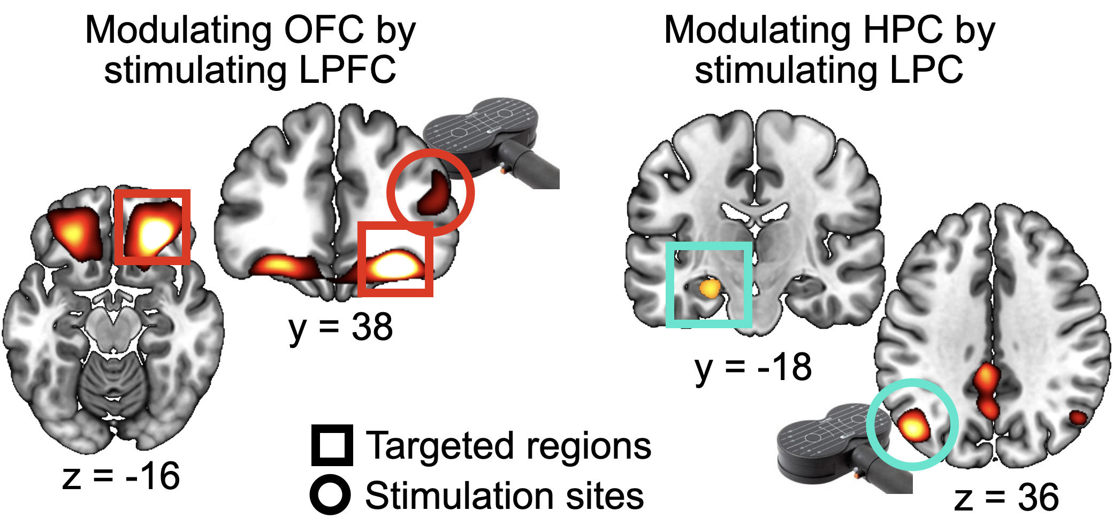
Network-targeted TMS
LPFC: lateral prefrontal cortex
LPC: lateral parietal cortex
Notes:
Lastly, modulating brain activity in the OFC or HPC using TMS is not a trivial problem, because both brain structures cannot be directly accessed by TMS.
I want to use network-targeted TMS, and this method leverages functional connectivity structures to directly stimulate the LPFC, or the LPC.
This works as an indirect way to modulate the OFC or HPC activity.

Slide 12



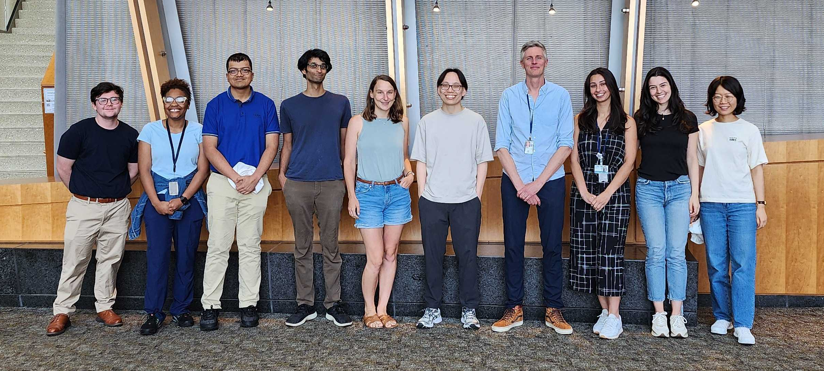
Acknowledgement
Mentor: Thorsten Kahnt, Ph.D.
Co-mentor: Geoffrey Schoenbaum, Ph.D.
Co-mentor: Angela Langdon, Ph.D.
Postdocs:
  Avinash Vaidya, Ph.D.
  Phil Witkowski, Ph.D.
  Clara Raithel, Ph.D.
  Daria Porter, Ph.D.
Postbacs:
  Noelle Henein
  Taaseen Khan
  Nicole Moussa
  Carter Sale
  Yao Zhao (now at UPenn)
Research coordinator:
  Cassidy Schweibenz
Notes:
With that, I want to thank my mentor Thorsten, co-mentors Geoff and Angela for their support to this project. I also want to thank all the other lab members for their helpful discussions, especially Carter, Taaseen, and Yao for their assistance in data collection.

