Slide 1
From pieces to pipeline: Why AI isn’t ready for end-to-end systematic review and meta-analysis

Slide 2
Paper outline
1. Introduction: why systematic review matters + brief intro of AI trend on it
2. Current landscape
  2.1 LLM use in stagewise SR tasks
  2.2 Agentic system and end-to-end pipeline
3. Missing pieces in AI-assisted SRs
4. Future directions
5. Conclusion
Notes:
Source: AI_end_to_end_SR_perspective.pdf, Sections 1–5, pp. 1–9.

Slide 3
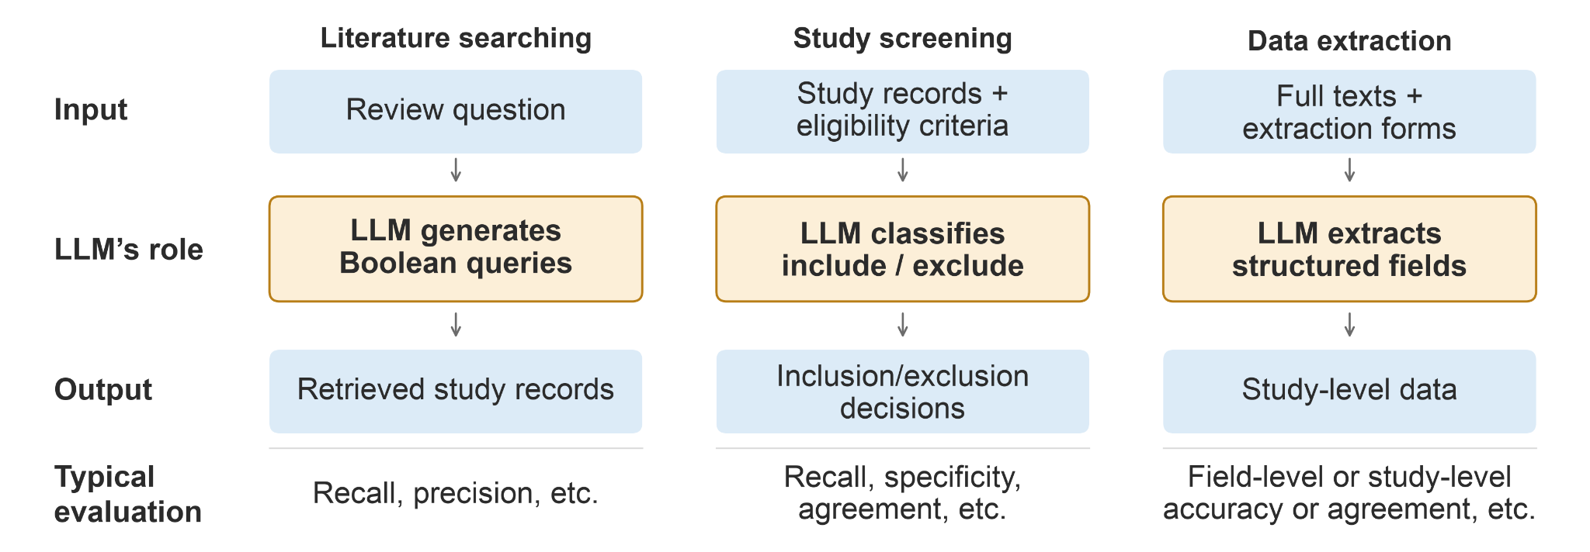
2. Current landscape of AI-assisted SR
2.1 Most LLM research targets searching, screening and extraction.

Slide 4
LLM performance on stagewise tasks
Searching: Poor retrieval —68–96% of relevant studies missed [2]
Screening: Promising but inconsistent—median positive agreement of 92% for titles/abstracts and 93% for full texts [1], but substantial errors reported (median incorrect inclusion decisions 10%, median incorrect exclusion decisions 28%) [2]
Data extraction: High median accuracy (95%), but wide variability (36–100%) [1]; numerical extraction is more difficult than categorical extraction [3]; Better for simple fields; worse for outcome data and intervention descriptions [2].
References
[1] Laignelot et al. (2026). J Clin Epidemiol, 194, 112221.
[2] Clark et al. (2025). Res Synth Methods, 16, 601–619.
[3] Scherbakov et al. (2025). J Am Med Inform Assoc, 32, 1071–1086.

Slide 5
2.2 Agentic systems and end-to-end pipeline

Slide 6
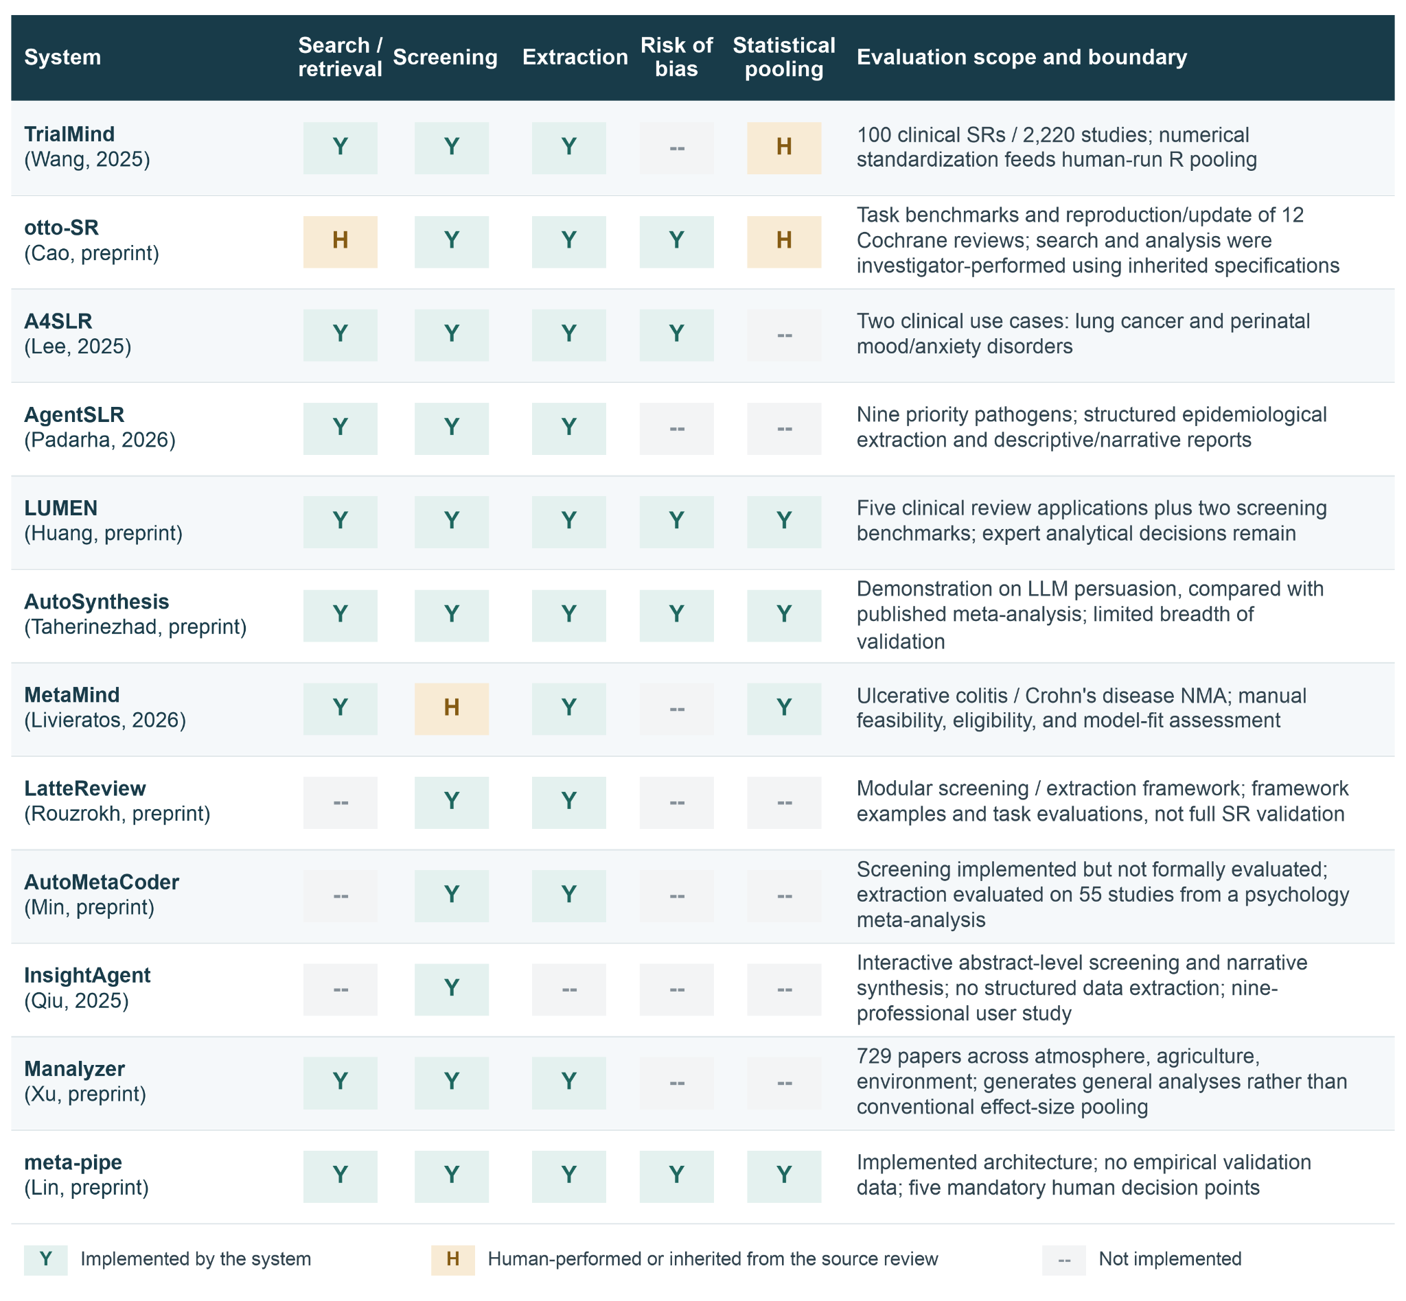
Notes:
Source: AI_end_to_end_SR_perspective.pdf, Figure 2, p. 4. Original figure retained from the supplied presentation.

Slide 7
3. Missing pieces in end-to-end SRs and MAs
3.1 Deciding what is worth reviewing
3.2 Establishing review-level PICO-S
3.3 Extraction specifications and outcomes
3.4 Characterizing error propagation
3.5 Integrating multiple data sources
3.6 Assessing risk of bias reliably
3.7 Keeping pace with evolving LLMs
3.8 Distinguishing the roles humans play
Notes:
Source: AI_end_to_end_SR_perspective.pdf, Sections 3.1–3.8, pp. 3–9.

Slide 8
3.1 Deciding what is worth reviewing
A useful question addresses an important knowledge gap or a growing body of primary evidence.
  The question shapes the protocol, eligibility criteria, search and analysis.
  A well-conducted review adds little if the question is redundant or unimportant.
Current pipelines generally start with a human-defined question or protocol.
Notes:
Source: AI_end_to_end_SR_perspective.pdf, Section 3.1, p. 3.

Slide 9
3.2 Establishing review-level PICO-S
PICO-S defines the population, intervention, comparator, outcome and study design for the review.
How PICO is formulated for a review is generally overlooked in current agentic systems.
Notes:
Source: AI_end_to_end_SR_perspective.pdf, Section 3.2 and Figure 3, pp. 3–5.

Slide 10
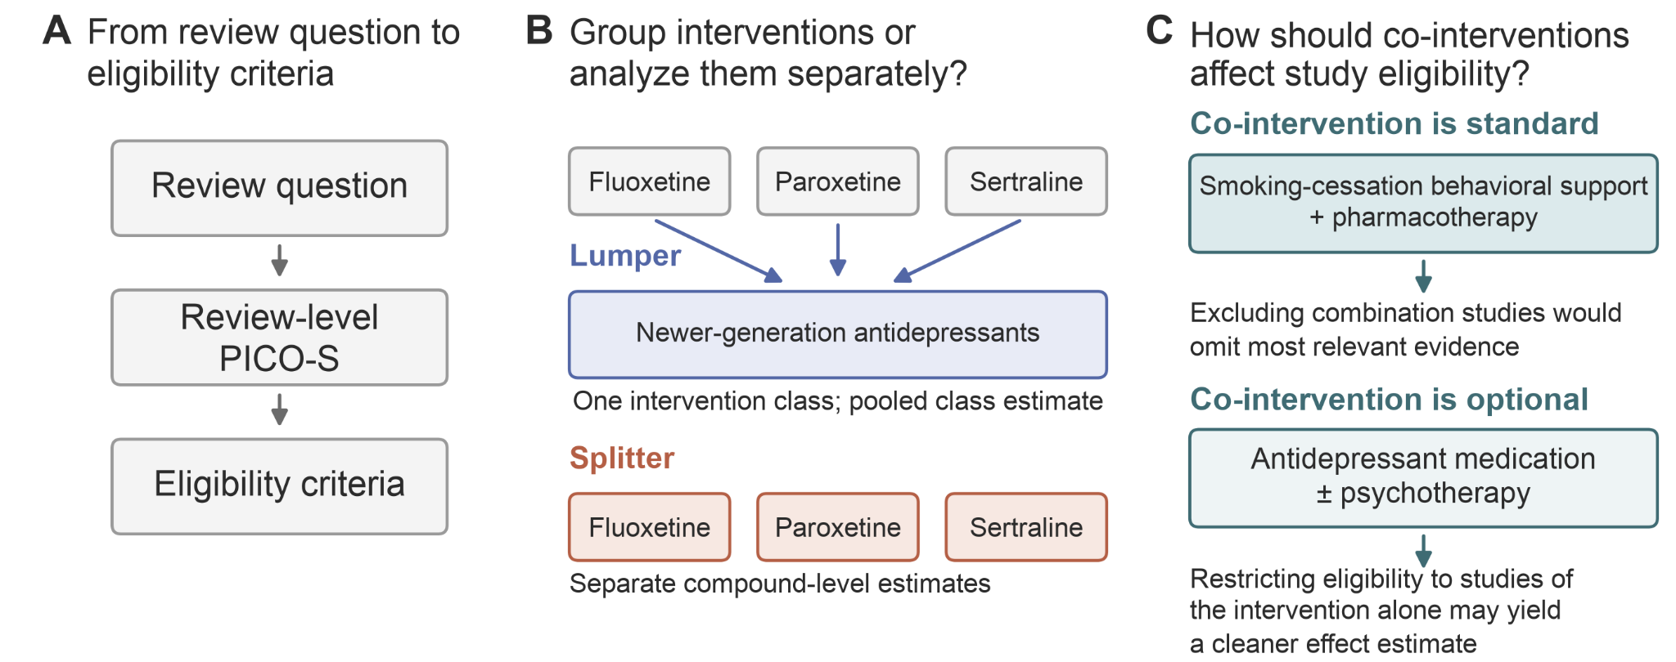

Slide 11
3.3 Extraction specifications and outcome alignment
Existing LLM-based data extraction studies typically start with a predefined extraction form: outcome name, effect measure, etc.
Notes:
Source: AI_end_to_end_SR_perspective.pdf, Section 3.3 and Figure 4, pp. 5–6.

Slide 12
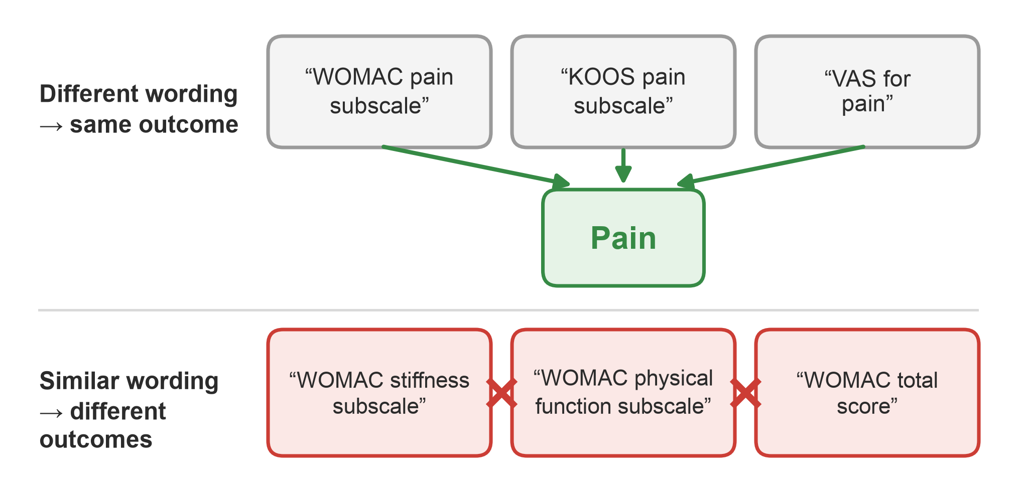
Notes:
Source: AI_end_to_end_SR_perspective.pdf, Figure 4, p. 6. Original figure retained from the supplied presentation.

Slide 13
Notes:
Source: AI_end_to_end_SR_perspective.pdf, Figure 4, p. 6. Original figure retained from the supplied presentation.

Slide 14
3.3 Extraction specifications and outcome alignment
Existing LLM-based data extraction studies typically start with a predefined extraction form.
Extraction performance is affected by the accuracy of outcome definition.
Core Outcome Measures in Effectiveness Trials (COMET) Initiative may reduce ambiguity through standardized definitions.
Notes:
Source: AI_end_to_end_SR_perspective.pdf, Section 3.3 and Figure 4, pp. 5–6.

Slide 15
3.4 Characterizing error propagation
Upstream mistakes in search and screening can pass into extraction and alter the final synthesis.
Aggregate accuracy can hide uncommon errors with substantial downstream impact.
Evaluation should trace consequential edge cases throughout the pipeline.
Notes:
Source: AI_end_to_end_SR_perspective.pdf, Section 3.4 and Figure 5, pp. 6–7.

Slide 16
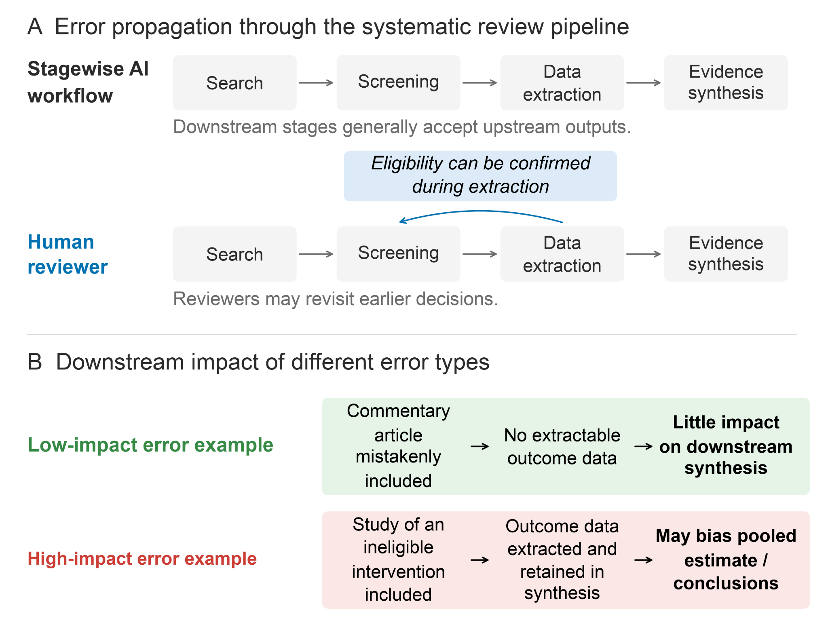
Notes:
Source: AI_end_to_end_SR_perspective.pdf, Figure 5, p. 7. Original figure retained from the supplied presentation.

Slide 17
3.5 Integrating multiple data sources
Relevant data may appear in article text, tables, figures or supplementary materials.
  Outcomes with nonsignificant findings are particularly vulnerable to incomplete or selective reporting.
Human reviewers may contact study authors to resolve ambiguity or obtain missing data.
  Automated outreach raises questions about professional credibility and the burden on study authors.
Notes:
Source: AI_end_to_end_SR_perspective.pdf, Section 3.5, p. 7.

Slide 18
3.6 Assessing risk of bias reliably
Risk-of-bias judgments affect confidence in pooled effect estimates.
AI agreement with human judgments varies widely across studies and assessment tools.
RoB assessment by AI is mostly studied separately
    The effect of incorrect AI judgments on synthesis results and their interpretation remains understudied.
Notes:
Source: AI_end_to_end_SR_perspective.pdf, Section 3.6, p. 8.

Slide 19
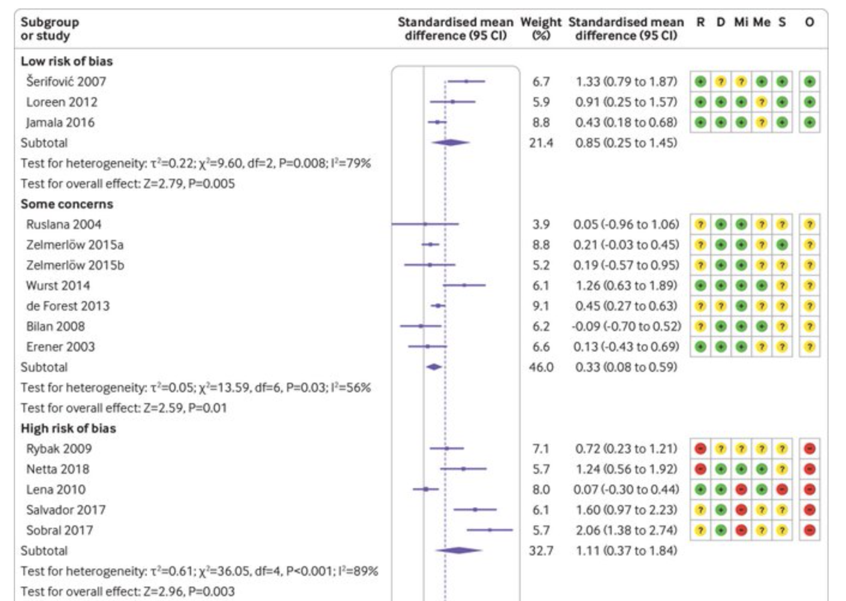

Slide 20
3.7 Keeping pace with evolving LLMs
Performance across stages of an AI-assisted SR depends substantially on the capabilities of the underlying LLM.
  Model performance appears to be task dependent: a model that excels at one stage may not necessarily be optimal at another.
The field lacks a widely adopted benchmark suite maintained across tasks, domains and model generations.
Notes:
Source: AI_end_to_end_SR_perspective.pdf, Section 3.7, p. 8.

Slide 21
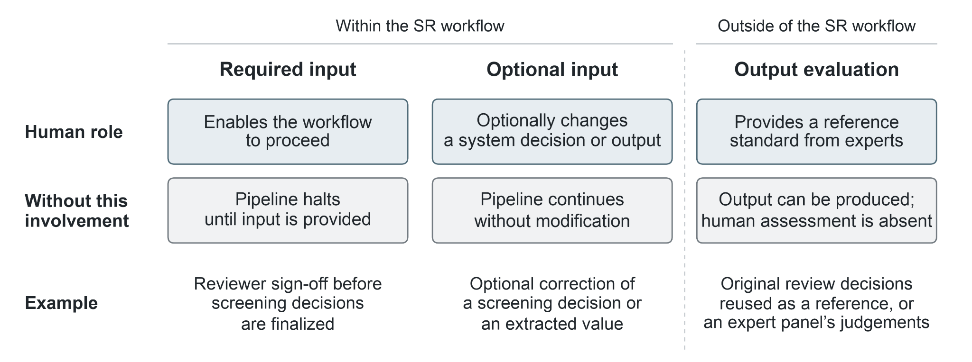
3.8 Distinguishing the roles humans play
Systems should specify human tasks and decision points when reporting performance.
Notes:
Source: AI_end_to_end_SR_perspective.pdf, Section 3.8 and Figure 6, pp. 8–9.

Slide 22
4. Future directions
Study neglected decisions in the pipeline
  Upstream choices: question selection, PICO-S formulation and outcome alignment.
Evaluation & benchmarking
  Build and continuously update benchmarks linking review questions to included studies, extracted data, and pooled results.
  Explicitly evaluate performance on critical edge cases, such as easily missed or misclassified studies.
  Track model versions and assess whether the complete pipeline preserves the validity and robustness of the final synthesis.
Define Human Involvement
  Conduct experiments evaluating how different modes and depths of human involvement affect task performance.
  Integrate human-AI interaction mechanics explicitly into system evaluations (specifying where and how humans intervene).
Improve data reporting & cleaning
  Standardize data reporting across abstract, full-text articles, supplement
  Build database serving as “mirrors” of the original papers to streamline SRs

Slide 23
5. Conclusion
LLMs can substantially assist systematic reviews and meta-analyses.
Current workflows still omit decisions essential to a complete review.
Reliable automation requires evidence about final synthesis quality and the downstream effects of errors.
Model evolution and human involvement must remain explicit in evaluation and reporting.
Reliable autonomous systematic review remains an unfulfilled goal.
Notes:
Source: AI_end_to_end_SR_perspective.pdf, Section 5, p. 9.

