Slide 1

Stock Price Prediction
Qinglin Gou

Slide 2
Part 0
Introduction of Project

Slide 3
Scenario
Our client is an investment company, and we are the data scientists of a third party fintech company they hire. The investment company needs to make a portfolio of financial products and our task is to provide the market analysts with the most accurate and short-term stock price predictions to Improve the investment company's performance.

Slide 4
The problem description
This project aims to develop a predictive model for accurately forecasting stock prices using historical market data, which includes a comprehensive set of technical indicators. The primary input involves detailed financial data, reflecting various market trends and movements. The output will be a set of predicted future stock prices, offering insights into potential market directions. Our objective is to harness advanced machine learning techniques to interpret this complex, high-dimensional data effectively, thereby providing valuable predictive tools for investors and market analysts.
Input:
Stock price from Yahoo Finance, including daily open, close, high, and low prices.
Technical indicators to serve as features calculated by daily close price.
Output:
Feature engineering techniques – Without FE, PCA, t-SNE, Boruta.
ML models for prediction – Linear regression, Random forest, Lasso regression, LSTM
Evaluation – Mean Absolute Error (MAE), Root Mean Squared Error (RMSE), and Mean Squared Error (MSE)
Select the best Feature engineering techniques + ML model combo based on the performance evaluation.

Slide 5
The dataset description
Apple stock price(AAPL) from Yahoo Finance website
Data | Apple stock price
Data Range | 2018/01/01 - 2024/01/26
Type | Csv file
Interval | Daily
volume | 1527 Rows
Features | 31
label | 1

Slide 6
The dataset description
Apple stock price(AAPL) from Yahoo Finance website
Scope and Relevance: The dataset from Yahoo Finance includes comprehensive historical stock prices and volumes, aligning well with the project's aim of predicting stock prices.
Source Credibility: The dataset from Yahoo Finance is highly credible, known for accuracy and comprehensive financial data coverage, making it an ideal source for the stock price prediction project.
Data Structure: The dataset is a time-series in a tabular format (CSV), including date-stamped records of stock prices and trading volumes, suitable for chronological analysis and forecasting.
Data Volume: The dataset comprises years of historical stock data for training and one year for testing, with variables like open, close, high, low prices, and volume, suitable for time-series analysis and model training.
Sample Representativeness: Several years of historical stock data for training and one year for testing from Yahoo Finance provide a representative sample of the stock's behavior in various market conditions.
Data Collection Method: The data was collected electronically from Yahoo Finance, ensuring high accuracy and minimal bias.
Temporal Relevance: The dataset, covering the past years, is timely and historically relevant for analyzing short to medium-term market trends and predicting stock prices.
Data Privacy and Ethics: No significant privacy or ethical concerns with the dataset from Yahoo Finance, as it contains publicly available market information.
Data Quality and Completeness: The data from Yahoo Finance is of high quality, with reliability and completeness, and occasional missing values or inconsistencies do not significantly impact its usability for stock price analysis.

Slide 7
Part 1
Data Preparation

Slide 8
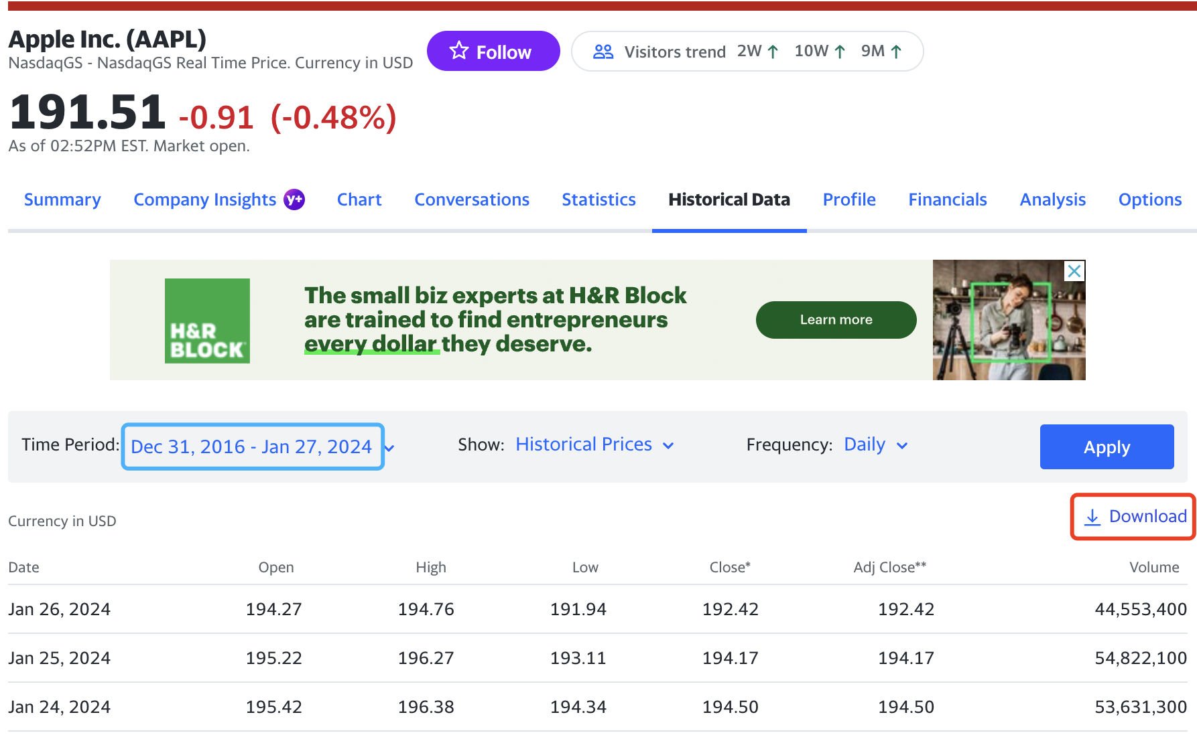
Obtaining Data
We download historical stock prices from Yahoo Finance website：

Slide 9
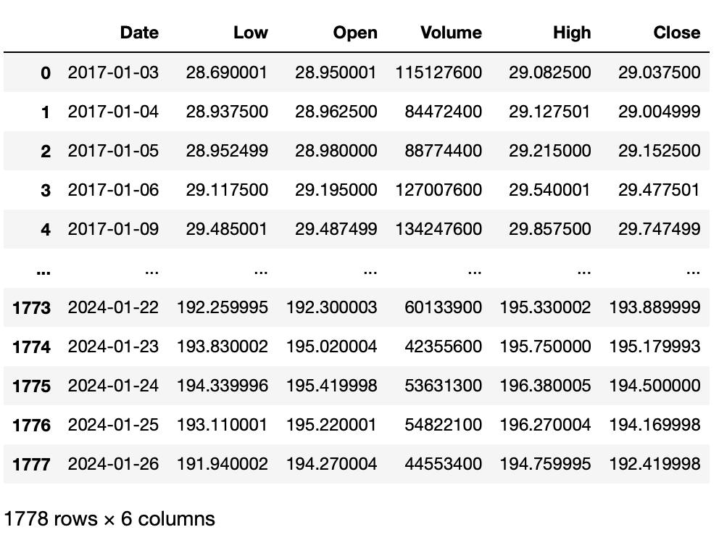
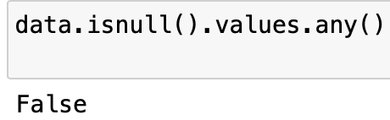
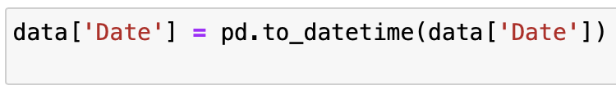
Data Processing
Use Python or Excel to check whether there’s any null or outliers
For there’s no wrong or blank historical data in this dataset, we don’t need to do much data clean.

Slide 10
Part 2
Study and Application of Technical Indicators

Slide 11
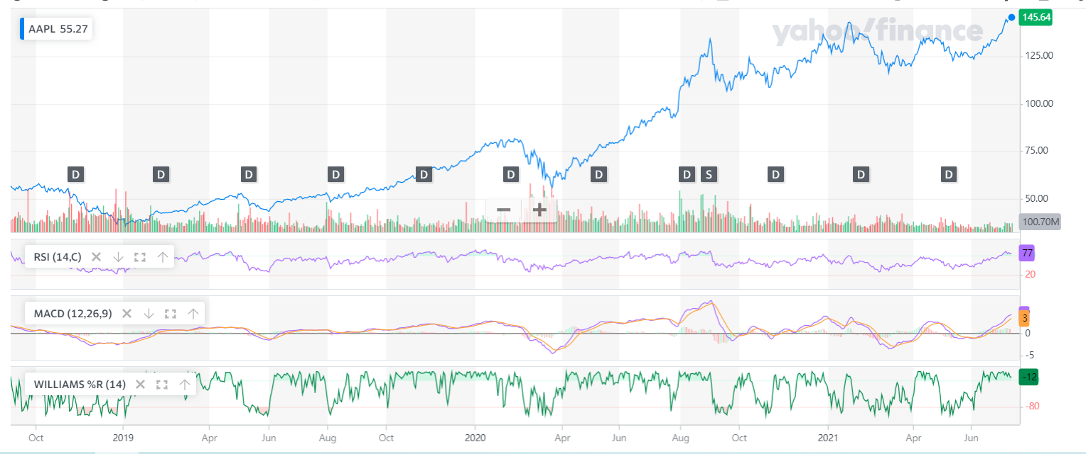
Stock Technical Indicators (STIs)
Common Technical Indicators
Simple moving average (SMA)
Exponential moving average (EMA)
Moving average convergence divergence (MACD)
Relative strength index (RSI)
The Momentum Indicator (MOM)
Stochastic oscillator (SO)
The accumulation/distribution indicator (A/D)
The Commodity Channel Index (CCI)
Williams percentage range (W%R)
Technical indicators can be useful while predicting the future prices of assets so they can be integrated into automated trading systems.

Slide 12
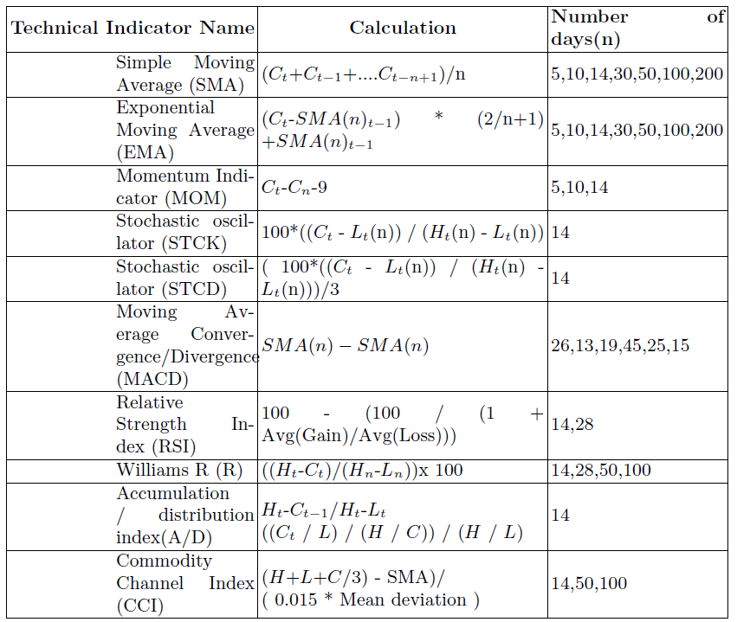
Stock Technical Indicators (STIs)
In our solution, we consider only the closing price of AAPL. From the data, we calculate 30 indicators.

Slide 13
