Slide 1
TF卷积函数
8-4

Slide 2
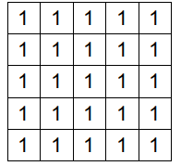
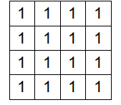
Input函数 # [batch, in_height, in_width, in_channels] [训练时一个batch的图片数量, 图片高度, 图片宽度, 图像通道数]
input = tf.Variable(tf.constant(1.0,shape = [1, 5, 5, 1]))
input2 = tf.Variable(tf.constant(1.0,shape = [1, 5, 5, 2]))
input3 = tf.Variable(tf.constant(1.0,shape = [1, 4, 4, 1]))

Slide 3






Filter函数 # [filter_height, filter_width, in_channels, out_channels] [卷积核的高度，卷积核的宽度，图像通道数，卷积核个数]
filter1 = tf.Variable(tf.constant([-1.0,0,0,-1],shape = [2, 2, 1, 1]))
filter2 = tf.Variable(tf.constant([-1.0,0,0,-1,-1.0,0,0,-1],shape = [2, 2, 1, 2]))
filter3 = tf.Variable(tf.constant([-1.0,0,0,-1,-1.0,0,0,-1,-1.0,0,0,-1],shape = [2, 2, 1, 3]))

Slide 4


filter4 = tf.Variable(tf.constant([-1.0,0,0,-1,
-1.0,0,0,-1,
-1.0,0,0,-1,
-1.0,0,0,-1],shape = [2, 2, 2, 2]))
filter5 = tf.Variable(tf.constant([-1.0,0,0,-1,-1.0,0,0,-1],shape = [2, 2, 2, 1]))

Slide 5
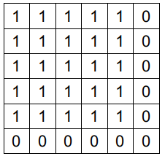
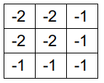
卷积操作
op1 = tf.nn.conv2d(input, filter1, strides=[1, 2, 2, 1], padding='SAME') #1个通道输入，生成1个feature map
input:
padding:
filter1
output:

Slide 6
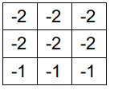
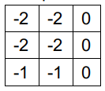
op2 = tf.nn.conv2d(input, filter2, strides=[1, 2, 2, 1], padding='SAME') #1个通道输入，生成2个feature map
input:
padding:
filter2
output:

Slide 7
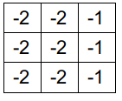
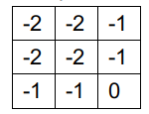
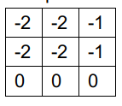
op3 = tf.nn.conv2d(input, filter3, strides=[1, 2, 2, 1], padding='SAME') #1个通道输入，生成3个feature map
input:
padding:
filter3
output:

Slide 8
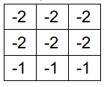
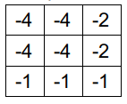
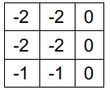
op4 = tf.nn.conv2d(input2, filter4, strides=[1, 2, 2, 1], padding='SAME') # 2个通道输入，生成2个feature
input2:
padding:
filter4
output:

Slide 9
op5 = tf.nn.conv2d(input2, filter5, strides=[1, 2, 2, 1], padding='SAME') # 2个通道输入，生成一个feature map
input2:
padding:
filter5
output:

Slide 10

vop1 = tf.nn.conv2d(input, filter1, strides=[1, 2, 2, 1], padding='VALID') # 5*5 对于pading不同而不同
input:
filter1:
output:

Slide 11
vop6 = tf.nn.conv2d(input3, filter1, strides=[1, 2, 2, 1], padding='VALID') #4*4与pading无关
input3:
filter1:
output:

