Slide 1
EyeLink and iEye Adaptation
Qingqing Yang, qy775@nyu.edu
Clayspace Lab Meeting

Slide 2
Contents
EyeLink Tutorial
Eye-Tracker data
Code for Setup and Message
iEye Tutorial
Procedure of data processing
Adaptation

Slide 3
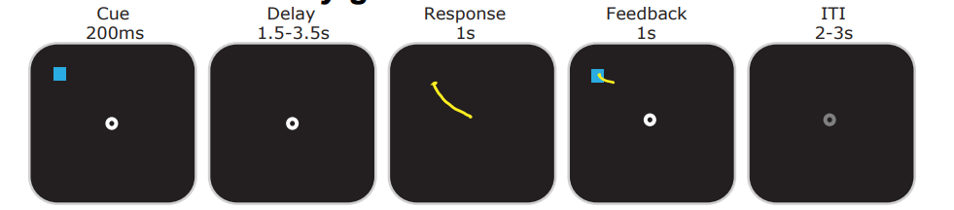
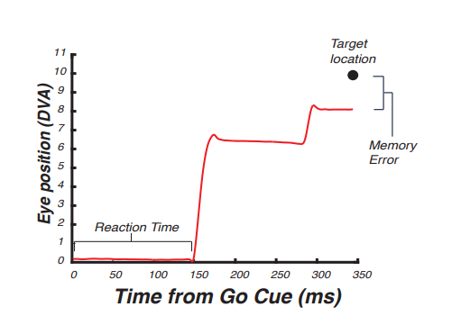
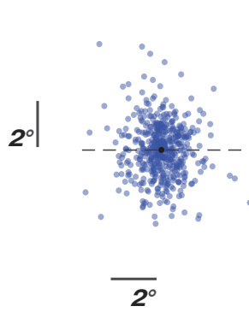
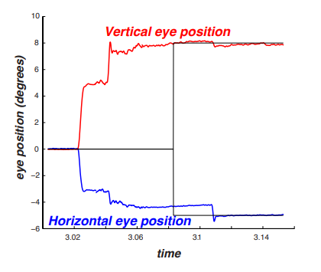
Memory Guide Saccade (MGS) Task
Epoch 1 2 3 4 5
Saccade Trajectory
Aligned Saccadic Endpoints

Slide 4
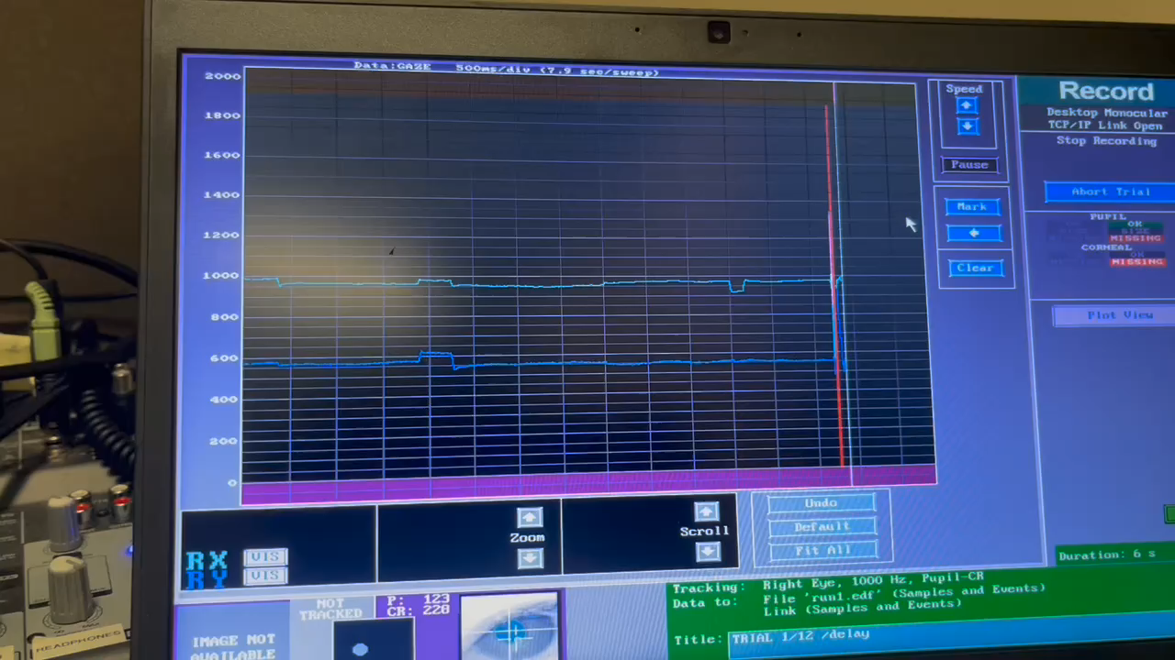

Eye-Tracker Data
X axis: Right +
Y axis: Down +
Video:
Right --> Left --> Up --> Down
Explanation SR-Research Eyelink(c) gazetrackers
Sample: pupil size, x & y gaze position (pixel) at each time point
Event: event type such as start-end of blink, saccade, fixation.

Slide 5
EyeLink Setup
EyelinkToolbox can be used to create eye-movement experiments and control the SR-Research Eyelink(c) gaze trackers
It’s incorporated into the PsychToolbox (Psychtoolbox-3 – EyelinkToolbox)
It provides a number of wrapper functions to simplify creating an eye-tracking program
The main functionality could be found in demos: EyelinkToolbox/EyelinkDemos

Slide 6
EyeLink Setup
Initialization
% Provide Eyelink with details about the graphics environment
el=EyelinkInitDefaults(window);
Eyelink('Initialize','PsychEyelinkDispatchCallback’);
Eyelink('command', 'sample_rate = 1000’);
% make sure that we get gaze and event data from the Eyelink
status=Eyelink('command','link_sample_data = LEFT,RIGHT,GAZE,AREA’);
Eyelink('command','file_sample_data = LEFT,RIGHT,GAZE,AREA,GAZERES,STATUS');
Eyelink('command','file_event_filter = LEFT,RIGHT,FIXATION,SACCADE,BLINK,MESSAGE,BUTTON’);

Slide 7
EyeLink Setup
Calibrate
% Calibration Setup
Eyelink('command', 'enable_automatic_calibration = YES');
Eyelink('command',’calibration_type= HV5’);
% Calibrate the eye tracker
EyelinkDoTrackerSetup(el);
% do a final check of calibration using driftcorrection
EyelinkDoDriftCorrection(el);

Slide 8
EyeLink Save File
Save data
% get gaze data from EyeTracker
tempedfFile = 'temp.edf';
edfFile='actual_file_name.edf';
Eyelink('openfile',tempedfFile);
% stop Eye Tracker Recording
if is_eyetracker
Eyelink('stoprecording’);
Eyelink('ReceiveFile',tempedfFile,tempedfFile);
movefile(tempedfFile,edfFile);
WaitSecs(3); print(‘Data Trans Completed.’);
Eyelink('Shutdown')
end

Slide 9
EyeLink Send Message
Send info of experiment epoch, target locations to eye tracker
During epoch fixed at the center
Eyelink('Message','TarX1 %s', num2str(0));
Eyelink('Message','TarY1 %s', num2str(0));
During the epoch respond to the target
Eyelink('Message','TarX1 %s', num2str(task.dotXdva{iTrial}));
Eyelink('Message','TarY1 %s', num2str(task.dotYdva{iTrial}));
Send Target Location in the unit of Degree of visual angle

Slide 10
EyeLink GazeContingent
Send info of experiment epoch, target locations to eye tracker
eye_used= Eyelink('EyeAvailable');
if Eyelink( 'NewFloatSampleAvailable') > 0
evt = Eyelink( 'NewestFloatSample’); % Get most recent sample data (gaze loc, pupil size)
if eye_used ~= -1 % do we know which eye to use yet?
% if we do, get current gaze position from sample
x = evt.gx(eye_used+1); % +1 as we're accessing MATLAB array
y = evt.gy(eye_used+1);
% do we have valid data and is the pupil visible?
if x~=el.MISSING_DATA && y~=el.MISSING_DATA && evt.pa(eye_used+1)>0
mx=x;
my=y;
end
end
end
Notes:
% Get available eye
eye_used= Eyelink('EyeAvailable');
if eye_used==el.BINOCULAR % if both eyes are tracked
eye_used=el.LEFT_EYE; % use left eye
end
if eye_used == -1 % dont know which eye is being tracked
eye_used = el.RIGHT_EYE;
end

Slide 11
EyeLink GazeContingent Cont.
Send info of experiment epoch, target locations to eye tracker
When subject gazes at an object, it changes color. When gaze moves away, it toggles back
% check for events
evtype=Eyelink('getnextdatatype’);
if evtype==el.ENDSACC % if the subject finished a saccade check if it fell on an object
% check if saccade landed on an object
choice=-1;
noobject=0;
i=1;
while 1
if 1==IsInRect(evt.genx,evt.geny, object(i).rect )
choice=i;
break;
end
i=i+1;
if i>length(object)
noobject=1;
break;
end
end
Notes:
% Get available eye
eye_used= Eyelink('EyeAvailable');
if eye_used==el.BINOCULAR % if both eyes are tracked
eye_used=el.LEFT_EYE; % use left eye
end
if eye_used == -1 % dont know which eye is being tracked
eye_used = el.RIGHT_EYE;
end

Slide 12
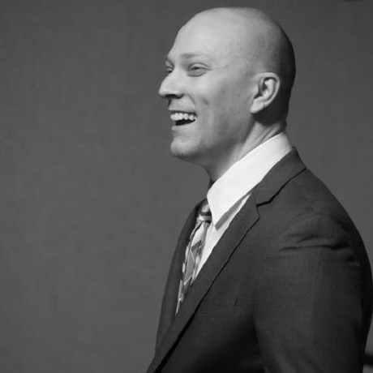

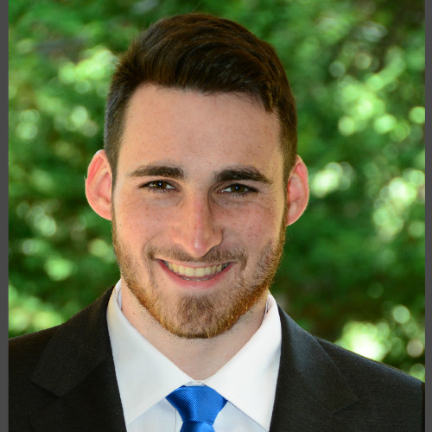
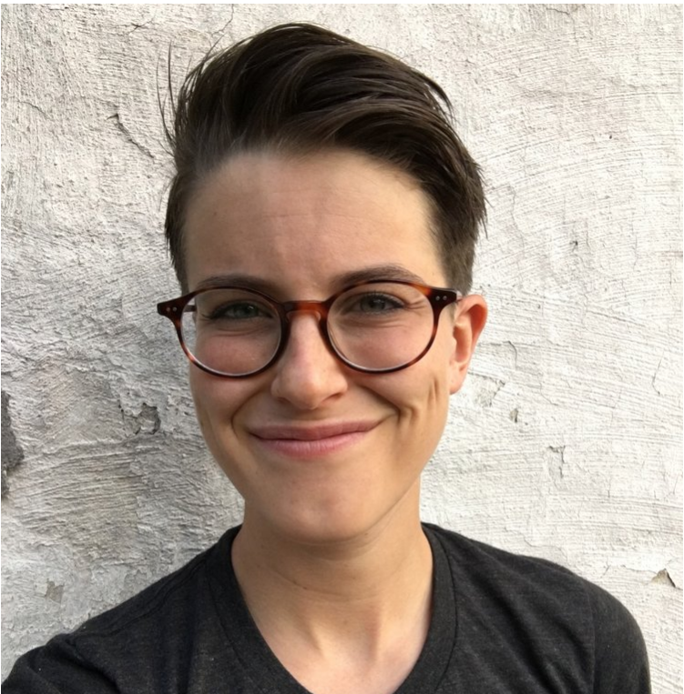
iEye Procedure
iEye is a set of command line functions built to translate data from 'raw' format (typically, EDF files) into scored responses on each trial.
clayspacelab/iEye at iEye_ts (github.com)

Slide 13
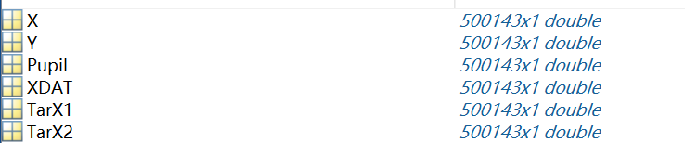
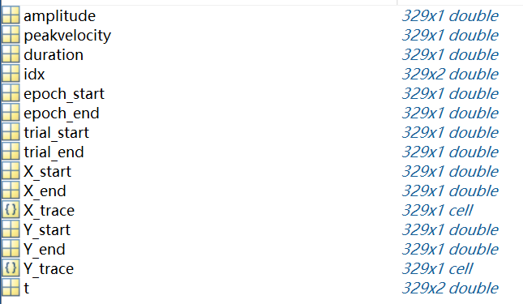
iEye Procedure
Preprocessing
ii_preproc.m
ii_import
ii_data
Message events based on .ifg
ii_trim, ii_rescale, ii_invert, ii_censorchans, ii_definetrial
ii_blinkcorrect
% blink correction
ii_params.blink_thresh = 1.5; % PERCENTILE
ii_params.blink_window = [150 50]; % before and after, ms
ii_smooth, ii_velocity
ii_findsaccades, ii_extractsaccades
sacc_dur >= dur_thresh （0.0075） & sacc_amp >= amp_thresh （0.25）
& velocity > = 30 (dva/s)
ii_findfixations

Slide 14
iEye Procedure
Preprocessing cont.
ii_preproc.m
drift correction – epoch 1 & 2
ii_selectfixationsbytrial
ii_driftcorrect
Epoch 1 2 3 4 5

Slide 15
iEye Procedure
Preprocessing cont.
ii_preproc.m
calibration – epoch 4
ii_selectfixationsbytrial
ii_calibratebytrial
Epoch 1 2 3 4 5

Slide 16
iEye Procedure
Score the saccade error
Extract initial and final saccade eye position during certain response epoch 4
Targert coordinate in TarX, TarY
Calculate the Euclidian distance and response time
Mark bad trials in ii_sess.excl_trial
Epoch 1 2 3 4 5

Slide 17
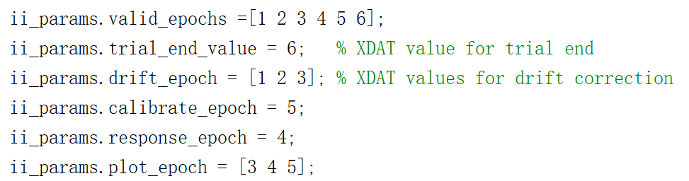
iEye Adaptation
Epochs in the main ieye script
Ifg channel num and names
Multi-item: score each target response separately, calibrate for every feedback (Qingqing-Yang-177/iEye_qy-WMLoads at iEye_ts)
Epoch 1 2 3 4 5

Slide 18
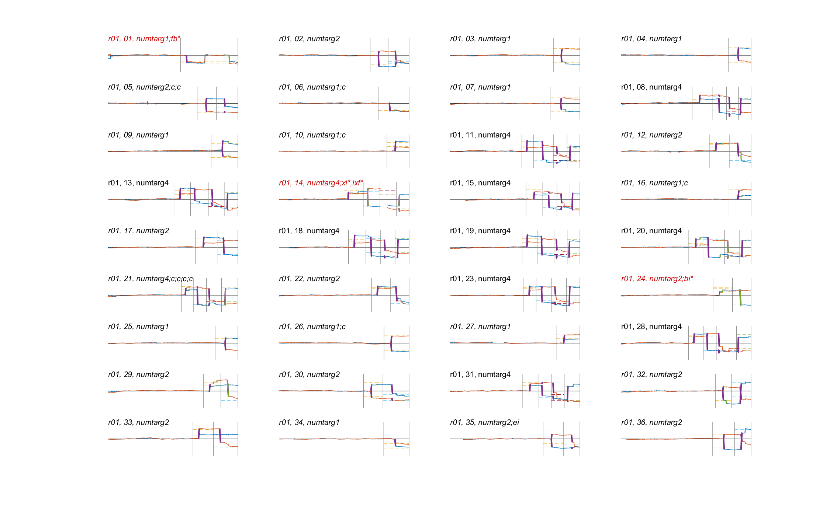
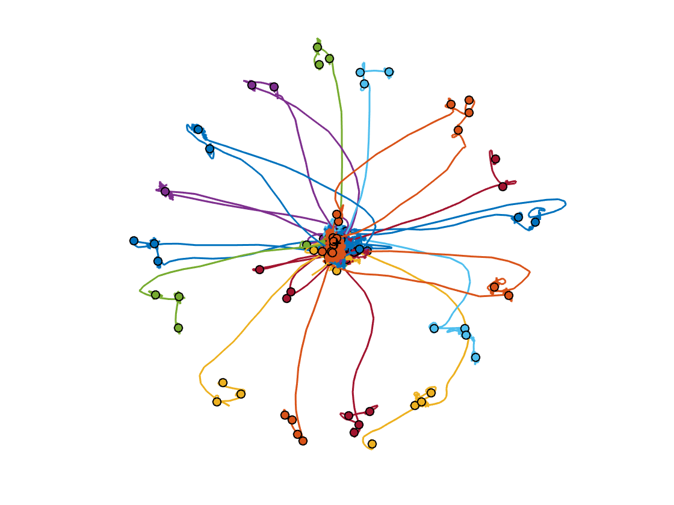
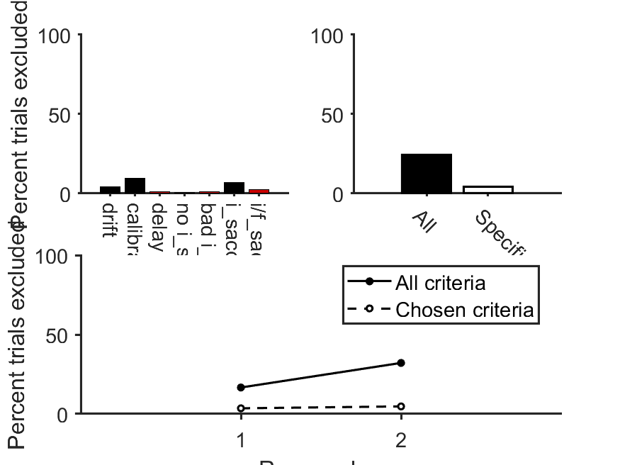
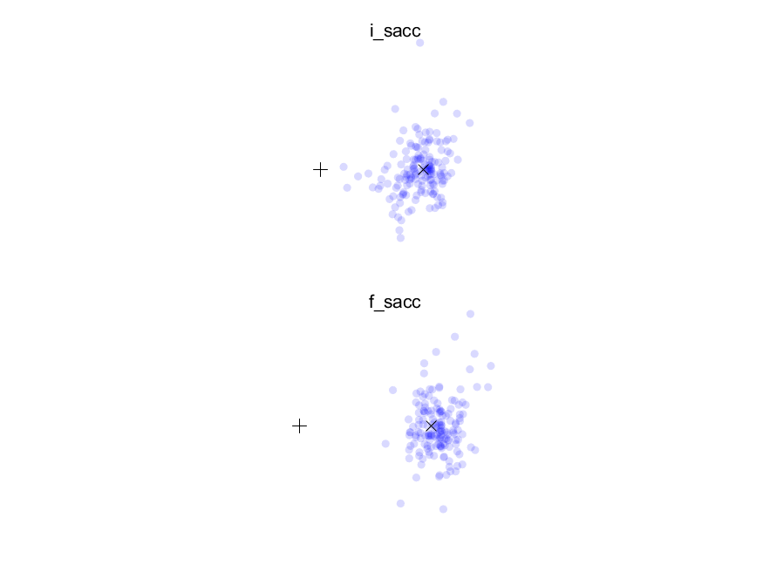
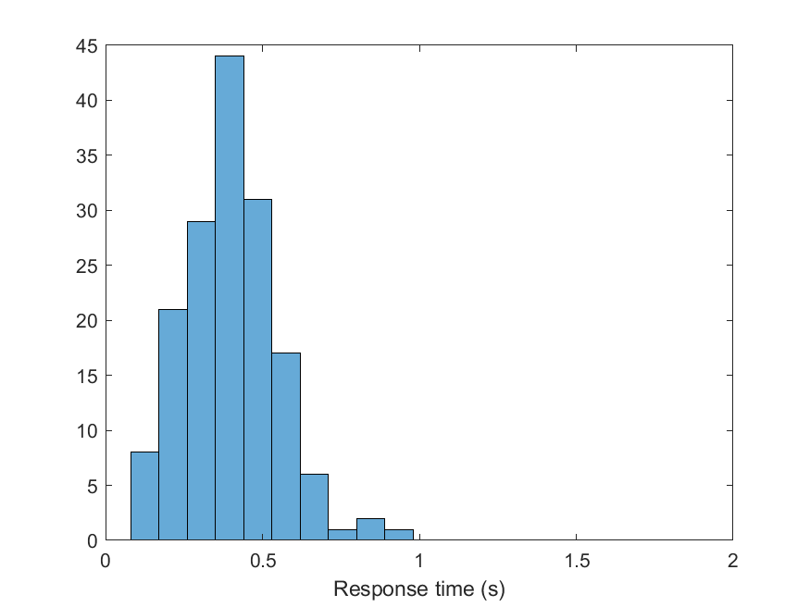
iEye Results

Slide 19
Thank you!

