Slide 1

Social Networks
Recommendations on Twitter
Jenish Jaientilal
Feng QingYang
Valentinas Salmanovicius
Andrew Chan
Hongyuan Wang
Jeroen Galle

Slide 2
Index
Introduction and motivation
Objectives
Architecture
Components

Slide 3
Motivation
To recommend users based on a “similarity”
Please give me more content

Slide 4
Index
Introduction and motivation
Objectives
Architecture
Components

Slide 5
Objectives
Find most similar people based on your interests
Visualize evolution of topics against time
Cluster words of a user’s recent tweets

Slide 6
Index
Introduction and motivation
Objectives
Architecture
Components

Slide 7
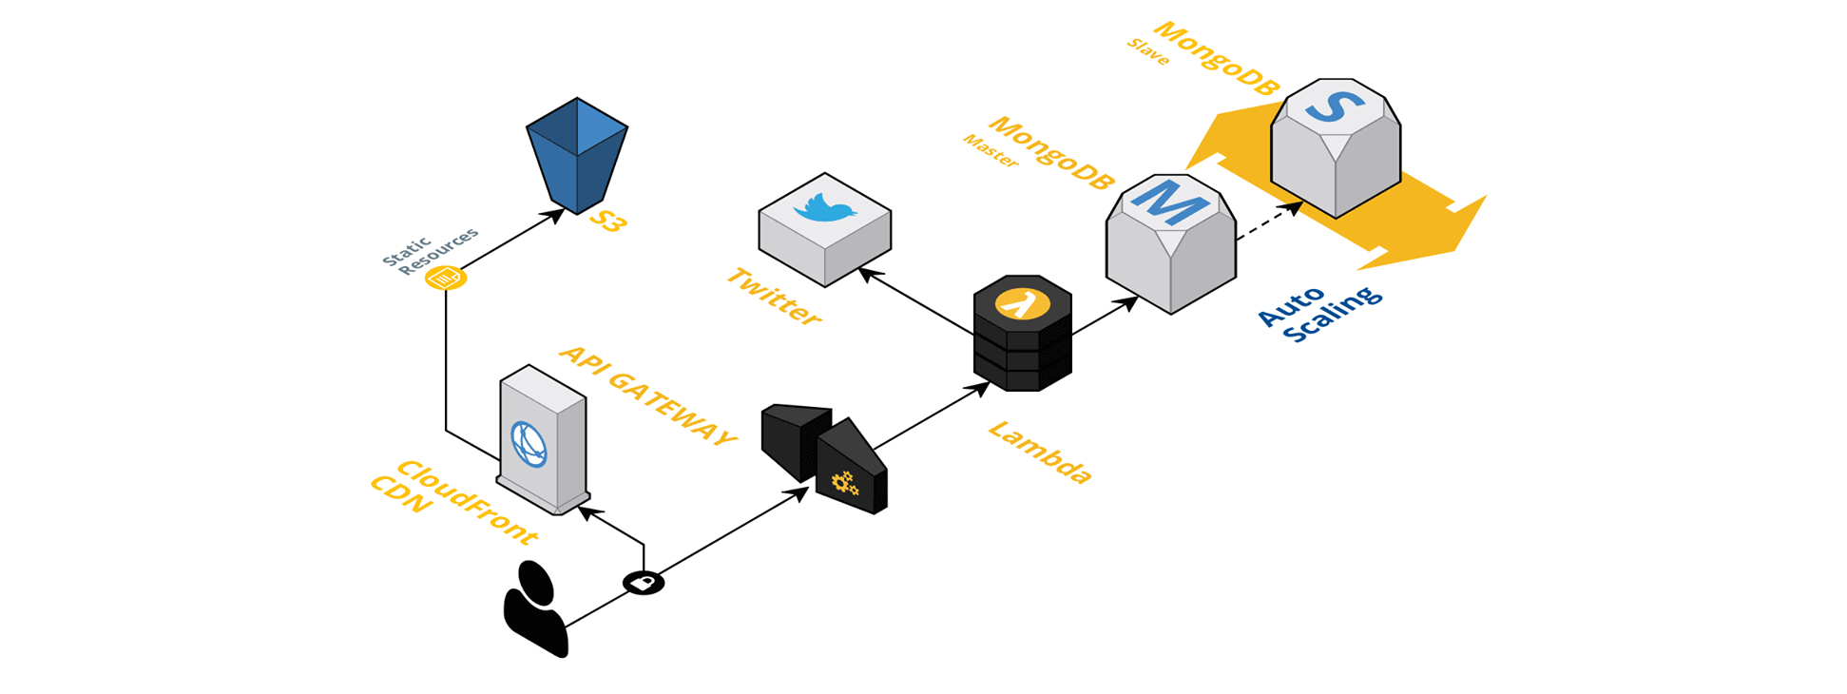
Architecture

Slide 8
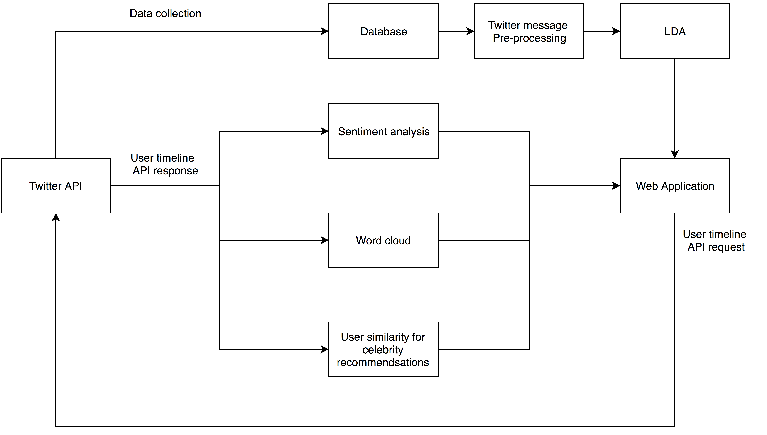
System Pipeline

Slide 9
Index
Introduction and motivation
Objectives
Architecture
Components

Slide 10
Why choose Twitter?
Popular social networking and microblogging service
Large data set(every second on average around 6000 tweets are generated[1])
Well documented API
Free access to Twitter data
[1] Twitter Usage Statistics – Internet Live State 2016

Slide 11
Data collection and storage
Twitter API :
Access to streaming data from a user’s timeline or keywords (e.g. hashtags)
Receive streamed tweets in real-time
Mongo DB:
No-SQL
A collection can contain different documents.
Easy to scale
Notes:
Each document can have different content, size and attributes, which is ideal for tweets because each tweet have different numbers of attributes)

Slide 12
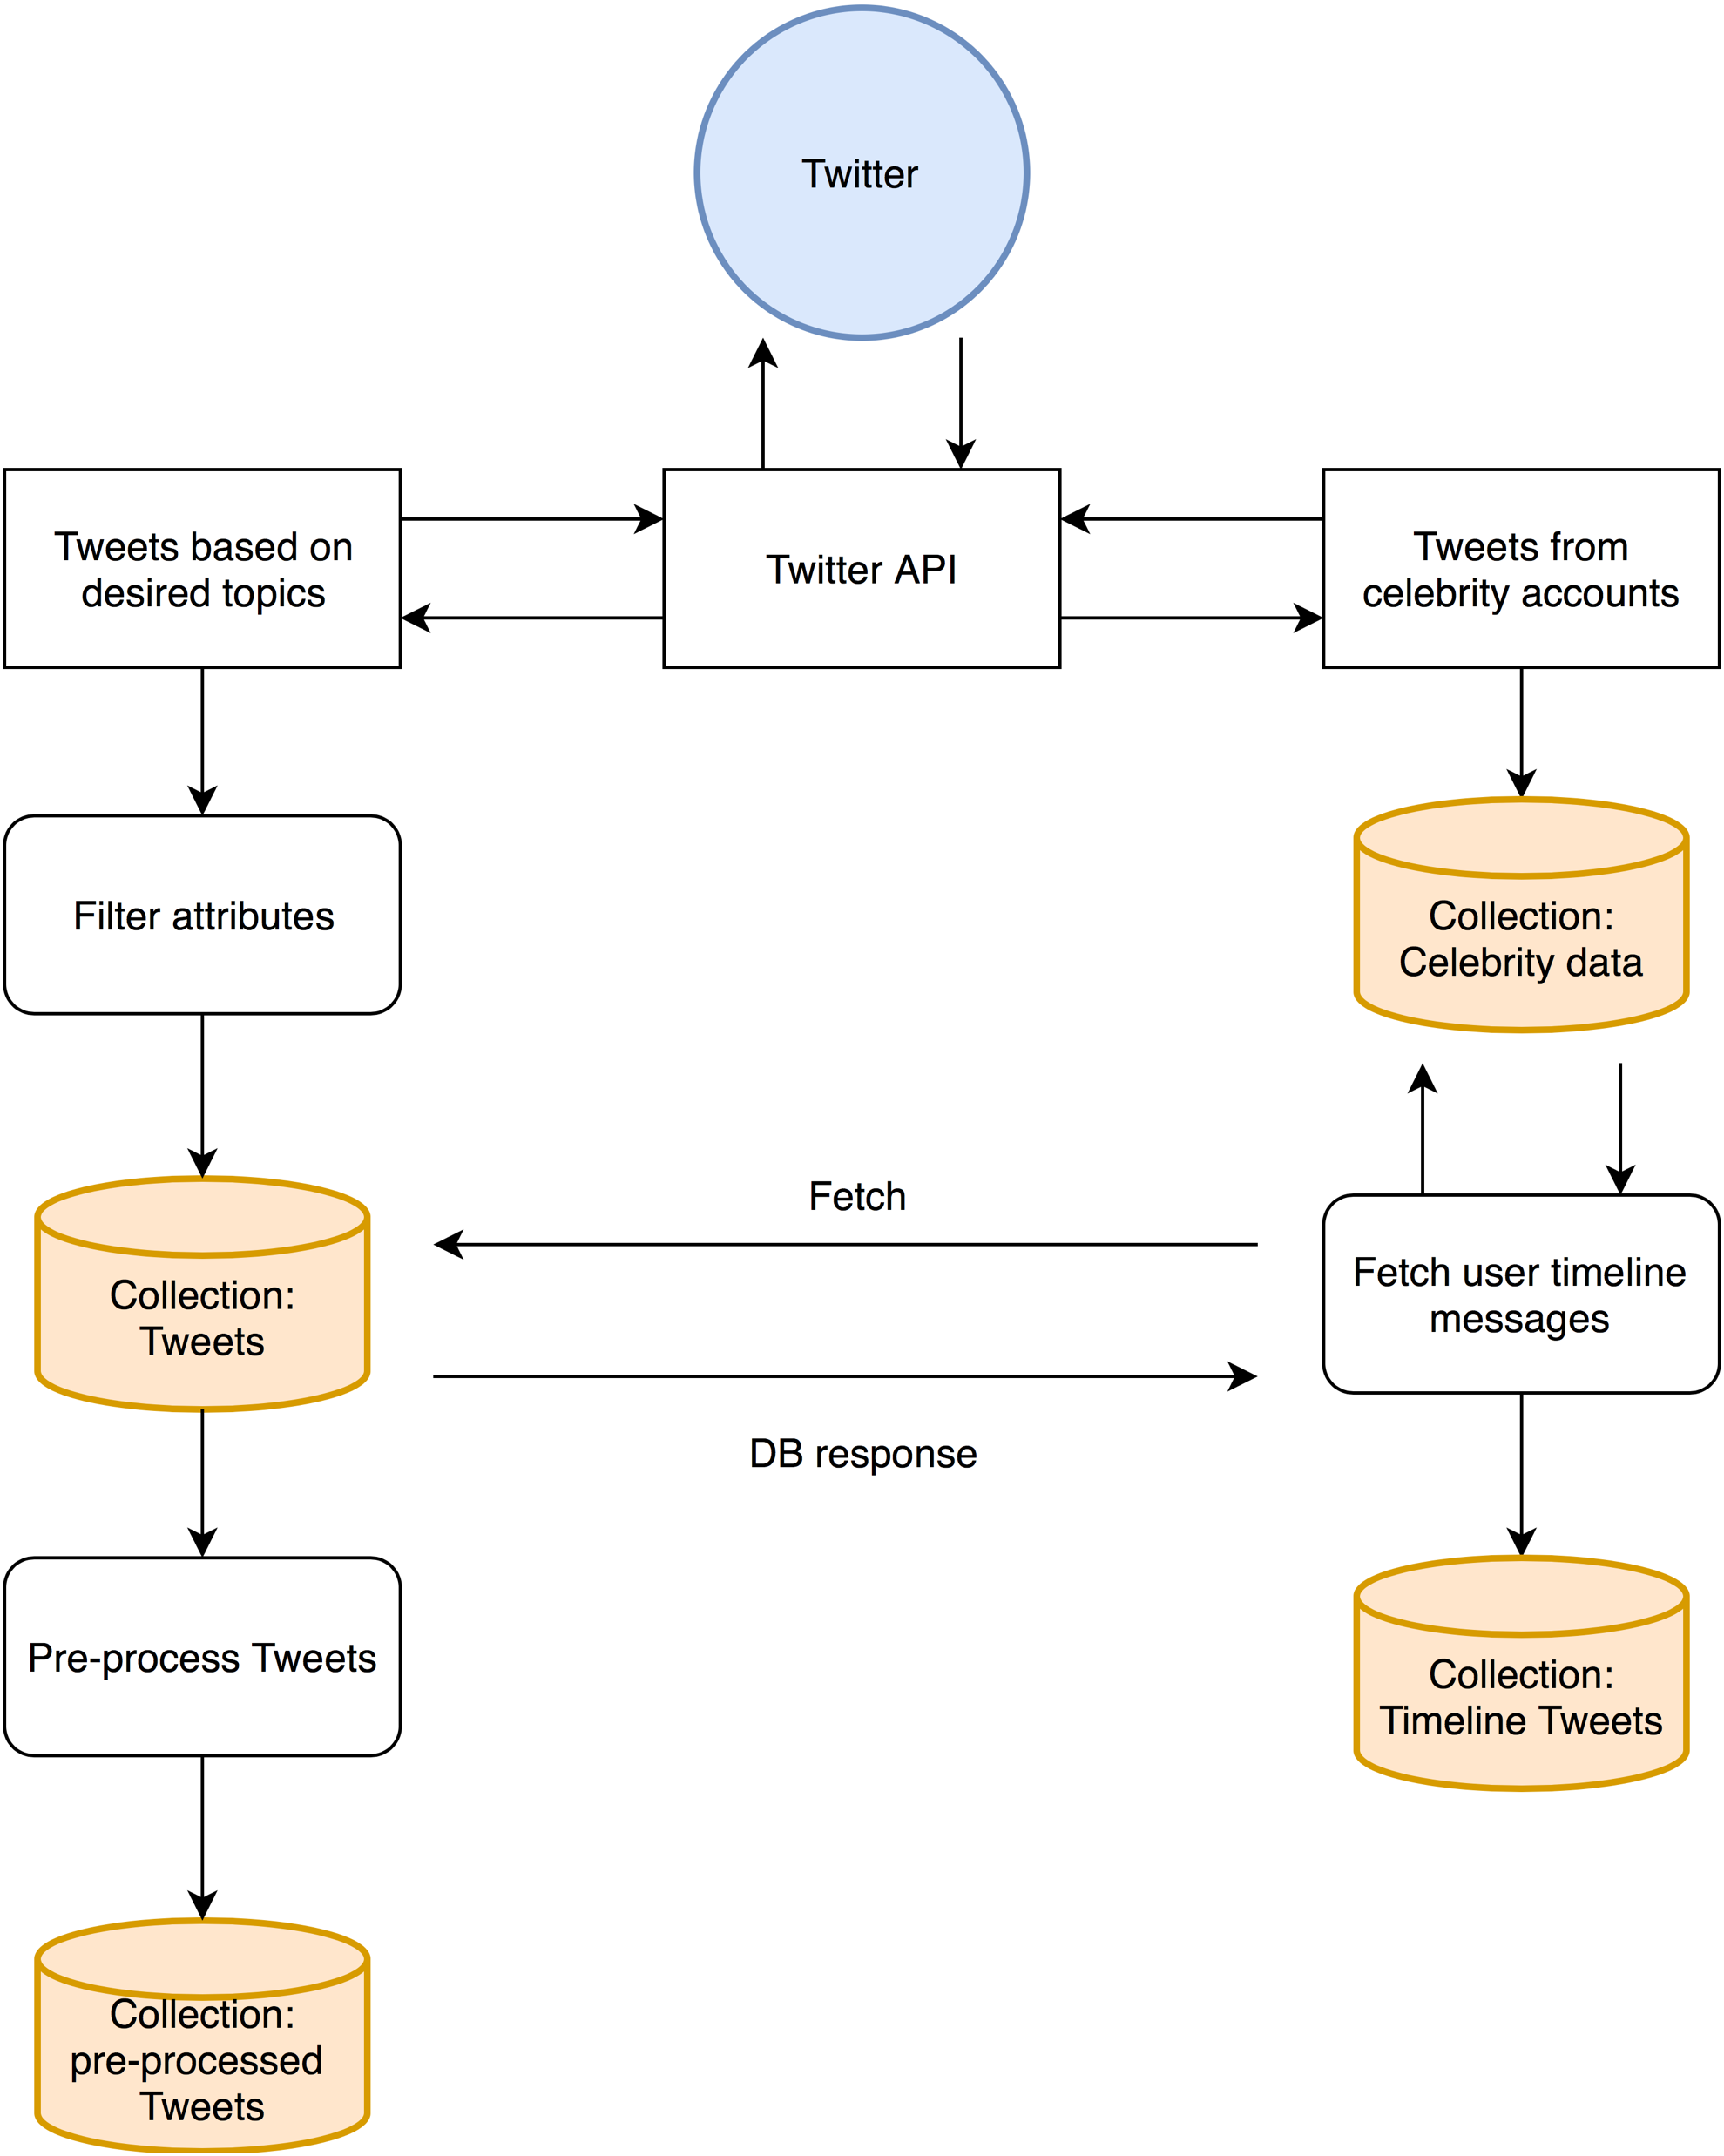
Mongo DB
Dictionary based data collection
Store Tweet ID, Screen name, Text,
Created time, Retweet number
Collects user’s 200 most recent tweets

Slide 13
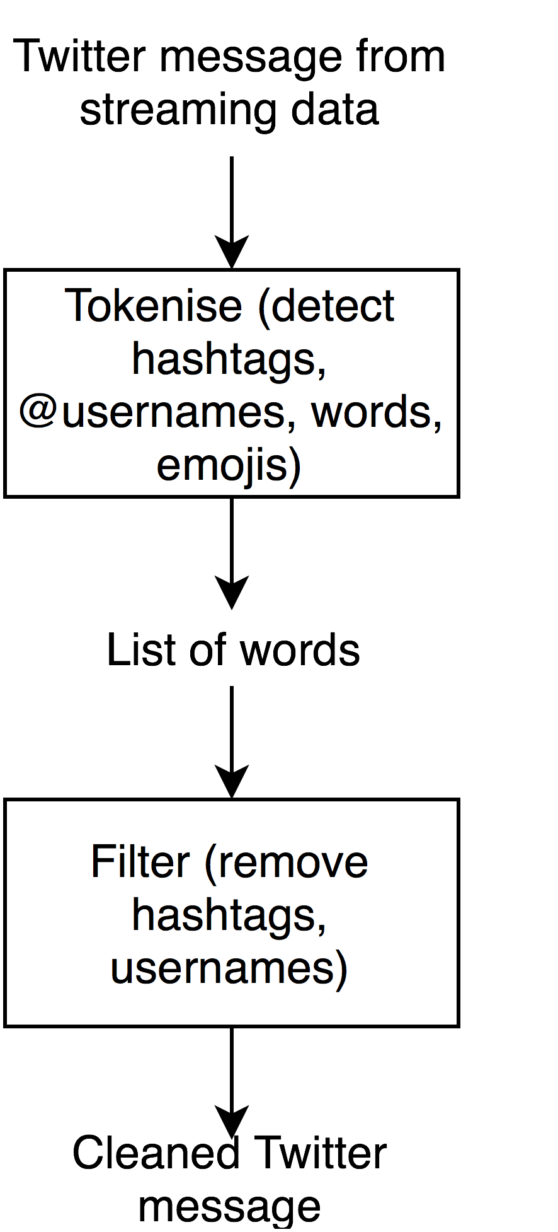
Pre-processing
Message: RT @someuser #happyfuncoding: this is a typical Twitter tweet :-)
Tokenized: [u'rt', u'@someuser', u'#happyfuncoding', u':', u'this', u'is', u'a', u'typical', u'twitter', u'tweet', u':-)']
Tokenized and filtered: [u'RT', u'a', u'this', u'is', u'Twitter', u':', u'tweet', u'typical']

Slide 14
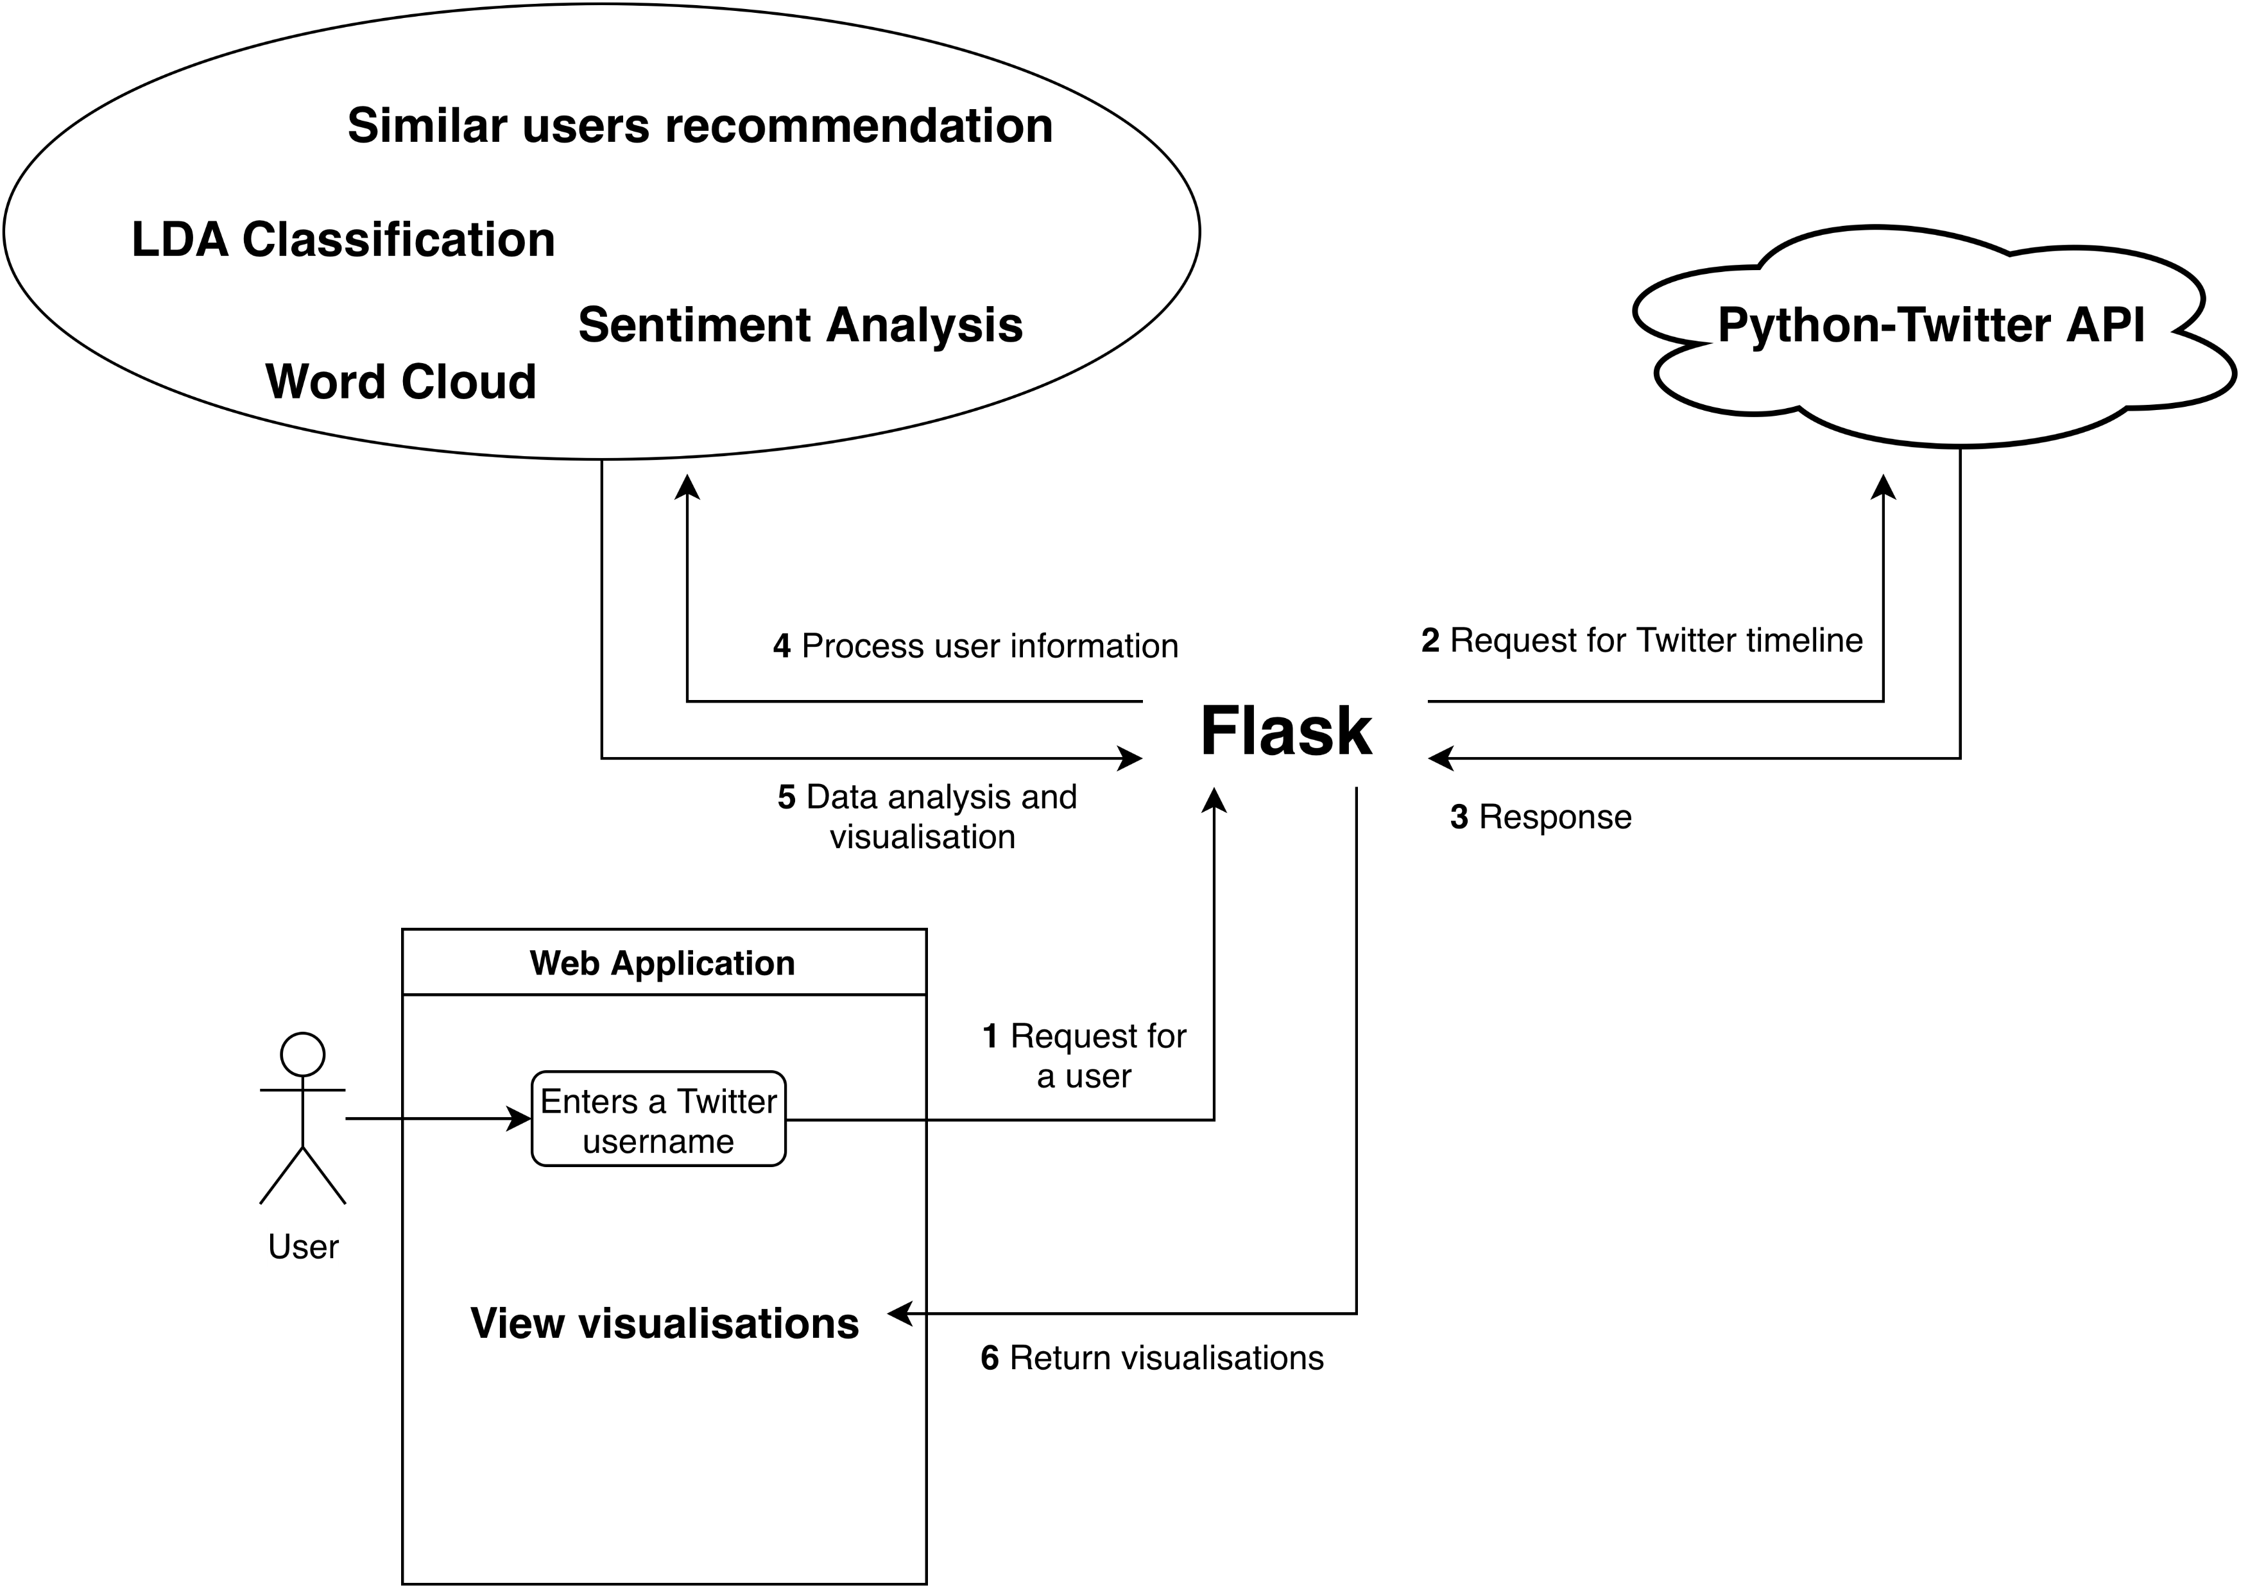
Flask

Slide 15
Topic modelling (LDA)
A statistical model that can be used to identify the topics of documents.
Topic is defined as a distribution over a set of words.
Document is considered to have a few topics each with a certain probability.

Slide 16
Topic modelling (LDA)
Document is generated by repetitively :
choosing a topic under certain probability distribution
choosing a word from this topic according to certain probability
including the word in the document
The key issue is to find out distributions of words and topics via observing the documents.

Slide 17
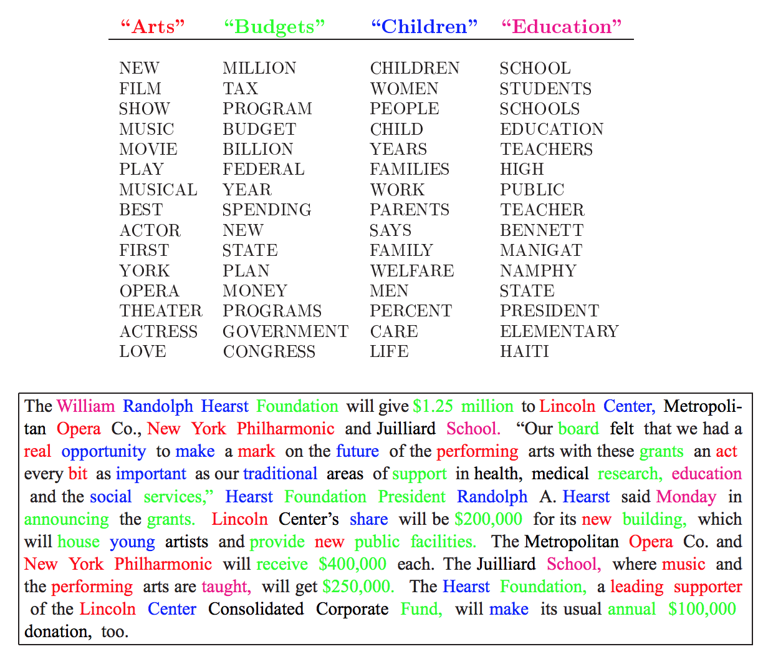
An illustration of LDA’s view of a document, where each colour marks a topic. There are 4 topics, “art”, “budgets”, “children”, and “education” which are further defined by the lists of words below them.

Slide 18
LDA
Advantages:
Easy to implement (Python Library)
Unsupervised (Requires no Labelled Data)
Limitations:
Fixed K (the number of topics are fixed and must be known ahead of time)
Uncorrelated topics (Dirichlet topic distribution cannot capture correlations)
Bag of words (word order in a document is ignored)

Slide 19
Web application
Need either a video or some snapshots
If you want to do a live demo instead then we don’t need this page

