Slide 1

Social Networks
Recommendations on Twitter
Jenish Jaientilal
Feng QingYang
Valentinas Salmanovicius
Andrew Chan
Hongyuan Wang
Jeroen Galle

Slide 2





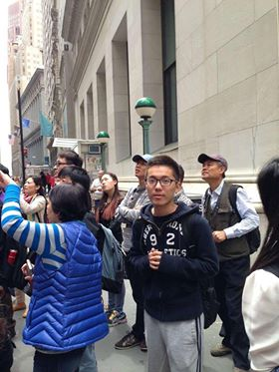
The team
Feng QingYang
Jeroen Galle
Andrew Chan
Valentinas Salmanovicius
Jenish Jaientilal
Hongyuan Wang
Notes:
We all come from different backgrounds, but we all find social networks to be interesting

Slide 3
Why social networks are interesting?
Notes:
In this slide I was going to show that more that nearly two billion people actively use social network accounts, but …

Slide 4
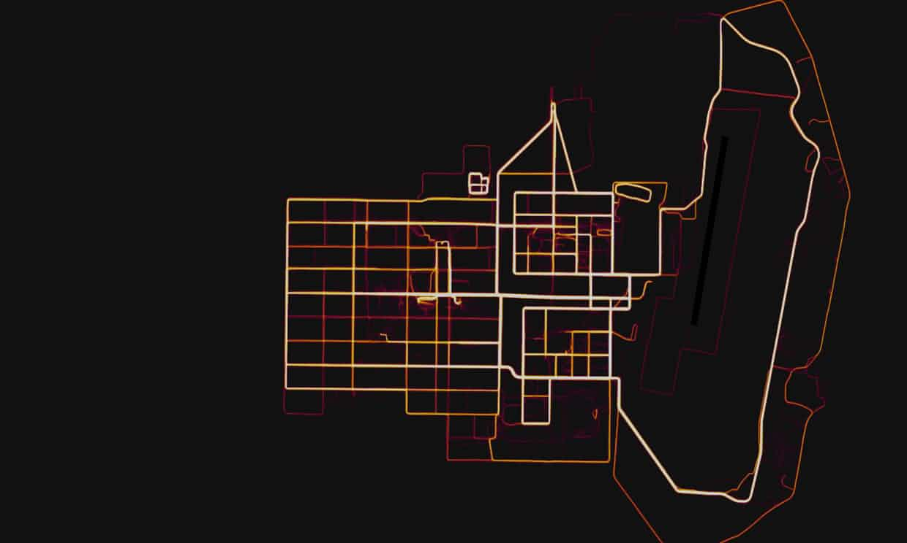
Why social networks are interesting?
Strava heatmap gives away location of secret US army bases
A military base in Helmand Province, Afghanistan. Photograph: Strava Heatmap
Notes:
What is more interesting, is what stories can be told with all of data being generated. This is one of them, a `secret’ military base

Slide 5

Why social networks are interesting?
Strava heatmap gives away location of secret US army bases
The data was used to influence voter opinion on behalf of politicians who hire them
A military base in Helmand Province, Afghanistan. Photograph: Strava Heatmap
[1] The Guardian, “Fitness tracking app gives away location of sectret US bases”
Notes:
Another recent example is probably something everyone knows already

Slide 6
So what is our goal here?
Notes:
Now let me state what is OUR goal here, before we dive into details.

Slide 7
So what is our goal here?
To learn.

Slide 8
So what is our goal here?
To learn.
By means of creating Twitter analytics page.

Slide 9
So what is our goal here?
To learn.
By means of creating Twitter analytics page.
Where one can get statistics and insights into Twitter profiles.

Slide 10
So what is our goal here?
To learn.
By means of creating Twitter analytics page.
Where one can get statistics and insights into Twitter profiles.
Objectives:
Natural Language Processing, Visualisations, Topic Modelling.

Slide 11
Why choose Twitter?
Popular social networking and microblogging service
Large data set(every second on average around 6000 tweets are generated[1])
Well documented API
Free access to Twitter data
[1] Twitter Usage Statistics – Internet Live State 2016

Slide 12
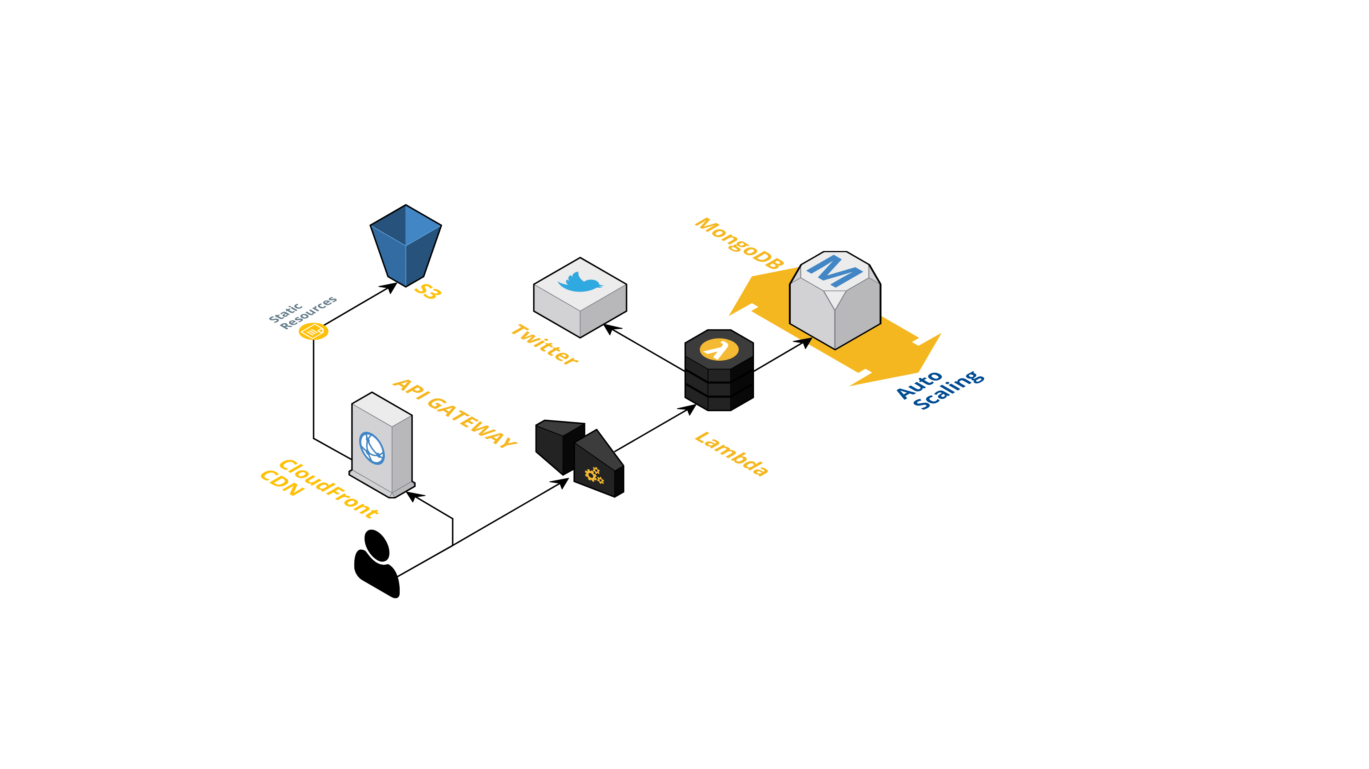
Architecture

Slide 13
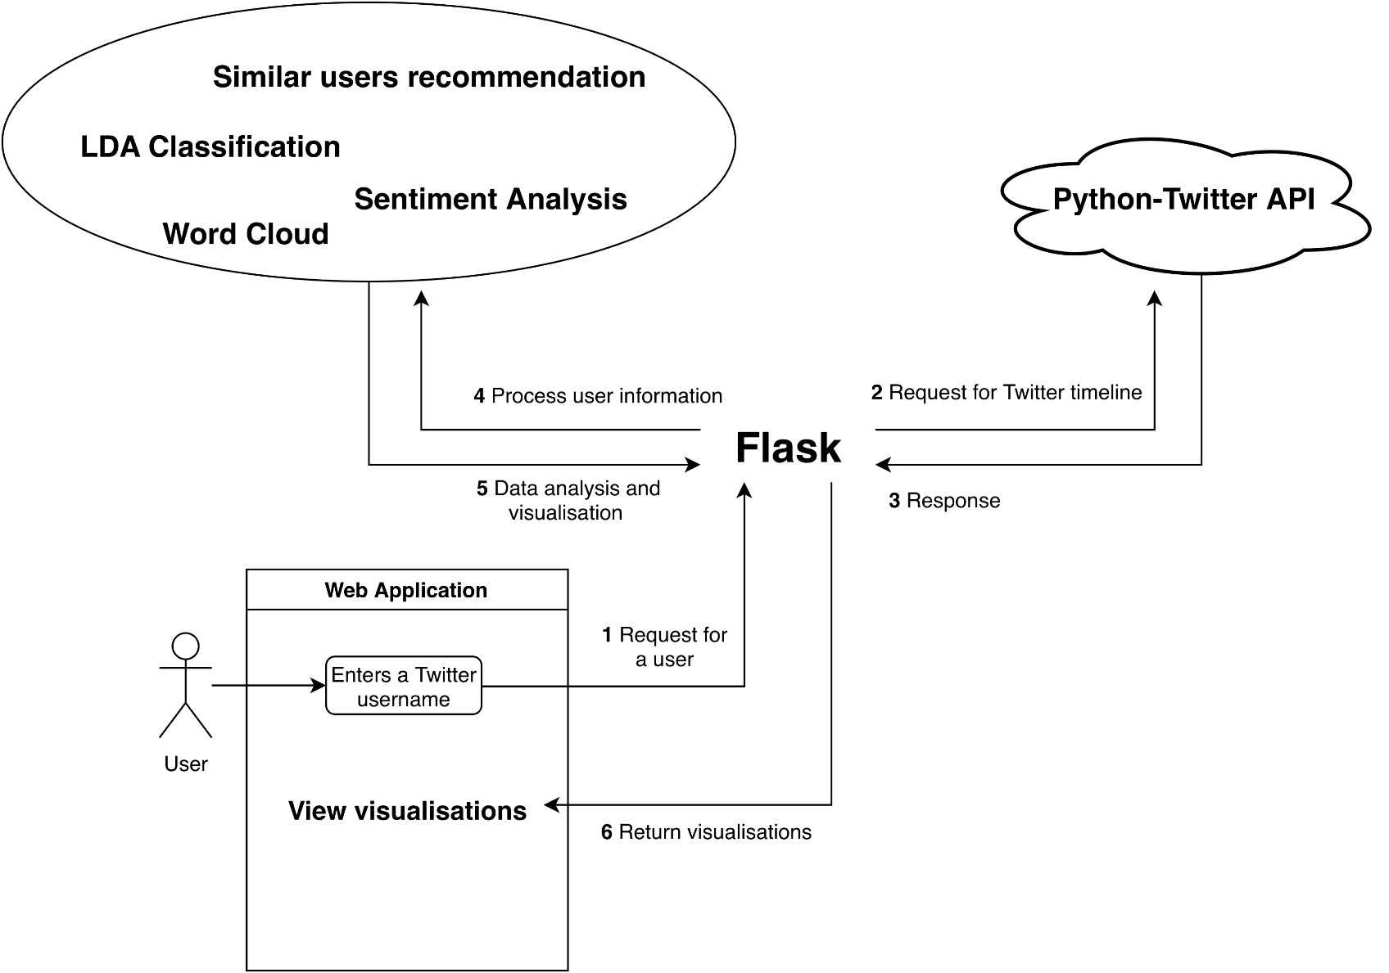
Flask

Slide 14
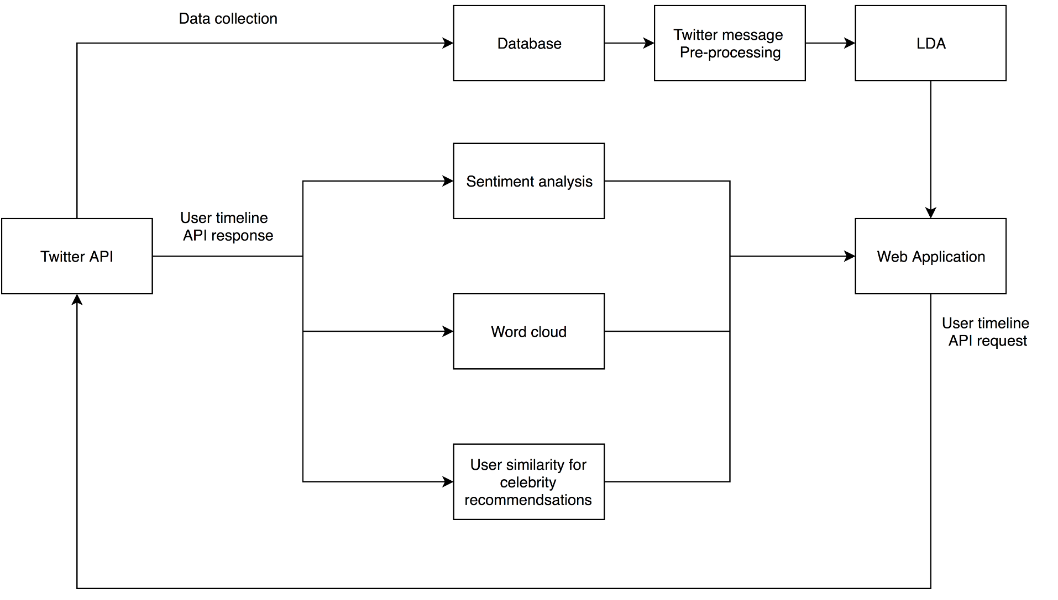
System Pipeline

Slide 15
Data collection and storage
Twitter Stream API :
Access to streaming data from a user’s timeline or keywords (e.g. hashtags)
Receive streamed tweets in real-time
Mongo DB:
NoSQL
A collection can contain different documents.
Easy to scale
Notes:
Each document can have different content, size and attributes, which is ideal for tweets because each tweet have different numbers of attributes)

Slide 16
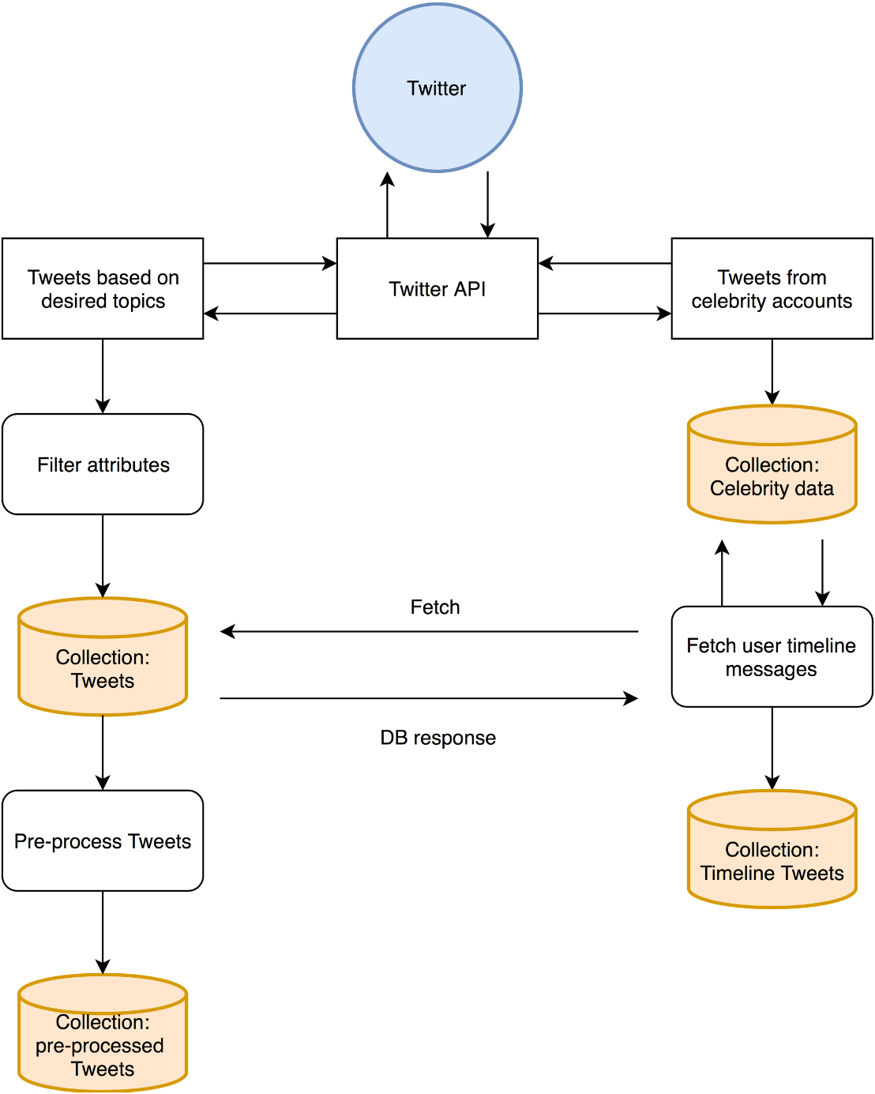
Data collection
Dictionary based data collection
Store Tweet ID, Screen name, Text,
Created time, Retweet number
Collects user’s 200 most recent tweets

Slide 17
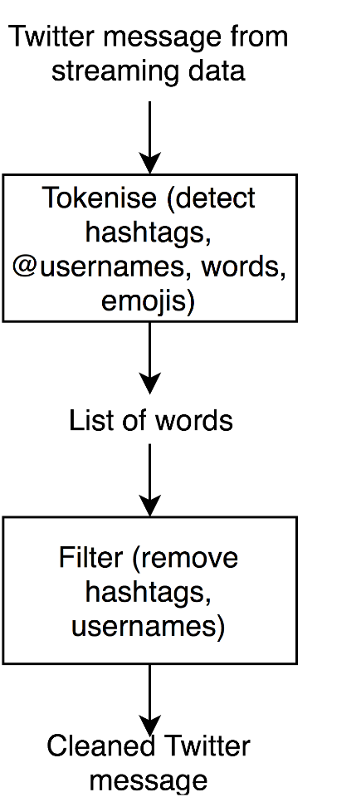
Pre-processing
Message: RT @someuser #happyfuncoding: this is a typical Twitter tweet :-)
Tokenized: [u'rt', u'@someuser', u'#happyfuncoding', u':', u'this', u'is', u'a', u'typical', u'twitter', u'tweet', u':-)']
Tokenized and filtered: [u'RT', u'a', u'this', u'is', u'Twitter', u':', u'tweet', u'typical']

Slide 18
Topic modelling (LDA)
A statistical model that can be used to identify the topics of documents.
Topic is defined as a distribution over a set of words.
Document is considered to have a few topics each with a certain probability.

Slide 19
Topic modelling (LDA)
Document is generated by repetitively :
choosing a topic under certain probability distribution
choosing a word from this topic according to certain probability
including the word in the document
The key issue is to find out distributions of words and topics via observing the documents.

Slide 20
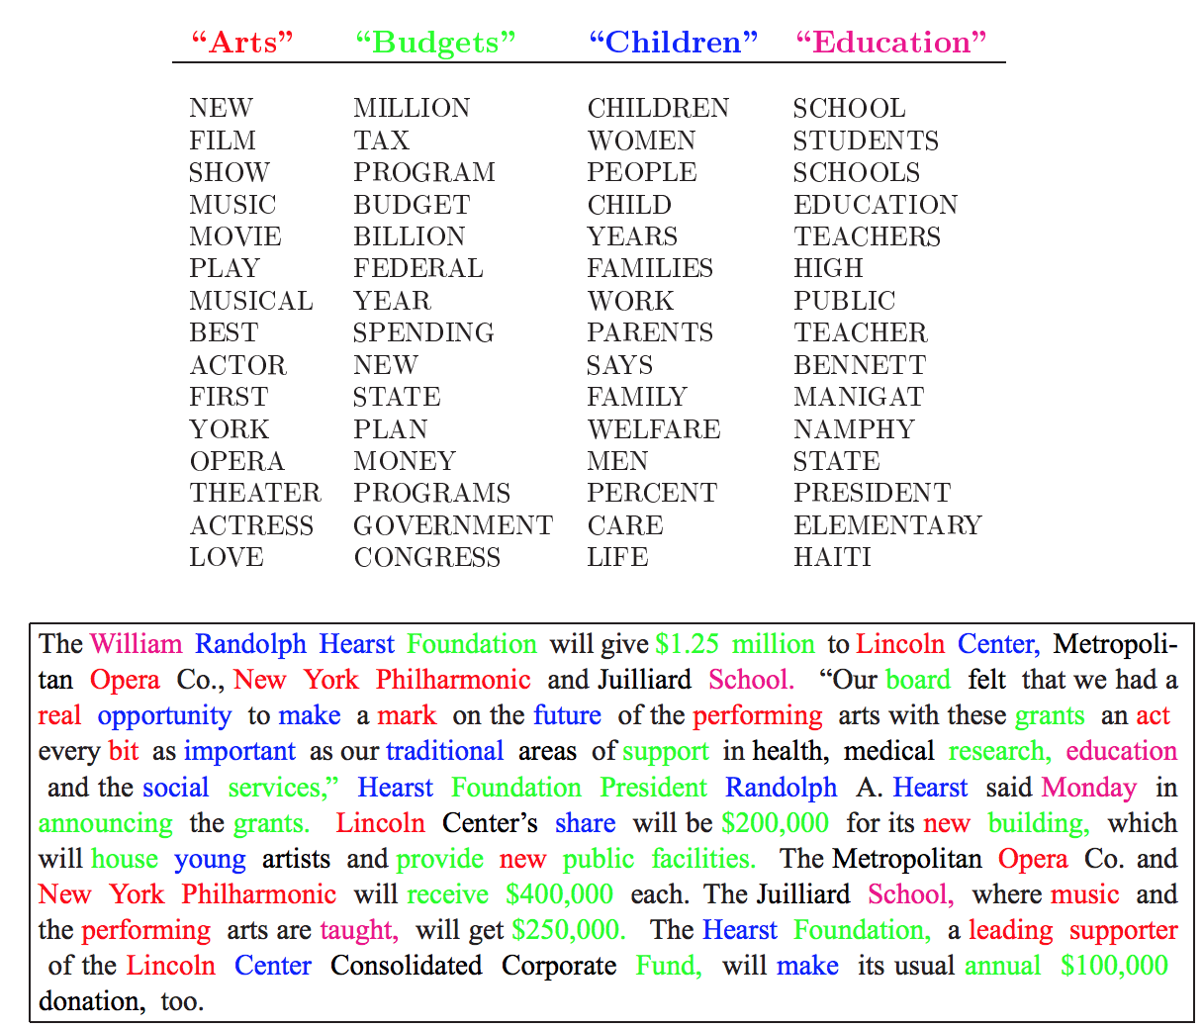
An illustration of LDA’s view of a document, where each colour marks a topic. There are 4 topics, “art”, “budgets”, “children”, and “education” which are further defined by the lists of words below them.

Slide 21
LDA
Advantages:
Easy to implement (Python Library)
Unsupervised (Requires no Labelled Data)
Limitations:
Fixed K (the number of topics are fixed and must be known ahead of time)
Uncorrelated topics (Dirichlet topic distribution cannot capture correlations)
Bag of words (word order in a document is ignored)

Slide 22
DEMO

Slide 23
Conclusion

Slide 24
Conclusion
This is still work in progress

Slide 25
Conclusion
So far we have gained experience with:
MongoDB
NoSQL
Twitter Search API
Twitter Streaming API
Data Preprocessing
Regular Expressions
Python
Tokenization
Data Modelling
LDA
Gensim
Topic Modelling
NLTK
Data Visualisation
JavaScript
D3js
CSS
HTML
Flask
Data Storage

