Slide 1

Sprocket Central Pty Ltd
Data analytics approach
Qingyi Xu - Consultant

Slide 2
Agenda
Introduction
Data Exploration
Model Development
Interpretation

Slide 3
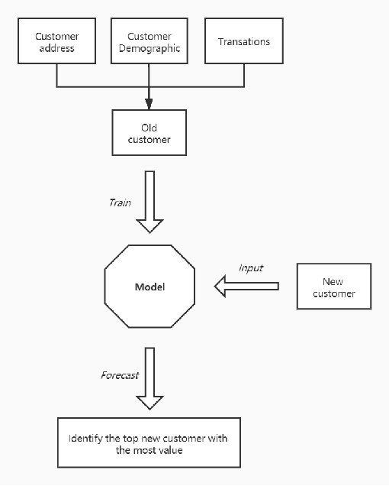
Introduction
The goal of our task
Using the existing 3 datasets (Customer demographic, customer address and transactions) as a labelled dataset
Recommend which of these 1000 new customers should be targeted to drive the most value for the organisation.

Slide 4
Introduction
The outline of our task
Data Exploration
Customer Analysis
Model Development
RFM Analysis
Feature selection

Slide 5
Data Exploration
Customer analysis
Age & Gender distribution
Job category distribution
Wealth Segment distribution
Recent bike-related purchases
The number of cars owned in each state

Slide 6
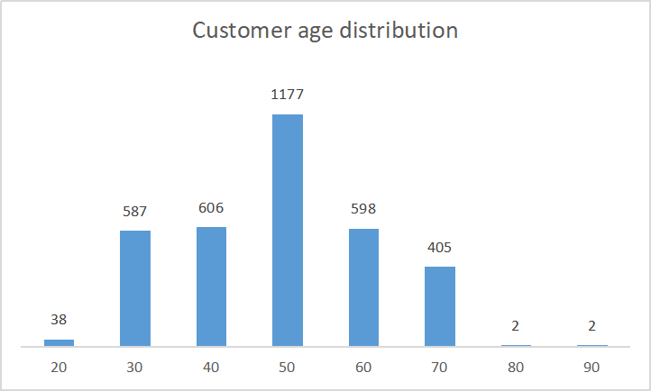
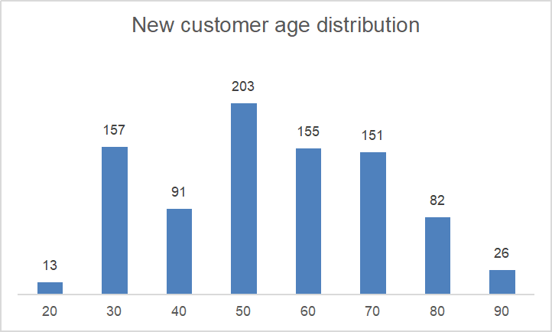
Data Exploration
Age distibution
Old customer's age is generally in line with normal distribution
For both new and old customers, the number of customers aged 50-59 is the largest
The percentage of new customers aged over 80 is larger than the porportion of old customers

Slide 7
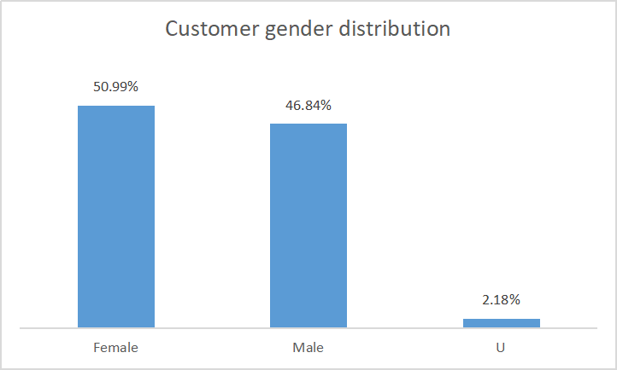

Data Exploration
Gender distibution
Gender distribution is almost even for both new and old customers
The proportion of customers with unknown gender (respenting 'U') is around 2%

Slide 8
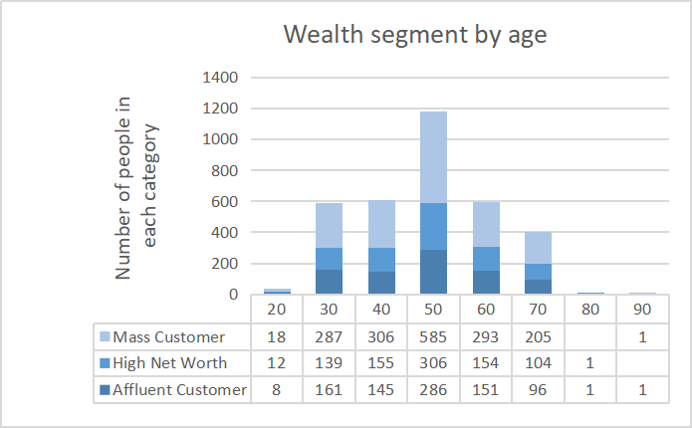
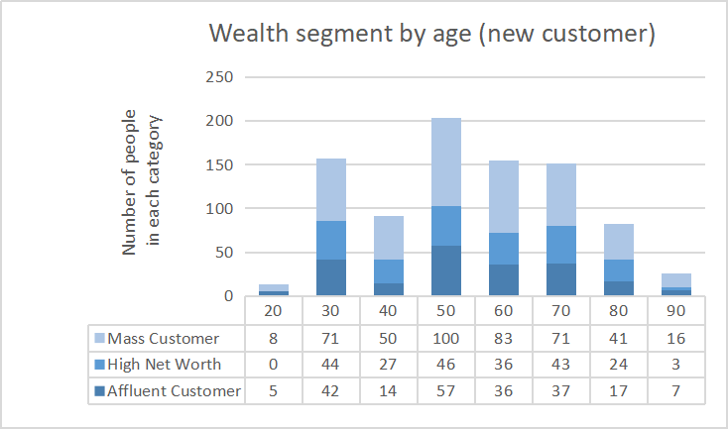
Data Exploration
Wealth segment distribution
In all age groups, the majority of customers are classified as 'Mass Customer'
The next category is 'High Net Worth'
For new customers aged between 50-59, 'Affluent Customer' has larger number than 'High Net Worth'

Slide 9
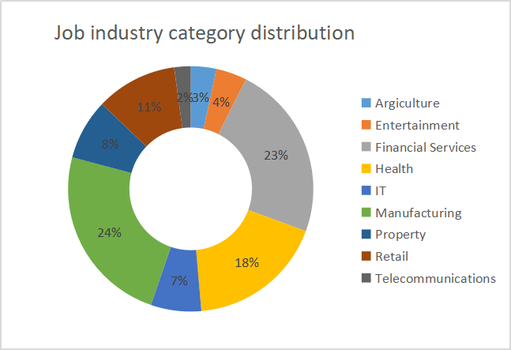
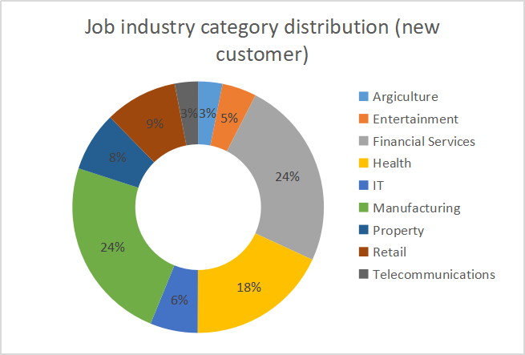
Data Exploration
Job industry category distribution
Manufacturing (24%) accounted for the largest number of customers, followed by financial services (23%-24%) for both new and old customers
The smallest number of customers are in Telecommunications and Agriculture

Slide 10
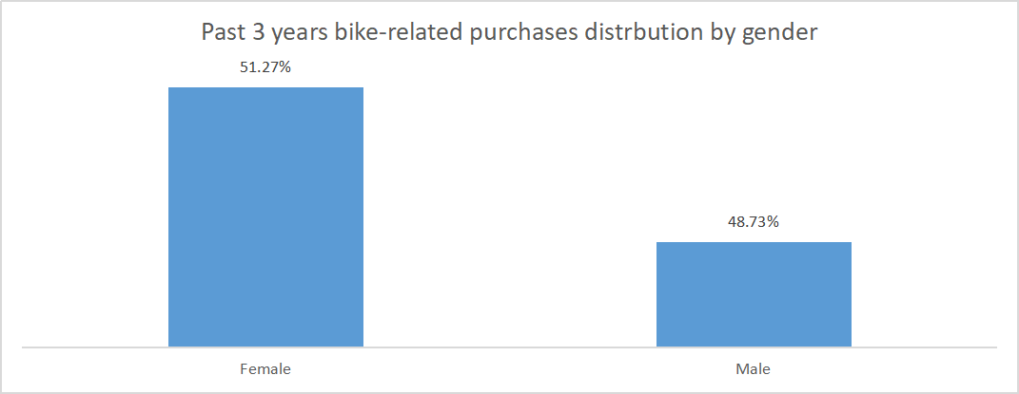
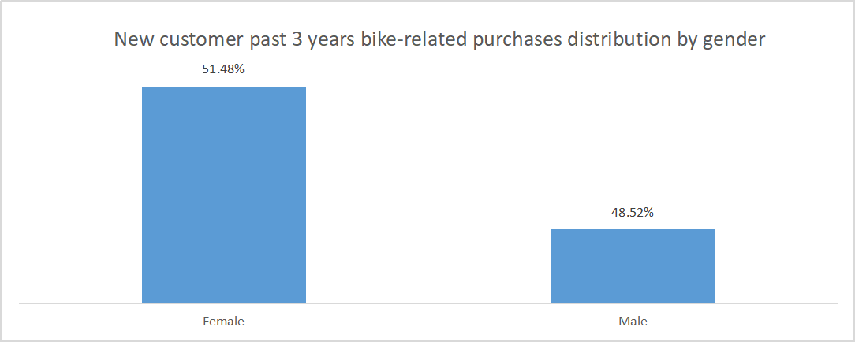
Data Exploration
Recent bike-related purchases
For both new and old customer lists, females make up the majority of bike-related purchases in past 3 years
New and old customers share with similar purchase patterns

Slide 11
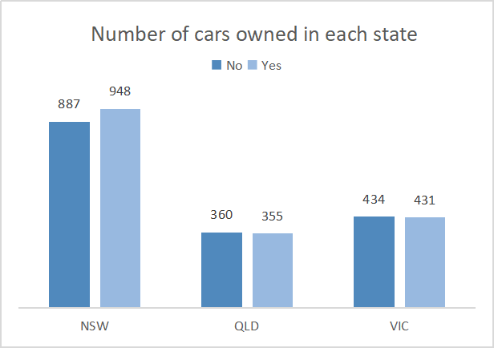
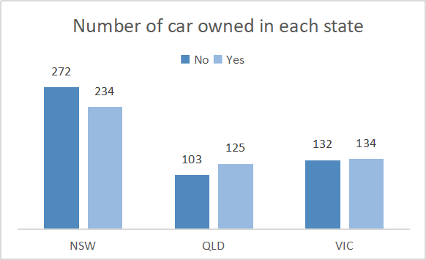
Data Exploration
The number of cars owned in each state
NSW has the largest number of customers that do not own a car for both new and old customer
For new customers, VIC and QLD has more customers that own car than that who don’t

Slide 12
Model Development
RFM Analysis
RFM analysis is used to determine which customers a business should target to increase its revenue and value
R - Recency
F - Frequency
M - Monetary

Slide 13
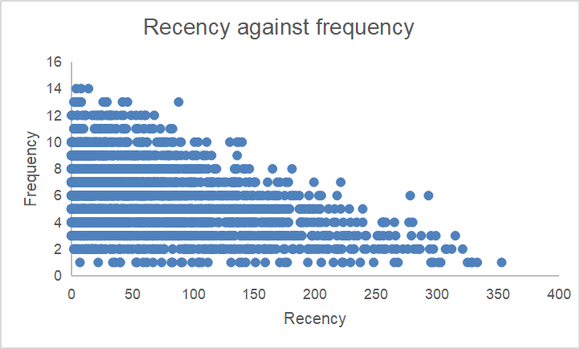
Model Development
Scatter plot based on RFM analysis
Customers that have visited more recently (0-50 days) are more likely to visit more frequently
Higher frequency has a negative relationship with recency values

Slide 14
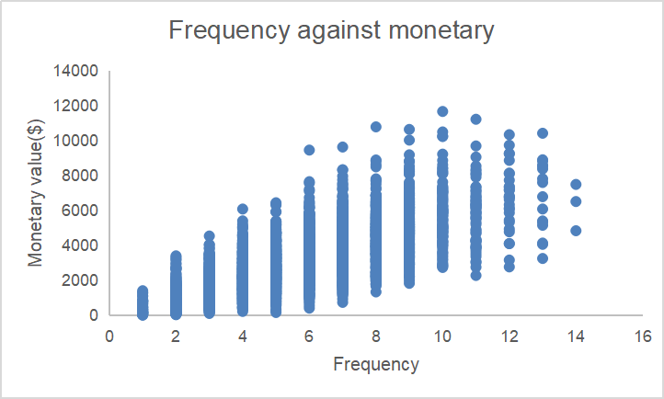
Model Development
Scatter plot based on RFM analysis
There is a positive relationship between frequency and monetary gained for the business

Slide 15
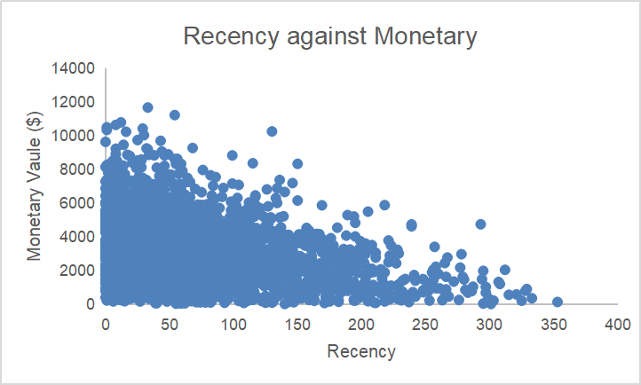
Model Development
Scatter plot based on RFM analysis
The figure shows that customers who purchased more recently have generated more revenue than those who shopped a while ago
Customers from recent pasy (50-100 days) show to generate a moderate amount of revenue
Customers who visited over 250 days ago generate low revenue

Slide 16
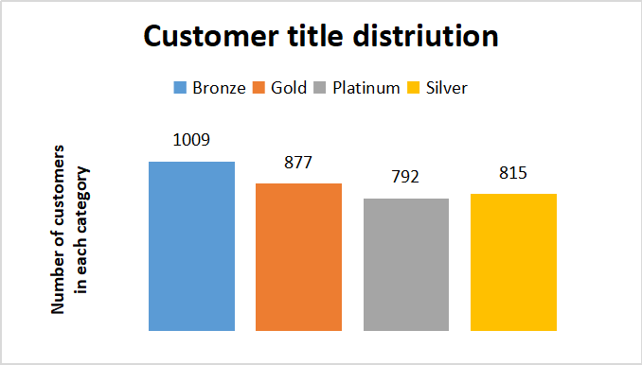
Model Development
Customer title along with RFM values assigned
We assigned each customer with an RFM value according to the formula:
RFM value = Recency*100+Frequency*10+Monetary
Then customer titles were given:
0-211 | 211-311 | 311-411 | 411-433
Bronze | Silver | Gold | Platinum

Slide 17
Model Development
Feature selection
Top factors in terms of feature importance
age
past_3_years bike_related_purchases
tenure
property_valuation
job_industry_category
wealth_segment

Slide 18
Interpretation
Added point
'Customer title' from old customer list was used as labels for modeling in order to select the most important feature to identify new customer with high value
Random Forest algorithmn was applied for feature selection

Slide 19
Appendix

Slide 20
Appendix

