Slide 1

NoSQL injections
A login without
the password
Reproducing operator injection from Ron et al. (2016)
Five configurations and 150 recorded outcomes
Ercong Kee / Pheobe Neo / Kendrick Poon / Liu Qingyu
Ron et al., 2016 / controlled local reproduction
01
Notes:
Target time: 0:20
Today we examine Ron, Shulman-Peleg and Puzanov's 2016 IEEE Security & Privacy article on NoSQL injections. We clarify its attack taxonomy, then reproduce one operator-injection route in a controlled local experiment. Imagine logging in as Alice without knowing her password. We follow one small change in a request through the database and into a false login, then test which defences actually stop it.
Sources: https://research.ibm.com/publications/analysis-and-mitigation-of-nosql-injections
Project evidence: nosql-lab/evidence/results.json and results.csv; 15 cases × 5 configurations × 2 runs.

Slide 2
A query is a test on a record
DOCUMENT = A STORED RECORD
{ username: "alice", password: "…" }
Alice’s stored password is a non-empty string in the vulnerable lab.
EQUALITY CONDITION
OPERATOR CONDITION
password: "wrong"
password: { $ne: "" }
Does the password equal “wrong”?
Is the password different from an empty string?
Predicate = condition $ne = not equal "" = empty string
Scope: MongoDB’s document model
MongoDB 7.0 $ne documentation / illustrative teaching record
02
Notes:
Target time: 0:55
NoSQL includes several data models. We study MongoDB's document model, which stores records called documents. A document contains named fields, such as username and password. A query asks which records satisfy a condition, also called a predicate. On the left, the password must equal the supplied text. On the right, dollar-ne means not equal, and the empty quotes mean an empty string. Alice has a non-empty stored password, so that second condition matches her. This deliberately vulnerable teaching record stores plaintext. Our fixed design later uses a password hash.
Sources: https://www.mongodb.com/docs/v7.0/reference/operator/query/ne/
Project evidence: nosql-lab/evidence/results.json and results.csv; 15 cases × 5 configurations × 2 runs.

Slide 3
Where the login goes wrong
ONE CONTINUOUS FALSE-LOGIN PATH
01
02
03
04
05
Attacker request
App builds query
MongoDB
App creates session
Private notes
Knows “alice” and
sends an object
Copies request values
into the filter
Alice’s record
matches
Treats the match as
password proof
Protected access
is granted
A database match is not password proof.
Threat model / local synthetic records
03
Notes:
Target time: 0:45
The attacker knows Alice's username and controls the JSON request. They cannot connect directly to MongoDB or change the stored records. The application copies the submitted values into a query. MongoDB returns a matching account, and the application creates a session, meaning a remembered login. That session opens Alice's protected notes. The database service account is allowed to read her record, but that permission does not prove the caller knows her password. The application makes the wrong authentication decision.
Sources: https://www.infoq.com/articles/nosql-injections-analysis/
Project evidence: nosql-lab/evidence/results.json and results.csv; 15 cases × 5 configurations × 2 runs.

Slide 4
Ron et al. describe several injection boundaries
OUR MEASURED ROUTE
Operator object
Changes the query condition
A record matches
without the correct
password
Operator injection measured in our experiment
OTHER BOUNDARIES IN RON ET AL. (2016)
Query text
JavaScript source
Protocol command
Trusted browser (CSRF)
Experiment focus: the operator route
Ron et al., 2016 / author manuscript and republication
04
Notes:
Target time: 0:40
Ron and colleagues describe five classes. We group their query examples together here, and keep the original names in the small labels. Other inputs can become JavaScript source or an extra protocol command. Their origin-violation example is cross-site request forgery: a browser performs an unwanted action using a user's authority. Our experiment tests the highlighted operator route. Later we compare it with JavaScript injection conceptually. The research question is which controls stop this attack from creating a login session.
Sources: https://www.infoq.com/articles/nosql-injections-analysis/
https://www.researchgate.net/publication/300367234_Analysis_and_Mitigation_of_NoSQL_Injections

Slide 5
The password value becomes a condition
01 CLIENT REQUEST
02 VULNERABLE APPLICATION
03 DATABASE
username
users.findOne({
username
equals Alice
"alice"
username: body.username,
password: body.password
AND
password
})
{ "$ne": "" }
password
is not empty
The app lets the request define
the password condition.
The value is an object.
MATCH
Alice’s stored password is non-empty, so this condition matches.
C04 / native MongoDB driver / synthetic plaintext reproduction
05
Notes:
Target time: 1:00
The username stays Alice. The password value becomes an object containing dollar-ne. The vulnerable code passes both values directly into findOne, which asks MongoDB for one matching record. The resulting test is: username equals Alice, and password is not the empty string. Both are true for this synthetic account. The application creates an Alice session even though no correct password was supplied. This needs no JavaScript execution. MongoDB runs an ordinary supported operator. The application allowed the client to change what its password check meant.
Sources: https://www.mongodb.com/docs/v7.0/reference/operator/query/ne/
Project evidence: nosql-lab/evidence/results.json and results.csv; 15 cases × 5 configurations × 2 runs.

Slide 6
The parsed type changes the query meaning
OBJECT
STRING
{ "$ne": "" }
"{\"$ne\":\"\"}"
MongoDB sees
MongoDB sees
an operator condition
ordinary literal text
Alice matches
Alice does not match
06
Notes:
Target time: 0:45
These inputs look similar but have different types. The first is an object, so MongoDB recognises the operator and Alice matches. The second is a string containing the same characters. In this query it stays ordinary text and fails to match her stored password. We tested that second case as a negative control. The attack also assumes that the endpoint accepts objects, Alice's stored password is non-empty, and any returned record creates a session. Those assumptions define the claim we can test.
Sources: https://www.mongodb.com/docs/v7.0/reference/operator/query/ne/
https://cheatsheetseries.owasp.org/cheatsheets/NoSQL_Security_Cheat_Sheet.html
Project evidence: nosql-lab/evidence/results.json and results.csv; 15 cases × 5 configurations × 2 runs.

Slide 7
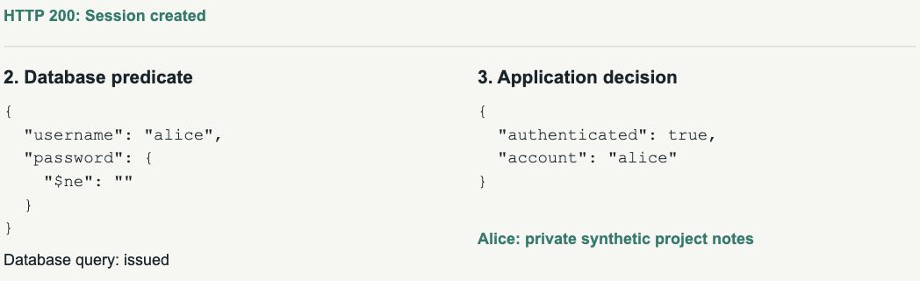
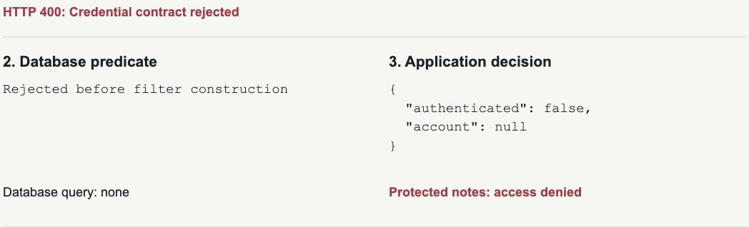
Same attack, different login decision
ATTACK SUCCEEDS
THE SAME ATTACK IS STOPPED
SESSION
Created
SESSION
Rejected
DATABASE
1 query sent
DATABASE
No query sent
ACCESS
Alice’s notes exposed
ACCESS
Protected access denied
ACTUAL BROWSER CAPTURE
ACTUAL BROWSER CAPTURE
07
Notes:
Target time: 1:30
We tested fifteen request cases across five configurations twice. This demo shows four recorded outcomes. First, a wrong password fails and Alice's notes stay closed. Next, we replace only the password value with the operator object. The vulnerable path accepts the attack, logs us in as Alice and opens her synthetic private notes. We submit the same attack request to the hardened path. It rejects the object before any database query and denies access. Finally, the correct credentials still log in successfully. That last check matters: rejecting every request would stop the attack but would also break the application. The captured results on this slide preserve the evidence if the live service fails.
Sources: Project evidence: nosql-lab/evidence/results.json and results.csv; 15 cases × 5 configurations × 2 runs.

Slide 8
Which controls stopped the attack?
3
controls still allow
the attack
2
application controls stop it
before any query
Configuration | Attack outcome | Database query | Correct login
Baseline | Attack succeeds | 1 query sent | Login works
JavaScript disabled | Attack succeeds | 1 query sent | Login works
Read-only DB account | Attack succeeds | 1 query sent | Login works
String validation | Attack stopped | No query sent | Login works
Full hardened login | Attack stopped | No query sent | Login works
Scripting and read-only controls do not stop this read-only operator attack.
08
Notes:
Target time: 1:00
The same attack request succeeds in the baseline, with JavaScript disabled, and with a read-only database account. In each case, the app sends one query and logs in as Alice. Both validation paths stop the attack before any query. Correct credentials still work in all five configurations. Disabling scripting does not stop a normal query operator. Read-only access prevents writes, but this attack needs only a read. The isolated validation comparison identifies the effective change: the application rejects the unexpected password object before building the query. The numbers in parentheses are HTTP response codes. They support the result, but the important outcome is whether the attack created a session.
Sources: Project evidence: nosql-lab/evidence/results.json and results.csv; 15 cases × 5 configurations × 2 runs.
https://cheatsheetseries.owasp.org/cheatsheets/NoSQL_Security_Cheat_Sheet.html

Slide 9
A safe login keeps the password out of the query
SAFE LOGIN PATH
01
02
03
04
Check inputs
Find account
Verify password
Create session
Require username and
password text
Query by username
only
Check the stored
password hash
Only after a
successful check
Object password
The password never becomes a database query condition.
Rejected. No query.
Local source / OWASP NoSQL and password-storage guidance
09
Notes:
Target time: 0:50
The attack payload fails at the first step because its password is an object, not text. For a legitimate request, the application accepts only the expected username and password strings. It asks MongoDB for the account using the username alone, so the password cannot change the query. The application then compares the submitted password with the stored hash. A password hash is a one-way stored verifier; the hardened account collection does not store the plaintext password. Only a successful comparison creates a session. This separation is the complete idea: validate the request, look up the account, verify the password and then decide whether to log in.
Sources: https://cheatsheetseries.owasp.org/cheatsheets/Password_Storage_Cheat_Sheet.html
https://cheatsheetseries.owasp.org/cheatsheets/NoSQL_Security_Cheat_Sheet.html
Project evidence: nosql-lab/evidence/results.json and results.csv; 15 cases × 5 configurations × 2 runs.

Slide 10
Different injection types need different defences
 | Operator injection Measured in our lab | JavaScript injection Literature only
Input form | JSON object with $ne | Text inserted into JavaScript source
Interpreter | MongoDB query engine | JavaScript engine
Effective control | Require expected types Build the query in application code | Never build code from input Disable unused scripting
Only operator injection was demonstrated. JavaScript injection is a literature comparison.
Literature comparison / MongoDB 7.0 $where documentation
10
Notes:
Target time: 0:40
The left column is our measured attack. A JSON object contains dollar-ne, and MongoDB reads it as a query condition. That makes the filter match without the correct password. Requiring text in login fields and building the query in application code stops this route. The right column comes from the literature. An application may insert user text into JavaScript source, and the JavaScript engine then executes changed program logic. Prevent that by never building code from user text and by disabling scripting when it is unused. We did not demonstrate the JavaScript attack. Our fixed dollar-where probe only checked whether scripting was enabled.
Sources: https://www.mongodb.com/docs/v7.0/reference/operator/query/where/
https://www.infoq.com/articles/nosql-injections-analysis/
https://cheatsheetseries.owasp.org/cheatsheets/NoSQL_Security_Cheat_Sheet.html

Slide 11
What our experiment shows
1
The attack succeeds
Session created
Operator object logs the attacker in as Alice
2
The attack is stopped
No query sent
Object rejected before MongoDB receives a query
3
Legitimate login still works
Protected access granted
Correct credentials retain protected access
Scope: one recorded stack, synthetic accounts and 15 request cases.
Recorded local experiment / results.json and results.csv
11
Notes:
Target time: 0:35
Three observations support our conclusion. First, the operator object logs the attacker in as Alice in the vulnerable path. Second, validation rejects that same input before MongoDB receives a query. Third, correct credentials still work after the fix. The slide states the security outcome first and places the HTTP response code beneath it as supporting evidence. These claims cover our known account, fifteen request cases and recorded MongoDB stack. We have not demonstrated a JavaScript exploit or measured how common this problem is in deployed systems.
Sources: Project evidence: nosql-lab/evidence/results.json and results.csv; 15 cases × 5 configurations × 2 runs.

Slide 12

The application must keep control of the query
APPLICATION RULE
Choose the query structure.
Validate input values.
Verify the password.
NEXT STUDY
Can flexible search preserve
customer separation?
User-selected filters must never remove the required customer filter.
Proposed follow-up study / OWASP NoSQL guidance
12
Notes:
Target time: 0:40
For a login, the application should choose the fields and operators, validate the values, and verify the password separately. Rich search APIs are harder because users may legitimately choose filters. For example, a tenant is a customer organisation whose records must stay separate from another customer's records. Our next study would compare allowed fields and operators with a query builder that always adds the tenant restriction. We would test cross-tenant access as well as legitimate search. That is future work, beyond the login result presented today.
Sources: https://cheatsheetseries.owasp.org/cheatsheets/NoSQL_Security_Cheat_Sheet.html
Project evidence: nosql-lab/evidence/results.json and results.csv; 15 cases × 5 configurations × 2 runs.

Slide 13
How we tested the controls
15
×
5
×
2
=
150
CASES
CONFIGURATIONS
RUNS
RECORDED RESULTS
FOR EVERY REQUEST, WE RECORDED
Login decision
Protected access
Database query count
Did the app create a session?
Could the caller open Alice’s notes?
Did MongoDB receive a find command?
Separate probes verified that the read-only and scripting controls were active.
13
Notes:
Target time: 0:45
We ran fifteen request cases through five configurations, twice. The cases include the attack, correct and wrong passwords, and unexpected input shapes. For each request we recorded the login result, protected-page access and actual MongoDB find commands. Separate probes verified that scripting really was disabled and the read-only account really could not write. The validation-only configuration retains the vulnerable query after validation, so it isolates the effect of rejecting objects. The two runs show repeatability in this lab. They do not estimate attack prevalence.
Sources: Project evidence: nosql-lab/evidence/results.json and results.csv; 15 cases × 5 configurations × 2 runs.

Slide 14
Recorded environment
Component | Recorded value
MongoDB | 7.0.0
Node.js | v23.6.1
Express / native driver | 5.1.0 / 6.20.0
Transport / parser | Loopback HTTP / JSON / express.json
Password verification | scrypt N=131072, r=8, p=1
Evidence | 15 cases × 5 modes × 2 runs
Original experiment record. Fresh browser captures: 1 November 2026.
14
Notes:
Target time: Q&A
MongoDB 7.0.0 and Node v23.6.1 are the original recorded environment. The authenticated databases bind to loopback. The version is an experimental record, not a deployment recommendation. GitHub CI separately reproduced the lab under Node 22. The evidence commit identifies the source and results used in the deck.
Sources: Project evidence: nosql-lab/evidence/results.json and results.csv; 15 cases × 5 configurations × 2 runs.
https://www.mongodb.com/docs/v8.0/core/server-side-javascript/
https://github.com/Qingyu255/CS440-Project/tree/c8252d2bb3baeb543a011992e2a79ee2123ecfec

Slide 15
The vulnerable session decision
CLIENT VALUES ENTER THE QUERY
const filter = {
username: req.body.username,
password: req.body.password
};
const account = await users.findOne(filter);
if (account) createSession(account);
Condensed vulnerable excerpt. A match is incorrectly accepted as password proof.
15
Notes:
Target time: Q&A
This is a condensed teaching excerpt. The application takes values from the request, builds a filter, and creates a session when a record is returned. The full source counts actual database commands for each request. Synthetic plaintext records make the failure easy to inspect.
Sources: Project evidence: nosql-lab/evidence/results.json and results.csv; 15 cases × 5 configurations × 2 runs.

Slide 16
The hardened session decision
1
Validate exactly two non-empty strings
if (!validContract(body)) return reject(400);
2
Look up by username only
const account = await users.findOne({ username });
3
Verify a salted password hash
const ok = await verifyPassword(password, storedHash);
4
Create a session after verification
if (account && ok) createSession(account);
Condensed code. Full source includes field/length checks and a dummy hash for unknown users.
16
Notes:
Target time: Q&A
The full validator allows exactly username and password with non-empty strings and bounded lengths. The account lookup uses the username only. The accounts_hashed collection contains no plaintext password. Unknown accounts follow a dummy-hash verification path and receive the same invalid-credentials response.
Sources: https://cheatsheetseries.owasp.org/cheatsheets/Password_Storage_Cheat_Sheet.html
Project evidence: nosql-lab/evidence/results.json and results.csv; 15 cases × 5 configurations × 2 runs.

Slide 17
Case results C01 to C08
Case | Request shape | Three vulnerable modes | Protected modes
C01 | Valid credentials | Login succeeds | Login succeeds
C02 | Wrong string password | Login rejected | Login rejected
C03 | Unknown username | Login rejected | Login rejected
C04 | Password operator object | Attack succeeds | Stopped before query
C05 | Username operator with wrong password | Login rejected | Stopped before query
C06 | Operator-looking literal string | Login rejected | Login rejected
C07 | Null password | Login rejected | Stopped before query
C08 | Array password | Login rejected | Stopped before query
Vulnerable modes: baseline, scripting disabled and read-only. Both runs agree.
17
Notes:
Target time: Q&A
The three vulnerable configurations are baseline, scripting disabled and read-only. They agree for these cases. The protected configurations are string validation and the full hardened login. They agree on the displayed request outcome, although their password-verification designs differ. Both repetitions agree. Plain-language outcomes appear in the cells; the HTTP codes are retained only in the footer as secondary evidence.
Sources: Project evidence: nosql-lab/evidence/results.json and results.csv; 15 cases × 5 configurations × 2 runs.

Slide 18
Case results C09 to C15
Case | Request shape | Three vulnerable modes | Protected modes
C09 | Missing password | Login rejected | Stopped before query
C10 | Numeric password | Login rejected | Stopped before query
C11 | Extra field with valid credentials | Request accepted | Stopped before query
C12 | Top-level array | Login rejected | Stopped before query
C13 | Both fields contain operators | Attack succeeds | Stopped before query
C14 | Empty password | Login rejected | Stopped before query
C15 | Empty username | Login rejected | Stopped before query
Vulnerable modes: baseline, scripting disabled and read-only. Both runs agree.
18
Notes:
Target time: Q&A
This continuation includes missing, numeric and empty fields, an extra field, a top-level array and both fields containing operators. C11 uses correct credentials plus an extra field: the hardened modes intentionally reject the shape. These are input-policy tests, not fifteen separate exploit classes.
Sources: Project evidence: nosql-lab/evidence/results.json and results.csv; 15 cases × 5 configurations × 2 runs.

Slide 19
The controls were independently checked
Control | Independent observation
Read-only identity | Authenticated as labreader with the read role
Read permitted | Alice lookup succeeds
Write denied | MongoDB blocks the write (error 13)
JavaScript probe enabled | The fixed $where probe returns Alice
JavaScript probe disabled | The same probe fails as expected (error 6108304)
Both controls are active, but neither stops attack C04.
The fixed $where expression tests configuration, not attacker-controlled JavaScript.
19
Notes:
Target time: Q&A
The read-only account authenticates with the read role on cs440_lab. A read succeeds and a synthetic write fails with Unauthorized code 13. The fixed where expression finds Alice on the enabled server and fails with code 6108304 on the disabled server. The probe tests configuration only. It contains no attacker-controlled code construction.
Sources: Project evidence: nosql-lab/evidence/results.json and results.csv; 15 cases × 5 configurations × 2 runs.

Slide 20
Captured evidence: attack succeeds
{"username":"alice","password":{"$ne":""}}
HTTP
Session created
200
DATABASE
Query sent
1 find
ACCESS
Alice’s notes exposed
granted
The vulnerable app treats a record match as password proof.
20
Notes:
Target time: Q&A
Fresh browser evidence captured on 1 November 2026 from the same local teaching lab. The request is Alice plus the password operator object. The unmodified response region shows the query, session decision and protected-note outcome. Full-page captures accompany the deck.
Sources: Project evidence: nosql-lab/evidence/results.json and results.csv; 15 cases × 5 configurations × 2 runs.

Slide 21
Captured evidence: attack stopped
{"username":"alice","password":{"$ne":""}}
HTTP
Credential contract rejected
400
DATABASE
No query sent
0 find
ACCESS
Protected notes denied
denied
The hardened app rejects the object before constructing a filter.
21
Notes:
Target time: Q&A
The hardened mode receives the same payload. The application reports rejection before filter construction, no database query and denied protected access. Valid credentials also succeed in the separate functional control. Full-page captures accompany the deck.
Sources: Project evidence: nosql-lab/evidence/results.json and results.csv; 15 cases × 5 configurations × 2 runs.

Slide 22
What remains untested
ESTABLISHED
NOT ESTABLISHED
1 Operator payload creates a session
2 Across 150 recorded outcomes, both runs agreed in all five configurations
3 The fix rejects before query and retains correct login
1 No JavaScript exploit or prevalence estimate
2 Not all drivers or database versions
3 No administrator-access or production-security claim
Next experiment: allow flexible search without leaking another customer’s records.
22
Notes:
Target time: Q&A
The study establishes that this operator payload creates a login session in the vulnerable path and records how the tested controls respond. It does not measure deployed prevalence, prove administrator access, cover all drivers or MongoDB versions, demonstrate JavaScript injection, or certify production security. A tenant-filter experiment is a proposed next study.
Sources: Project evidence: nosql-lab/evidence/results.json and results.csv; 15 cases × 5 configurations × 2 runs.
https://cheatsheetseries.owasp.org/cheatsheets/NoSQL_Security_Cheat_Sheet.html

Slide 23
Article and database references
Ron, Shulman-Peleg and Puzanov (2016)
Analysis and Mitigation of NoSQL Injections
IEEE Security & Privacy 14(2), 30–39
DOI: 10.1109/MSP.2016.36
Author-uploaded manuscript and authors’ InfoQ republication
Original classes: tautologies, union queries, JavaScript injection,
piggybacked queries and origin violation.
MongoDB 7.0: $ne and $where documentation
Full URLs in the notes and team guide.
23
Notes:
Target time: Q&A
Publication identity follows the IBM record and DOI 10.1109/MSP.2016.36. The authors’ InfoQ republication and author-uploaded manuscript were checked for the five classes. The publisher library proxy remained unavailable; the author manuscript is not claimed to be the final typeset version. No original page or figure numbers are asserted. MongoDB semantics are linked to version 7.0 documentation.
Sources: https://research.ibm.com/publications/analysis-and-mitigation-of-nosql-injections
https://www.researchgate.net/publication/300367234_Analysis_and_Mitigation_of_NoSQL_Injections
https://www.infoq.com/articles/nosql-injections-analysis/
https://www.mongodb.com/docs/v7.0/reference/operator/query/ne/
https://www.mongodb.com/docs/v7.0/reference/operator/query/where/

Slide 24
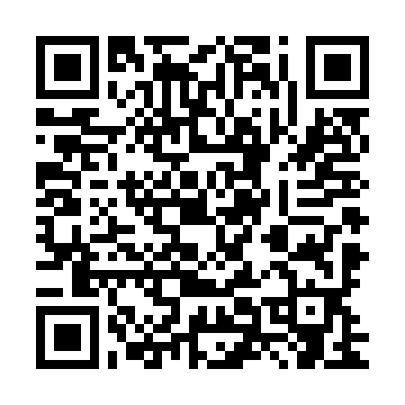
Defences and reproducible evidence
OWASP NoSQL Security Cheat Sheet
OWASP Password Storage Cheat Sheet
github.com/Qingyu255/CS440-Project
Evidence commit: c8252d2
Source and results are fixed at this revision.
results.json / results.csv / server.mjs / experiment.mjs
Fresh captures and team guide accompany the revised deck.
24
Notes:
Target time: Q&A
The immutable evidence commit is c8252d2bb3baeb543a011992e2a79ee2123ecfec. It records the source and experiment used for this study. The repository’s current revision adds redesigned slides, fresh browser captures and team handover materials. OWASP provides complementary guidance. The local teaching application is not a production deployment template.
Sources: https://cheatsheetseries.owasp.org/cheatsheets/NoSQL_Security_Cheat_Sheet.html
https://cheatsheetseries.owasp.org/cheatsheets/Password_Storage_Cheat_Sheet.html
https://github.com/Qingyu255/CS440-Project/tree/c8252d2bb3baeb543a011992e2a79ee2123ecfec

