Slide 1
NoSQL injections
A login without
the password
"password": "wrong"
{ "$ne": "" }
A controlled comparison of five login configurations
Ercong Kee / Pheobe Neo / Kendrick Poon / Liu Qingyu
Ron et al., 2016 / controlled local reproduction
01
Notes:
Target time: 0:20
Imagine logging in as Alice without knowing her password. Our local experiment does exactly that. We follow one small change in a request through the database and into a false login, then test which defences actually stop it.
Sources: https://research.ibm.com/publications/analysis-and-mitigation-of-nosql-injections
Project evidence: nosql-lab/evidence/results.json and results.csv; 15 cases × 5 configurations × 2 runs.

Slide 2
A query is a test on a record
DOCUMENT = A STORED RECORD
{ username: "alice", password: "…" }
Alice’s stored password is a non-empty string in the vulnerable lab.
EQUALITY CONDITION
OPERATOR CONDITION
password: "wrong"
password: { $ne: "" }
Does the password equal “wrong”?
Is the password different from an empty string?
Predicate = condition $ne = not equal "" = empty string
NoSQL models: document, key-value, graph, wide-column. Here: MongoDB documents.
MongoDB 7.0 $ne documentation / illustrative teaching record
02
Notes:
Target time: 0:55
NoSQL includes several data models. We study MongoDB's document model, which stores records called documents. A document contains named fields, such as username and password. A query asks which records satisfy a condition, also called a predicate. On the left, the password must equal the supplied text. On the right, dollar-ne means not equal, and the empty quotes mean an empty string. Alice has a non-empty stored password, so that second condition matches her. This deliberately vulnerable teaching record stores plaintext. Our fixed design later uses a password hash.
Sources: https://www.mongodb.com/docs/v7.0/reference/operator/query/ne/
Project evidence: nosql-lab/evidence/results.json and results.csv; 15 cases × 5 configurations × 2 runs.

Slide 3
Where the login goes wrong
THE ATTACKER CONTROLS THE REQUEST
Client
Application
MongoDB
Session
Private notes
Sends JSON
Builds query
Returns Alice
Remembers Alice
Allows access
The failure occurs when input changes the query condition.
Known username, no direct database access, no changes to stored records
Threat model / local synthetic records
03
Notes:
Target time: 0:45
The attacker knows Alice's username and controls the JSON request. They cannot connect directly to MongoDB or change the stored records. The application copies the submitted values into a query. MongoDB returns a matching account, and the application creates a session, meaning a remembered login. That session opens Alice's protected notes. The database service account is allowed to read her record, but that permission does not prove the caller knows her password. The application makes the wrong authentication decision.
Sources: https://www.infoq.com/articles/nosql-injections-analysis/
Project evidence: nosql-lab/evidence/results.json and results.csv; 15 cases × 5 configurations × 2 runs.

Slide 4
The paper covers several attack boundaries
INPUT ENTERS…
WHAT CAN CHANGE
Query conditions
Operator object changes a condition
Tautologies / our experiment
Query text
Added logic changes which records match
“Union queries” / literature
JavaScript source
String becomes executable source
JavaScript injection / comparison
A protocol command
A separator introduces another command
Piggybacked queries / literature
A trusted browser
Browser sends an unwanted action
Origin violation / CSRF / adjacent issue
Which controls stop the highlighted operator route?
Ron et al., 2016 / author manuscript and republication
04
Notes:
Target time: 0:40
Ron and colleagues describe five classes. We group their query examples together here, and keep the original names in the small labels. Other inputs can become JavaScript source or an extra protocol command. Their origin-violation example is cross-site request forgery: a browser performs an unwanted action using a user's authority. Our experiment tests the highlighted operator route. Later we compare it with JavaScript injection conceptually. The research question is which controls stop this particular login bypass.
Sources: https://www.infoq.com/articles/nosql-injections-analysis/
https://www.researchgate.net/publication/300367234_Analysis_and_Mitigation_of_NoSQL_Injections

Slide 5
The password value becomes a condition
1 CLIENT REQUEST
{"username":"alice","password":{"$ne":""}}
2 APPLICATION COPIES THE VALUES
3 BOTH CONDITIONS MATCH
users.findOne({
username: body.username,
password: body.password
})
username equals Alice
AND
password is not ""
A match becomes a session without password proof.
For this record, the stored password is non-empty. $ne: "" also matches missing fields.
C04 / native MongoDB driver / synthetic plaintext reproduction
05
Notes:
Target time: 1:00
The username stays Alice. The password value becomes an object containing dollar-ne. The vulnerable code passes both values directly into findOne, which asks MongoDB for one matching record. The resulting test is: username equals Alice, and password is not the empty string. Both are true for this synthetic account. The application creates an Alice session even though no correct password was supplied. This needs no JavaScript execution. MongoDB runs an ordinary supported operator. The application allowed the client to change what its password check meant.
Sources: https://www.mongodb.com/docs/v7.0/reference/operator/query/ne/
Project evidence: nosql-lab/evidence/results.json and results.csv; 15 cases × 5 configurations × 2 runs.

Slide 6
An object and a string behave differently
OBJECT
MongoDB operator
MATCH
Alice returned
{ "$ne": "" }
STRING
Literal text
NO MATCH
Login fails
"{\"$ne\":\"\"}"
The parsed input type changes what the query means.
C04 object and C06 string controls
06
Notes:
Target time: 0:45
These inputs look similar but have different types. The first is an object, so MongoDB recognises the operator and Alice matches. The second is a string containing the same characters. In this query it stays ordinary text and fails to match her stored password. We tested that second case as a negative control. Our bypass also assumes that the endpoint accepts objects, Alice's stored password is non-empty, and any returned record creates a session. Those assumptions define the claim we can test.
Sources: https://www.mongodb.com/docs/v7.0/reference/operator/query/ne/
https://cheatsheetseries.owasp.org/cheatsheets/NoSQL_Security_Cheat_Sheet.html
Project evidence: nosql-lab/evidence/results.json and results.csv; 15 cases × 5 configurations × 2 runs.

Slide 7
How we tested the controls
15 cases
5 CONFIGURATIONS
2 RUNS
Baseline
Login decision
Protected access
Query count
Correct / wrong passwords
Operator objects
Unexpected types and fields
JavaScript disabled
Read-only DB account
String validation
Full hardened login
150 recorded outcomes
Control probes verify settings.
Repeated runs show local repeatability.
15 cases × 5 configurations × 2 runs / results.json
07
Notes:
Target time: 0:45
We ran fifteen request cases through five configurations, twice. The cases include the attack, correct and wrong passwords, and unexpected input shapes. For each request we recorded the login result, protected-page access and actual MongoDB find commands. Separate probes verified that scripting really was disabled and the read-only account really could not write. The validation-only configuration retains the vulnerable query after validation, so it isolates the effect of rejecting objects. The two runs show repeatability in this lab. They do not estimate attack prevalence.
Sources: Project evidence: nosql-lab/evidence/results.json and results.csv; 15 cases × 5 configurations × 2 runs.

Slide 8
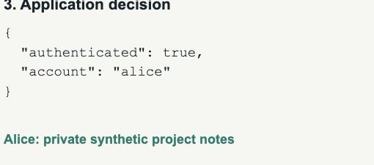
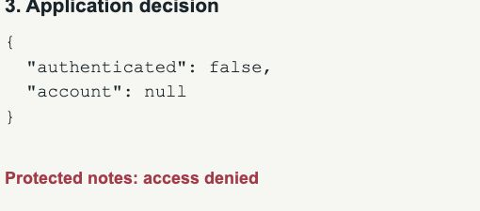
Same attack, different login decision
01
02
03
04
Wrong password
Operator object
Same object + fix
Correct password
Rejected
Alice session
Rejected
Alice session
CAPTURED BYPASS
CAPTURED REJECTION
Live lab: http://127.0.0.1:4400 Offline video: 90 seconds
Actual browser captures / local synthetic lab / 1 November 2026
08
Notes:
Target time: 1:30
First, a wrong password fails and Alice's notes stay closed. Next, we replace only the password value with the operator object. The vulnerable path creates an Alice session and opens her synthetic private notes. We submit the identical request to the hardened path. It rejects the input before any database query and denies access. Finally, the correct credentials still log in successfully. That last check matters: rejecting every request would stop the attack but would also break the application. The captured results on this slide preserve the evidence if the live service fails.
Sources: Project evidence: nosql-lab/evidence/results.json and results.csv; 15 cases × 5 configurations × 2 runs.

Slide 9
Which controls stopped the bypass?
Configuration | Attack result | Find queries | Valid login
Baseline | BYPASS / 200 | 1 | Works / 200
JavaScript disabled | BYPASS / 200 | 1 | Works / 200
Read-only DB account | BYPASS / 200 | 1 | Works / 200
String validation | BLOCKED / 400 | 0 | Works / 200
Full hardened login | BLOCKED / 400 | 0 | Works / 200
Scripting control: this attack uses an ordinary query operator.
Read-only control: this attack needs a read, not a write.
Focal attack C04 / complete matrix in slides 17–18
09
Notes:
Target time: 1:00
The same operator request succeeds in the baseline, with JavaScript disabled, and with a read-only database account. Each sends one find command. Both validation paths reject it before a find command. Correct credentials still work in all five configurations. Disabling scripting does not stop a normal query operator. Read-only access prevents writes, but this bypass needs only a read. The isolated validation comparison identifies the effective change: the application rejects the unexpected password object before building the query. The appendix contains every case, including wrong-password controls.
Sources: Project evidence: nosql-lab/evidence/results.json and results.csv; 15 cases × 5 configurations × 2 runs.
https://cheatsheetseries.owasp.org/cheatsheets/NoSQL_Security_Cheat_Sheet.html

Slide 10
A login needs separate password verification
MINIMAL TESTED CONTROL
Reject username or password if it is not a string.
COMPLETE LOGIN DESIGN
01
02
03
04
Validate input
Find account
Verify hash
Create session
Exactly two fields
Non-empty strings
Length limits
Use validated
username only
Check supplied
password against
stored scrypt hash
Only after
verification
succeeds
Local source / OWASP NoSQL and password-storage guidance
10
Notes:
Target time: 0:50
The minimal experimental control rejects non-string credentials. The full login checks the expected fields, non-empty values and length limits. It looks up the account by the validated username only, then verifies the supplied password against a salted scrypt hash. A session is created only after verification succeeds. Hashing protects stored credentials; validation protects how input enters the query. We test both. This remains a teaching implementation: deployment protections such as transport security and rate limiting still need their own design and tests.
Sources: https://cheatsheetseries.owasp.org/cheatsheets/Password_Storage_Cheat_Sheet.html
https://cheatsheetseries.owasp.org/cheatsheets/NoSQL_Security_Cheat_Sheet.html
Project evidence: nosql-lab/evidence/results.json and results.csv; 15 cases × 5 configurations × 2 runs.

Slide 11
The defence depends on what reads the input
MEASURED OPERATOR INJECTION
Object with $ne
Query engine
Changed condition
Control: require credential strings and construct the query in application code.
LITERATURE COMPARISON
String inside source
JavaScript engine
Changed program
Control: avoid source construction and disable unused scripting.
Our fixed $where probe checks configuration only.
Literature comparison / MongoDB 7.0 $where documentation
11
Notes:
Target time: 0:40
Our measured input is an object interpreted by MongoDB's query engine. In a different design, an application may concatenate a string into JavaScript source and pass it to a database scripting feature such as dollar-where. A string type check would accept that input type. The safer design avoids building executable source from client values and disables unused scripting. This is a literature comparison. Our fixed, harmless dollar-where probe only checks configuration; it is not a second injection exploit.
Sources: https://www.mongodb.com/docs/v7.0/reference/operator/query/where/
https://www.infoq.com/articles/nosql-injections-analysis/
https://cheatsheetseries.owasp.org/cheatsheets/NoSQL_Security_Cheat_Sheet.html

Slide 12
What the experiment establishes
1
The input can change the check
200 / bypass
Operator object creates an Alice session
2
Validation stops this payload
0 finds
Rejected before the database query
3
Correct login still works
200 / valid
Correct credentials retain protected access
Scope: one recorded stack, synthetic accounts and 15 request cases.
Recorded local experiment / results.json and results.csv
12
Notes:
Target time: 0:35
Three observations support our conclusion. The operator object creates a false Alice session in the vulnerable path. Validation rejects that same input before a database query. Correct credentials still work after the fix. These claims are about our known account, fifteen request cases and recorded MongoDB stack. We have not demonstrated a JavaScript exploit or measured how common this problem is in deployed systems. That limited claim is still useful because it identifies a concrete mistake and a tested correction.
Sources: Project evidence: nosql-lab/evidence/results.json and results.csv; 15 cases × 5 configurations × 2 runs.

Slide 13
The application must keep control of the query
Choose the query structure.
Validate values. Verify the password.
NEXT QUESTION
How can flexible search preserve customer separation?
User-selected filter
+
Mandatory tenant rule
Proposed test: allowed filters vs a builder that always adds the tenant rule.
Proposed follow-up study / OWASP NoSQL guidance
13
Notes:
Target time: 0:40
For a login, the application should choose the fields and operators, validate the values, and verify the password separately. Rich search APIs are harder because users may legitimately choose filters. For example, a tenant is a customer organisation whose records must stay separate from another customer's records. Our next study would compare allowed fields and operators with a query builder that always adds the tenant restriction. We would test cross-tenant access as well as legitimate search. That is future work, beyond the login result presented today.
Sources: https://cheatsheetseries.owasp.org/cheatsheets/NoSQL_Security_Cheat_Sheet.html
Project evidence: nosql-lab/evidence/results.json and results.csv; 15 cases × 5 configurations × 2 runs.

Slide 14
Recorded environment
Component | Recorded value
MongoDB | 7.0.0
Node.js | v23.6.1
Express / native driver | 5.1.0 / 6.20.0
Transport / parser | Loopback HTTP / JSON / express.json
Password verification | scrypt N=131072, r=8, p=1
Evidence | 15 cases × 5 modes × 2 runs
Original experiment record. Fresh browser captures: 1 November 2026.
14
Notes:
Target time: Q&A
MongoDB 7.0.0 and Node v23.6.1 are the original recorded environment. The authenticated databases bind to loopback. The version is an experimental record, not a deployment recommendation. GitHub CI separately reproduced the lab under Node 22. The evidence commit identifies the source and results used in the deck.
Sources: Project evidence: nosql-lab/evidence/results.json and results.csv; 15 cases × 5 configurations × 2 runs.
https://www.mongodb.com/docs/v8.0/core/server-side-javascript/
https://github.com/Qingyu255/CS440-Project/tree/c8252d2bb3baeb543a011992e2a79ee2123ecfec

Slide 15
The vulnerable session decision
CLIENT VALUES ENTER THE QUERY
const filter = {
username: req.body.username,
password: req.body.password
};
const account = await users.findOne(filter);
if (account) createSession(account);
Condensed vulnerable excerpt. A match is incorrectly accepted as password proof.
15
Notes:
Target time: Q&A
This is a condensed teaching excerpt. The application takes values from the request, builds a filter, and creates a session when a record is returned. The full source counts actual database commands for each request. Synthetic plaintext records make the failure easy to inspect.
Sources: Project evidence: nosql-lab/evidence/results.json and results.csv; 15 cases × 5 configurations × 2 runs.

Slide 16
The hardened session decision
1
Validate exactly two non-empty strings
if (!validContract(body)) return reject(400);
2
Look up by username only
const account = await users.findOne({ username });
3
Verify a salted password hash
const ok = await verifyPassword(password, storedHash);
4
Create a session after verification
if (account && ok) createSession(account);
Condensed code. Full source includes field/length checks and a dummy hash for unknown users.
16
Notes:
Target time: Q&A
The full validator allows exactly username and password with non-empty strings and bounded lengths. The account lookup uses the username only. The accounts_hashed collection contains no plaintext password. Unknown accounts follow a dummy-hash verification path and receive the same invalid-credentials response.
Sources: https://cheatsheetseries.owasp.org/cheatsheets/Password_Storage_Cheat_Sheet.html
Project evidence: nosql-lab/evidence/results.json and results.csv; 15 cases × 5 configurations × 2 runs.

Slide 17
Case results C01 to C08
Case | Request shape | Three toy modes | Validated / hardened
C01 | Valid credentials | 200 | 200
C02 | Wrong string password | 401 | 401
C03 | Unknown username | 401 | 401
C04 | Password operator object | 200 | 400
C05 | Username operator with wrong password | 401 | 400
C06 | Operator-looking literal string | 401 | 401
C07 | Null password | 401 | 400
C08 | Array password | 401 | 400
Toy modes = baseline, scripting disabled, read-only. Both runs agree.
200: session + access 401: failed login 400: rejected before query
17
Notes:
Target time: Q&A
The three toy configurations are baseline, scripting disabled and read-only. They agree for these cases. Validated and hardened modes agree on HTTP status, while their password-verification designs differ. Both repetitions agree. 200 means a session and protected access, 401 means authentication failure, and 400 means rejection before a find command.
Sources: Project evidence: nosql-lab/evidence/results.json and results.csv; 15 cases × 5 configurations × 2 runs.

Slide 18
Case results C09 to C15
Case | Request shape | Three toy modes | Validated / hardened
C09 | Missing password | 401 | 400
C10 | Numeric password | 401 | 400
C11 | Extra field with valid credentials | 200 | 400
C12 | Top-level array | 401 | 400
C13 | Both fields contain operators | 200 | 400
C14 | Empty password | 401 | 400
C15 | Empty username | 401 | 400
Toy modes = baseline, scripting disabled, read-only. Both runs agree.
200: session + access 401: failed login 400: rejected before query
18
Notes:
Target time: Q&A
This continuation includes missing, numeric and empty fields, an extra field, a top-level array and both fields containing operators. C11 uses correct credentials plus an extra field: the hardened modes intentionally reject the shape. These are input-policy tests, not fifteen separate exploit classes.
Sources: Project evidence: nosql-lab/evidence/results.json and results.csv; 15 cases × 5 configurations × 2 runs.

Slide 19
The controls were independently checked
Control | Independent observation
Read-only identity | Authenticated as labreader / read role
Read permitted | Alice lookup succeeds
Write denied | MongoDB Unauthorized / code 13
Scripting enabled | Fixed $where expression returns Alice
Scripting disabled | Same expression fails / code 6108304
Both controls are active. Neither stops the C04 login bypass.
The fixed $where expression tests configuration, not attacker-controlled JavaScript.
19
Notes:
Target time: Q&A
The read-only account authenticates with the read role on cs440_lab. A read succeeds and a synthetic write fails with Unauthorized code 13. The fixed where expression finds Alice on the enabled server and fails with code 6108304 on the disabled server. The probe tests configuration only. It contains no attacker-controlled code construction.
Sources: Project evidence: nosql-lab/evidence/results.json and results.csv; 15 cases × 5 configurations × 2 runs.

Slide 20
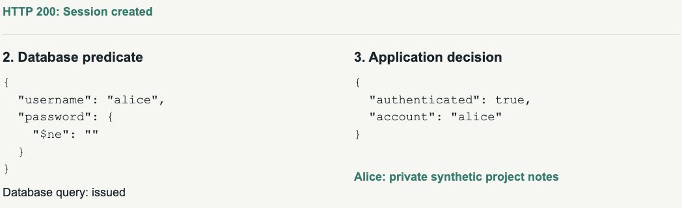
Captured bypass evidence
VULNERABLE BASELINE
{"username":"alice","password":{"$ne":""}}
IDENTICAL REQUEST / ACTUAL RESPONSE REGION
20
Notes:
Target time: Q&A
Fresh browser evidence captured on 1 November 2026 from the same local teaching lab. The request is Alice plus the password operator object. The unmodified response region shows the query, session decision and protected-note outcome. Full-page captures accompany the deck.
Sources: Project evidence: nosql-lab/evidence/results.json and results.csv; 15 cases × 5 configurations × 2 runs.

Slide 21
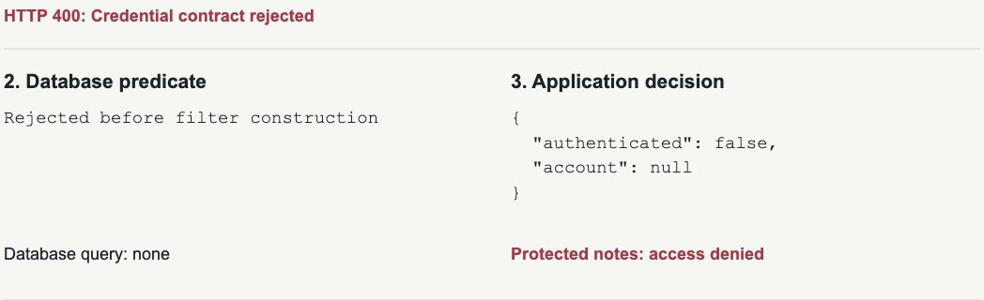
Captured rejection evidence
FULL HARDENED LOGIN
{"username":"alice","password":{"$ne":""}}
IDENTICAL REQUEST / ACTUAL RESPONSE REGION
21
Notes:
Target time: Q&A
The hardened mode receives the same payload. The application reports rejection before filter construction, no database query and denied protected access. Valid credentials also succeed in the separate functional control. Full-page captures accompany the deck.
Sources: Project evidence: nosql-lab/evidence/results.json and results.csv; 15 cases × 5 configurations × 2 runs.

Slide 22
What remains untested
ESTABLISHED
NOT ESTABLISHED
This operator bypass
Behaviour of five configurations
Rejection before a find query
Preservation of correct login
A JavaScript exploit
Real-world prevalence
All drivers or DB versions
Administrator access
Complete production security
Next experiment: permitted search without cross-tenant access.
22
Notes:
Target time: Q&A
The study establishes this login bypass and the tested control outcomes in the recorded environment. It does not measure deployed prevalence, prove administrator access, cover all drivers or MongoDB versions, demonstrate JavaScript injection, or certify production security. A tenant-filter experiment is a proposed next study.
Sources: Project evidence: nosql-lab/evidence/results.json and results.csv; 15 cases × 5 configurations × 2 runs.
https://cheatsheetseries.owasp.org/cheatsheets/NoSQL_Security_Cheat_Sheet.html

Slide 23
Paper and database references
Ron, Shulman-Peleg and Puzanov (2016)
Analysis and Mitigation of NoSQL Injections
IEEE Security & Privacy 14(2), 30–39
DOI: 10.1109/MSP.2016.36
Author-uploaded manuscript and authors’ InfoQ republication
Original classes: tautologies, union queries, JavaScript injection,
piggybacked queries and origin violation.
MongoDB 7.0: $ne and $where documentation
Full URLs in the notes and team guide.
23
Notes:
Target time: Q&A
Publication identity follows the IBM record and DOI 10.1109/MSP.2016.36. The authors’ InfoQ republication and author-uploaded manuscript were checked for the five classes. The publisher library proxy remained unavailable; the author manuscript is not claimed to be the final typeset version. No original page or figure numbers are asserted. MongoDB semantics are linked to version 7.0 documentation.
Sources: https://research.ibm.com/publications/analysis-and-mitigation-of-nosql-injections
https://www.researchgate.net/publication/300367234_Analysis_and_Mitigation_of_NoSQL_Injections
https://www.infoq.com/articles/nosql-injections-analysis/
https://www.mongodb.com/docs/v7.0/reference/operator/query/ne/
https://www.mongodb.com/docs/v7.0/reference/operator/query/where/

Slide 24
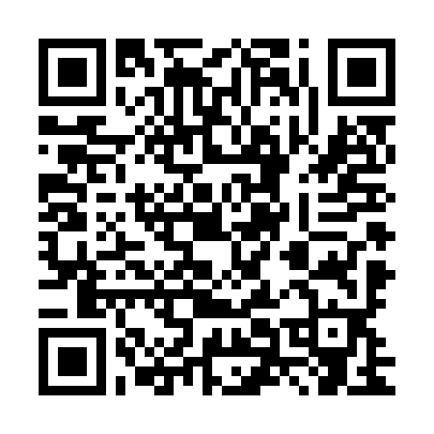
Defences and reproducible evidence
OWASP NoSQL Security Cheat Sheet
OWASP Password Storage Cheat Sheet
github.com/Qingyu255/CS440-Project
Evidence commit: c8252d2
Source and results are fixed at this revision.
results.json / results.csv / server.mjs / experiment.mjs
Fresh captures and team guide accompany the revised deck.
24
Notes:
Target time: Q&A
The immutable evidence commit is c8252d2bb3baeb543a011992e2a79ee2123ecfec. It records the source and experiment used for this study. The repository’s current revision adds redesigned slides, fresh browser captures and team handover materials. OWASP provides complementary guidance. The local teaching application is not a production deployment template.
Sources: https://cheatsheetseries.owasp.org/cheatsheets/NoSQL_Security_Cheat_Sheet.html
https://cheatsheetseries.owasp.org/cheatsheets/Password_Storage_Cheat_Sheet.html
https://github.com/Qingyu255/CS440-Project/tree/c8252d2bb3baeb543a011992e2a79ee2123ecfec

