Slide 1
BIG PICTURE FIRST
We turned the Home Credit project into a production-ready ML system.
Home Credit Risk MLOps Team
Presentation deck
Team + GitHub IDs
github.com/QingyuanWang-Data/INSY684_Group
Repository named
Evidence committed
0.7644
0.7679
450
50,000
final test ROC-AUC
best tuned validation ROC-AUC
engineered features
sampled final-eval run
Course 5.9 expectation: document what we did, highlight the big picture first, and explain business objective fit.
INSY684 FINAL PRESENTATION
01

Slide 2
SUBMISSION REQUIREMENTS
Everything the LMS asks for is visible before the technical deep dive.
Deck
Team
GitHub IDs
this PPTX
Home Credit Risk MLOps Team
4 members
Repository
Dataset continuity
GitHub work
INSY684_Group
Home Credit
branch code
QingyuanWang-Data | Hankpapa | xuechen-17 | yasmminee
One teammate submits; repository evidence is already pushed and synchronized.
Evidence: docs/SUBMISSION_INFO.md and GitHub branch code.
INSY684 FINAL PRESENTATION
02

Slide 3
5.9.1 CONTEXT
The business problem is ranking default risk before a credit decision is made.
8.0%
50,000
450
default-positive rate in sampled run
applications in fresh experiment
signals after multi-table aggregation
Objective: prioritize high-risk applications so policy teams can manage default cost and approval tradeoffs.
Stakeholders: risk managers, product managers, analysts, and ML engineers need one explainable serving workflow.
Evidence: docs/BUSINESS_CONTEXT.md, docs/DATA_REPORT.md, artifacts/training_report.json.
INSY684 FINAL PRESENTATION
03

Slide 4
5.9.2 HYPOTHESIS
A supervised ranking model should beat random approval decisions and support threshold policy.
Null hypothesis
Working hypothesis
The model cannot rank default risk better than random assignment.
Aggregated credit history improves risk ordering and supports lower-cost threshold decisions.
ROC-AUC <= 0.50
ROC-AUC > 0.50
Testing strategy: stratified splits, validation AUC, PR-AUC, confusion matrix, and threshold cost curves.
INSY684 FINAL PRESENTATION
04

Slide 5
5.9.3 DATA
Eight raw Home Credit files are compressed into applicant-level risk signals.
Raw tables
Aggregates
Training frame
application, bureau, previous, POS, installments, cards
mean, max, min, sum, std, counts
one applicant row with target and features
450
35k / 10k / 5k
ID columns are normalized before joins, which fixed the pandas merge error and strengthens reproducibility.
final feature count
train / validation / test
Evidence: src/homecredit_service/features.py and artifacts/training_report.json.
INSY684 FINAL PRESENTATION
05

Slide 6
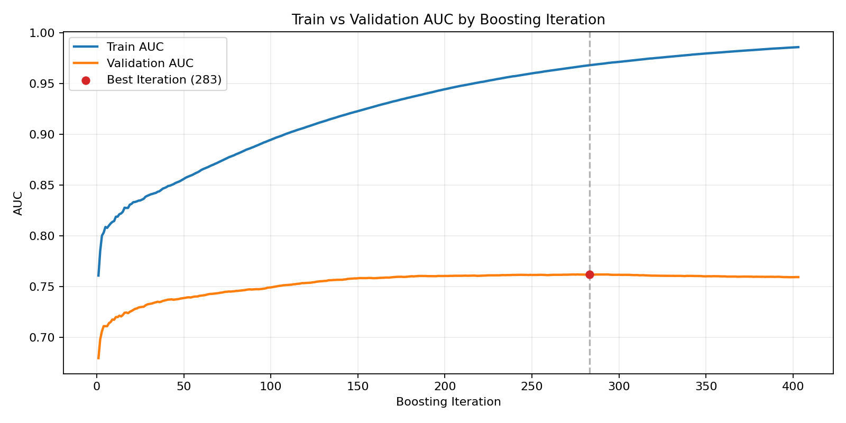
5.9.4 MODEL
LightGBM gives strong ranking performance; Optuna shows tuning work was real.
0.7619
0.7679
fresh validation ROC-AUC
best Optuna validation ROC-AUC
Model type: supervised binary classification with class imbalance handling, threshold optimization, and MLflow run tracking.
Evidence: artifacts/plots/train_validation_learning_curve.png, artifacts/tuning_report.json.
INSY684 FINAL PRESENTATION
06

Slide 7
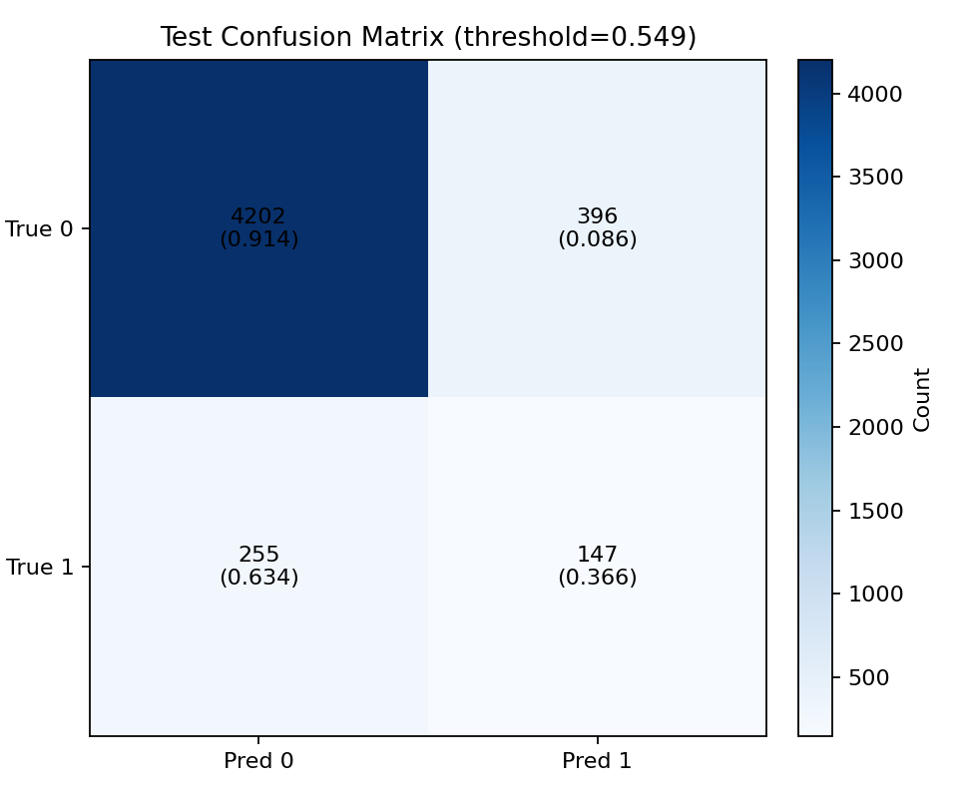
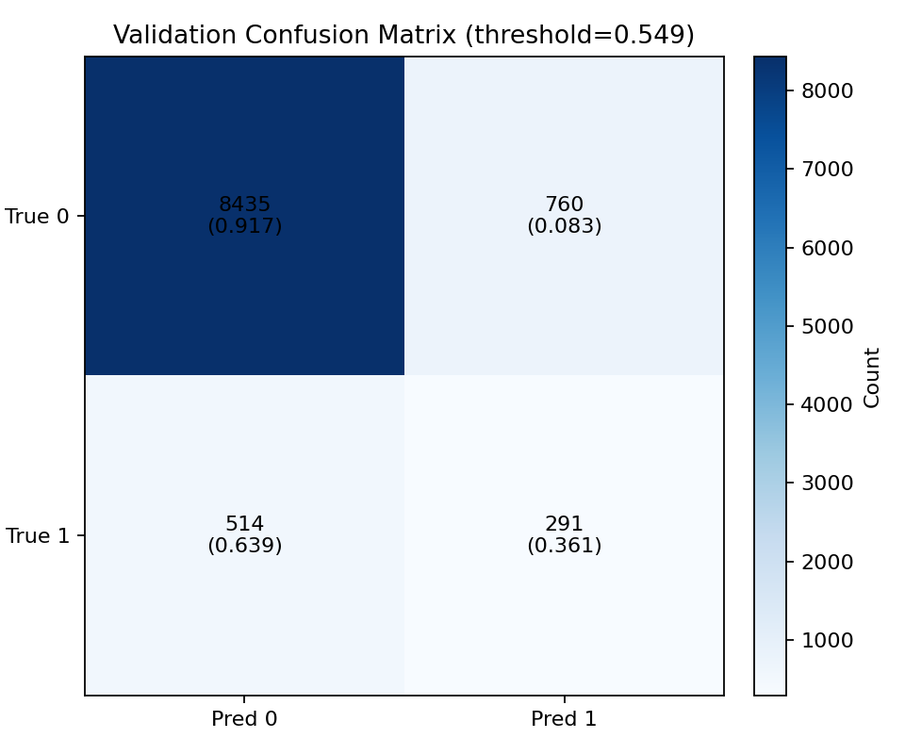
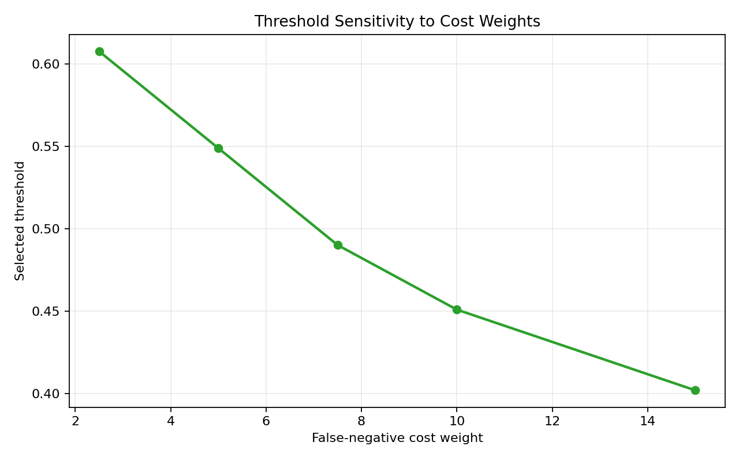
5.9.5 RESULTS
The model beats random ranking and exposes the cost of different thresholds.
0.7644
final test ROC-AUC
0.2309
test PR-AUC
The result is not just a score; it becomes a policy lever for approval, decline, and review decisions.
Evidence: validation_confusion_matrix.png, cost_sensitivity_threshold_curve.png, training_report.json.
INSY684 FINAL PRESENTATION
07

Slide 8
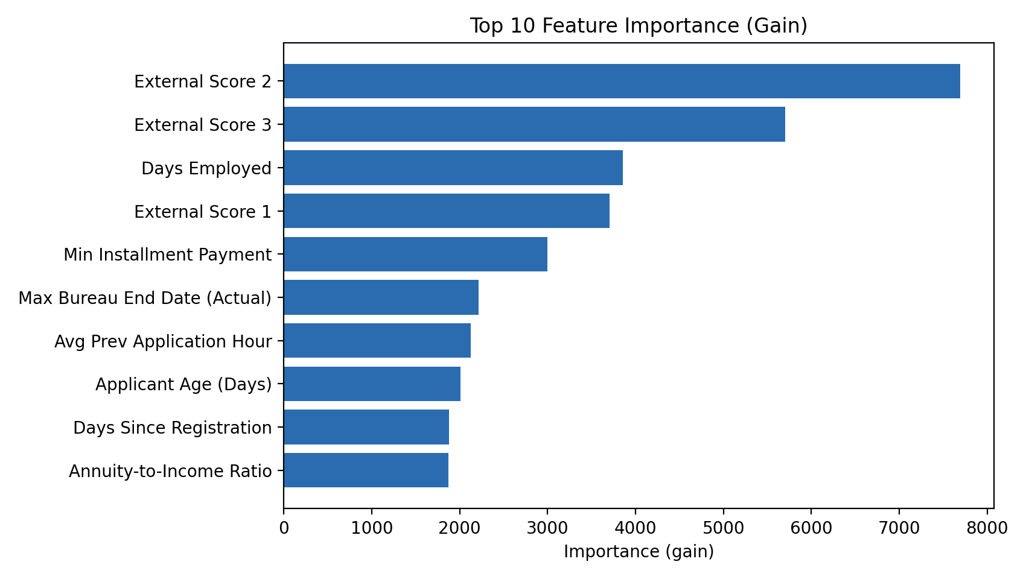
5.9.6 EXPLAINABILITY
Feature importance turns the model into a reviewable risk-ranking tool.
What to say
The strongest signals come from engineered financial and historical-credit features. We use global importance for model review, not as a causal claim.
Governance use: review surprising drivers, monitor drift in top features, and document limits in the model card.
Evidence: artifacts/plots/top10_feature_importance.png and docs/EXPLAINABILITY.md.
INSY684 FINAL PRESENTATION
08

Slide 9
5.9.7 THREATS TO VALIDITY
The main risks are data leakage, historical bias, and production drift.
Leakage
Bias
Drift
Historical tables may contain timing patterns that need careful event-time cutoffs.
Credit outcomes reflect previous lending policy, not a neutral ground truth.
Applicant mix and macro conditions can change after launch.
Mitigation: model card, fairness report, monitoring report, PSI drift checks, and future retraining workflow.
Evidence: docs/LIMITATIONS.md, docs/FAIRNESS.md, docs/MONITORING.md.
INSY684 FINAL PRESENTATION
09

Slide 10
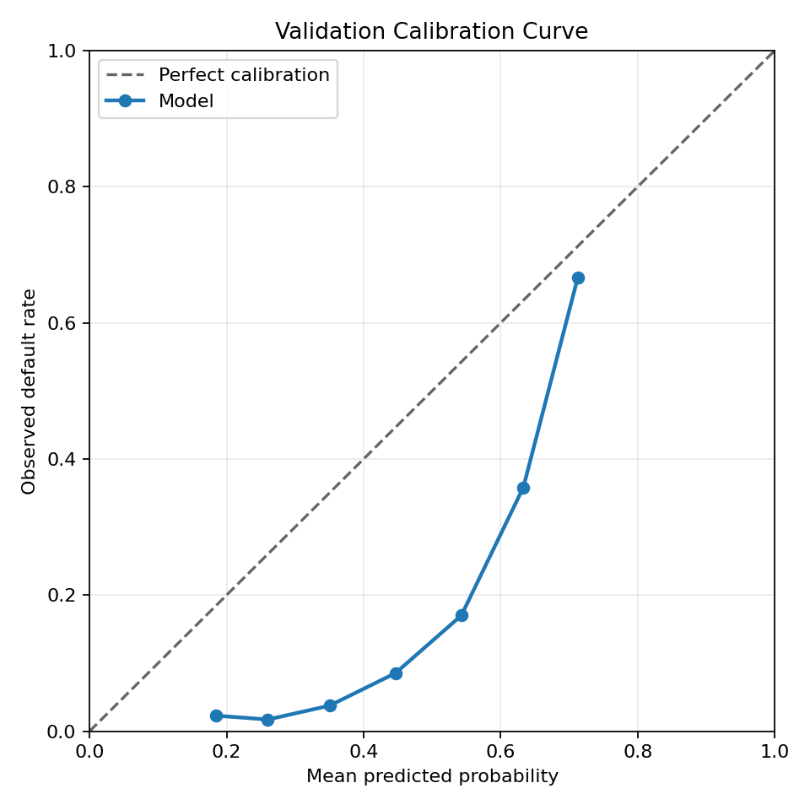
5.10 LAUNCHING, MONITORING, MAINTENANCE
The serving contract is ready; monitoring tells us when to intervene.
Launch
Monitor
Docker + FastAPI + /ready
AUC, PR-AUC, PSI, feature drift
Maintain
Govern
retrain on fresh data; review fairness
model card and threshold policy
Evidence: docs/DEPLOYMENT.md and docs/MONITORING.md.
INSY684 FINAL PRESENTATION
10

Slide 11
5.9.8-5.9.9 CONCLUSIONS AND LESSONS
The project is valuable because it connects model performance to operating discipline.
Built
Tracked
Governed
package, tests, CI, Docker, API
MLflow and Optuna evidence
fairness, drift, model card
Recommendation: present 0.7644 as final test ROC-AUC, with 0.7619 validation ROC-AUC and 0.7679 tuning evidence.
Lesson learned: production ML depends as much on reproducibility, monitoring, and clear limits as on one metric.
Next step for group deck: add formal course title slide and speaker assignments.
Evidence package committed to GitHub branch code.
INSY684 FINAL PRESENTATION
11

