Slide 1

Using Python in QGIS for repeatable processes

Slide 2
Use Cases:
Anticipate changes in client requests or input iterations
Beginner Python users (included with QGIS, no additional Python install)
Managed to get IT approval for QGIS but not Python
Create process with sample data and get coffee while full dataset is running

Slide 3
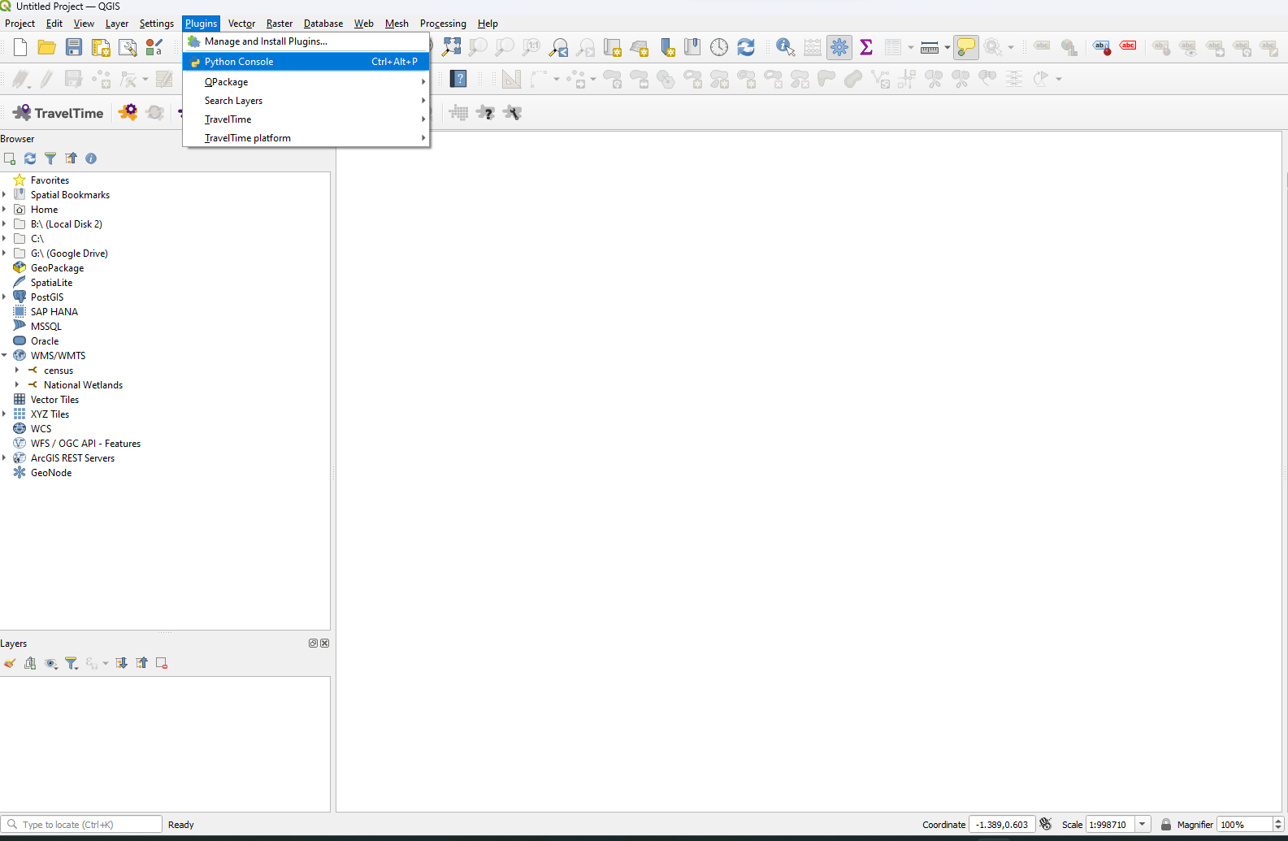
Notes:
Show Python Console

Slide 4
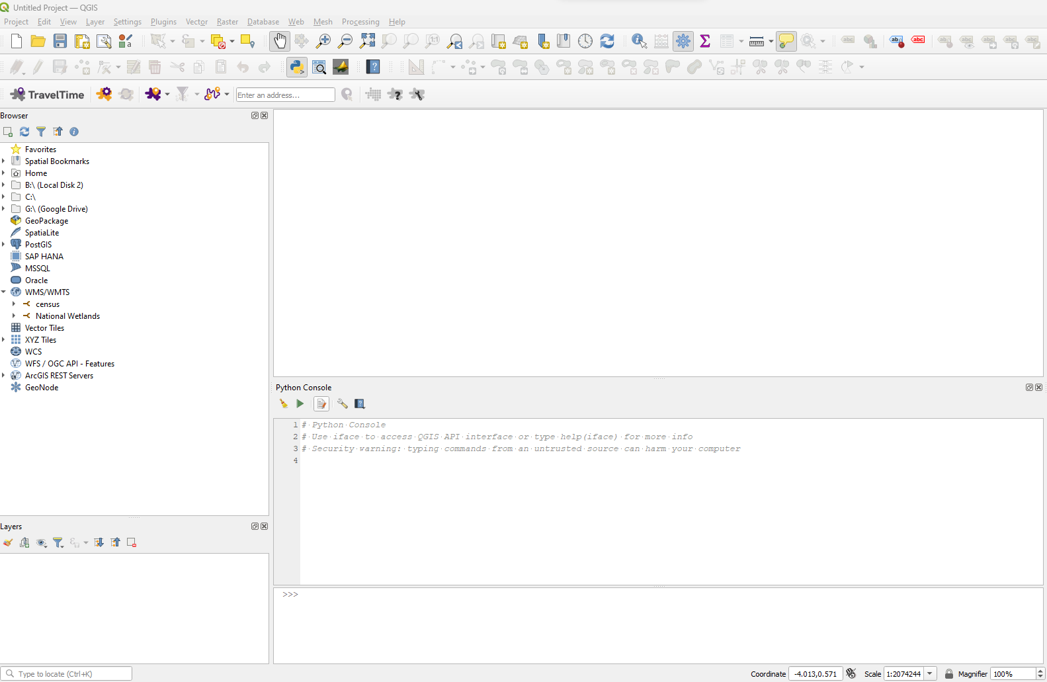

Slide 5
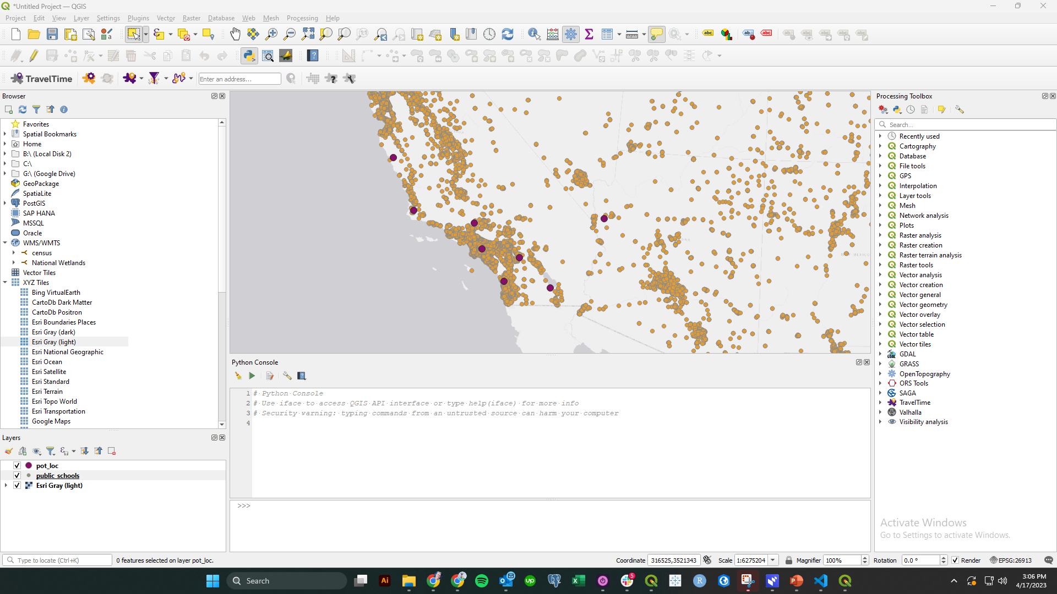

Slide 6
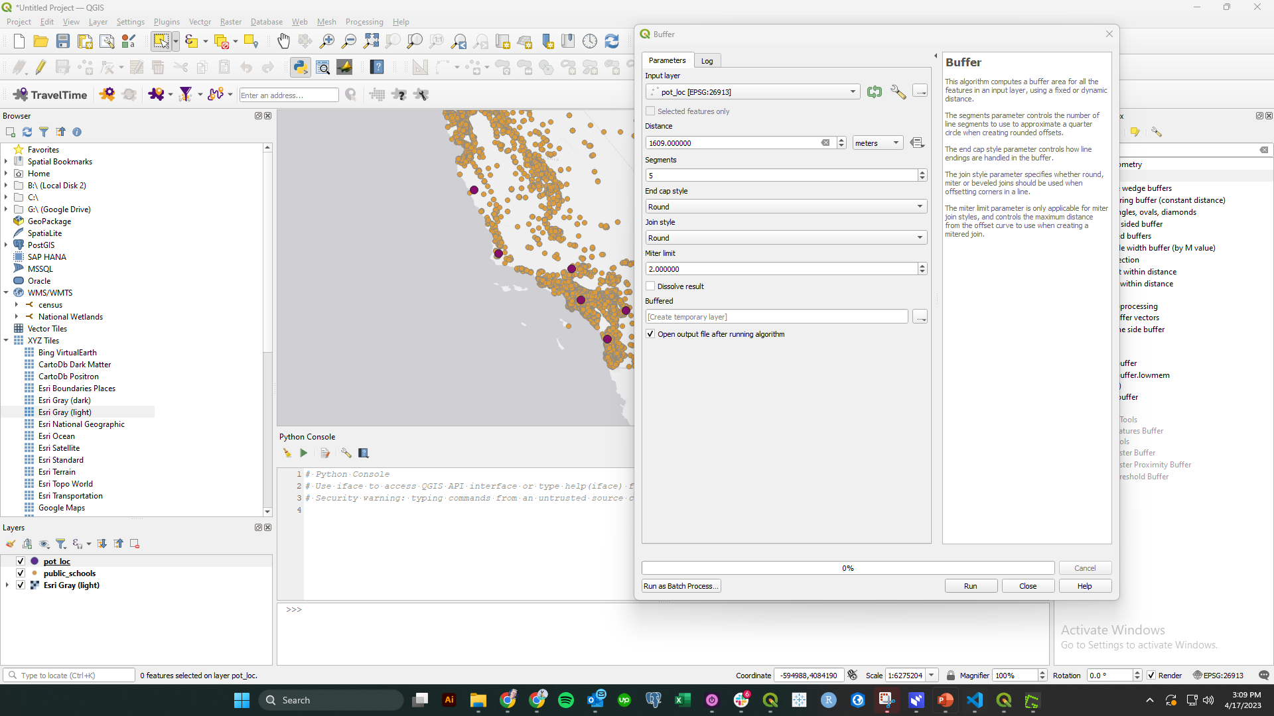
Notes:
Run desired processing tool

Slide 7
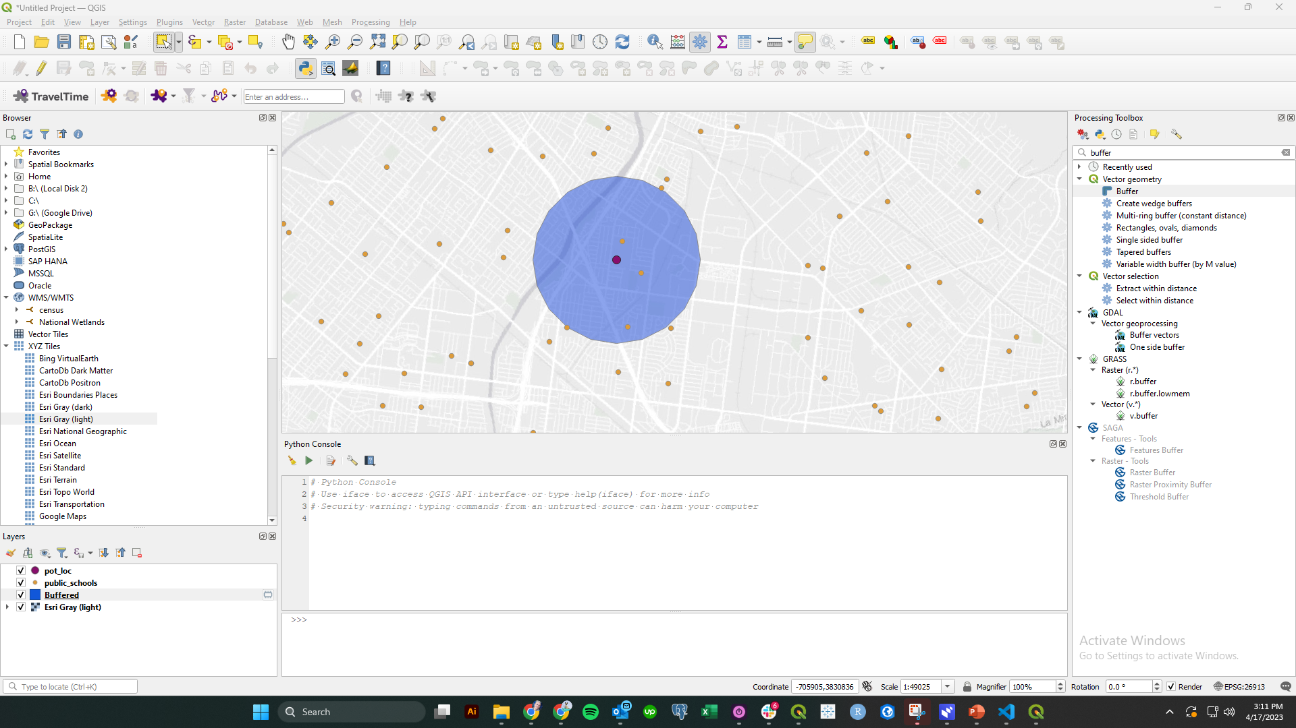

Slide 8
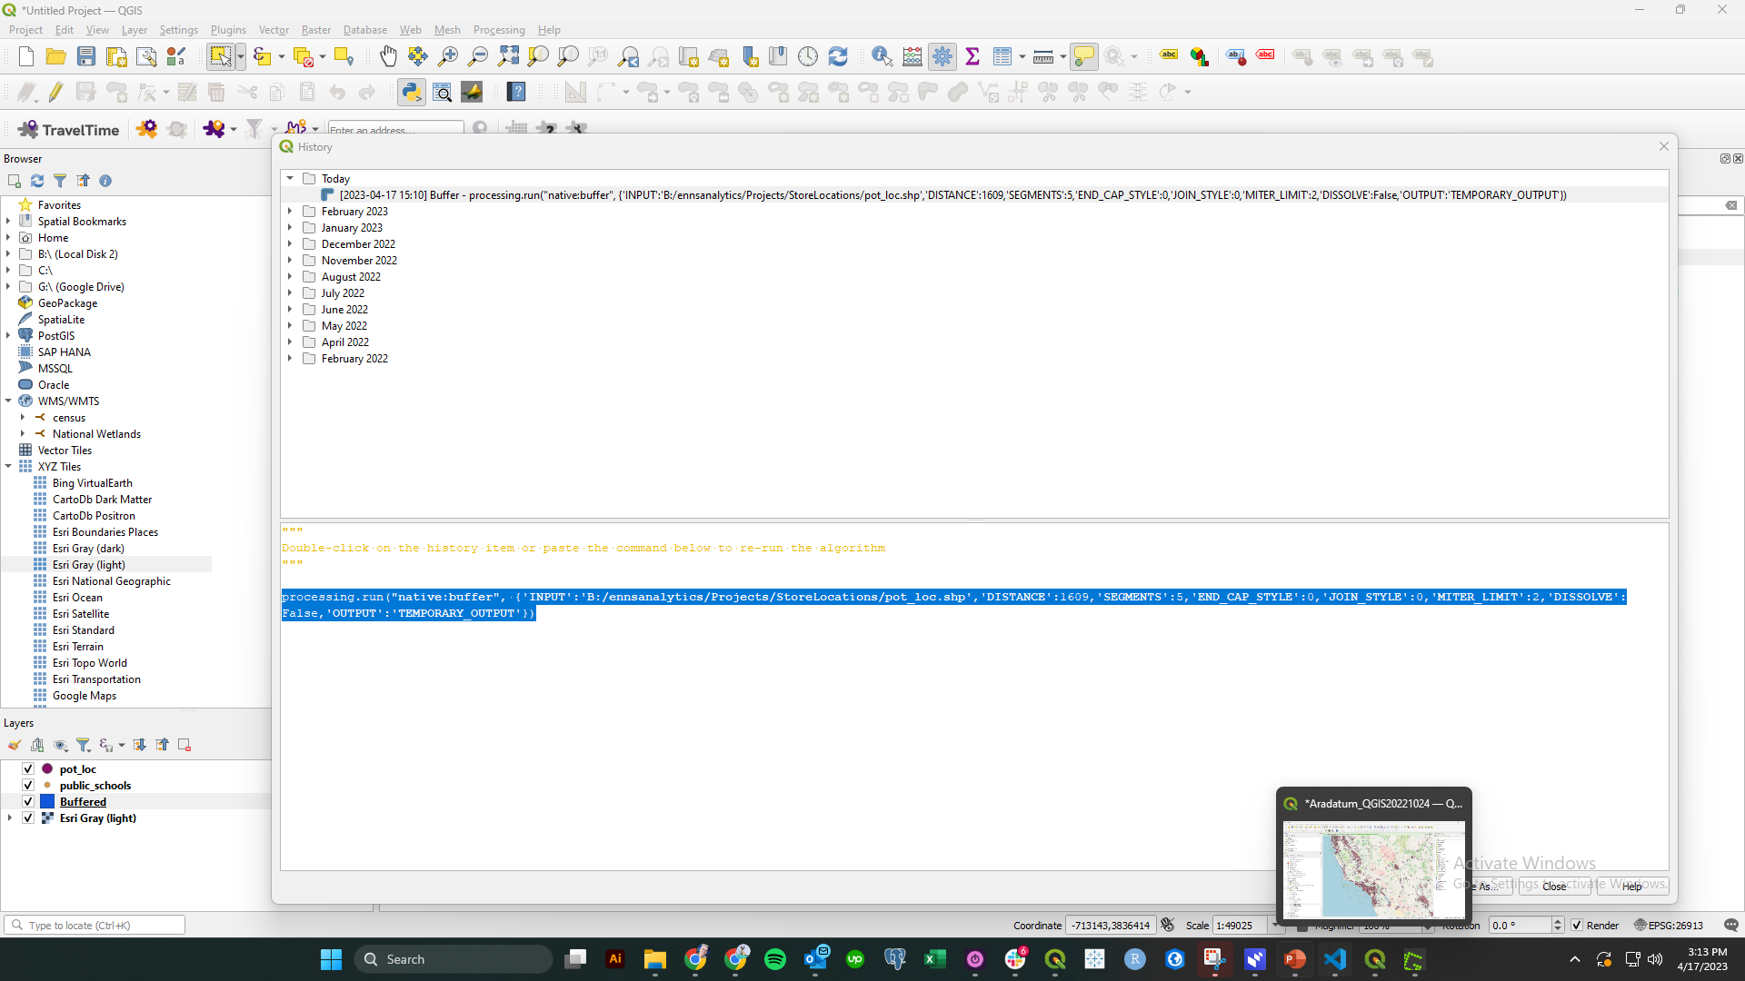
Notes:
Click on history and copy geoprocessing output code

Slide 9
#enter your path to the main folder
path = 'B:/ennsanalytics/Projects/StoreLocations/'
#path to GIS Output folder
outpath=f'{path}GIS_Outputs/'
processing.run("native:buffer", {'INPUT':f'{path}pot_loc.shp','DISTANCE':1609,'SEGMENTS':5,'END_CAP_STYLE':0,'JOIN_STYLE':0,'MITER_LIMIT':2,'DISSOLVE':False,'OUTPUT':f'{path}GIS_Outputs/buffer.shp'})
Notes:
Use a code editor such as Microsoft Visual Studio to help keep track of your code

Slide 10
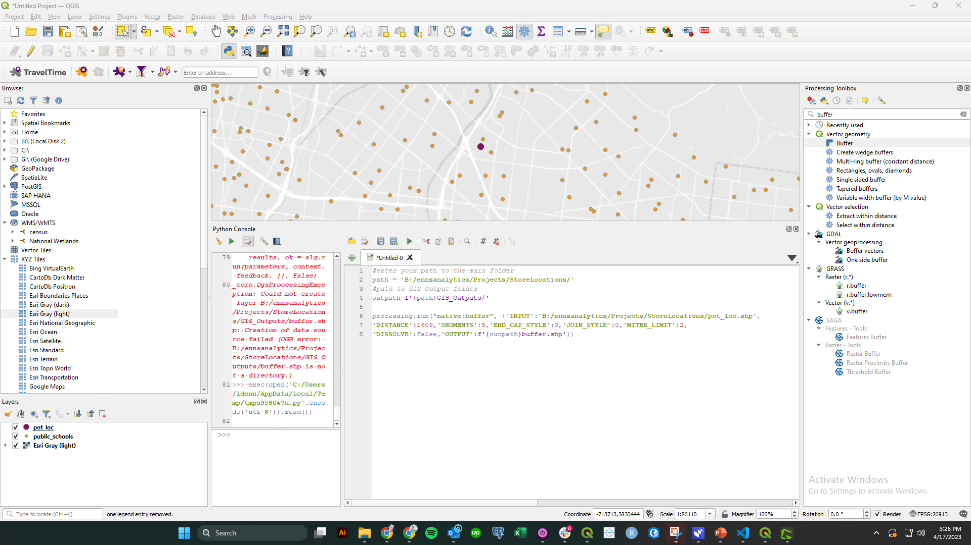
Notes:
Paste code in the script

Slide 11
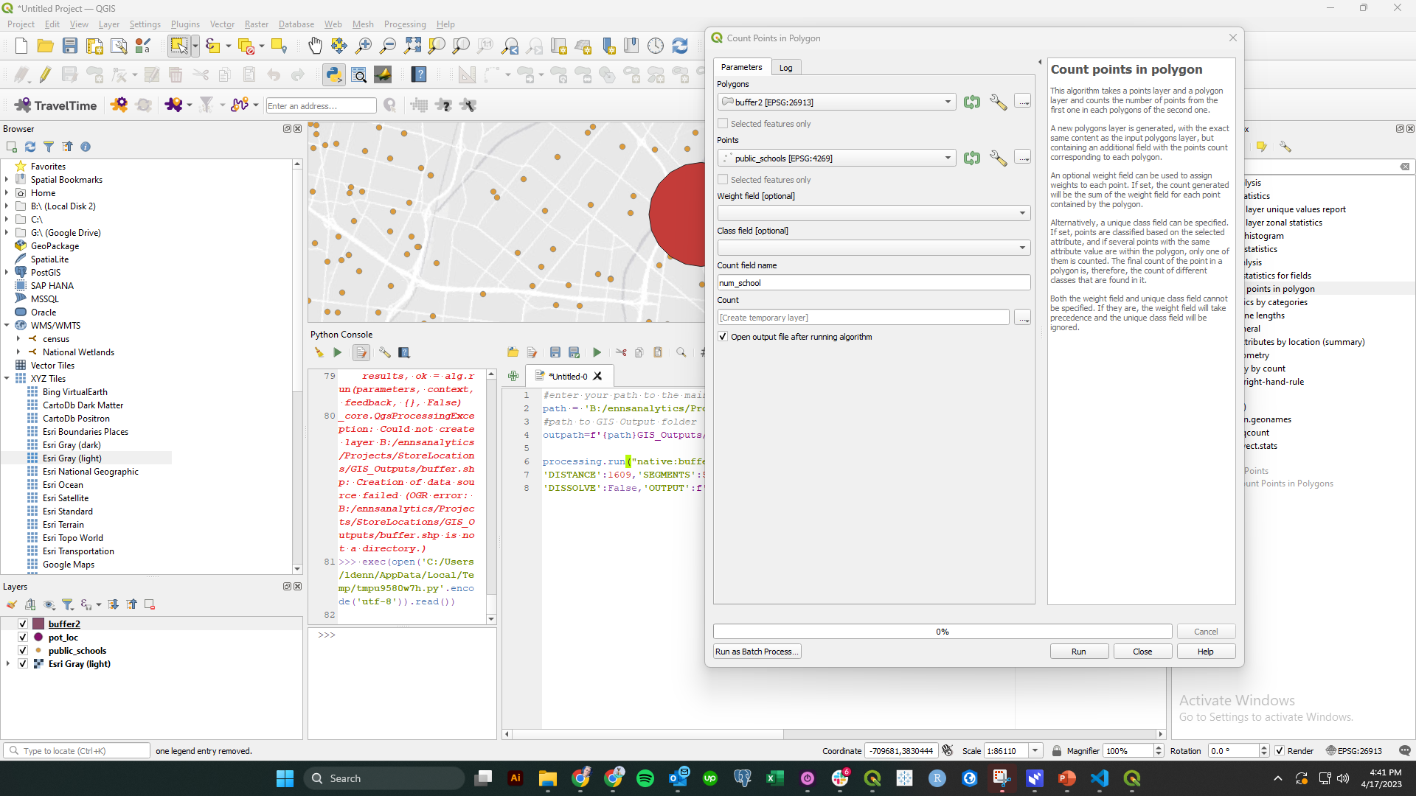

Slide 12
#enter your path to the main folder
path = 'B:/ennsanalytics/Projects/StoreLocations/'
#path to GIS Output folder
outpath=f'{path}GIS_Outputs/'
#create the buffer
processing.run("native:buffer", {'INPUT':f'{path}pot_loc.shp','DISTANCE':1609,'SEGMENTS':5,'END_CAP_STYLE':0,'JOIN_STYLE':0,'MITER_LIMIT':2,'DISSOLVE':False,'OUTPUT':f'{outpath}buffer.shp'})
#count number of schools in buffer
processing.run("native:countpointsinpolygon", {'POLYGONS':f'{path}GIS_Outputs/buffer.shp','POINTS':f'{path}public_schools.shp','WEIGHT':'','CLASSFIELD':'','FIELD':'num_school','OUTPUT':f'{outpath}num_school'})
Notes:
Add the new processing step to our code. If you don’t specify shapefile it will give you a geopackage file which is probably better

Slide 13
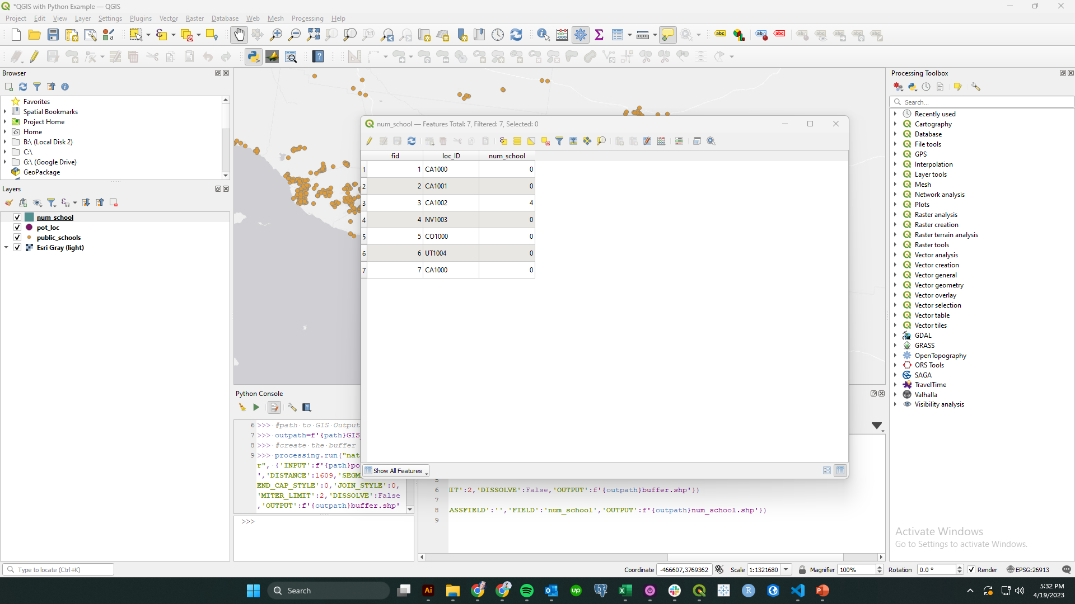

Slide 14
Power
Iterate over multiple layers with for loops
#file path to your points of interest layers
inpath=f'{path}Points of Interest/’
#list of the point of interest layers to be summarized in the buffer area. List must match the names of the shapefiles.
pointlayers = ['colleges','firestations','hospitals','police','Public_Schools','libraries']
#iterate through the points of interest
for x in pointlayers:
outname=f'{outpath}POI_{x}.shp'
pointname=f'{inpath}{x}.shp'
#name of the input polygon (buffers from previous step)
polyname=f'{outpath}buffer.shp'
processing.run("native:countpointsinpolygon",{'POLYGONS':polyname,
'POINTS':pointname,'WEIGHT':'','CLASSFIELD':'','FIELD':x,'OUTPUT':outname})

Slide 15
Power
Introduce variables to explore scenarios
#define buffer radius
bufdist = 3218 #2 miles converted to meters
#create the buffer
processing.run("native:buffer", {'INPUT':f'{path}pot_loc.shp','DISTANCE’:bufdist,'SEGMENTS':5,'END_CAP_STYLE':0,'JOIN_STYLE':0,'MITER_LIMIT':2,'DISSOLVE':False,'OUTPUT':f'{outpath}buffer.shp'})

Slide 16
Using Python in QGIS for repeatable processes

