Slide 1
From 2D to Spatial
My Data Journey from Medical to GIS

Slide 2
Biomedical Informatics
An interdisciplinary field that applies computational and information science methods to medical and health research
Subfields: Public Health, Clinical, and Genomic

Slide 3
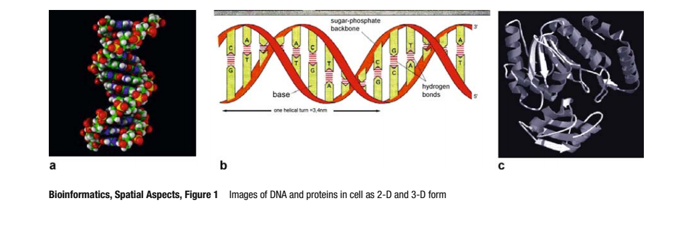
Genomic Data
Text file (FASTA) containing sequence of nucleotides along with the coordinate file with index to visualize the genomic structure
Mapping out the locations and therefore the interactions with molecules in DNA/Protein
Goal: identify patterns and relationships and discover the genetic basis of human diseases

Slide 4
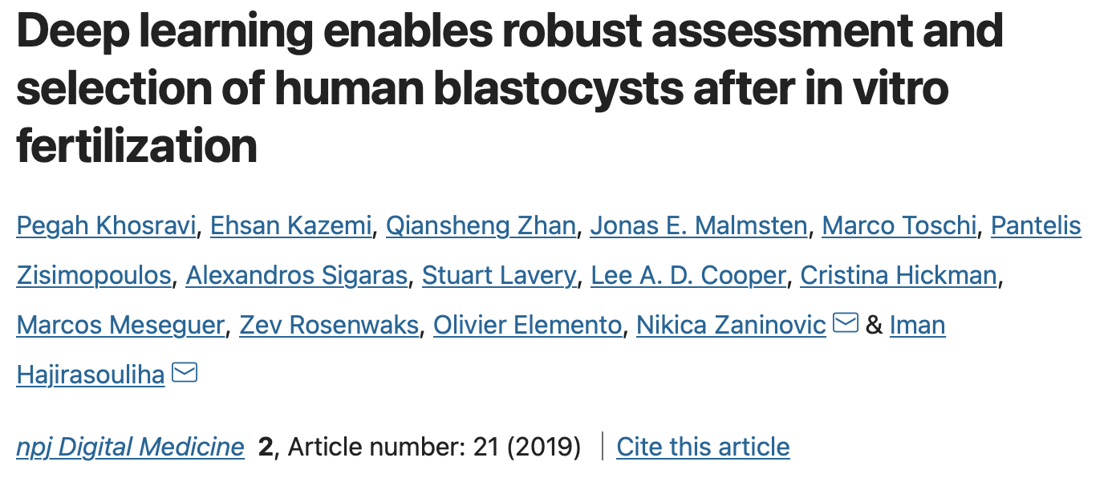
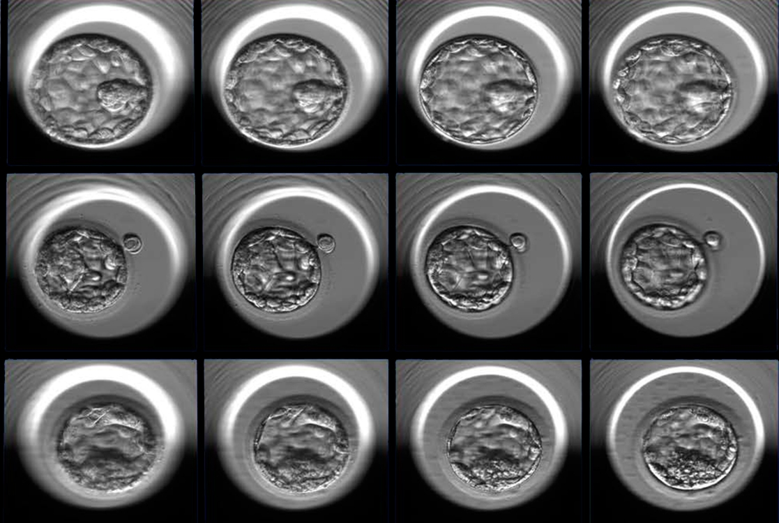
Clinical Data
Forms : Electronic Health Records and medical imaging (MRIs, CTs, X-rays, ultrasounds)
Use various Machine Learning and Deep Learning methods
Ex. Using image classification to train models to detect and classify quality of embryos for IVF

Slide 5
Public Health
Regression (predictive) modeling for epidemiology
Explanatory modeling for patient profiling to curate preventive care measurements by knowing what related attributes to look for
Primarily did analysis with text files

Slide 6
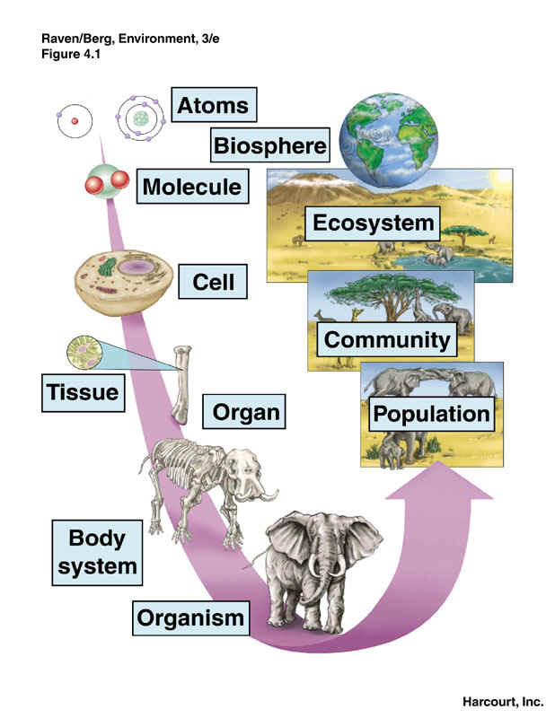
Take Away
Although the focus between GIS and Biomedical is on opposite spectrums of the levels of biological organization hierarchy
Both fields rely on biology and computational statistical analysis
Utilize similar techniques and applications to identify patterns and relationships with the data
Use data to make informed decisions that have a real-world impact

