Slide 1











Displacement
$D_{t},V_{t}∈R_{t}$
Shear force
$R_{t−1}$
$R_{t}$
$R_{t+1}$
$c_{t−1}$
$c_{t}$
$c_{t+1}$
$R_{t}$
: Structural responses at time $t$
$C_{t}$
: Damping ratio at time $t$

Slide 2
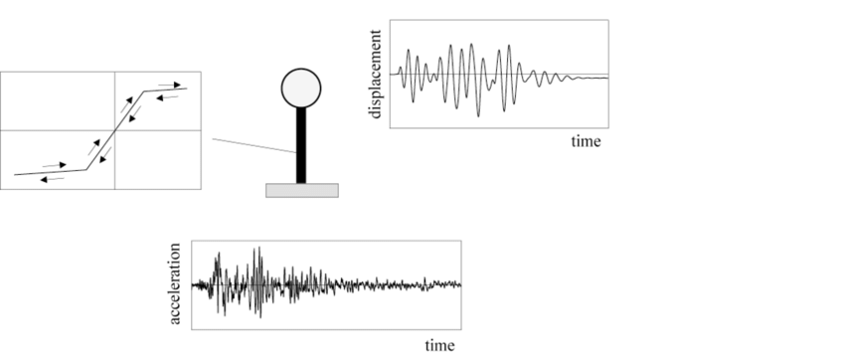



Response history (or Time history)
$\left\{R_{1},R_{2},…,R_{t}\right\}$
$R_{t}$
Time $t$
- It can be any structural responses (velocity, acceleration, force, …)
- but probably we will use the response history about displacement and force (which are required to calculate hysteresis energy)

Slide 3
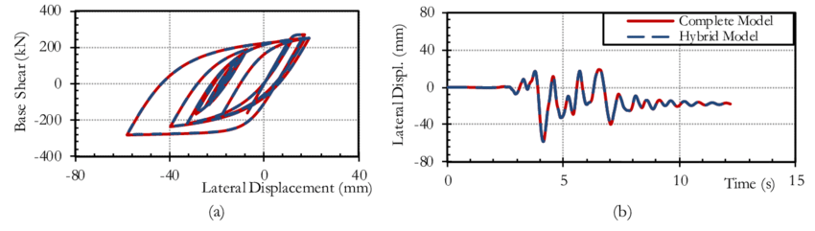
Hysteresis energy (Dissipated energy)
The area covered by the force-displacement relationship
It is often used as the indicator of structural collapse*
*https://www.nist.gov/programs-projects/energy-based-collapse-assessment-framed-structures-performance-based-seismic#:~:text=The%20advantages%20of%20using%20the,can%20be%20used%20to%20measure

Slide 4
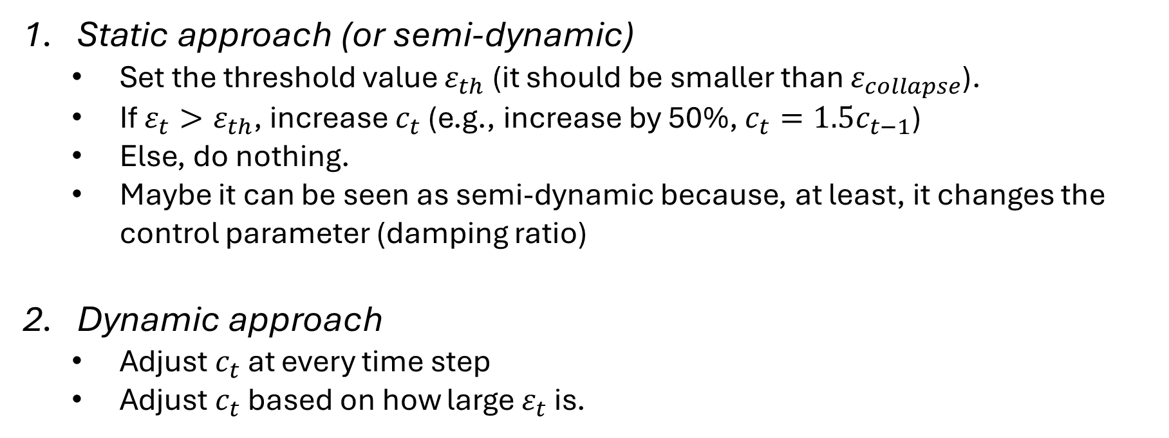


$R_{t−1}$
$R_{t}$
$R_{t+1}$
$c_{t−1}$
$c_{t}$
$c_{t+1}$
$R_{t}$
: Structural responses at time $t$
$C_{t}$
: Damping ratio at time $t$
Two ways to determine $c_{t}$ from $R_{t}$
First, determine the limit hysteresis energy value $ε_{collapse}$ that indicates collapse of the structure
Static approach (or semi-dynamic)
Set the threshold value $ε_{th}$ (it should be smaller than $ε_{collapse}$).
If $ε_{t}>ε_{th}$, increase $c_{t}$ (e.g., increase by 50%, $c_{t}=1.5c_{t−1}$)
Else, do nothing.
Maybe it can be seen as semi-dynamic because, at least, it changes the control parameter (damping ratio)
Dynamic approach
Adjust $c_{t}$ at every time step
Adjust $c_{t}$ based on how large $ε_{t}$ is.

Slide 5
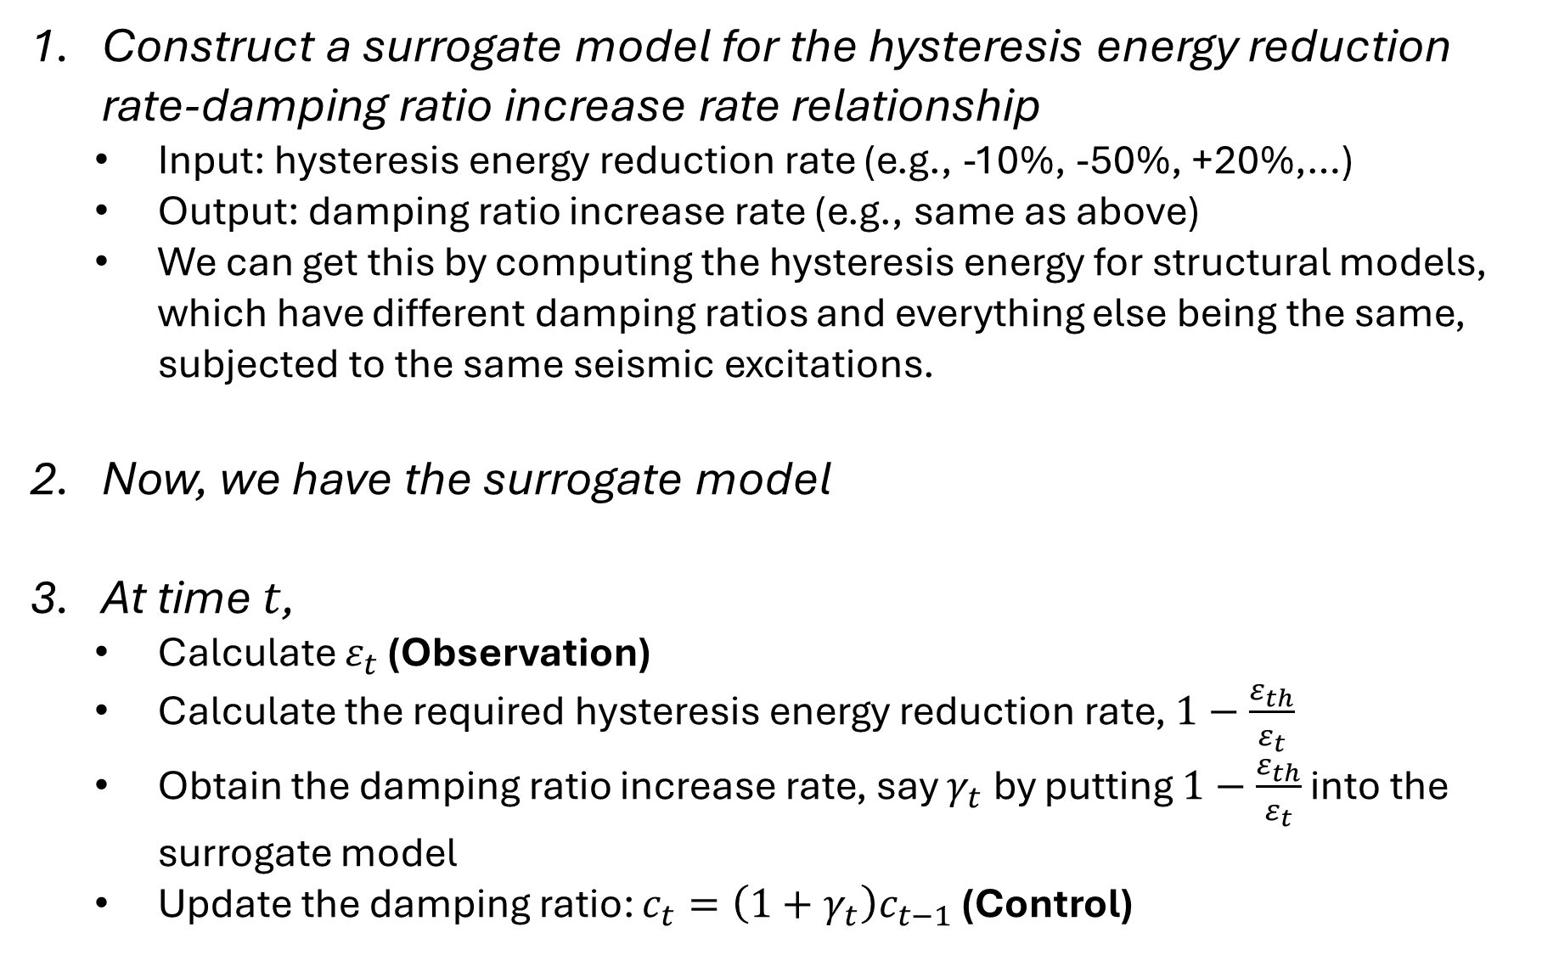
How much do we adjust $c_{t}$ based on$ε_{t}$?
We need the effect of damping ratio on the hysteresis energy. In other words, we want to know how much the hysteresis energy decreases when we increase the damping ratio.
Candidate methods for the surrogate model
Construct a surrogate model for the hysteresis energy reduction rate-damping ratio increase rate relationship
Input: hysteresis energy reduction rate (e.g., -10%, -50%, +20%,…)
Output: damping ratio increase rate (e.g., same as above)
We can get this by computing the hysteresis energy for structural models, which have different damping ratios and everything else being the same, subjected to the same seismic excitations.
Now, we have the surrogate model
At time $t$,
Calculate $ε_{t}$ (Observation)
Calculate the required hysteresis energy reduction rate, $1−\frac{ε_{th}}{ε_{t}}$
Obtain the damping ratio increase rate, say $γ_{t}$ by putting $1−\frac{ε_{th}}{ε_{t}}$ into the surrogate model
Update the damping ratio: $c_{t}=\left(1+γ_{t}\right)c_{t−1}$ (Control)
Most of regression models would be applicable because its input and output are both 1D.
Linear regression
SVM regression
Gaussian process regression
- It has its own advantages in that it also provide the confidence level for the estimate
(ANN)
- This is probably too much for this simple task

Slide 6
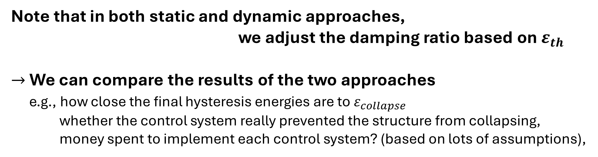
Note that in both static and dynamic approaches,
we adjust the damping ratio based on $ε_{th}$
$→$ We can compare the results of the two approaches
e.g., how close the final hysteresis energies are to $ε_{collapse}$
whether the control system really prevented the structure from collapsing, money spent to implement each control system? (based on lots of assumptions),

