Slide 1
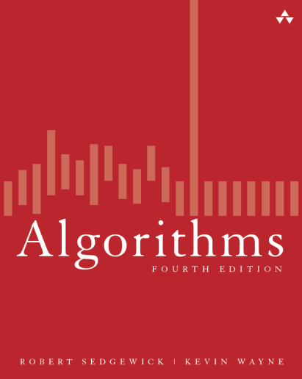
算法设计 与分析
计算机学院
祁建军

Slide 2
JAVA语言基础
Basic primitive (build-in) data types
int: Integers, with arithmetic operations
double: Real numbers, again with arithmetic operations
boolean: Booleans, the set of values { true, false } with logical operations
char: Characters, the alphanumeric characters and symbols that you type
Other primitive data types
long: 64-bit integers, with arithmetic operations
short: 16-bit integers, with arithmetic operations
byte: 8-bit integers, with arithmetic operations
float: 32-bit single-precision real numbers, with arithmetic operations

Slide 3
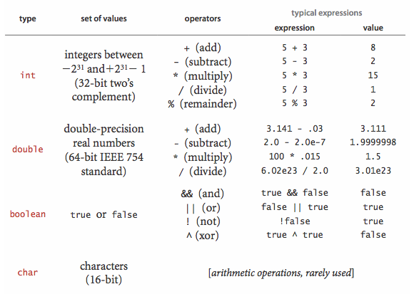
JAVA语言基础
Basic primitive types and most common operations

Slide 4
JAVA语言基础
Comparisons
==: equal
!=: not equal
<: less than
<=: less than or equal
>: greater than
>=: greater than or equal

Slide 5
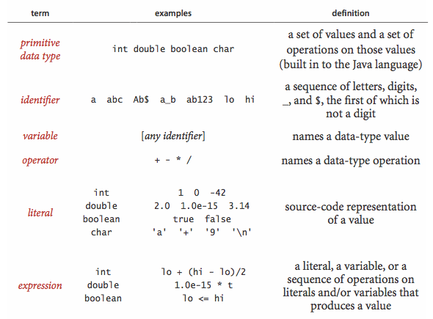
JAVA语言基础
Basic building blocks for Java programs

Slide 6
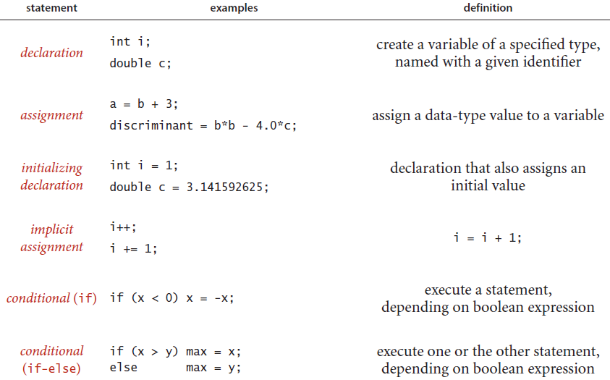
JAVA语言基础
Java statements 1

Slide 7
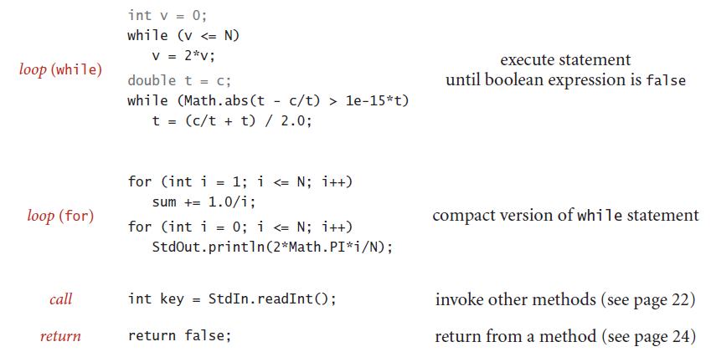
JAVA语言基础
Java statements 2

Slide 8
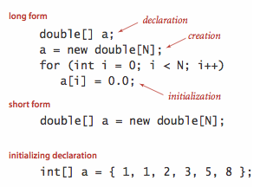
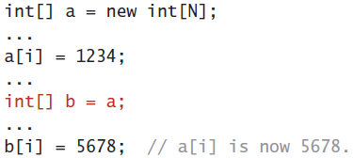
JAVA语言基础
Arrays
Declare the array name and type
Create the array
Initialize the array values
Aliasing

Slide 9
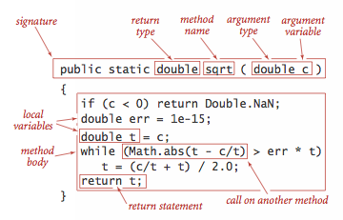
JAVA语言基础
Static methods

Slide 10
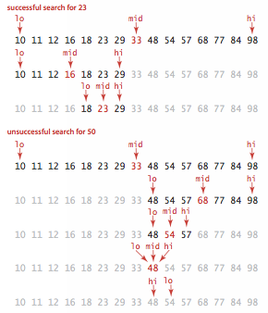
JAVA语言基础
Binary search

Slide 11
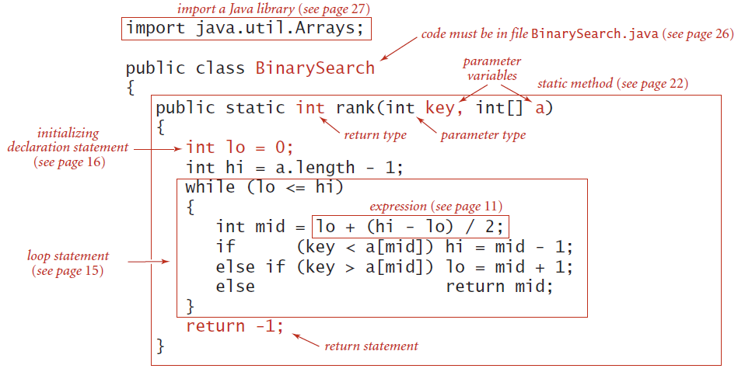
JAVA语言基础
Binary search

Slide 12
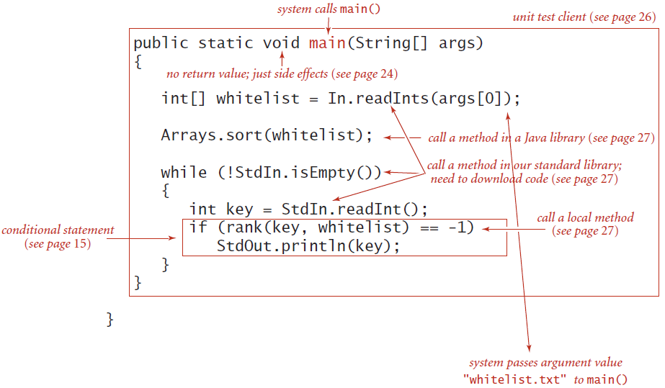
JAVA语言基础
Binary search

Slide 13
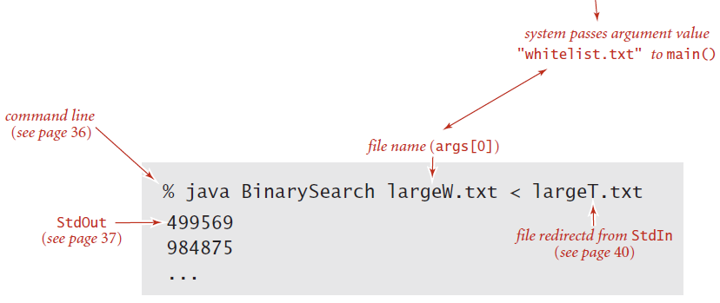
JAVA语言基础
Binary search

