Slide 1
Final Project Report
Face Swapping: Automatically Replacing Faces in Photographs
赵睿哲
1200012778

Slide 2
Overview
What is automatic face swapping?
Implementation
Performance
Discussion

Slide 3
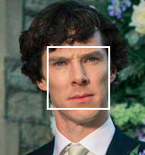
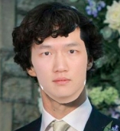
Automatic Face Swapping
We could swap the faces of two or more different people like this:
But it looks weird, and you need to specify which face you want to be replaced with. It’s not so convenient, and not appealing.

Slide 4
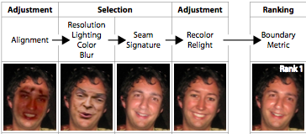
Automatic Face Swapping
So we have an automatic face swapping algorithm:
Face Library: This algorithm needs a large face library as swapping candidates.
Ranking: By detecting your input image, it could search that library, find the image which could match seamlessly.
Replace: Once you find the candidates with high rankings, merge them to the input image.
From the paper

Slide 5
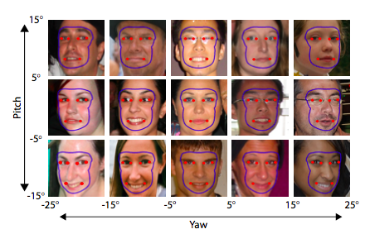
Automatic Face Swapping – Face Library
We build face library by following the steps provided by the paper:
Pose Bin: First we need to build a pose bin directory. Pose bin stores the faces with the same pose, by identifying their yaw, pitch, roll metrics.
Alignment: All the faces in the pose bin should be adjusted to fit the generic face coordinate.
Example:
There are 15 pose bins separated by using yaw and pitch metrics.
And also all the faces should be aligned to the generic face(the red points are the generic face’s landmarks)

Slide 6
Automatic Face Swapping – Ranking
Now we have an input image:
Detect: We could have this image’s pose and landmarks, for example, yaw and pitch, and the distance between eyes.
Rank:
According to yaw and pitch, we could find the pose bin for our input image.
Then we sort all the images in that pose bin by fitting the pose metrics and landmarks.

Slide 7
Automatic Face Swapping – Replacing
The rank list we got will be faces aligned to generic face.
Align input image: We need also fit our input image to that generic face.
Crop the face: From the faces in the rank list, get the contour of the face region and build a mask of face.
Cover: By using the mask, we could cover the new face onto our input image
Align back: Transform back our result image to the coordinate system of our input image.

Slide 8
Implementation – Overview
Our whole system could be divided into 2 parts:
Training: By using a face set downloaded from internet, we could build our face library, providing index file for the ranking or other functionalities.
Swap: The face library is ready and we could swap our input image now.
3rd Party Libraries:
Python programming language
OpenCV, with version 3.0.0-beta
Labeled Face in the Wild(LFW) Face Database, especially the face set aligned to generic face.
Face++ cloud face detecting service.
AWS S3 cloud storage

Slide 9
Implementation – Face Library
We build our library by following these steps:
Iterate the face set: find the path for all images, and process those images in the next step. (facelib/faceset.py)
Process the face: we process each image from the face set by first detecting their pose metrics and landmarks, and saving the cropped face image into the correct pose bin. (facelib/faceproc.py)
Add index file: we store the information for each face, like pose and landmarks, to a separate index file. We will use this file for faster sorting. (facelib/faceposebin.py)
The whole training step will be driven by the facelib/facetrain.py script. You should specify the path to face set and the place where you want to put your pose bin.
This step will take a quite long time, depending on the network status (we need connect to the face++ service to get the information of one face).

Slide 10
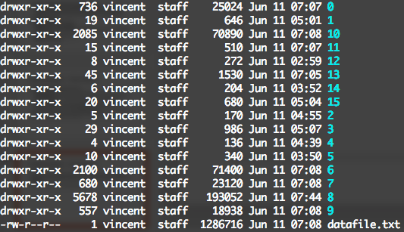
Implementation – Face Library
As the size of pose bin could be pretty large (~700M), we port our pose bin files onto AWS S3 server. And download the specific images we want by using the names inside the index file.
The general view of a pose bin could be like this:
Example:
We have 15 sub pose bins for different pose, and a sub pose bin with id 0 to store unrecognized face images.

Slide 11



Implementation – Ranking and Alignment
In our previous slides, we have discussed the ranking strategy. Here we’ll follow the same steps. (facelib/facerank.py)
For alignment, we’ll use affine transform to change the coordinate system of our input image:
Affine transform is just a matrix multiplication between our input image and a transform matrix.
In order to calculate this transform matrix, we use 3 corresponding points to solve the transform matrix: left eye center, right eye center and chin.
We use warpAffine to apply the affine transform and getAffineTransform to get the transform matrix.
Example
Affine transform from left to right.

Slide 12
Implementation – Face Swapping
The swapping phase will take 3 steps:
Extract face: First we need to extract the face out of our candidate image. We use the contour landmarks provided by Face++. And we could build a mask by using OpenCV ’s pointPolygonTest to build the mask.
Face replace: The seamlessClone function is quite useful in our case. We need to smooth the boundary between our target face and candidate face, and also try our best to merge the intensity conditions. So the seamless clone method discussed in the Poisson Image Editing paper will be useful.
Affine transform: The last step is to transform back the result to original coordinate system.
We have a final example in the next page.

Slide 13


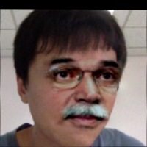
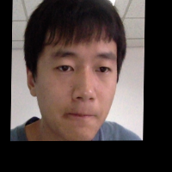

Source input image
Candidate image
Final result
Affine transform
Face contour
Example
In this final result, we could notice that, the light and shape of the original candidate has been changed to our input image.

Slide 14
Discussion
Most of the paper’s algorithm has been implemented, especially the pose bin face library, the generic face alignment, ranking by pose and resolution, and face replace with post operation.
However, as we are using a fast but yet not so specific method: seamless clone, we couldn’t reach the same performance as the paper has done, which are using harmonic spherical function and other high-level method.
Anyway, here we have build a simple and workable system(you could access through website), which I think is our main contribution.

