Slide 1

Prescriptive Optimization for Auto-insurance Pricing with Telematics Data
Qinyang He and Yonatan Mintz
Department of Industrial and System Engineering
UW-Madison

Slide 2

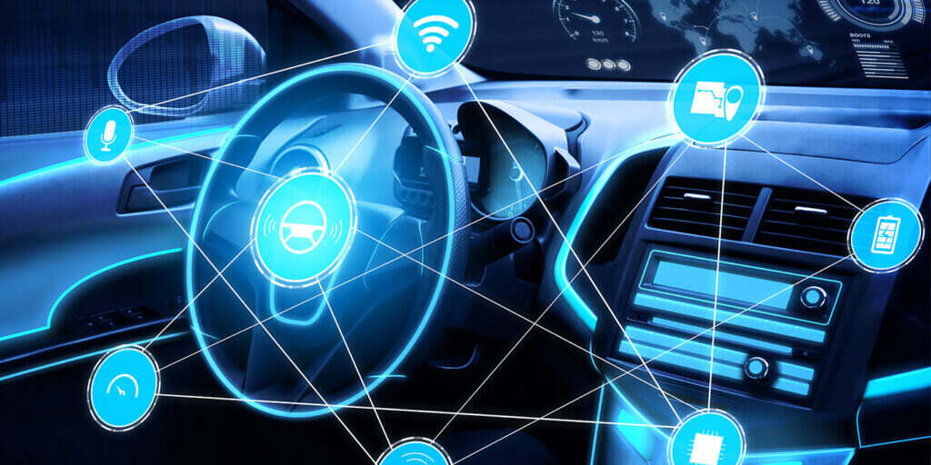
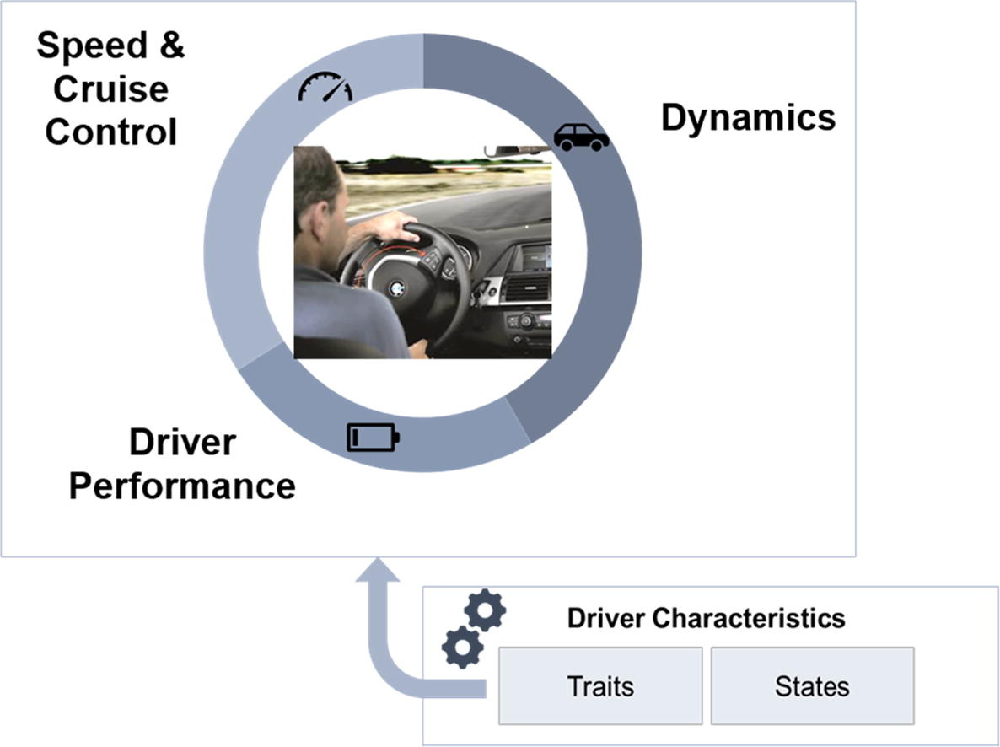
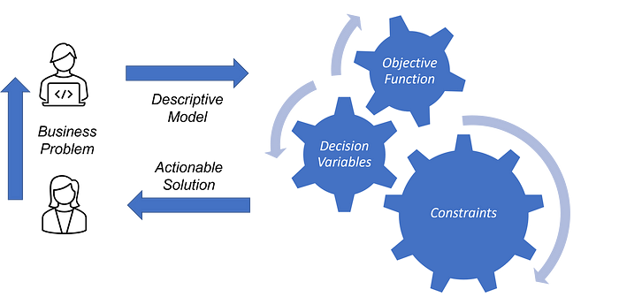
Motivation
Increased access to telematics data builds more accurate user profile vs. static demographic information with less personalization
Telematics data are obtained sequentially, therefore adaptive and long-term planning algorithm is needed
Optimization models support more complex decision making leveraging various constraints, resulting in potential increase in profit margin

Slide 3




Adaptive Pricing Framework
Telematics data collected
Machine learning method for evaluating driver risk level
Optimization for deciding individual premium
Iterate monthly
Change in driving behavior
New premium sent to policyholder

Slide 4
Research Milestones
Design the driver dynamics and formulate the optimization problem (finished).
Identify a suitable dataset and train machine learning models to evaluate driver risk level (ongoing)
Develop a solution method to the above optimization problem and develop theoretical guarantee if possible.
Conduct simulation and validate our framework.

Slide 5
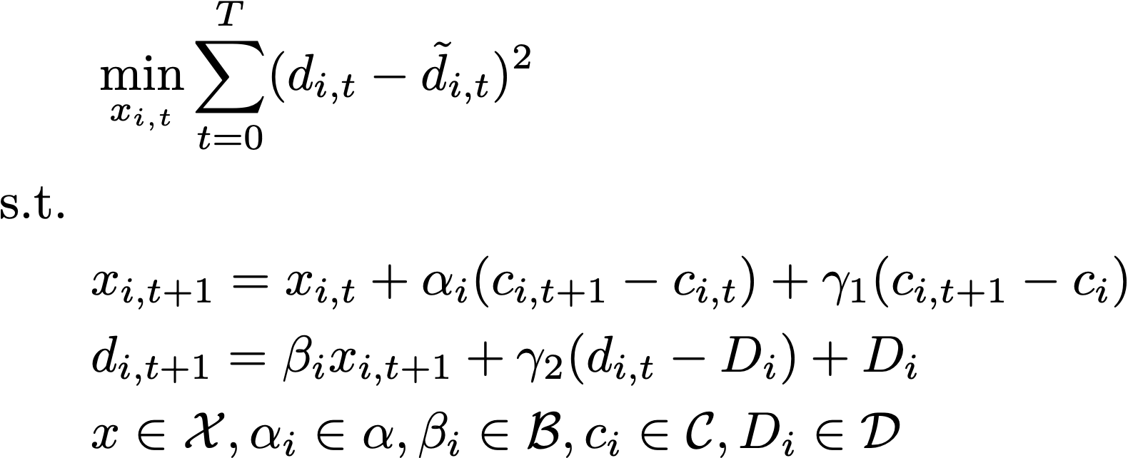
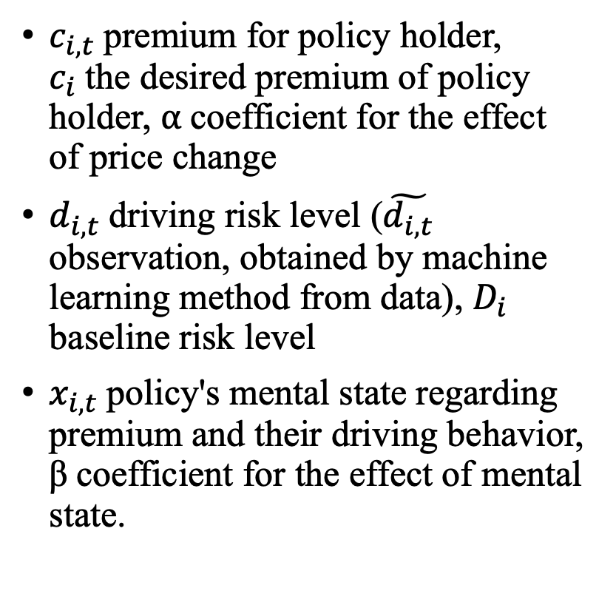
Optimization Model: driver’s parameter learning
$c_{i,t}$premium for policy holder, $c_{i}$the desired premium of policy holder, ⍺ coefficient for the effect of price change
$d_{i,t}$driving risk level ($\tilde{d_{i,t}}$ observation, obtained by machine learning method from data), $D_{i}$ baseline risk level
$x_{i,t}$policy's mental state regarding premium and their driving behavior, β coefficient for the effect of mental state.

Slide 6
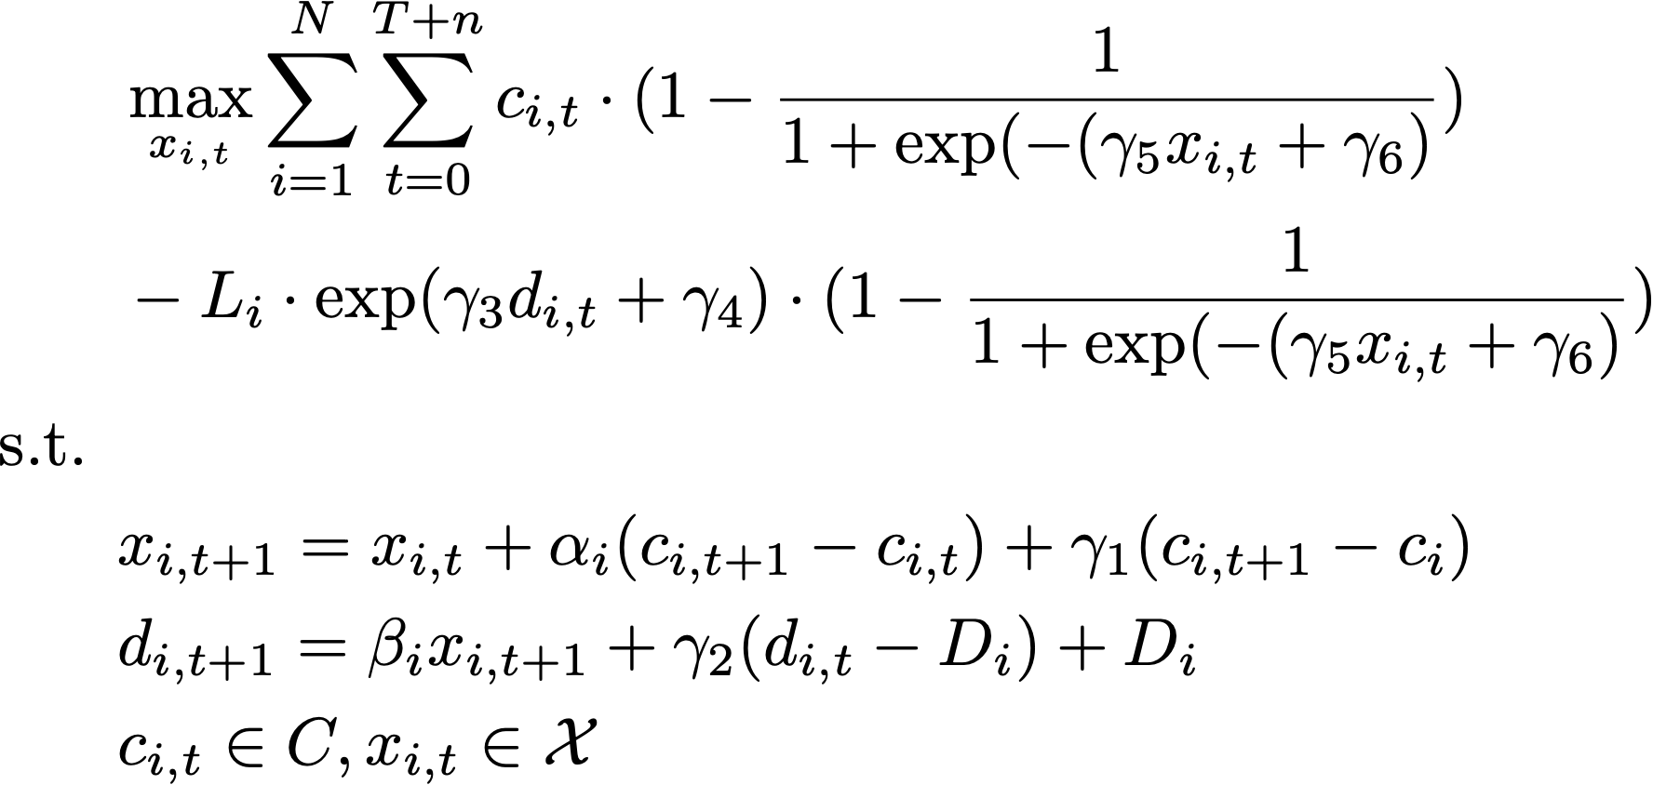
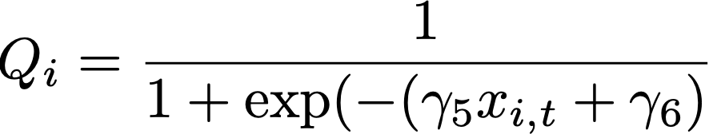

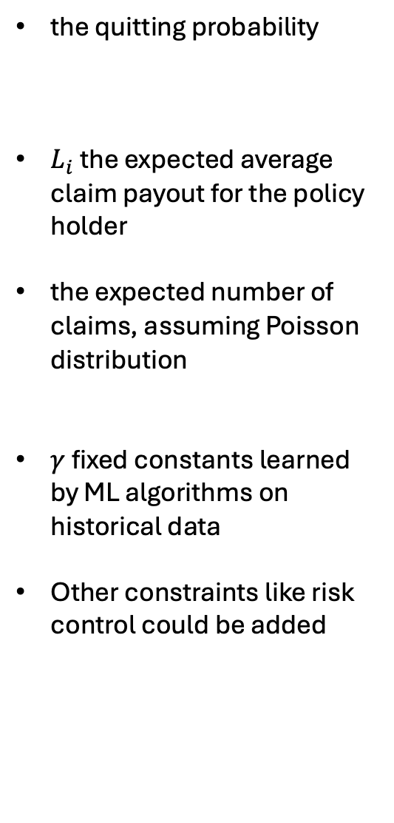
Optimization Model: Company’s decision problem
the quitting probability
$L_{i}$ the expected average claim payout for the policy holder
the expected number of claims, assuming Poisson distribution
$γ$ fixed constants learned by ML algorithms on historical data
Other constraints like risk control could be added

Slide 7
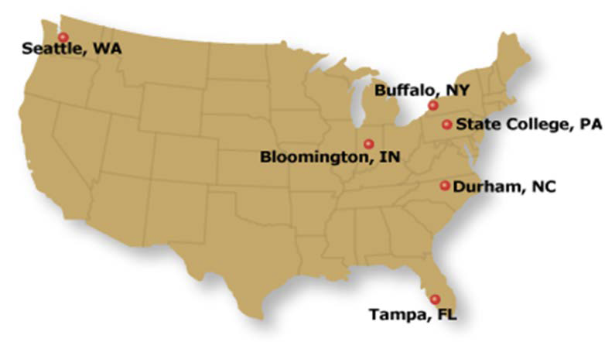
Dataset for Training and Validating Algorithms
SHRP2 NDS dataset: The second Strategic Highway Research Program Naturalistic Driving Study
3,542 drivers, all age/gender groups.
4,368 data years; 5.5 M trip files; 32.5 M vehicle miles
1,600 crashes and 2,900 near-crashes
3 years of data collection
- Most participants 1 to 2 years
Vehicle types: All light vehicles Passenger cars
- Minivans
- SUVs
- Pickup trucks
Six data collection sites
Second by second data on what happens in vehicle

Slide 8
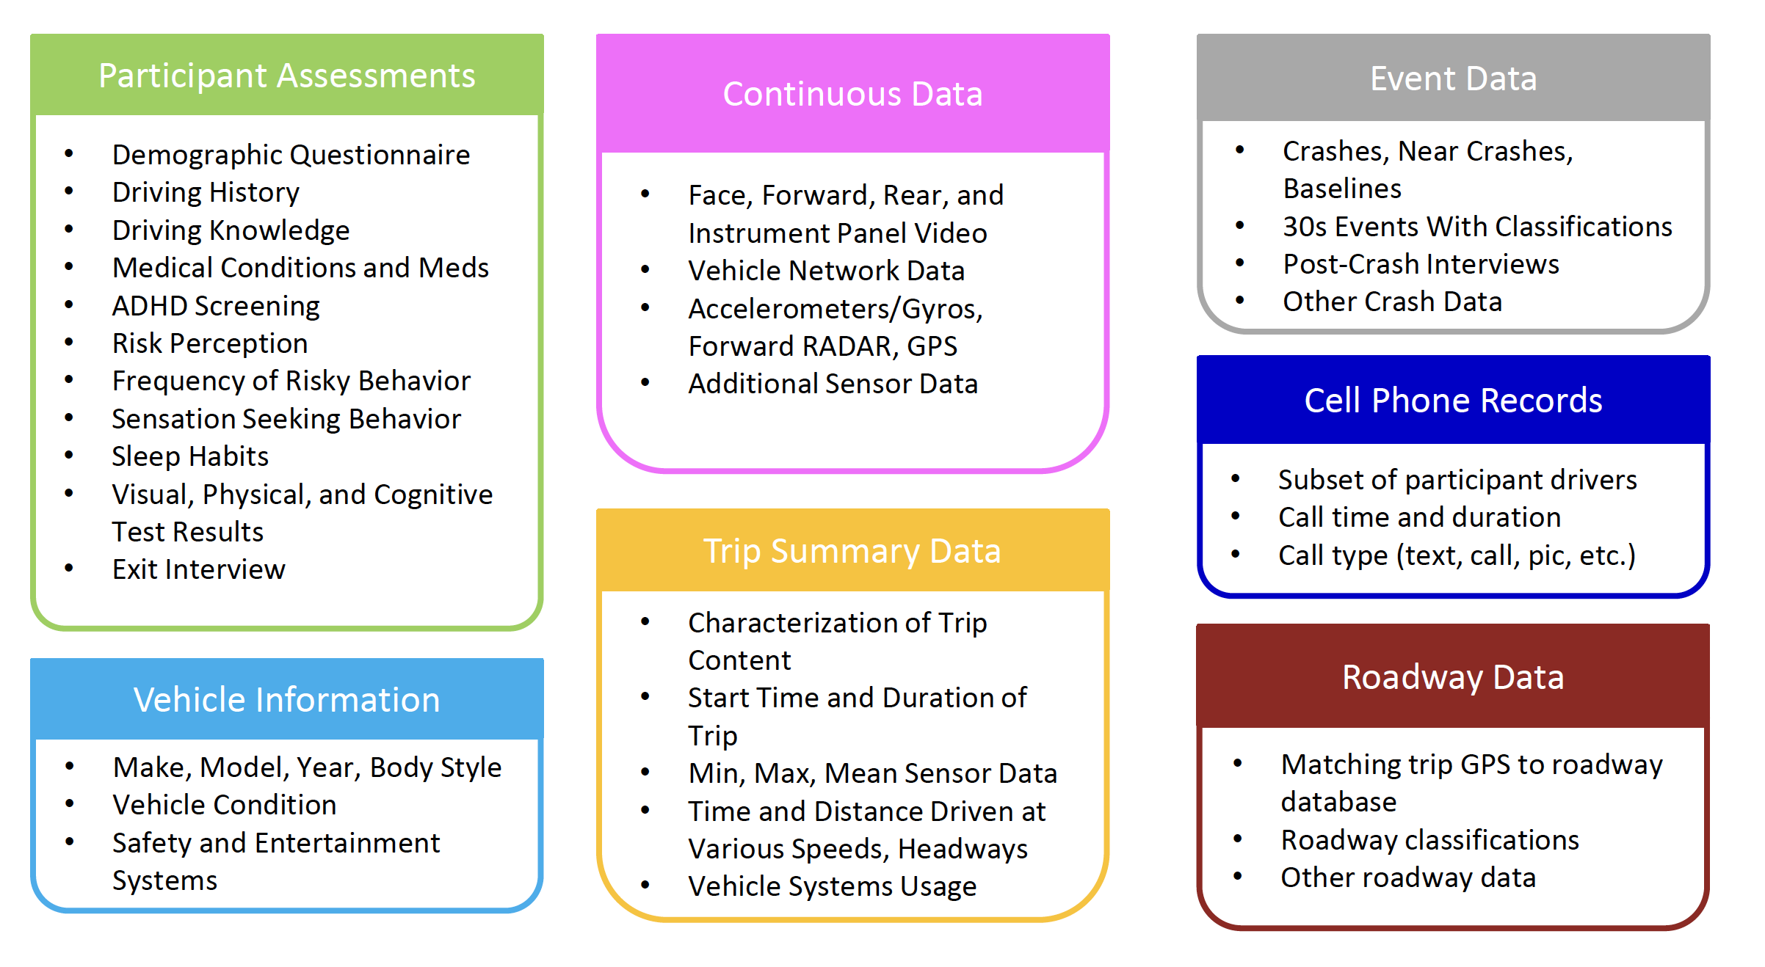
Dataset Schema

Slide 9
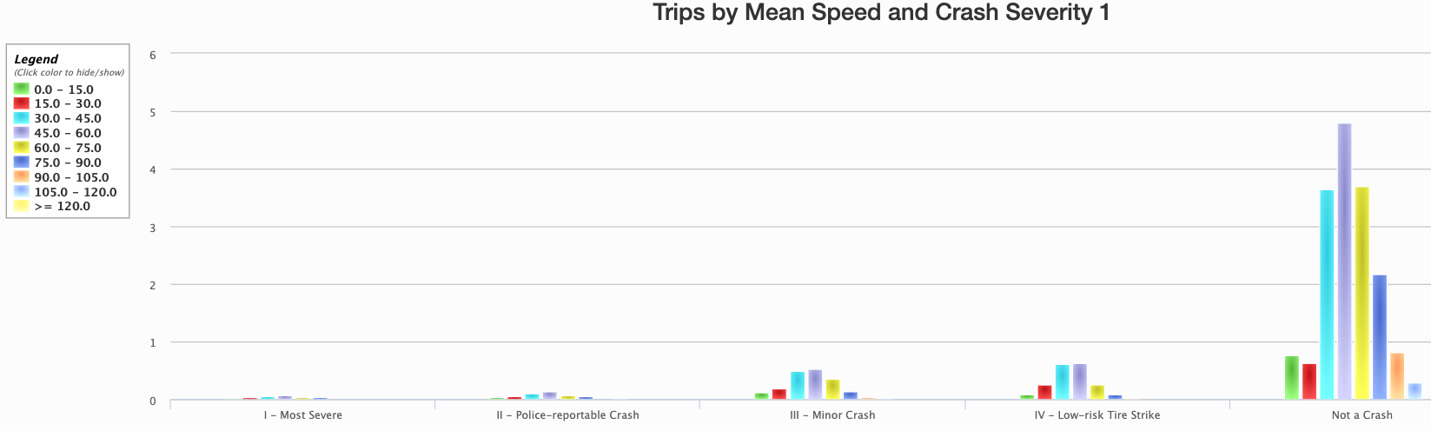
Example data summary

Slide 10
Driver Risk Level Evaluation from Telematics Data
Risk probability evaluated at trip level
Policy holder’s overall risk level obtained by aggregating trips during the past period
ML model for risk evaluation (logistic regression, Neural Network, decision trees)
features: trip distance, harsh braking (deceleration), harsh cornering (max turn rate), whether night drive, mobile phone use, traffic density, speeding or not, mean speed, max speed
Target: probability of most severe crash, police-reportable crash, minor crash, low-risk tire strike, no crash

Slide 11
Future work
Train and figure out the most effective machine learning model for driver risk level evaluation
Develop solution methods to the company’s optimization problem
Conduct simulation and evaluate our framework

